Slide 1
Team 5 – Solution Mates
Muhammad Zain
Nangyal Khan
Janne Asukas
Riccardo Carnesella
Yuran Im
Mehdi MK

Slide 2
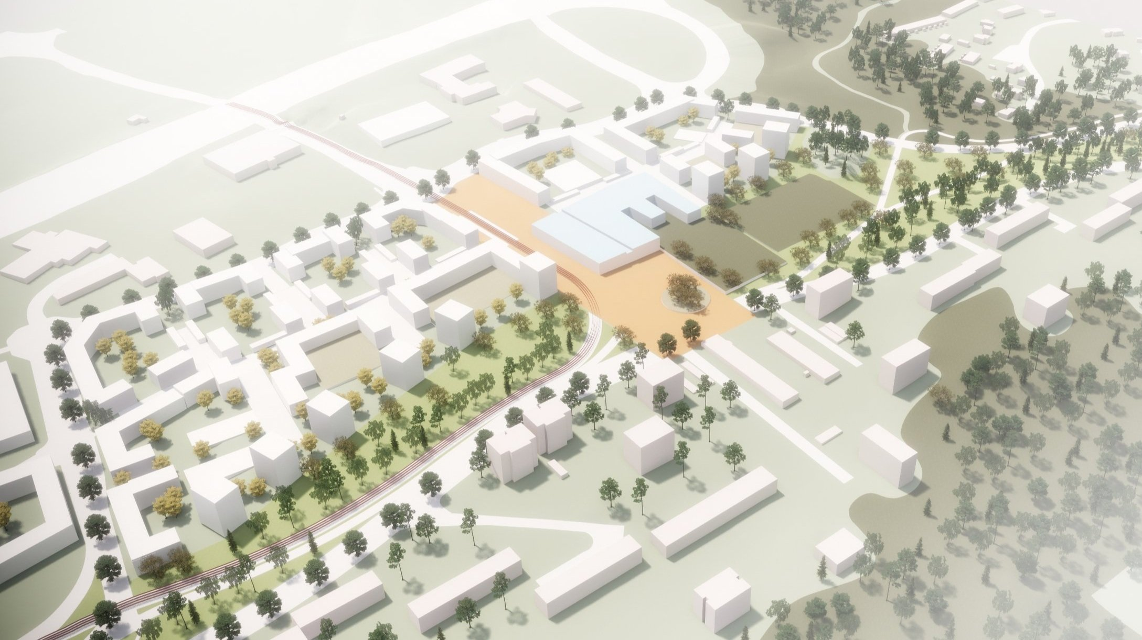
Peltolammi 3.0
Picture: Arkitehdit My

Slide 3
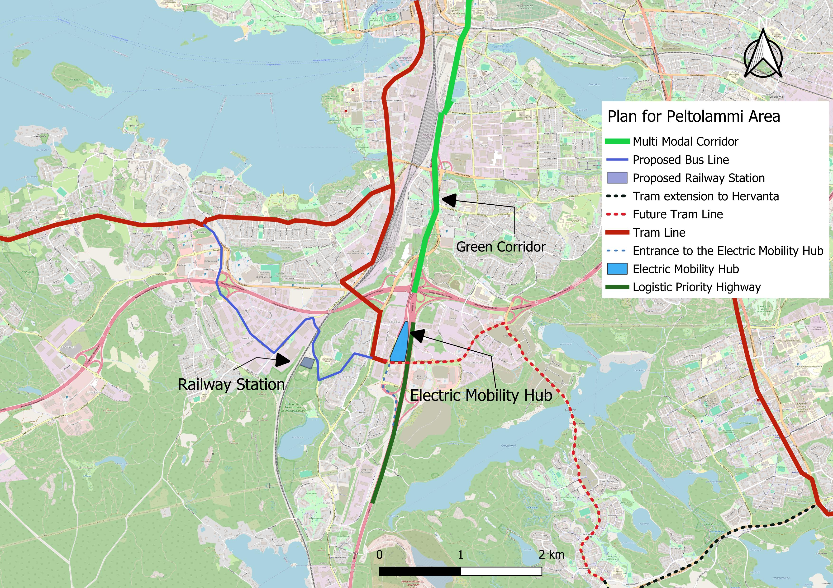
Transit Master Plan

Slide 4
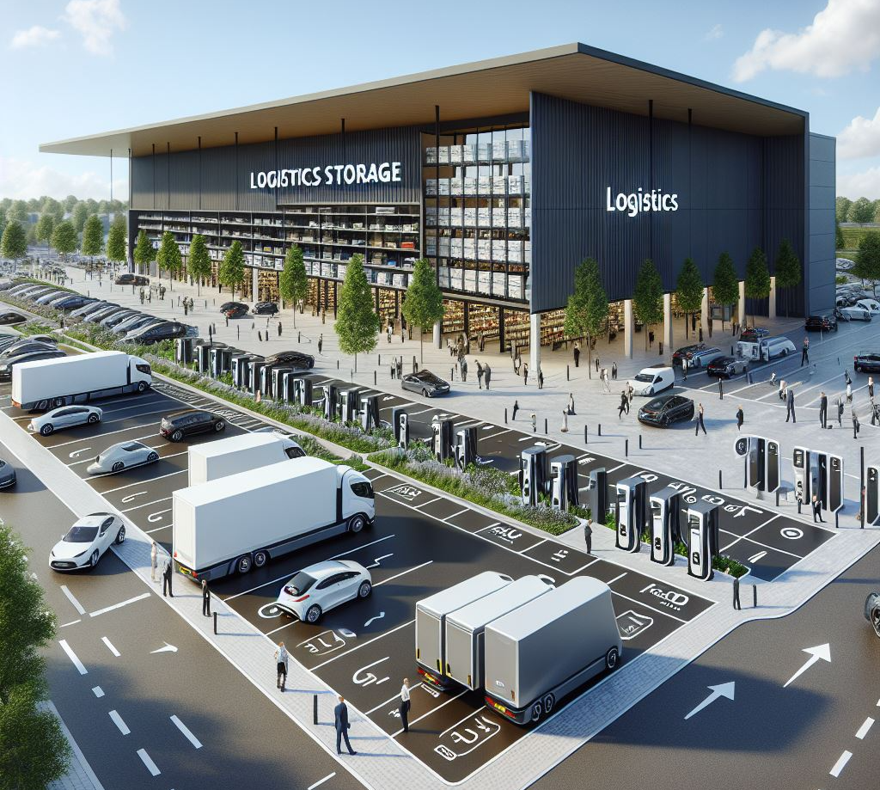
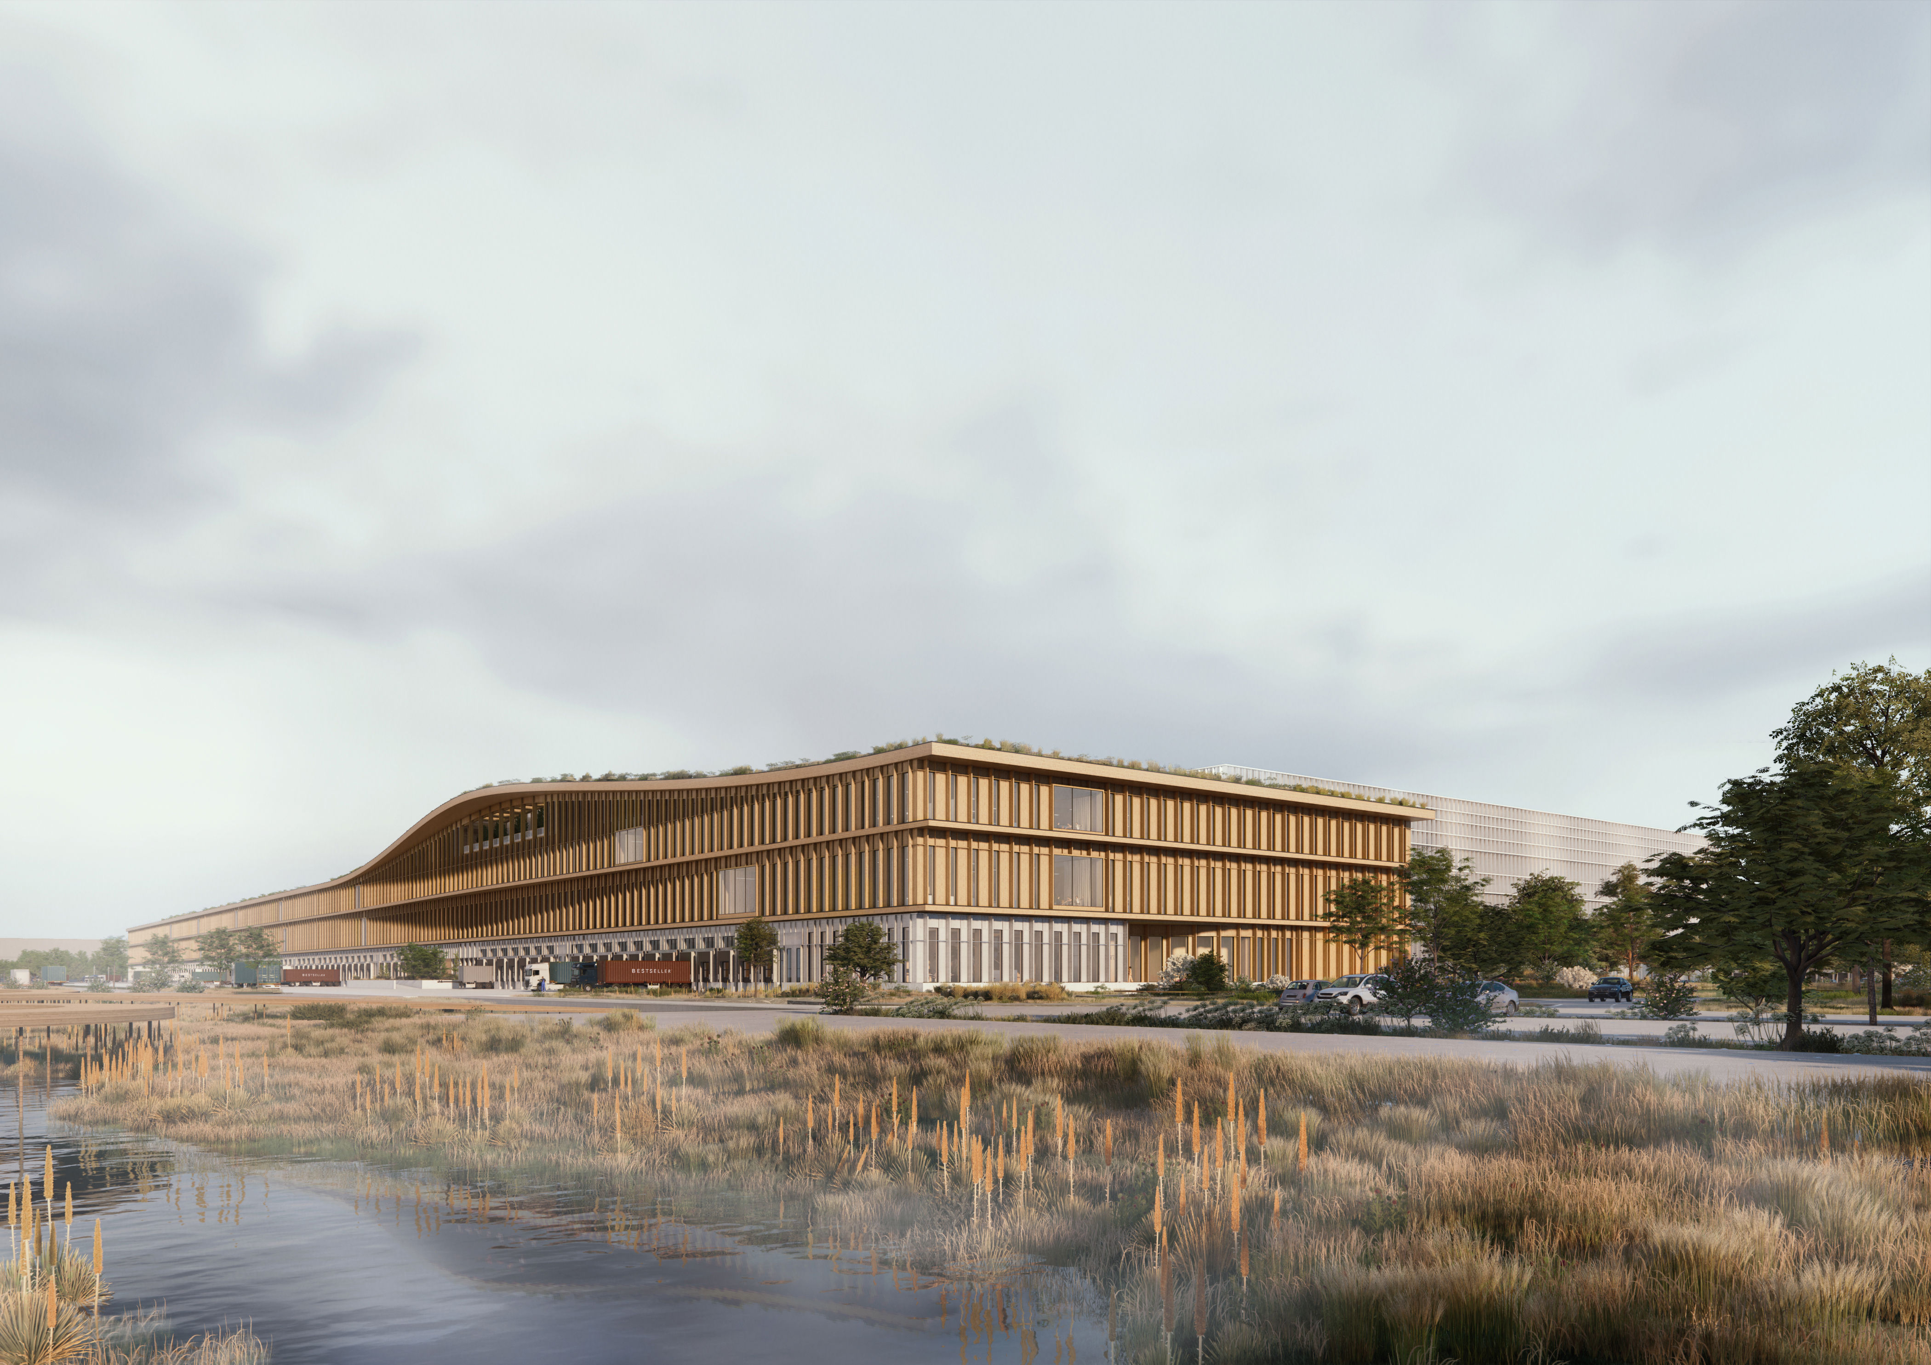
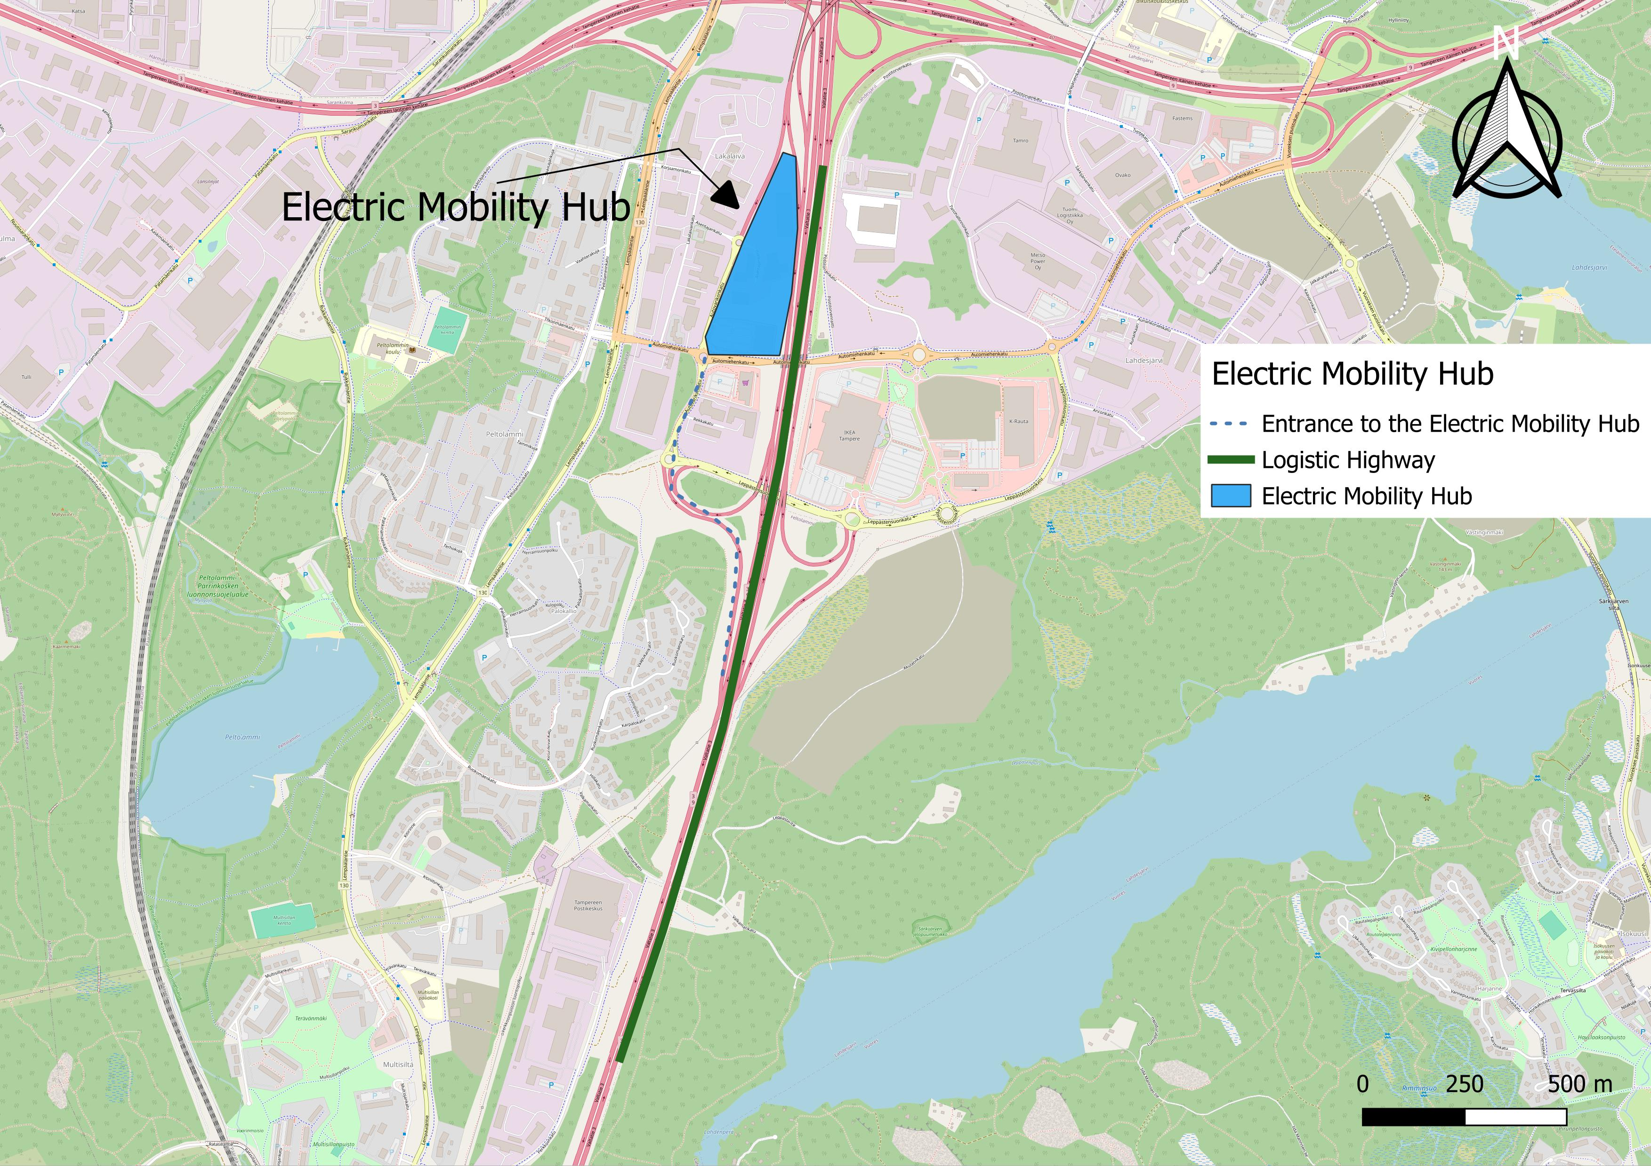
Electric Mobility Hub:
Photo: Henning-Larsen
Green roof top
Electricity from solar panels powers vehicles
Using wood to wall material
Using recycled material to base soil and under rooting

Slide 5
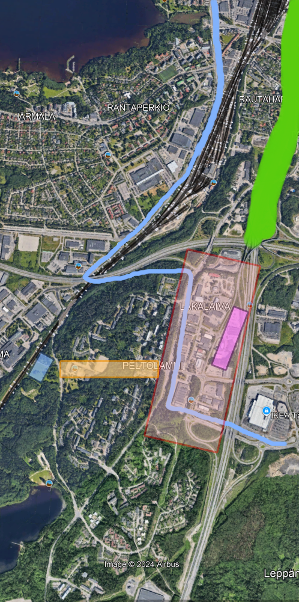
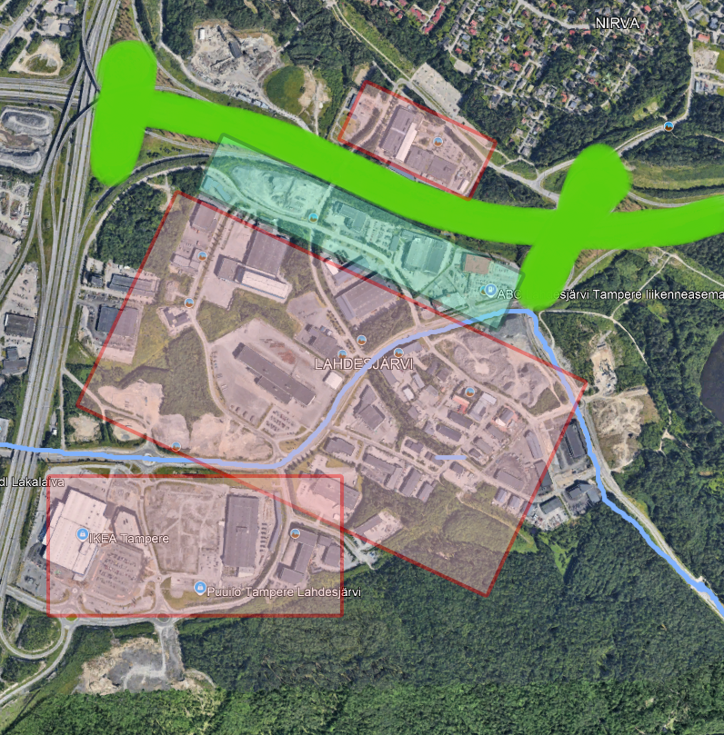
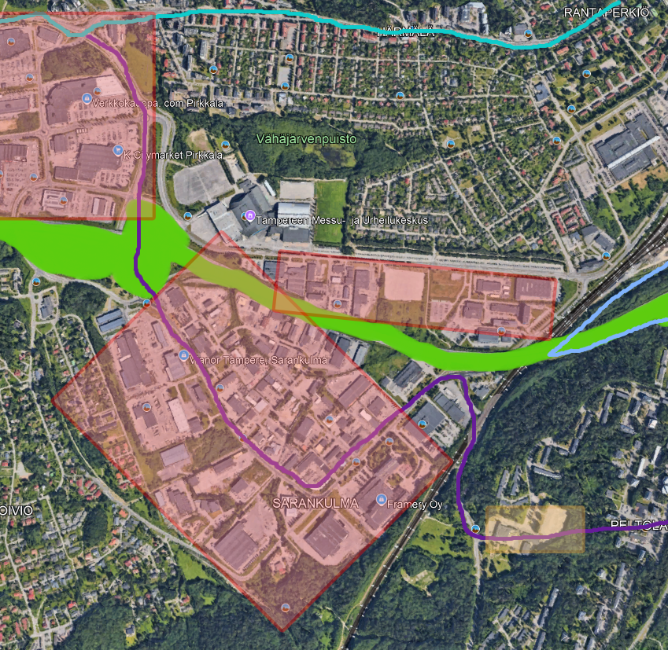
Scalability and phases
Data collection and optimisation
Considering unique geography
Habitat restoration

Slide 6
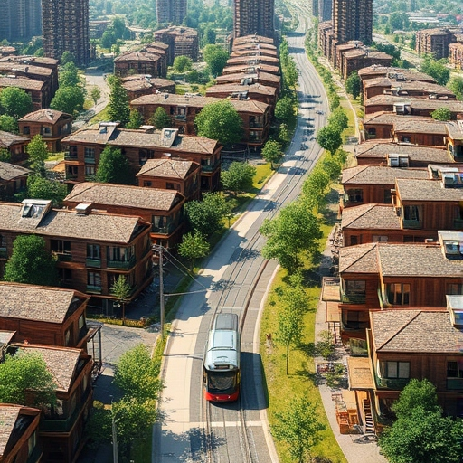
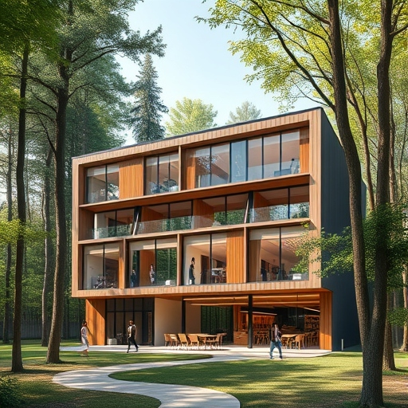
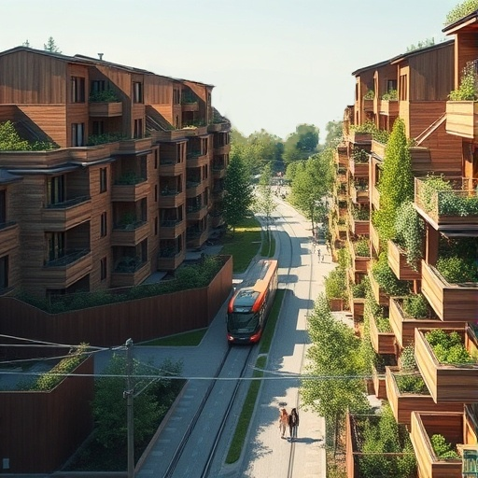
What could it look like?
No unnecessary environmental infringement
Road design to support the automated vehicles
Transport policy (Unified Tickets and credit system)
Community centres
Libraries
Offices and apartments with active ground floors
Health centres
Group program in nature
Socially inclusive
An easily navigable, liveable city that blends into the landscape
Built environment technologies

Slide 7
The need for a new hub
•Finland aims to be climate-neutral by 2035. To achieve carbon neutrality,
•Transport sector: 27% of total carbon emissions,
•40% of those emissions from road freight transport.
•Electrify Heavy Duty vehicles
•Range anxiety
Tampere is projected to grow by more than 3000 people per year until 2040
Need for relief around existing hubs
  Housing pressure
  Transit pressure
  Not enough supply for demand
The Peltolammi area is in the perfect position to be a link between all corners of Finland
The Peltolammi area also has a lot of unused, degraded land and natural beauty
Opportunity for a new, vibrant, and economically active area

Slide 8
Combining a logistics hub and a place to live
Combining unintrusive logistical infrastructure that blends into the landscape with technology in the built environment
Repurposing and retrofitting already present housing
Logistics-priority highways with electric, automated truck convoys
Wildlife decks above highways
Noise proofing through terrain and vegetation

Slide 9
How the Life of 7 Stakeholders Improved by the New Peltolammi and Lakalaiva Area

Slide 10
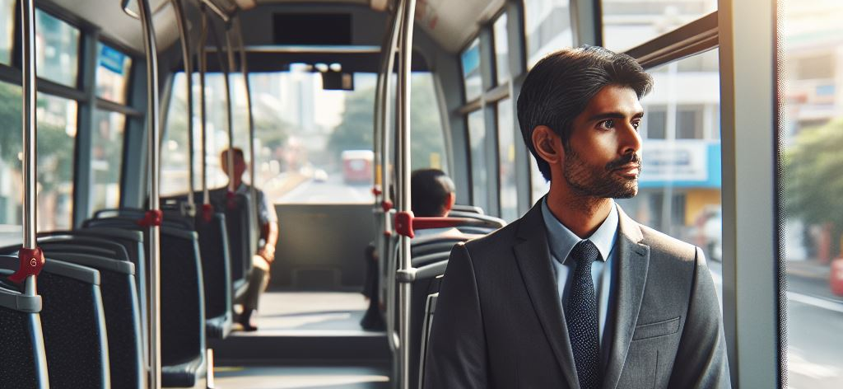
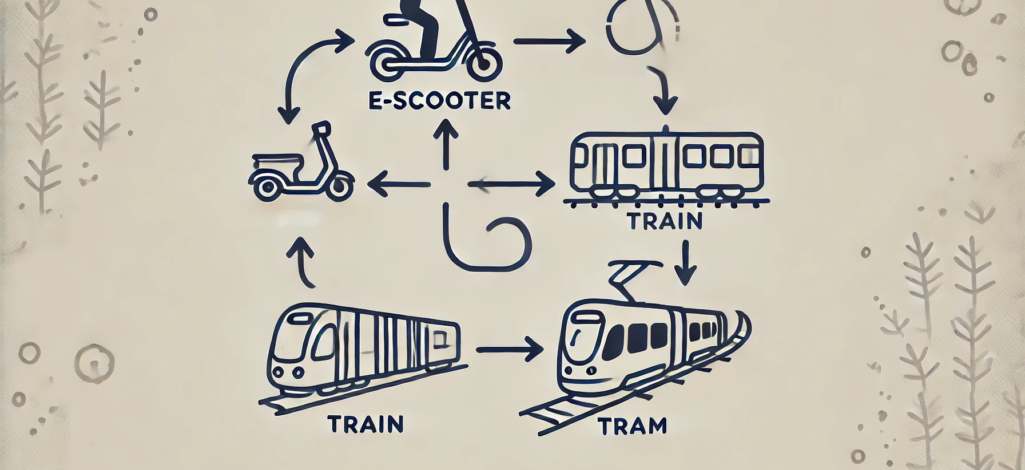
Meet Matti :
Lives in Peltolammi and works in Helsinki. He travels to Helsinki twice a week.
  New railway station
  single ticket system uniting databases of multiple cities
  Sustainable Transport Credits

Slide 11
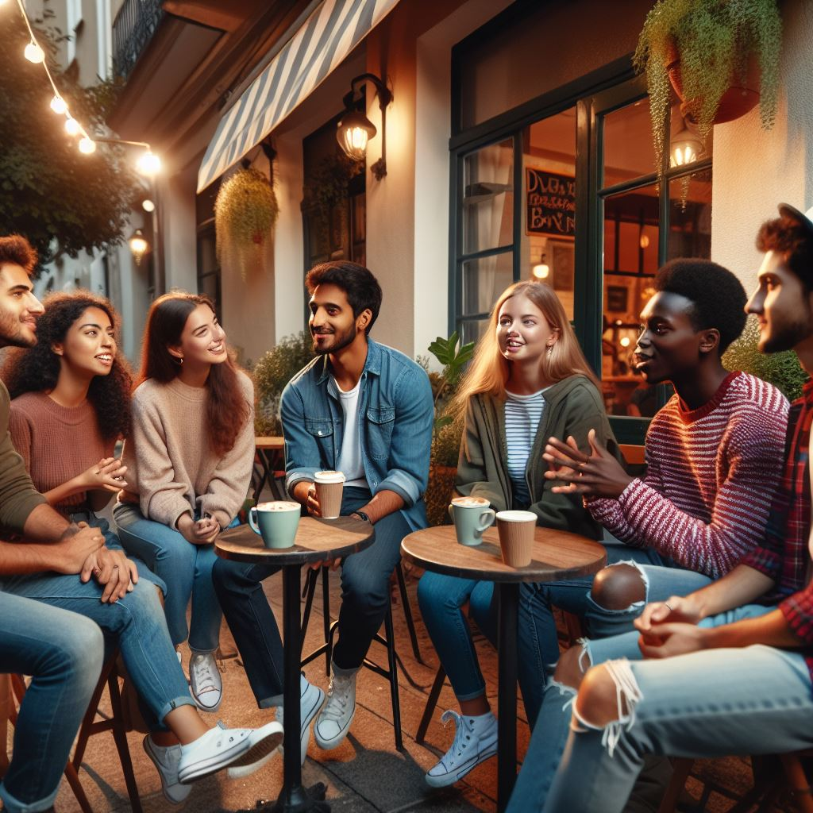
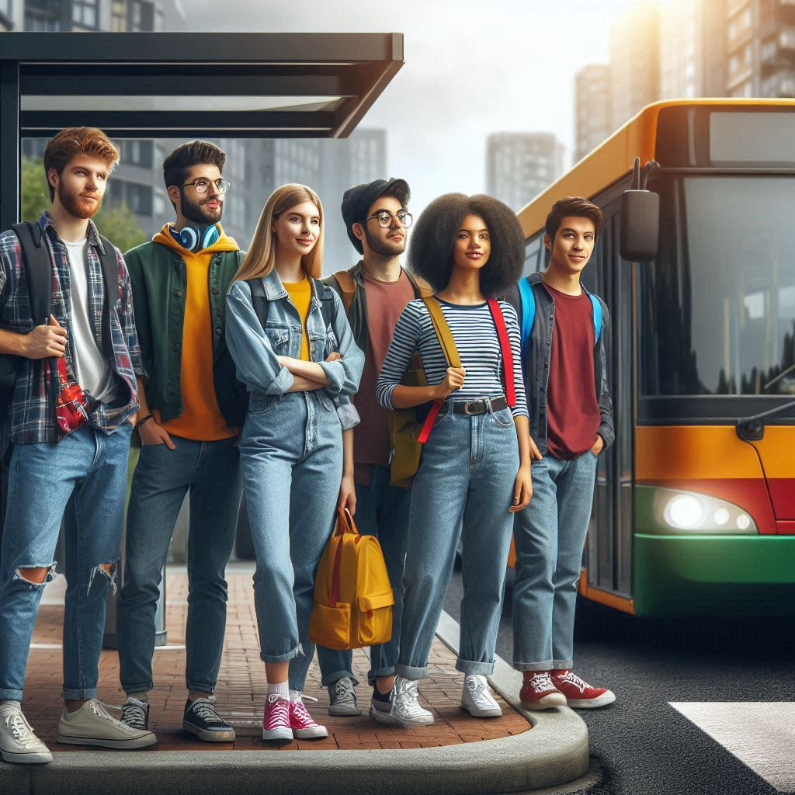
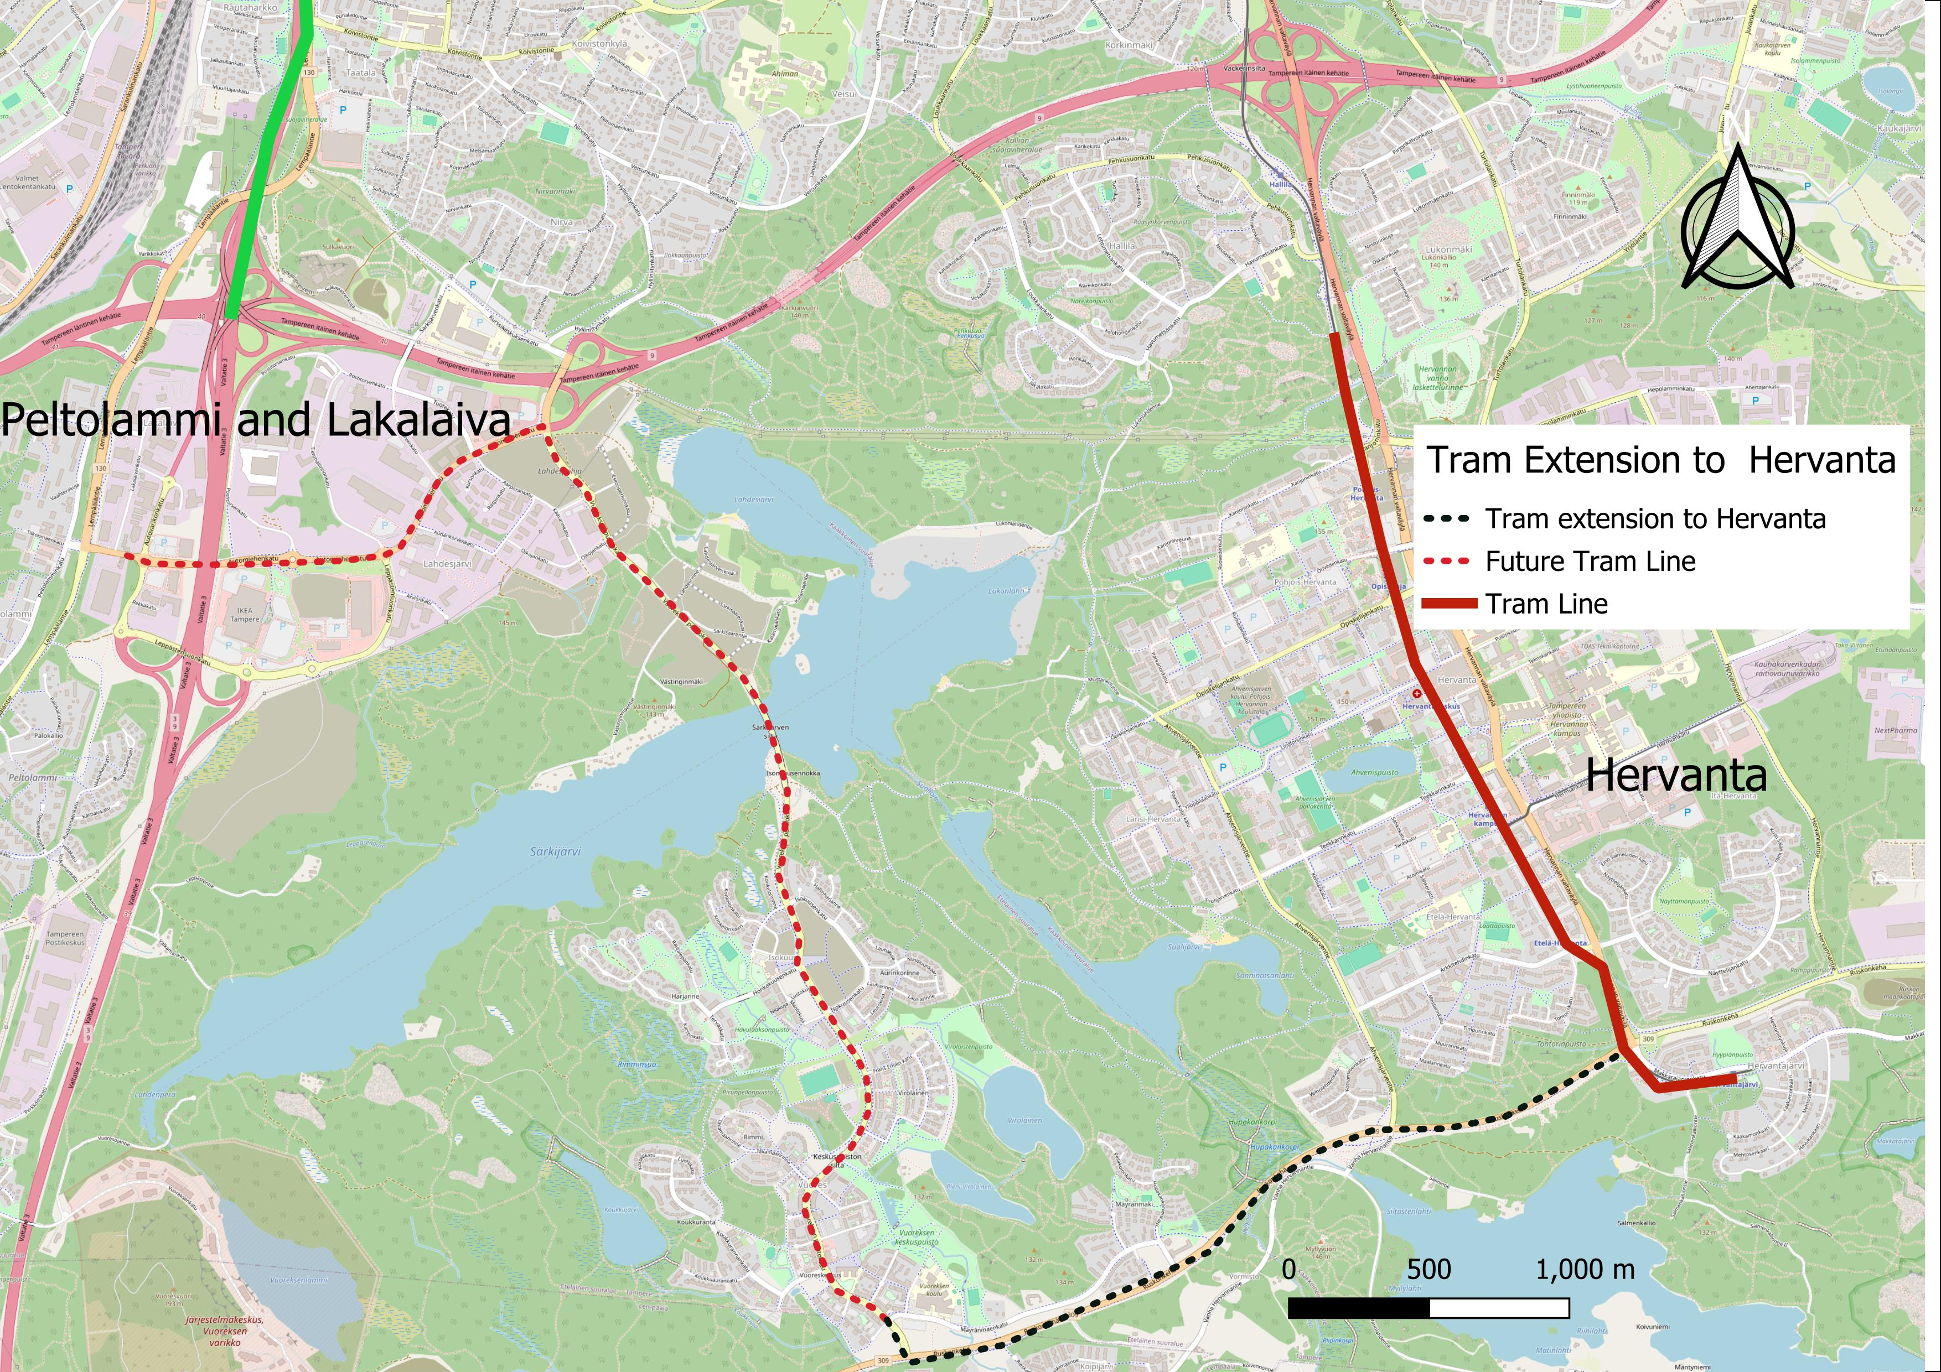
Meet Elisa:
Student in Hervanta
Lots of activities for them to take part in.
She picks Peltolammi over city centre for her social life
Tram connection
Biking to city centre through boulevard, or spending a day in nature

Slide 12
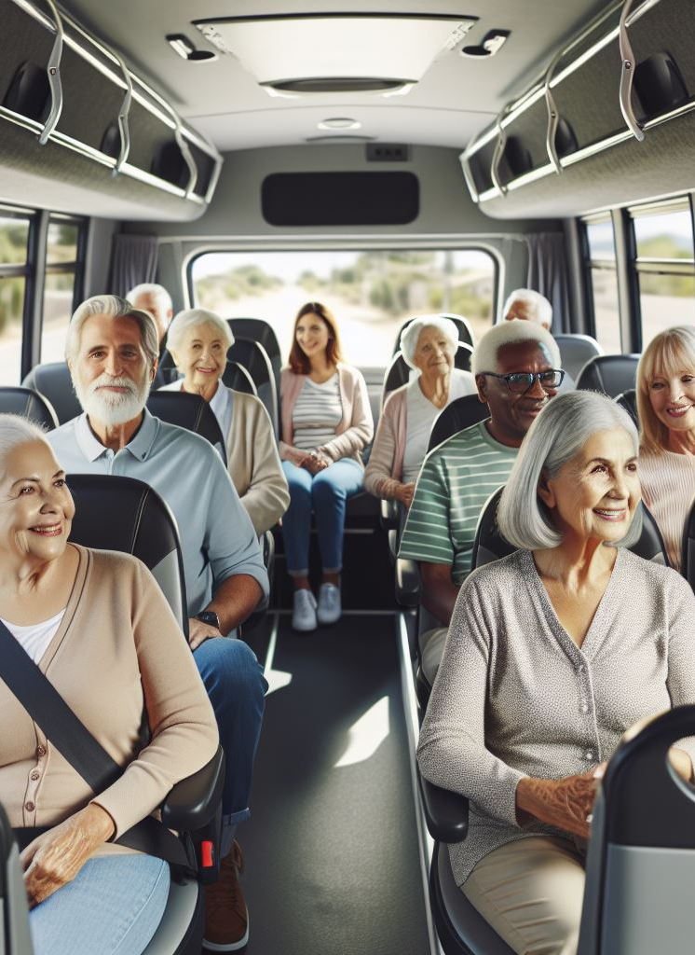
Meet Oskari:
He is 70 years old and lives in Peltolammi.
He mainly travels to the grocery shop and the community centre for visiting his friends.
City community shuttle service for senior citizens​
Increase in average age​
  Need for accommodation to the elderly​
Community centres and third places are an incredible advantage.​
Interconnectedness ​
  IoT for medical emergences​
  integrated transit systems​
  ease of navigation​

Slide 13
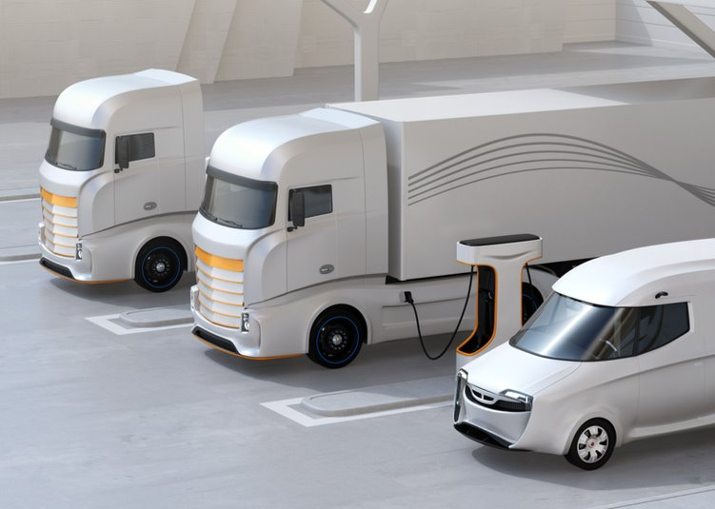
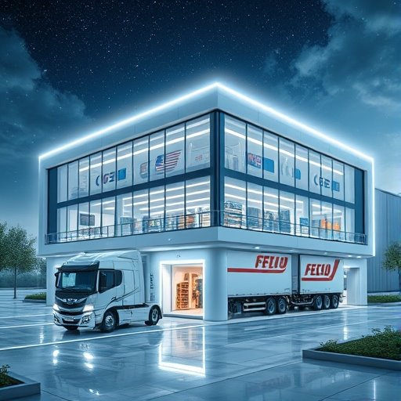
Meet Nordic Swift:
Logistics company.
Operates between Helsinki and Tampere
Mobility Hub between Tampere (Peltolammi) and Helsinki
Charging and safe storage for all modes of transport
Logistics and distribution centre for the city

Slide 14
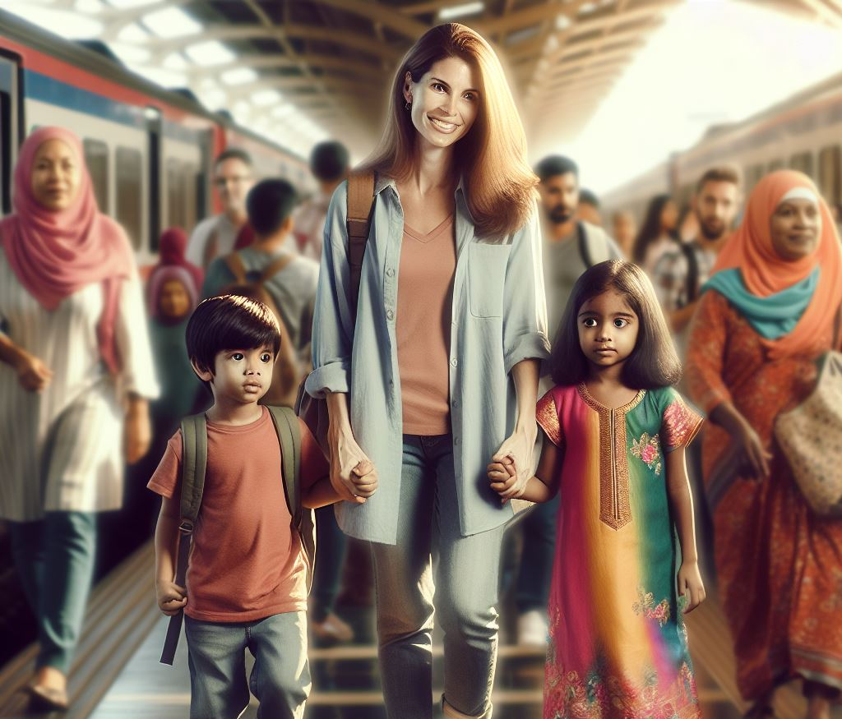
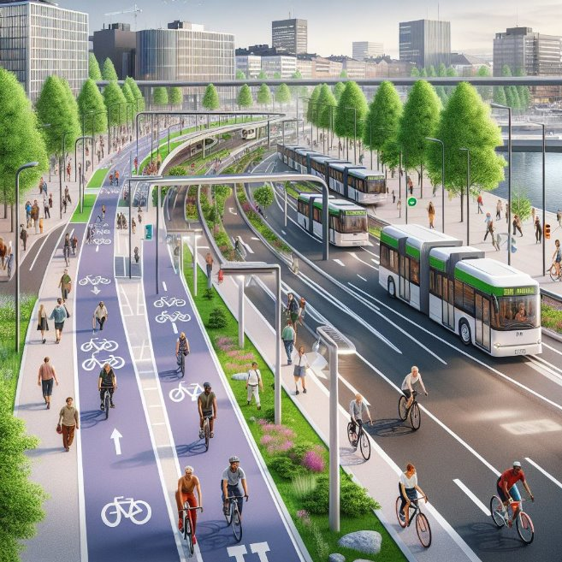
Meet Aino:
She Lives in Peltolammi. She has two children and works in another area of Tampere
Bus Rapid Transit service through boulevard
Autonomous delivery robots for her grocery needs in accommodating street design
Walking and cycling
Safe environment for children
nature-based environment
Community centre for two children

Slide 15
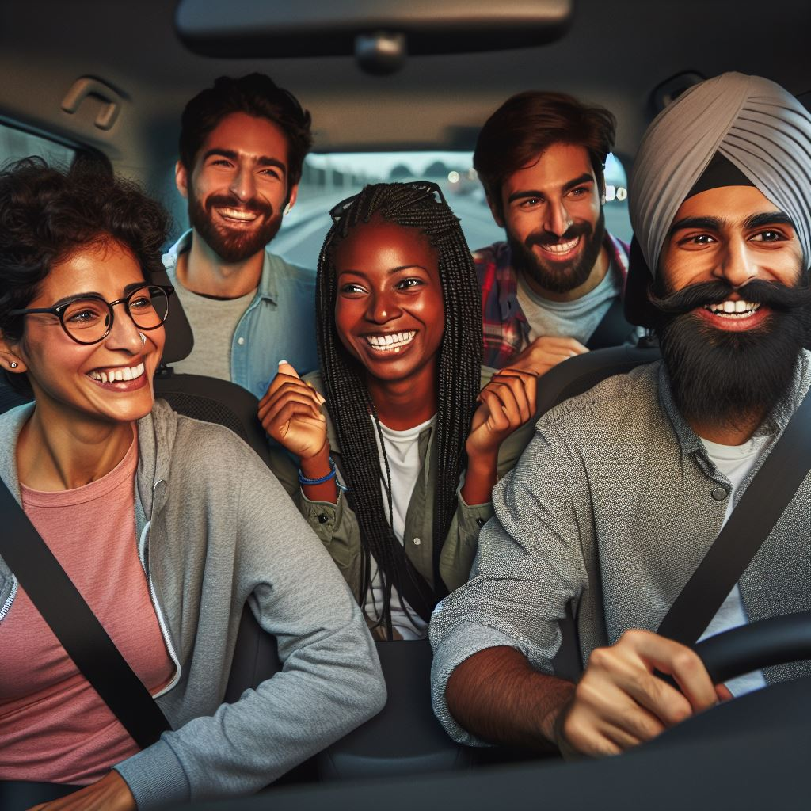
Meet Teemu (Car enthusiast):
Teemu is a car lover. He believes cars are the freest method of transportation, and he enjoys the feel of driving.
He travels between Helsinki and Tampere 3 times a week.
Because he cares about environment, he bought an electric car.
Seamless carpooling services between the cities​
It improves the space efficiency and allows Teemu to drive.​
Mobility hub for charging the car​

Slide 16
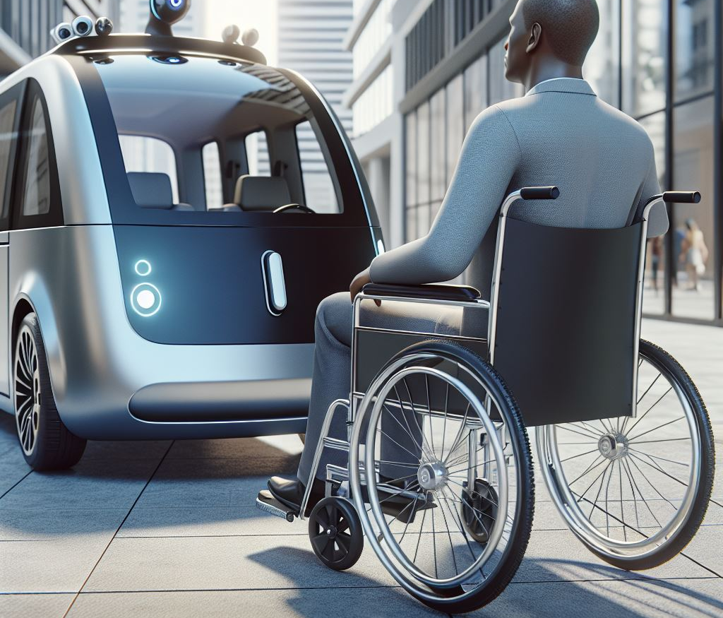
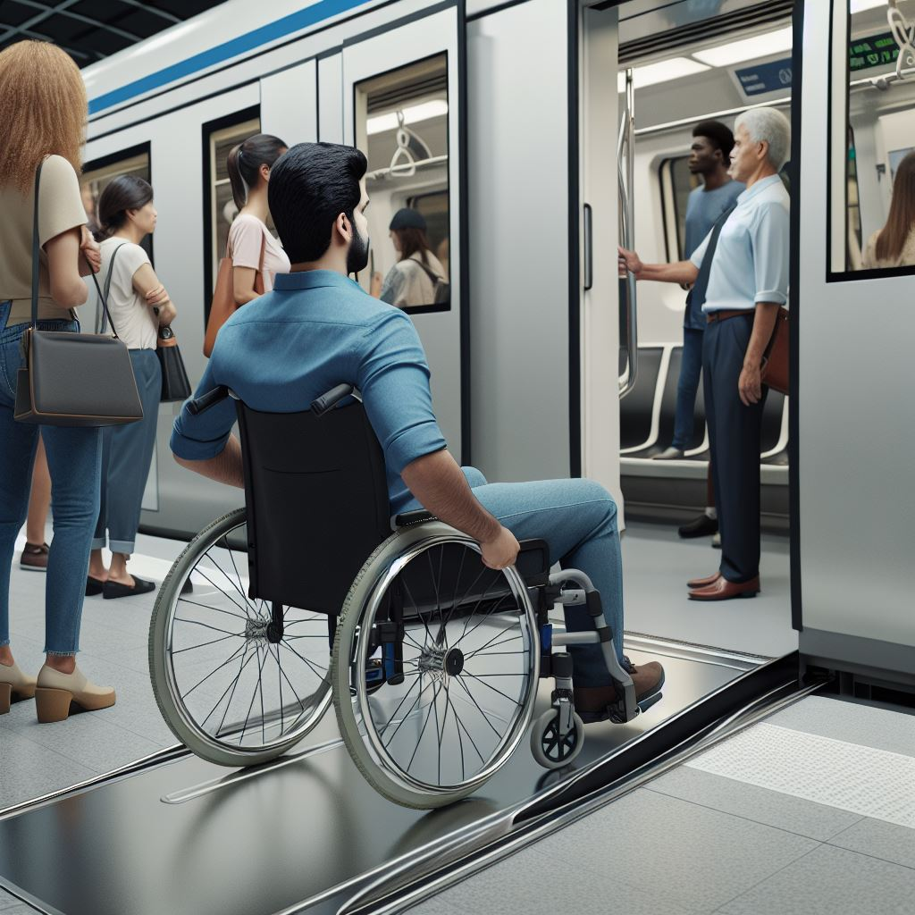
Meet Oliver:
Lives in Peltolammi. Due to an accident in his childhood, he can’t walk and uses a wheelchair for his daily movement.
Intercity travel made easy
  Accessible for people with reduced mobility
Spacious and frequent trams, car sharing services for more remote travels
Biomimicry ≠ inaccessibility!
  Spacious streets, navigable layouts

Slide 17
Logistic hub + living space
Regenerative, sustainable community
Interconnected, data-driven cities

Slide 18
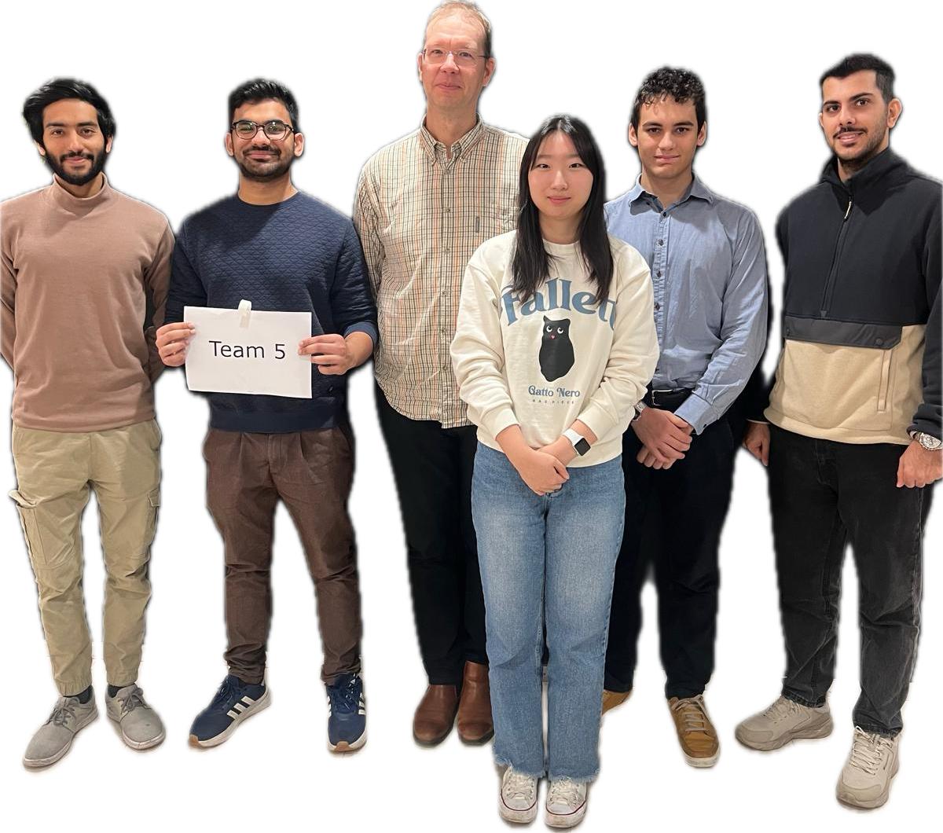
Thank you!!!!
Question time :)

