Slide 1
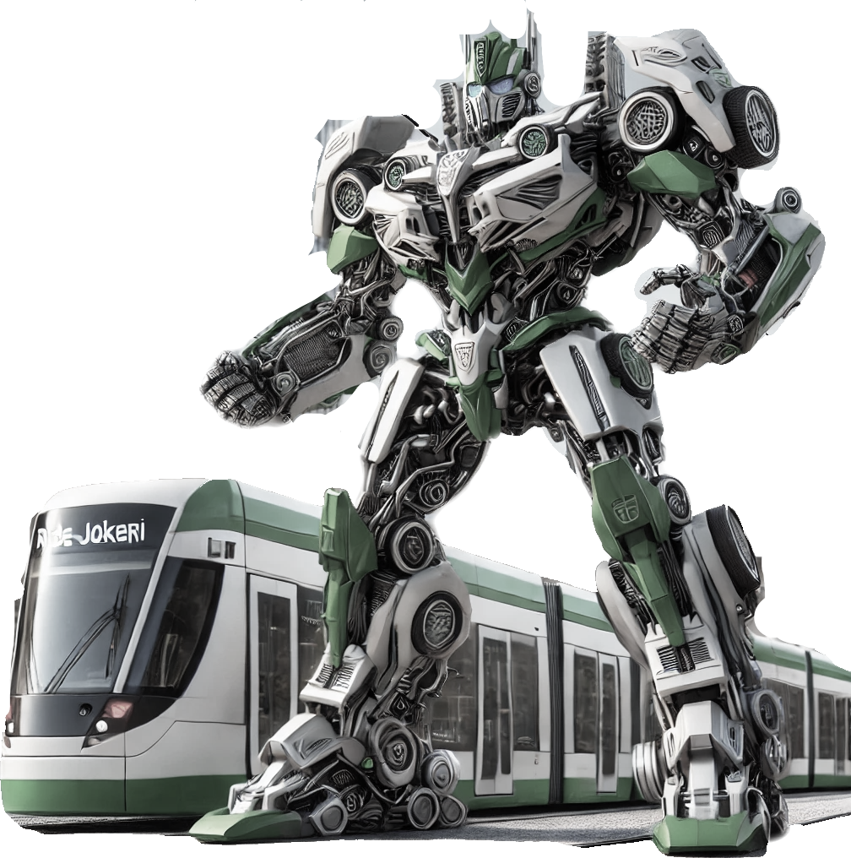
Transit Transformers
Kristina Honermann, Nagisa Takahashi,
Amanda Moilanen, Harit Tawabutr,
Bo Zhang, Dulani Ramanayake

Slide 2
Pitäjänmäki in the future
Connecting arts, technology, and nature

Slide 3
Context analysis of Pitäjänmäki

Slide 4
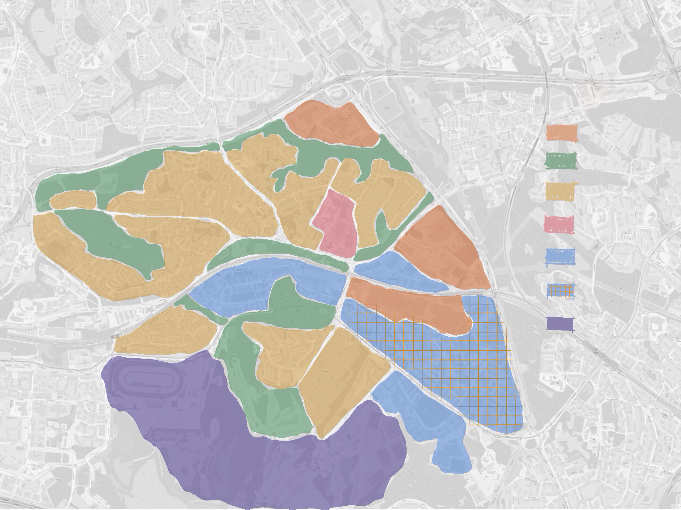
Function analysis
residential, green spaces and large-scale factories
Factories
Green spaces
Residential
North
Education
Business
office, business, sports facilities, residential, factory (ABB)
Mixed business and residential
Sports
South

Slide 5
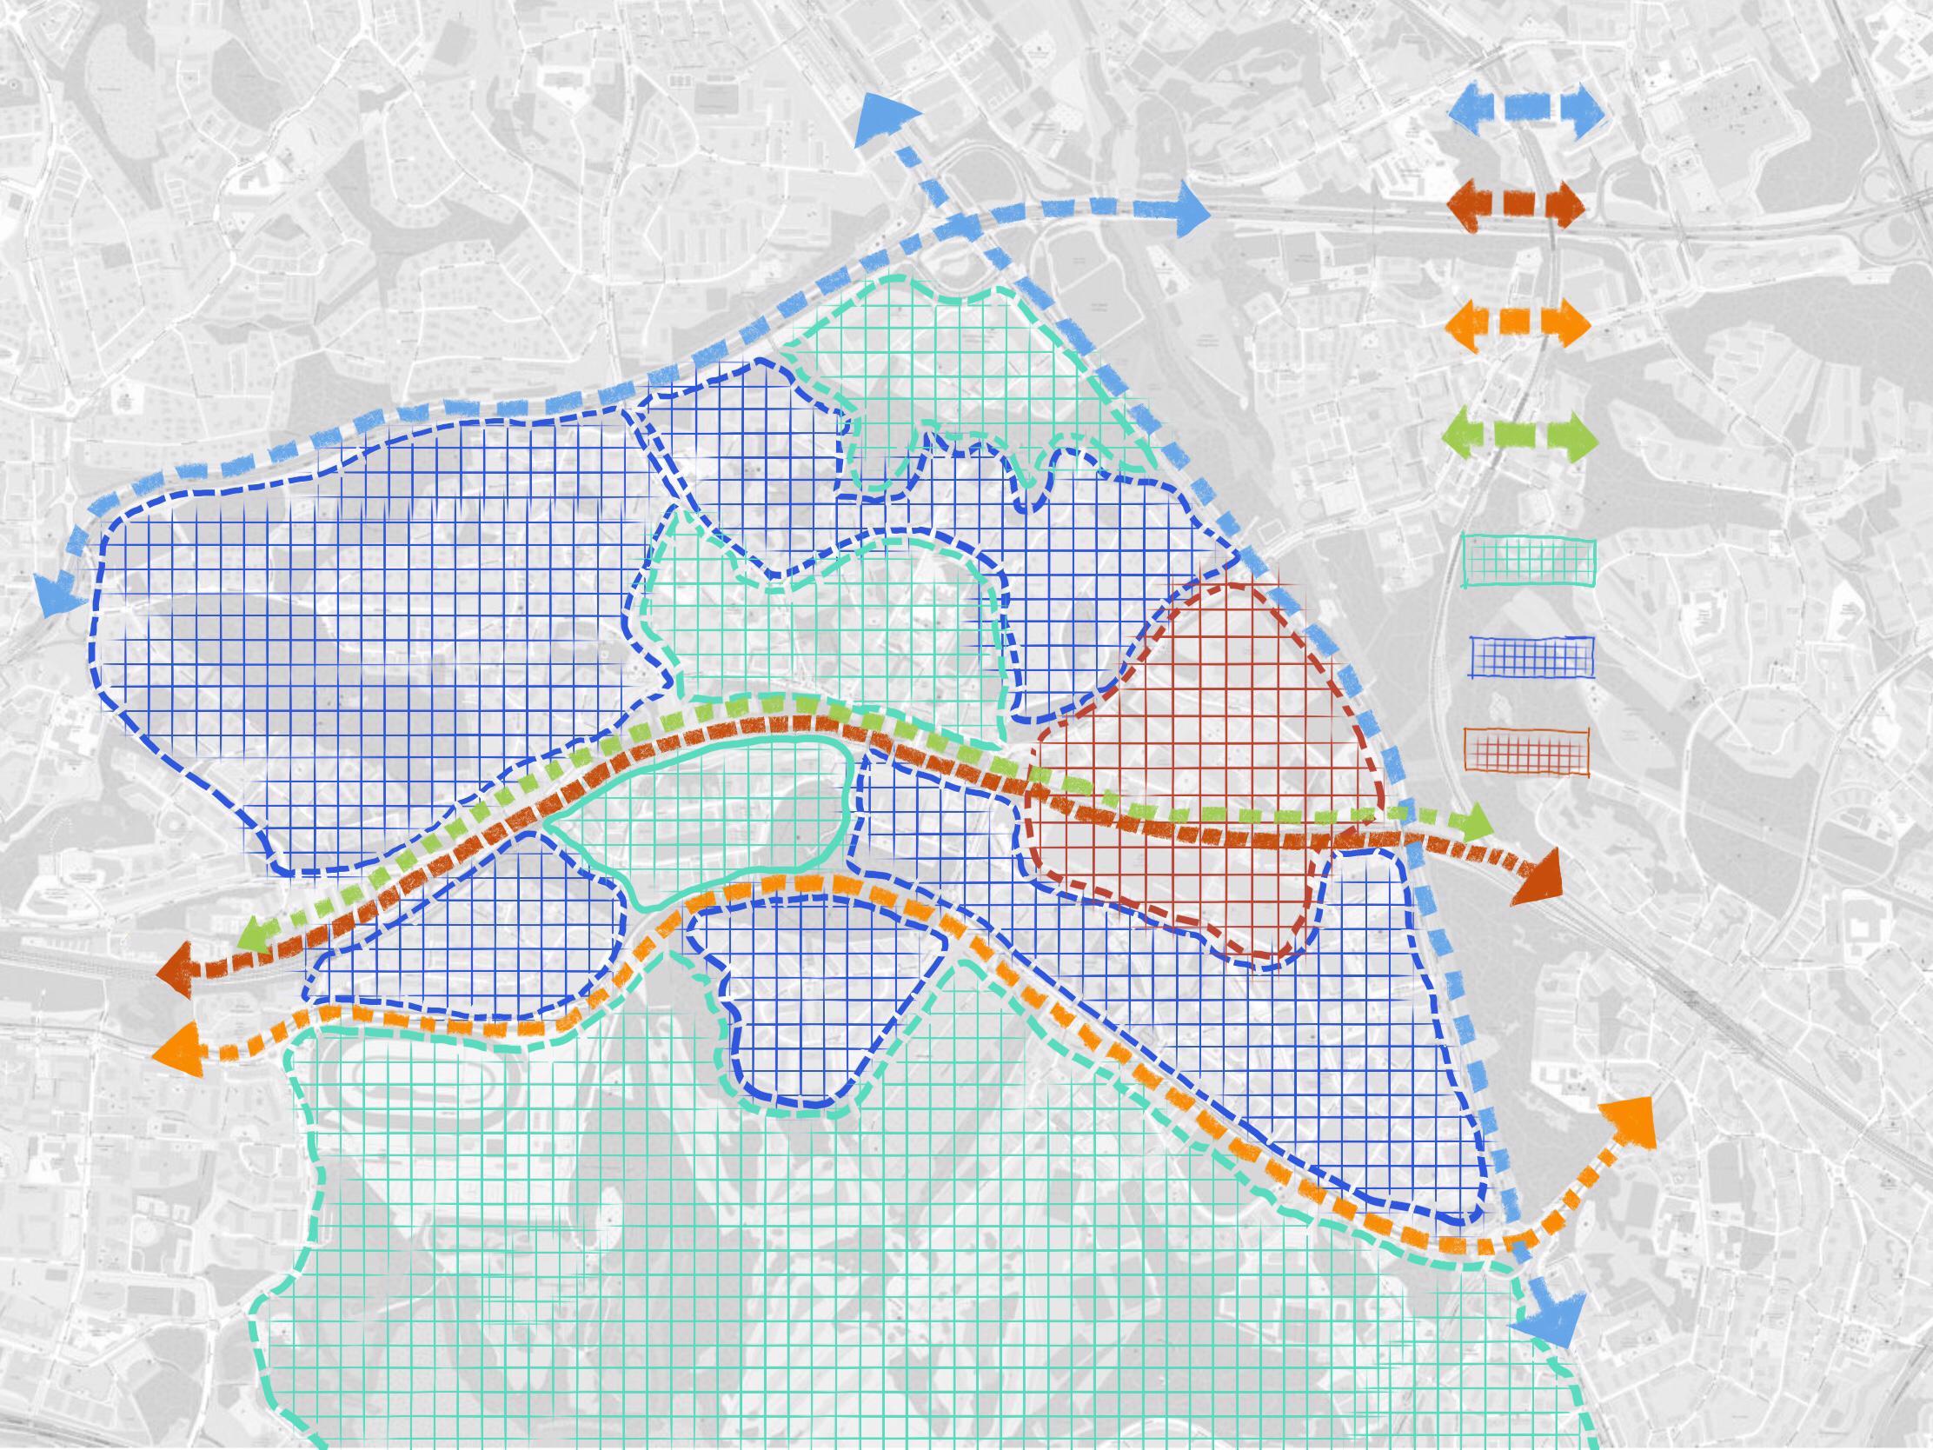
Inclusivity analysis
Main street
Mostly open-bordered and inclusive
In-between area is fenced and exclusive
Cutting off the connections between two parts
Railway
Tram way
Bike lane
Inclusive area
Semi-inclusive area
Exclusive area

Slide 6
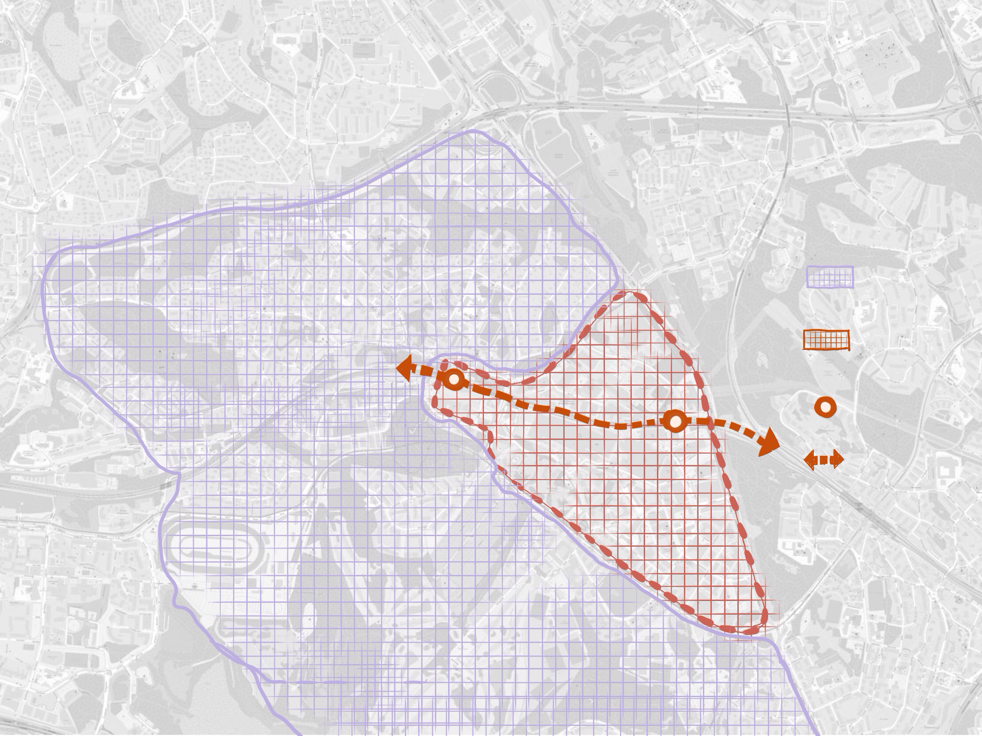
Proposal area
The in-between area where contradicts and conflicts happen
the potential to define the vision of regenerative Pitäjänmäki
Context Area
Proposal Area
Train station
Railway

Slide 7
Findings from fieldwork

Slide 8
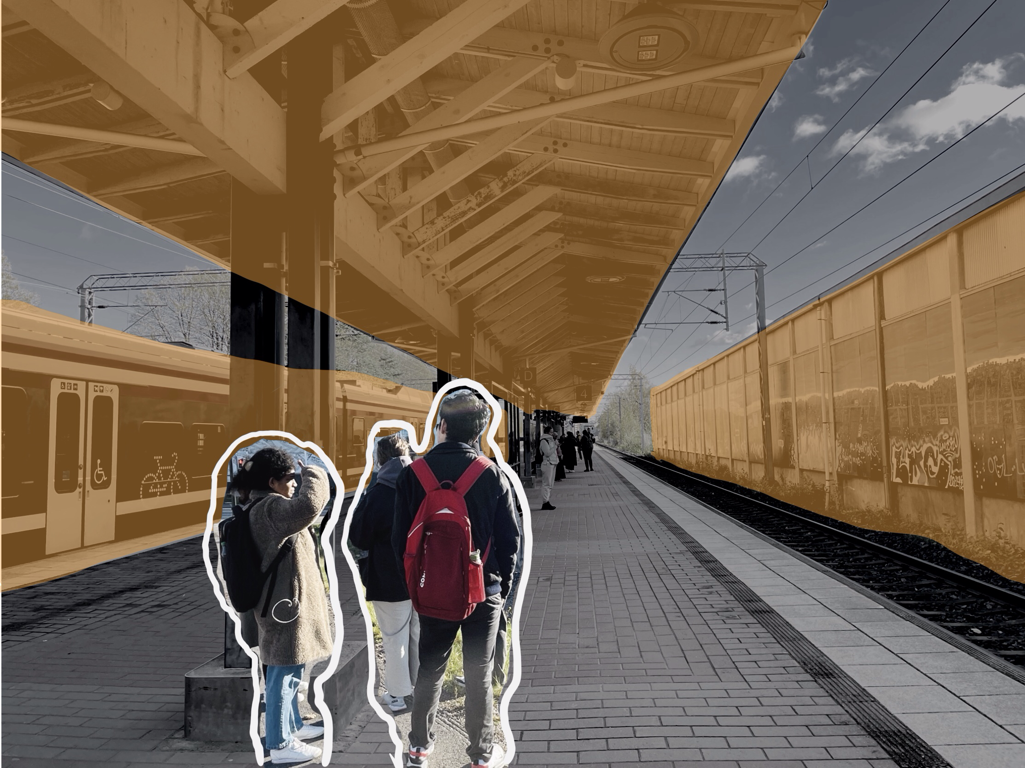
Ok, now we’re at Pitäjänmäki.
What to do?
Go to Leppävaara?
I like trains
Lacks interesting activities despite the well-established connections

Slide 9
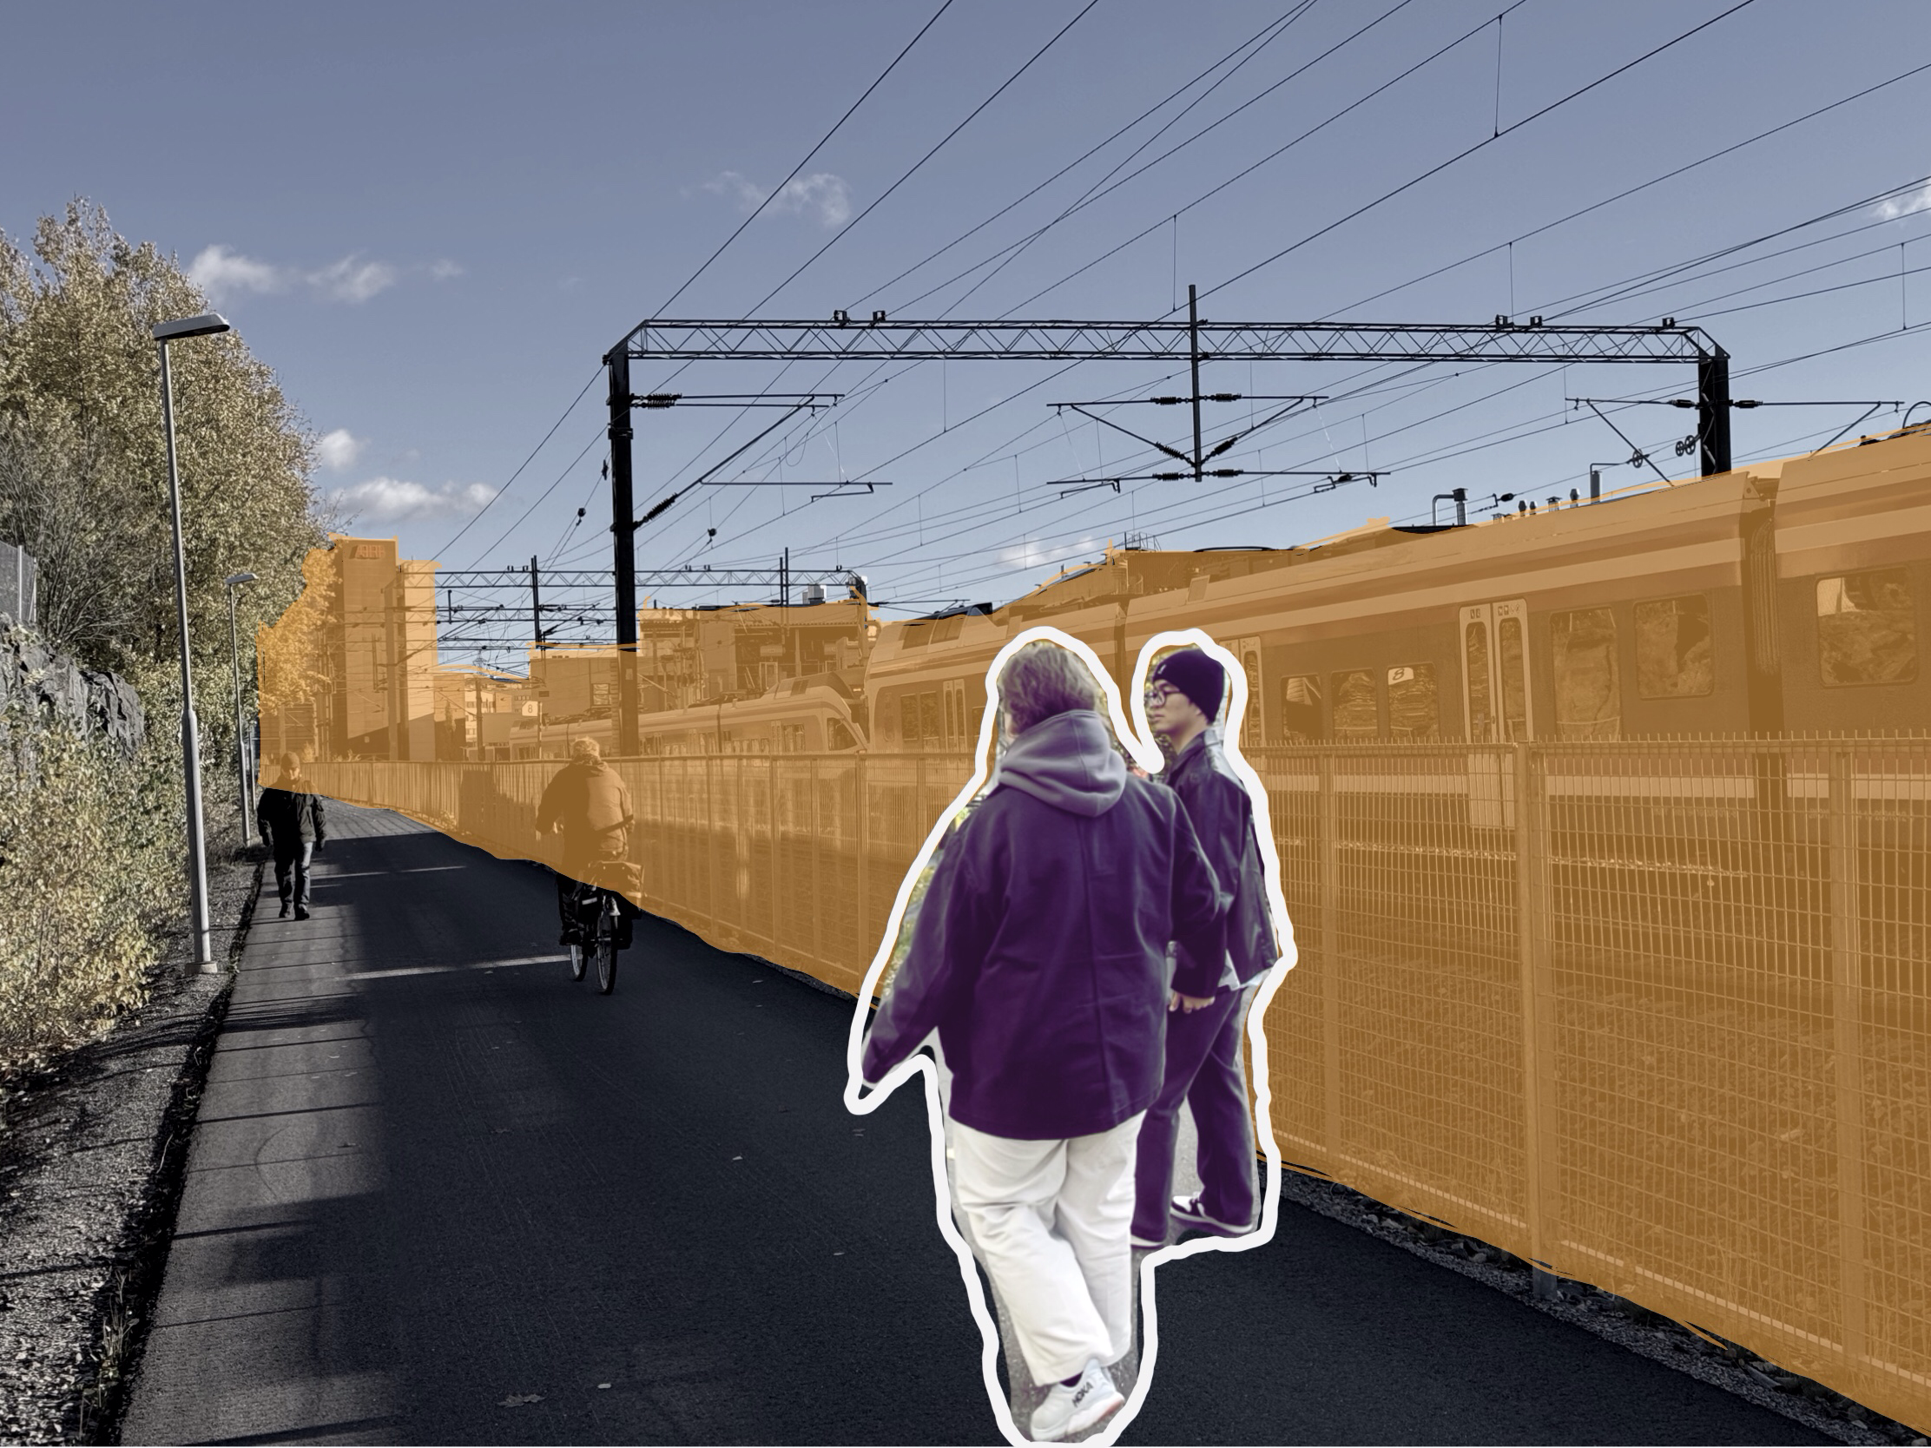
Good cycling environment.
But there’s nothing along the way.
Problems
Good walking & cycling infrastructure but no unique attractiveness
Limited access to surrounding areas
Good walking & cycling infrastructure but no unique attractiveness
Limited access to surrounding areas

Slide 10
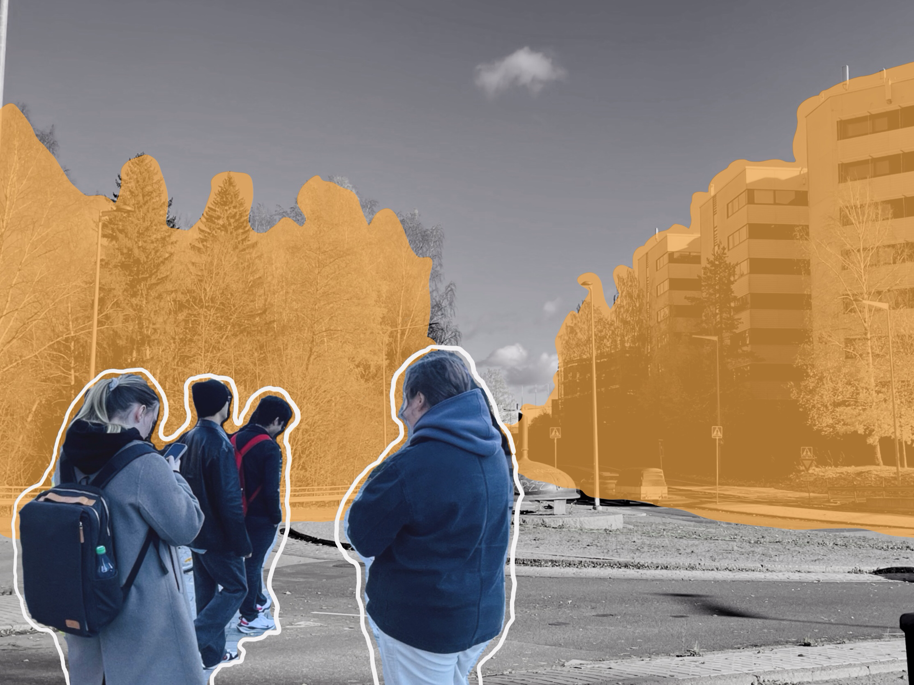
Problems
Where’s our friend?
She’s on the wrong side of the track!
Difficult to cross to another side of the track
Difficult to cross to another side of the track

Slide 11
Identified problems
Lack of identity
Limited connectivity
Separated community

Slide 12
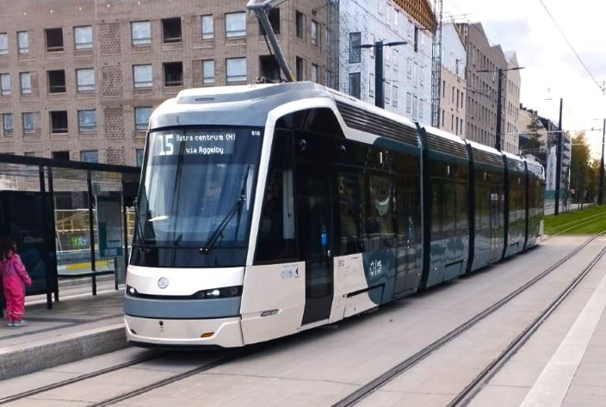
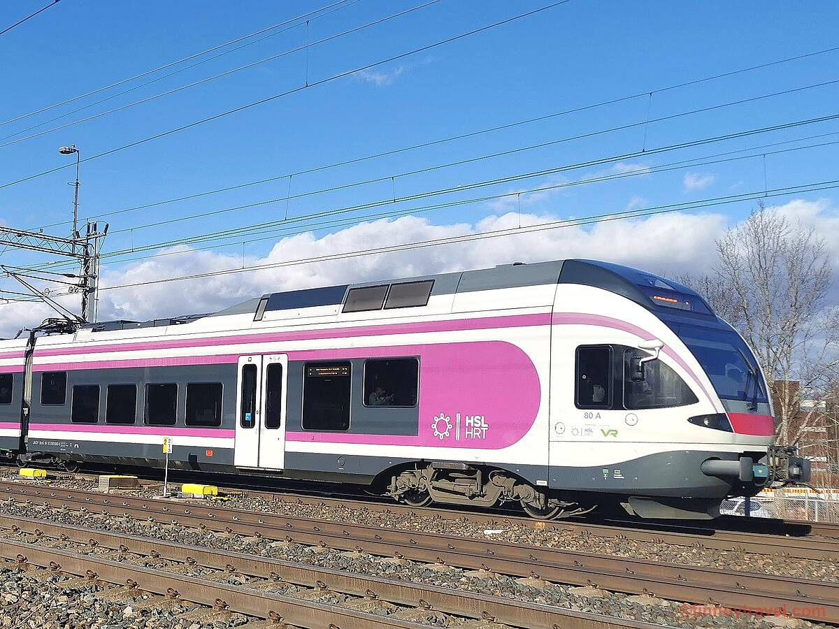
Potential
Connectivity through public transportation

Slide 13
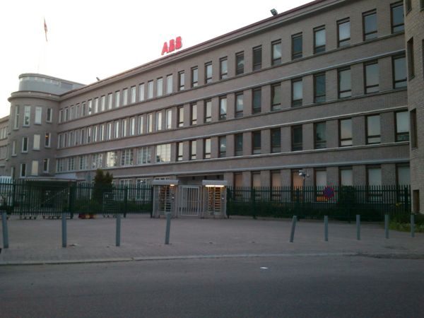
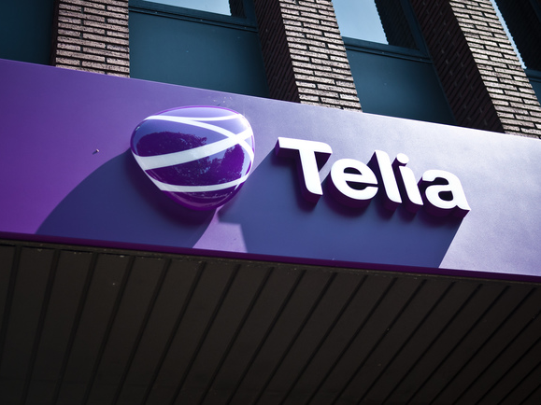
Potential
IT Center / Cluster of workplaces

Slide 14
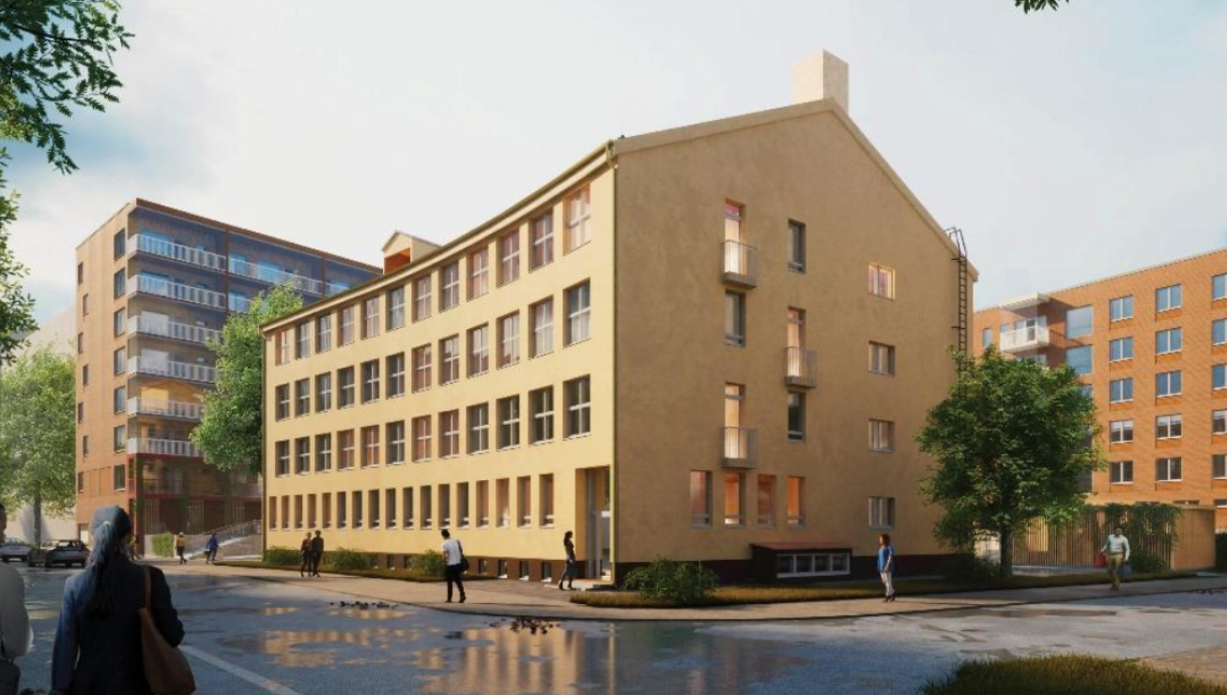
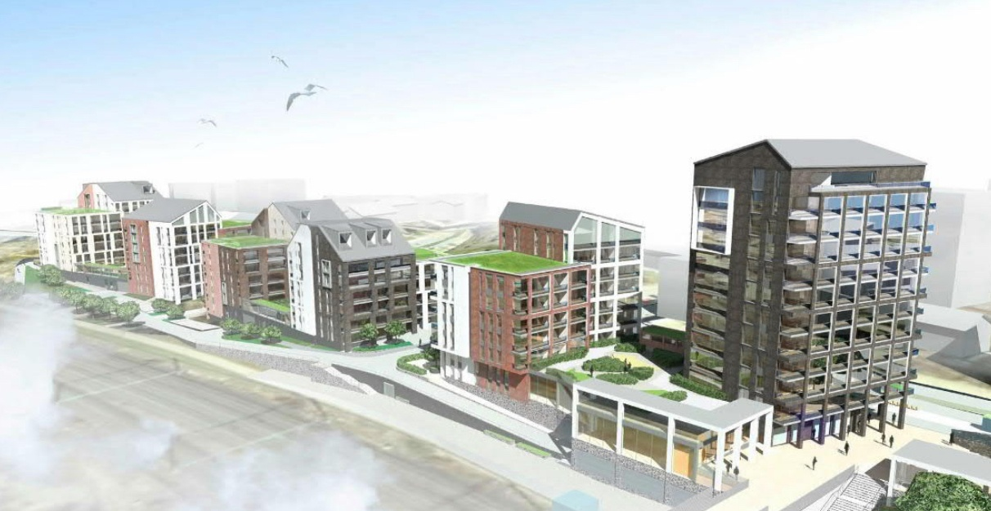
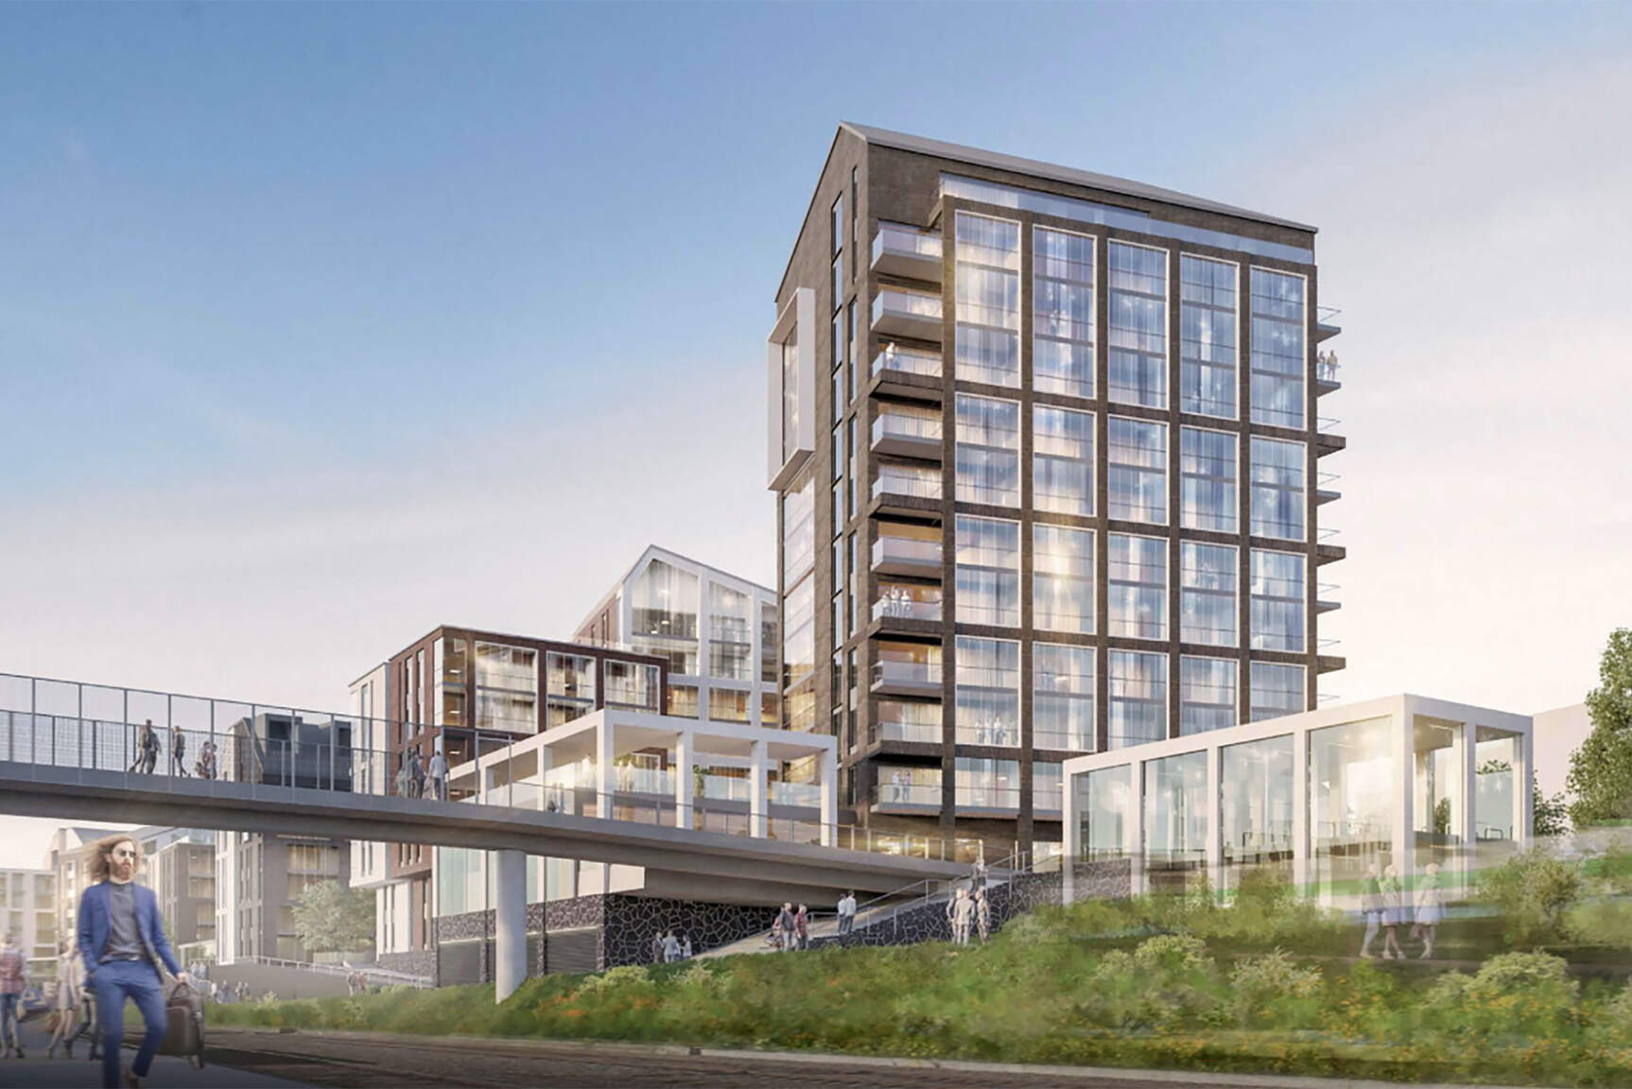
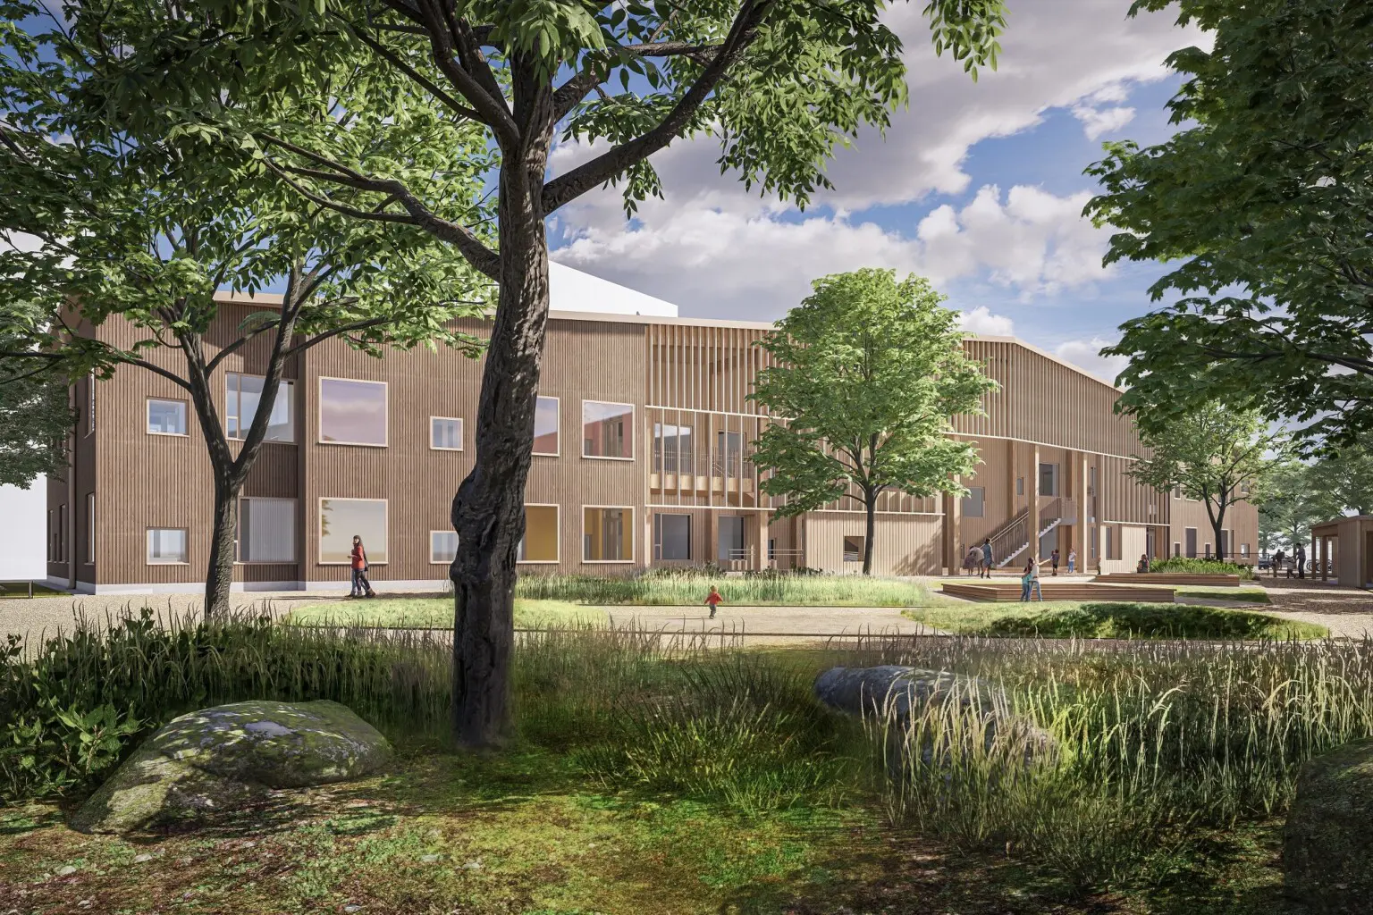
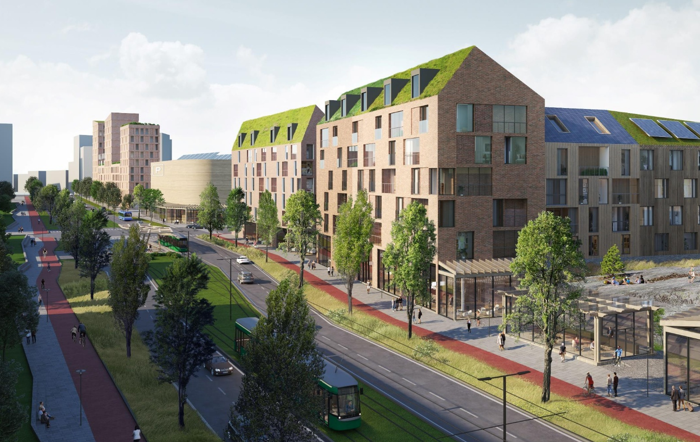
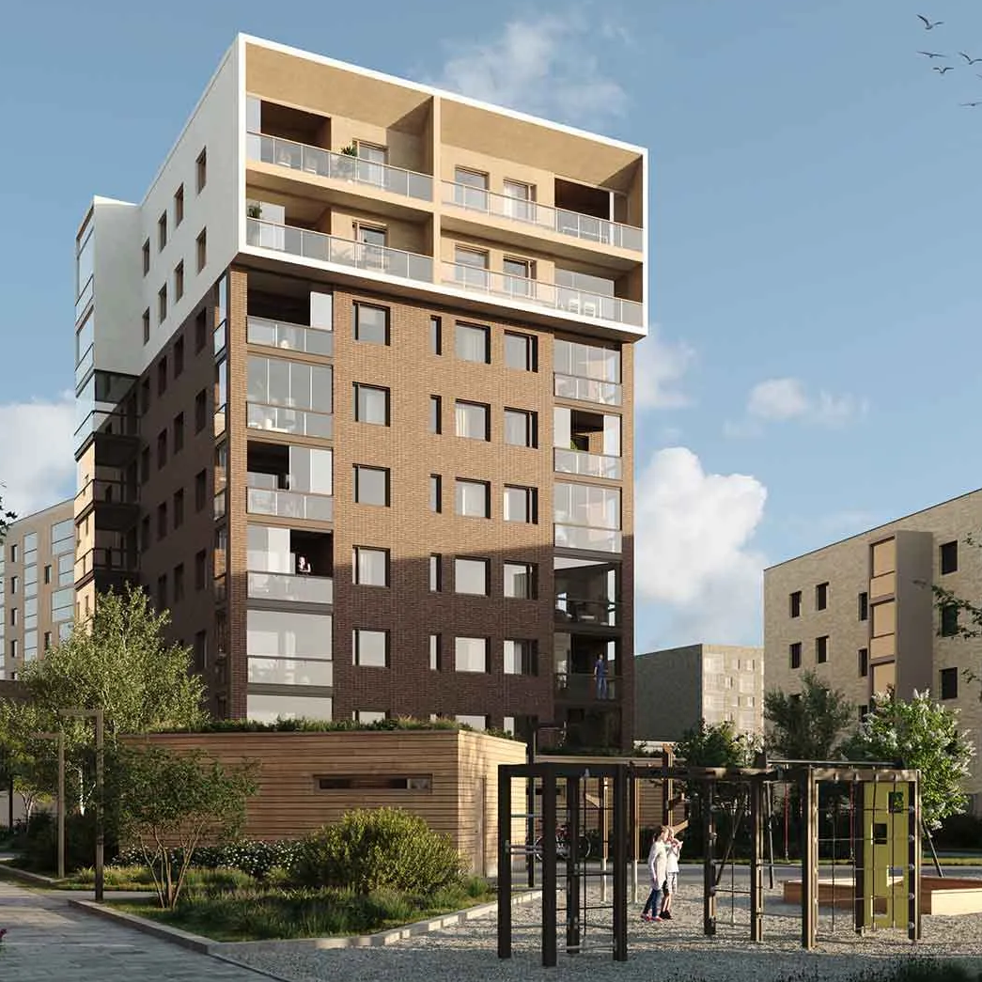
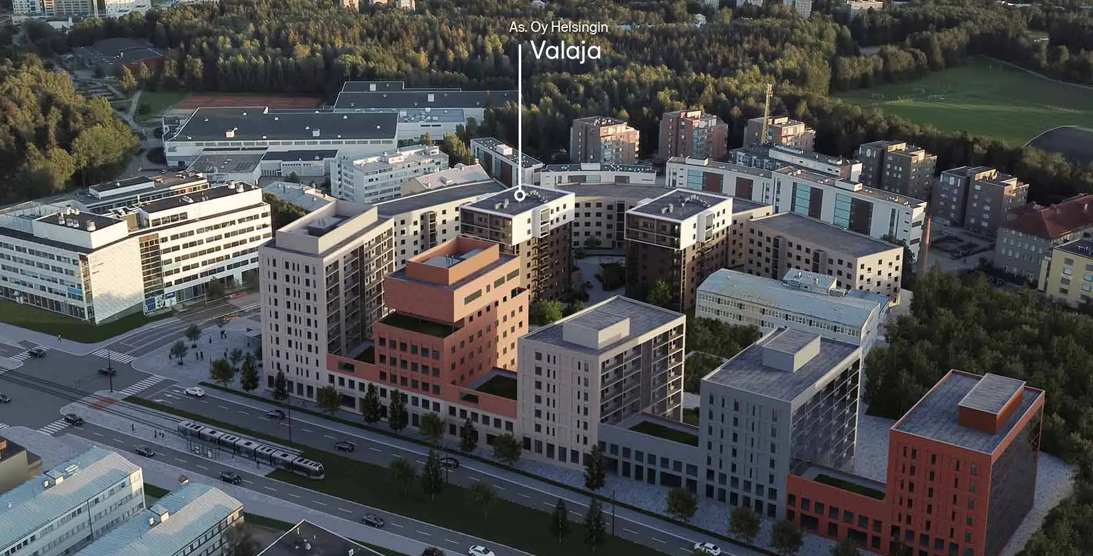
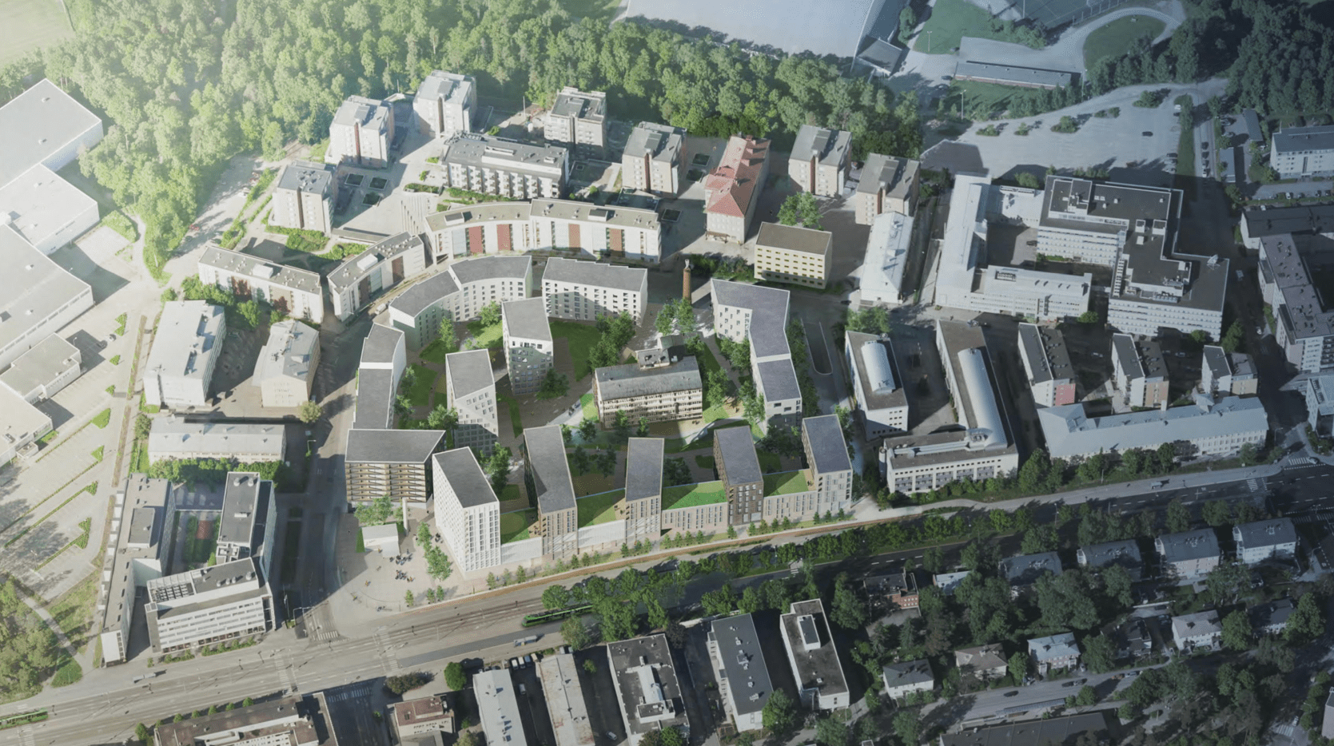
Ongoing projects in the area
Apartments near Pitäjänmäki station
Kutomokuja 3 daycare
Vihdintie boulevard
As. Oy Helsingin valaja near Pitäjänmäki boulevard and Raide-Jokeri tramway
Notes:
Sources for the pictures
1 https://www.rakennuslehti.fi/2024/06/autioituvaa-teollisuusaluetta-elvytetaan-asuntorakentamisella-helsingissa/
2 https://asuntomarkkina.fi/helsingin-pitajanmaen-asemapuistoon-570-asukasta/
3 https://www.hel.fi/fi/uutiset/kaupunginhallitus-esittaa-valtuustolle-pitajanmaen-asemanseudun-kaavamuutosta
4 https://hoivatilat.fi/kutomokujan-paivakoti/
5 https://asuntomarkkina.fi/vihdintien-bulevardikaupungin-asemakaavoitus-jatkuu-lansi-haagan-alueella/
6 and 7 https://www.etuovi.com/myytavat-asunnot/helsinki/taloyhtiot/t83329/as-oy-helsingin-valaja
8 https://asuntomarkkina.fi/pitajanmaki-muuttuu-vahitellen-asuinalueeksi-kutomotielle-lahes-50000-kerrosneliota-lisaa-asumiseen/

Slide 15
How to create a regenerative neighbourhood in Pitäjamäki?

Slide 16
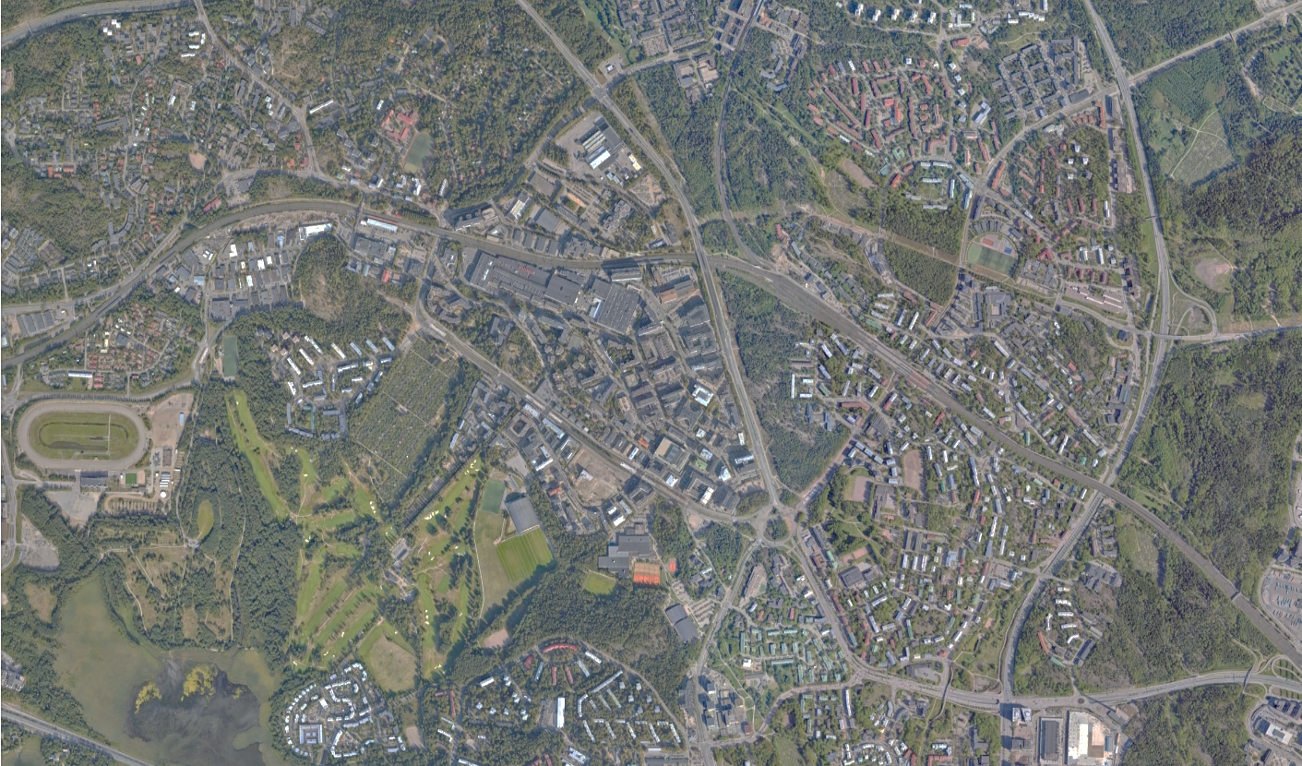
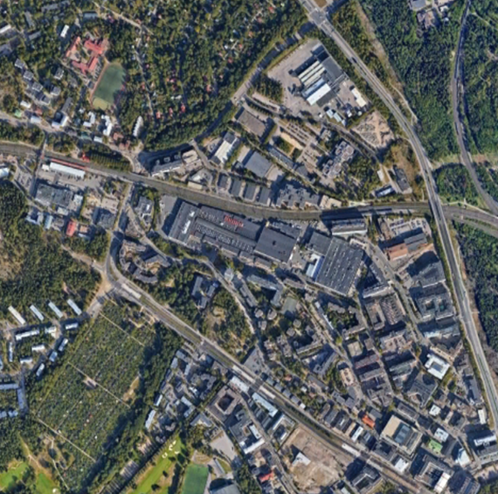
Proposal
Välimaa
Technopolis / Taidepolis
Community Center

Slide 17
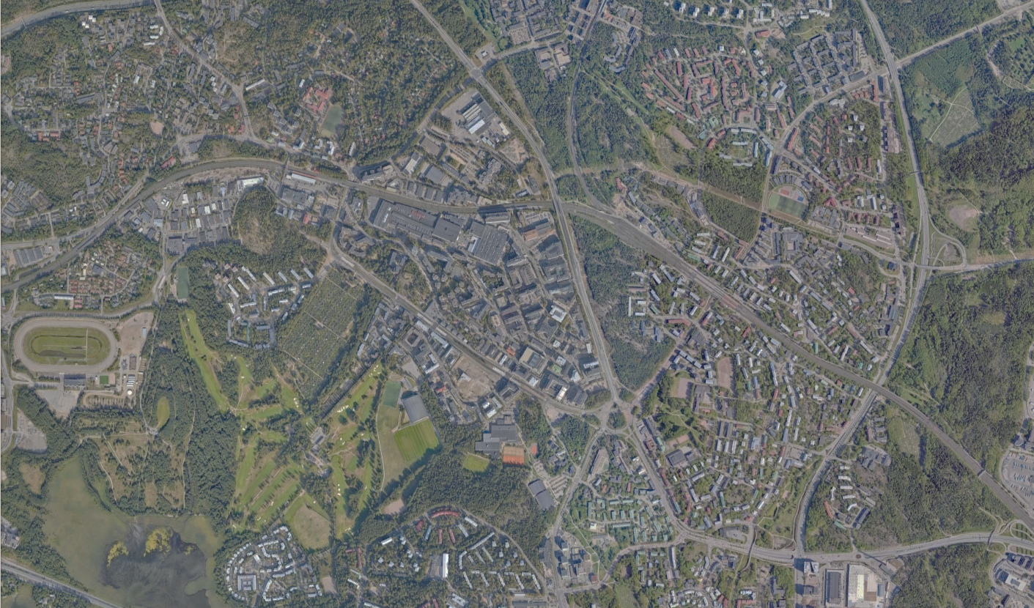
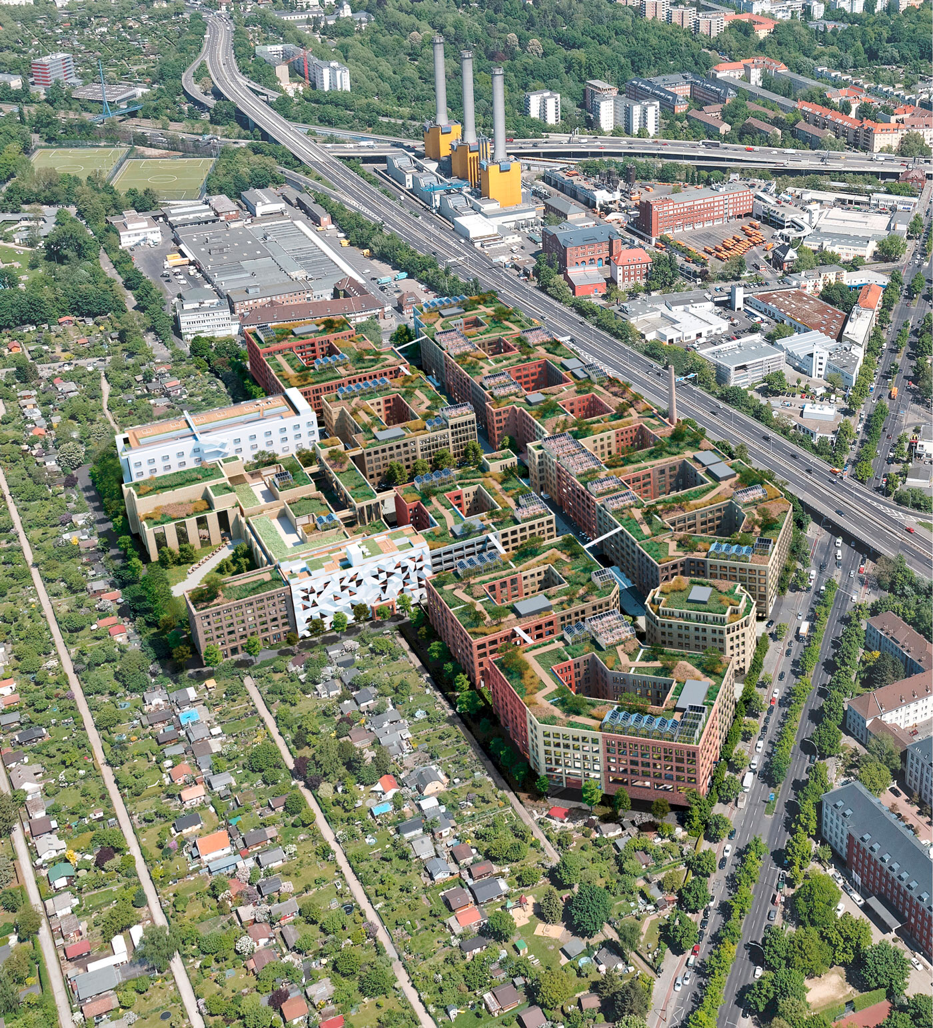
https://www.getmetotaiwan.com/culture/weiwu-mimi-street-art-village-lingya/
Technopolis / Taidepolis
Taidepolis (Art District)
Creating an identity for the area
Using the area to its full potential
Flexibility for usage
Regenerative concepts and technologies
GO West (Berlin)
Technopolis
(Business District)

Slide 18
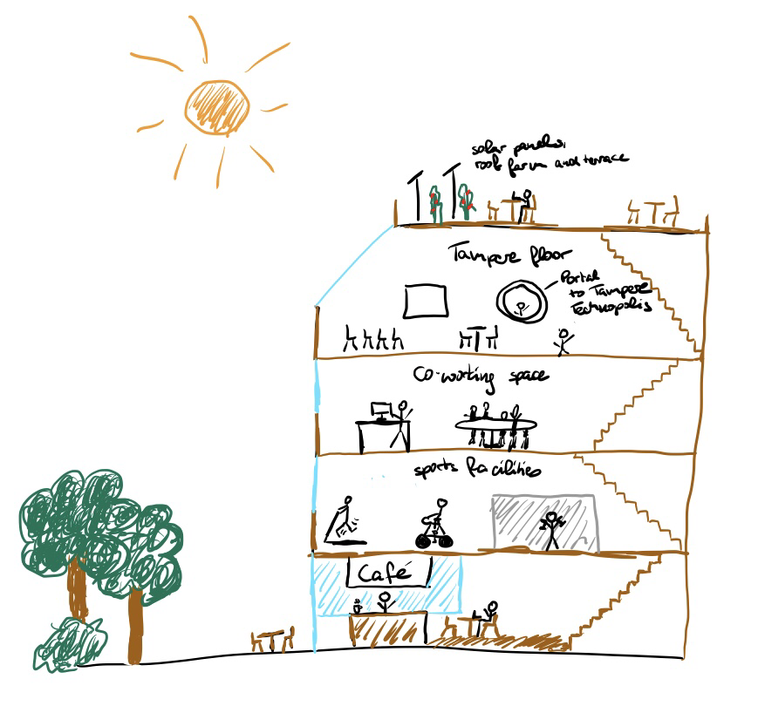
Technopolis
Booking system for vacant offices
Place-branding
Tampere House
(Collaborative work space)
Free bike-sharing
Autonomous shuttles
Roof gardens and farms
Reusing heat from data center
Connection to Tampere

Slide 19
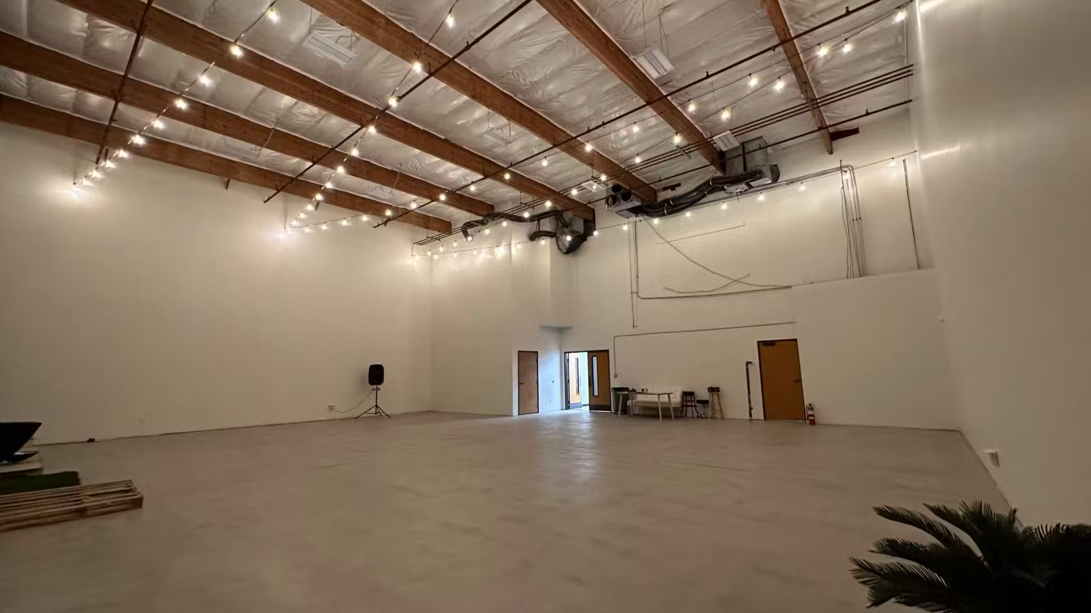
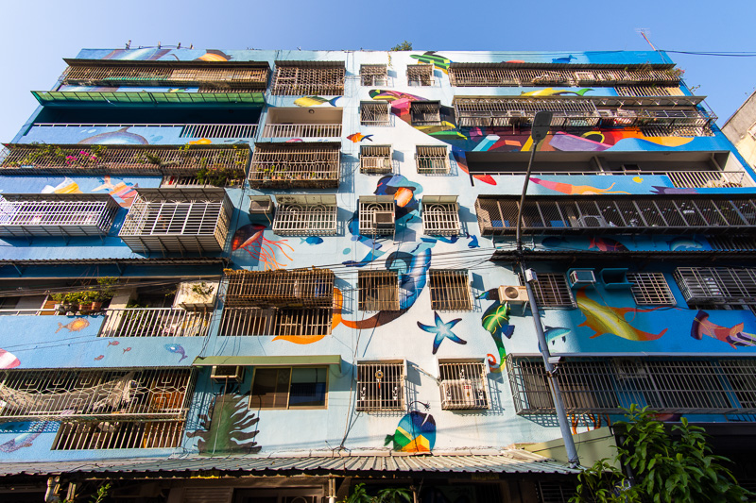
Taidepolis
Event Space
Swimply
Offices for artists, craftsmen and musicians
Vacant warehouses for events
Getmetotaiwan
Reimagined office buildings
14

Slide 20
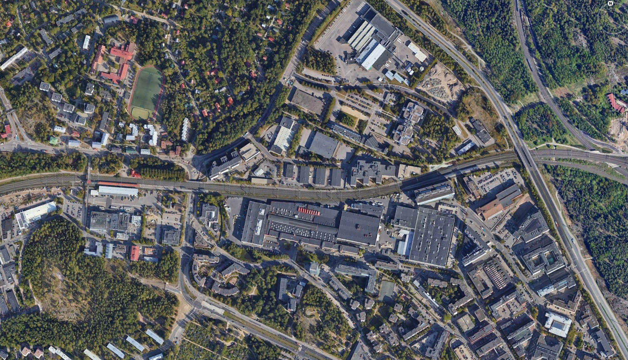
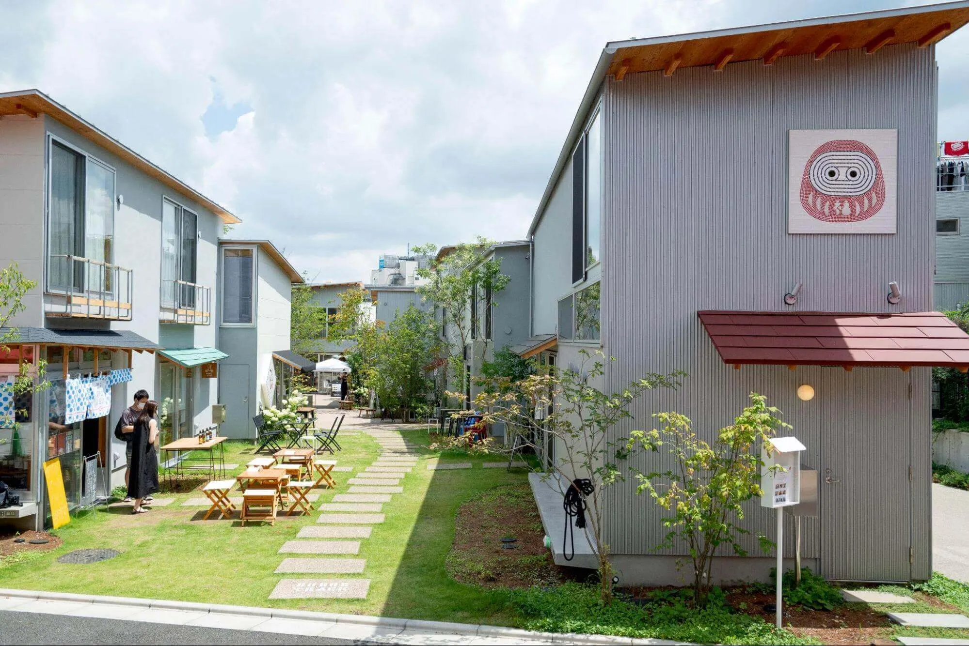
Välimaa
Pitäjänmäki station
Valimo station
Small-scale development connecting districts
and communities
Fun, functional, and comfortable walking experience
14
BONUS TRACK (Tokyo)
Notes:
Valima means middle ground in Finnish, and in our project, this Valima connects not only between the different areas
Enhances the interactions of people and revitalizing communities, social sustainability

Slide 21
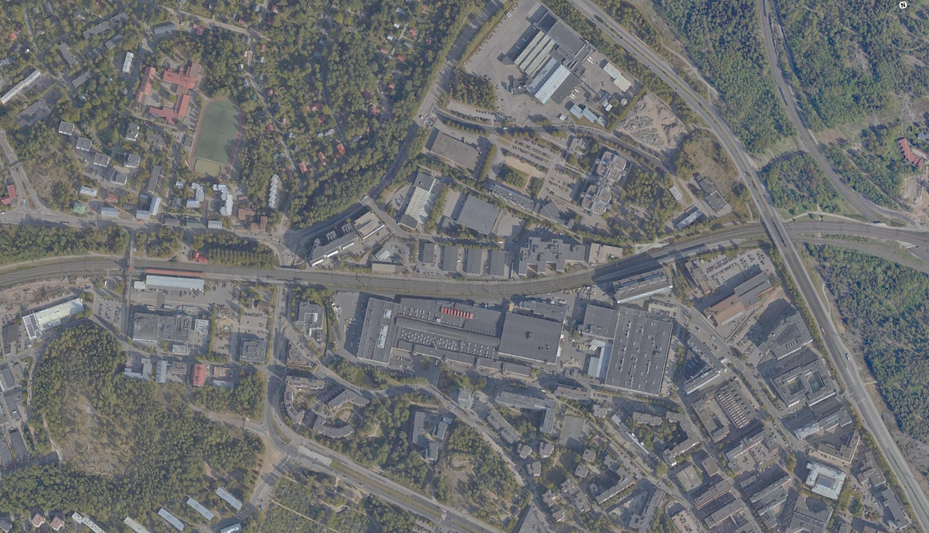
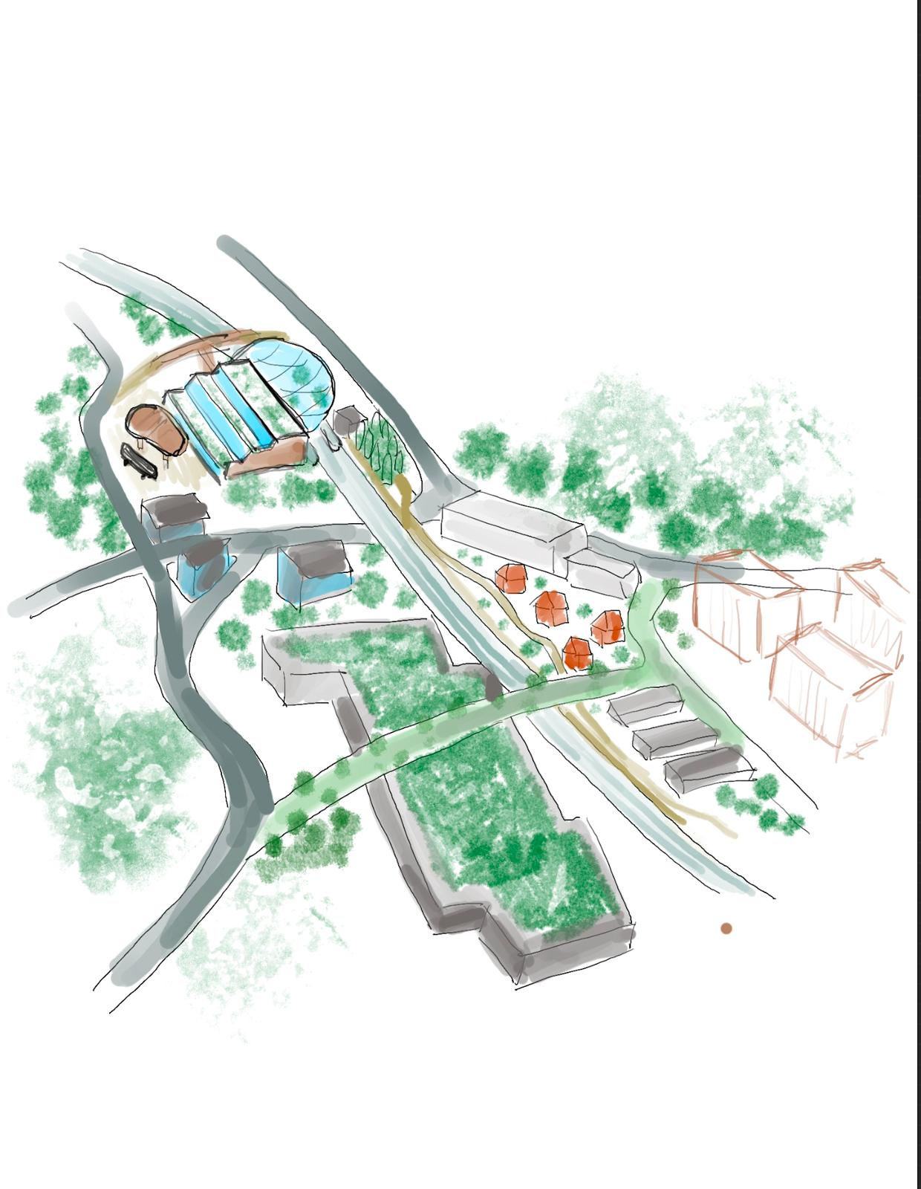
Välimaa
Green corridor
Small-scale businesses
Community center
Green roof

Slide 22
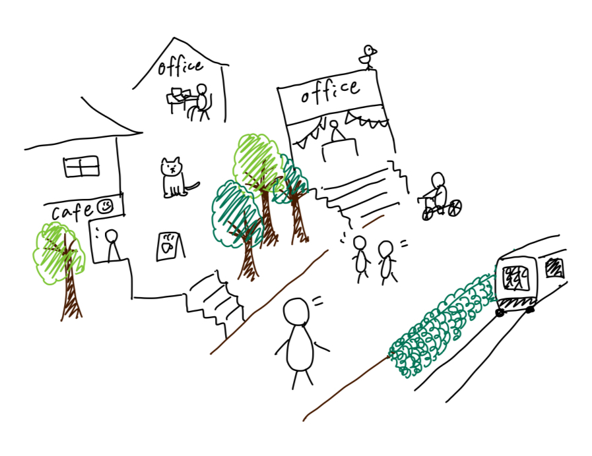
Botanical garden/station which is connected to the community centre
Green corridor
A bridge connecting North and South, promoting urban ecosystem
Notes:
Bushes to reduce the noise, wind
Residential on the second floor
→increasing interactions between people
Green roof and connecting the green, connecting the sides and city
Art and business, green colidors
Promoting urban ecosystem

Slide 23
Connectivity
Valimo
Pitäjänmäki

Slide 24
Connectivity
Valimo
Pitäjänmäki
ABB’s Factory
Strömberginpuisto

Slide 25
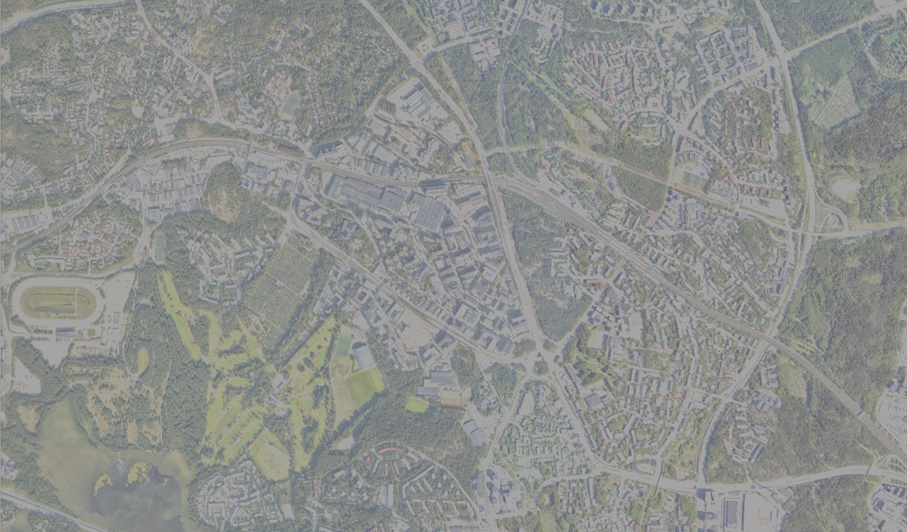
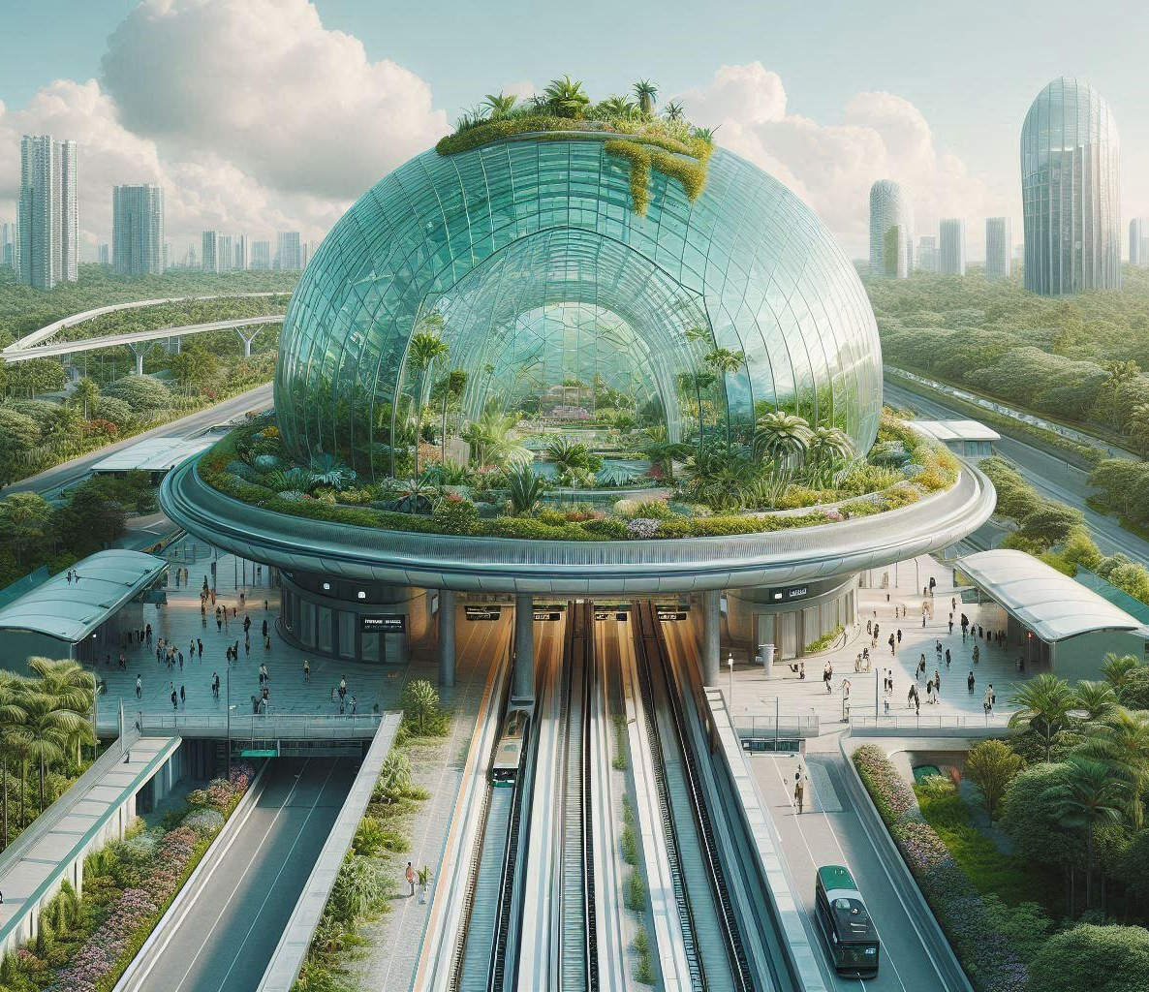
Better train station experiences
Community activity
Bus terminal
Commercial
Community center

Slide 26
Community Center
Library
Communal space
Regeneration as a focus
Transportation Center
Pop-up events
Connected to Pitäjänmäki station

Slide 27
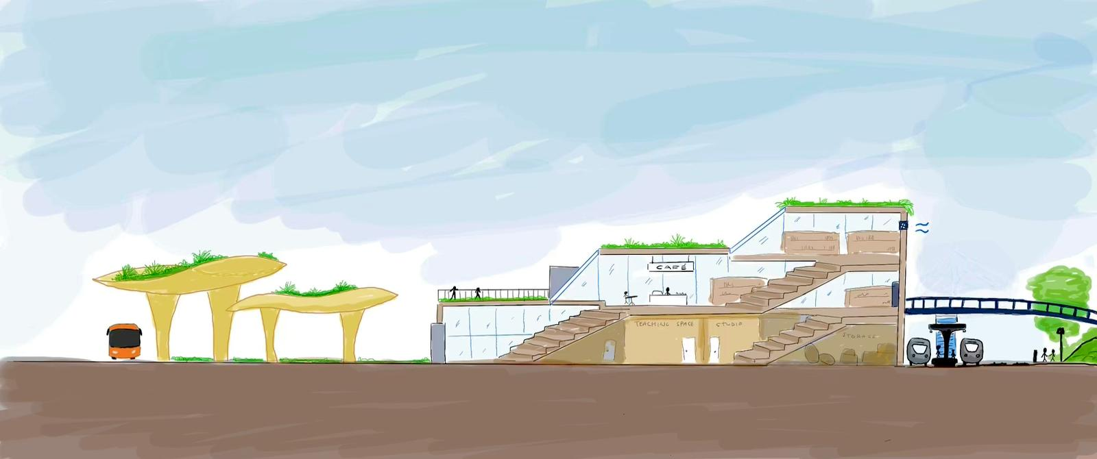
Community Center
Conceptual drawing by Amanda
Regenerative design principles, such as:
  Green moss roof, natural ventilation, rainwater collection and grey water usage
  Timber construction as carbon storage
  Utilising heat from local data centres etc.
→ Aiming for LEED Platinum certification
“Transit as a place”
Notes:
Pitäjänmäki has a lot of outdoor spaces but no indoors
Even the current library is small and mostly catered to children
Something that can be implemented in Tampere as well

Slide 28
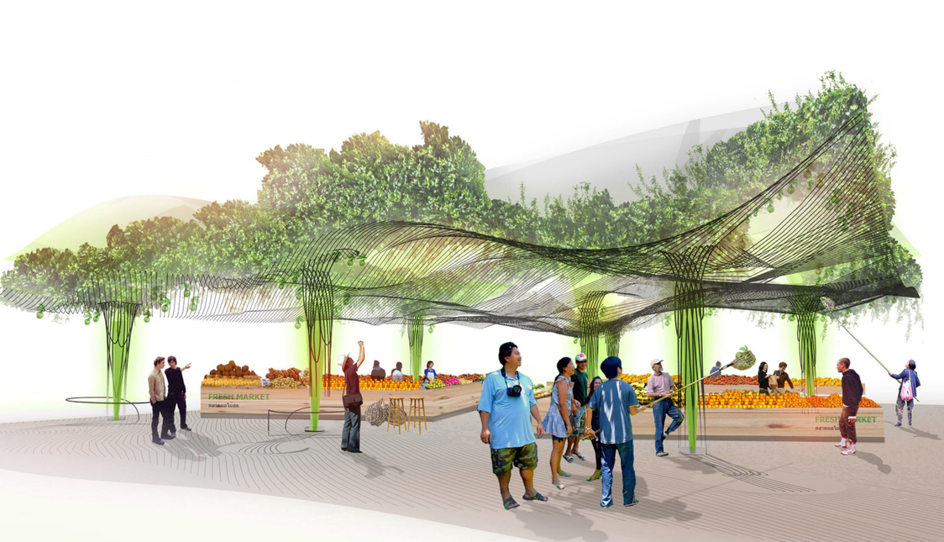
Community Center
Recycling and sharing
– a space where local people can bring unwanted, but still usable goods that are free to take
Open space that can be repurposed (voting, local events, arts and crafts exhibitions)
Space for hosting courses in ceramics, arts, manual skills
Green bus terminal will be built along the south side of the community centre to facilitate even better connections
Conceptual rendering from a project using a similar concept for the roof in Bangkok, Thailand
Notes:
Manual skills as part of Pitäjänmäki heritage (industry)
Crafts room have surplus material from local businesses to use for free

Slide 29
Design with nature in mind
Sustainable design/material
Waste heat transfer
Green roof
Area with circular wastewater management & clean energy

Slide 30
Good life for everyone
For residents, for businesses, for visitors, for the city,
for the planet

Slide 31
Image References
https://www.stadissa.fi/paikat/3763/tarppeja-raide-jokeri-pikaratikan-reitille
https://finnoytravel.com/en/finland/trains-in-finland/
Slide 1: Raide-Jokeri Transformer. Retrieved from ChatGPT.
Slide 3: all images retrieved from
Slides 5 to 7: all context analyses maps by Bo Zhang
Slide 8 and 10: pictures by Nagisa Takahashi, illustrations by Bo Zhang
Slide 9: picture by Harit Tawabutr, illustrations by Bo Zhang
Slide 12: Raide-Jokeri. Retrieved from https://www.stadissa.fi/paikat/3763/tarppeja-raide-jokeri-pikaratikan-reitille. Commuter train. Retrieved from https://finnoytravel.com/en/finland/trains-in-finland/
Slide 13: ABB Factory. Retrieved from https://www.fonecta.fi/profiili/abb-oy/123118.; Telia. Retrieved from https://www.lightreading.com/broadband/eurobites-telia-revenues-remain-flat-as-it-expands-5g-coverage
Slide 14: Rendered image of proposed development projects. Helsingin Kaupunki, Asuntomarkkina, & Puu Info.
Slide 17: GO West. Retrieved from: https://www.berliner-woche.de/wilmersdorf/c-bauen/projekt-go-west-geht-in-die-naechste-runde_a347303
Slide 18: sketch by Kristina Honermann
Slide 19: Reimagined office buildings: Getmetotaiwan. Retrieved from: https://www.getmetotaiwan.com/culture/weiwu-mimi-street-art-village-lingya/
Event space: Swimply. Retrieved from: https://swimply.com/pooldetails/66950
Slide 22 and 28: sketch by Amanda Moilanen
Slide 25: Conceptualized images. Retrieved from Microsoft Designer.
Slide 28: Bangkok Retail Development. Retrieved from https://www.architectkidd.com/index.php/2011/12/urban-farm-wins-holcim-silver-award/

Slide 32
More connected
Between people and spaces
Within Pitäjänmäki and between Pitäjänmäki and the world
What will the future attractive regenerative urban center look like?
How can the flows between cities be harnessed to enhance urban vitality?
What do attractive sustainable travel chains look like?

Slide 33
The case from Tokyo
Promotion of small businesses
Residential on the second floor
Promotes interactions
between people
BONUS TRUCK in Tokyo, Japan
Notes:
Connection with Japanese
Summer and winter

