Slide 1

Regenerating Malmi
HELmi: The Pearl of Helsinki
Notes:
Airport redevelopment, new housing, weathlier, will patron local businesses
Cycle path connection with underground bike parking, dutch style
Commuter train to tampere doesnt stop, but we add a stop so this connects the city in a green way
20-30 minute commute to downtown helsinki
Theme of citizen participation in design (multiple developers), engegement in taking care of greenery, lively streets
Community garden, childrens parks. Village vibes
The renovated terminal becomes a cultural/recreational/dining/services
Taking care of each other, regrenerative. Socially regeneratiave. Meeting more social needs to reduce travel for example. Subtle reduction
Wanting to leave your neighborhood is bad. The regenerative neightorhood of the future should hae everything you need
Cover the top of the rails with a park that also reduces the perceived sketchiness, which is social regeneration. Less harm vs more good.
3 minutes added. 200 max but runs at 160km, to add the stop
Densification
Crazy moonshot and also inteplementation plan with long term and short term
Nature.
Green boulevard is the spine of our idea from where all extra modifications spring up from
Small grandma bus
Shift station entrance closer
Entrance with city bike parking
Alternate route to the north for bus, delivery, emergency with bollards that only open sometimes
Problem Introduction -> Milla
Grand concept of the pearl -> Austin
The boulevard with tram, bike lanes -> Manja
Train station interchange & modifications, bike share -> Milla
Densification & economic revitalization around station area -> Austin
Car free neighborhood, heritage air museum, aviation street names -> Lorenzo
Culture/art, community involvement/participation -> Lorenzo
Feasibility & cost benefit breakdown -> Paul
Implementation plan, by phases -> Paul

Slide 2
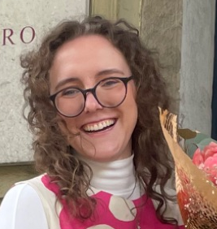
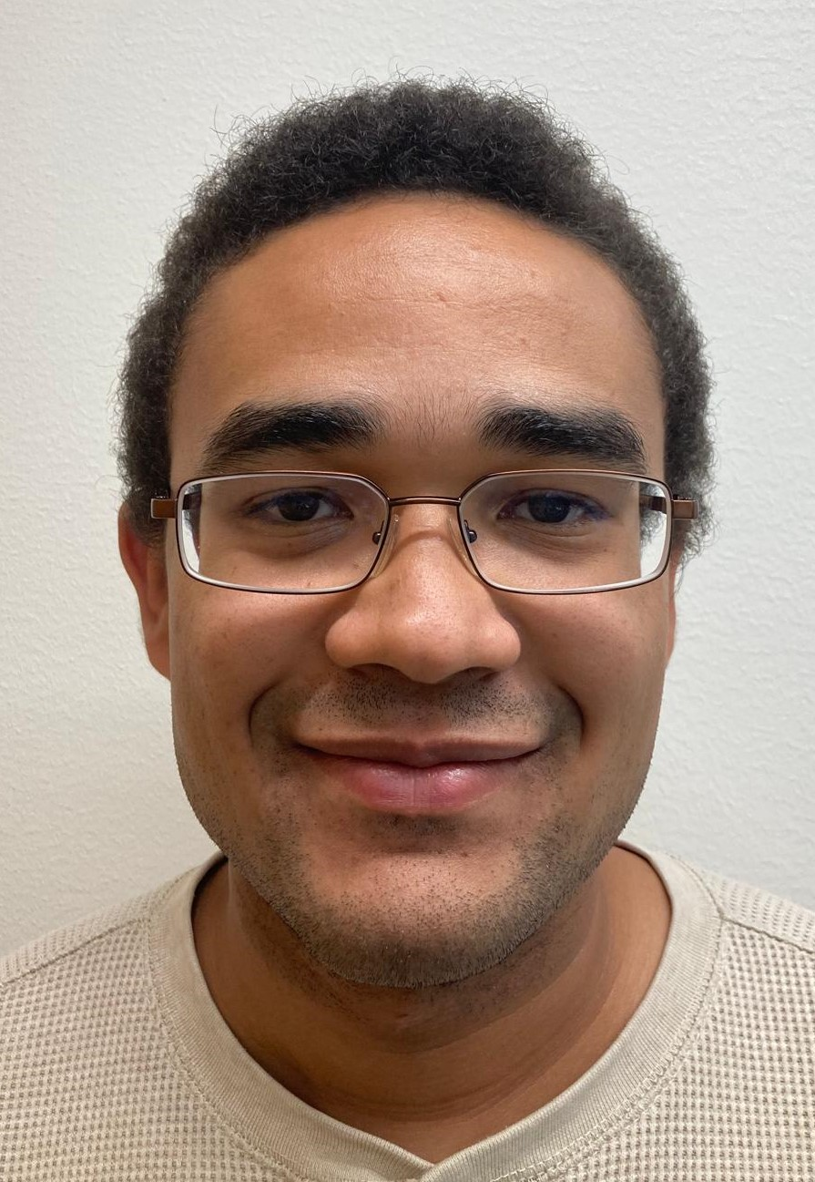
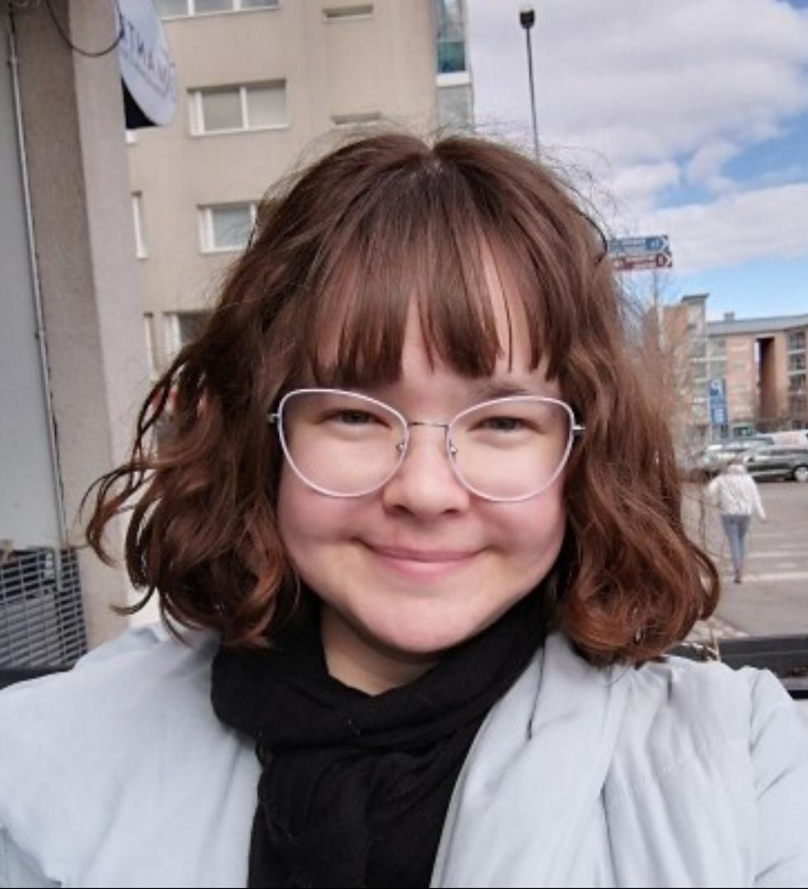
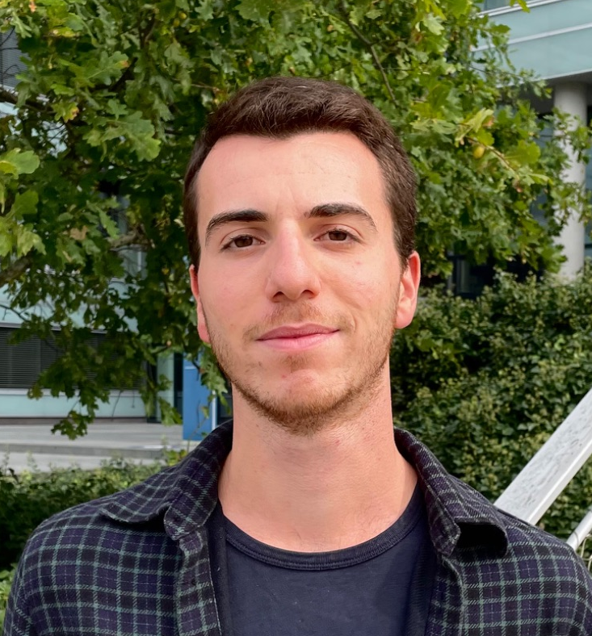
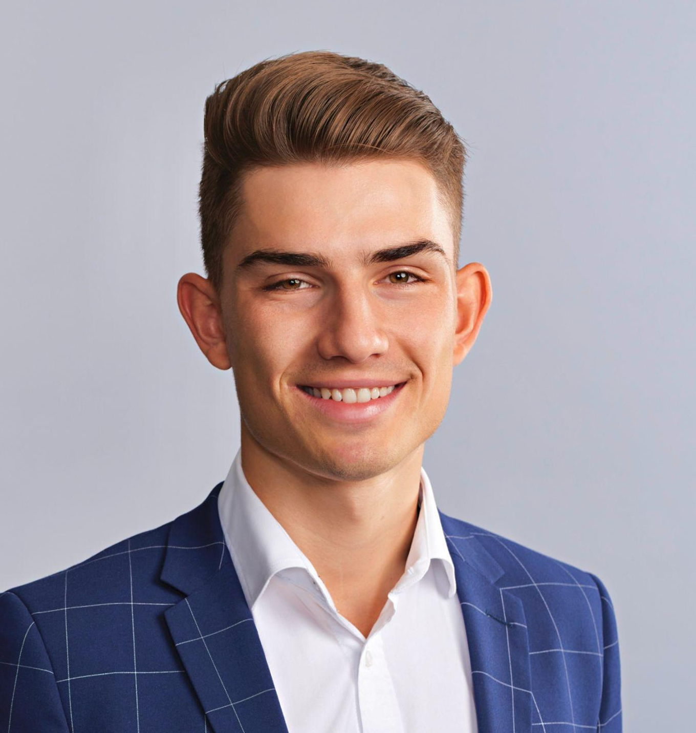
Meet The Team
Manja Platovšek
Austin Hämmerli
Milla Hirsimäki
Architect & Planner
City Branding Expert
Project Manager
Lorenzo Cammarota Paul Mates
Citizen Participation Expert Urban Economist

Slide 3
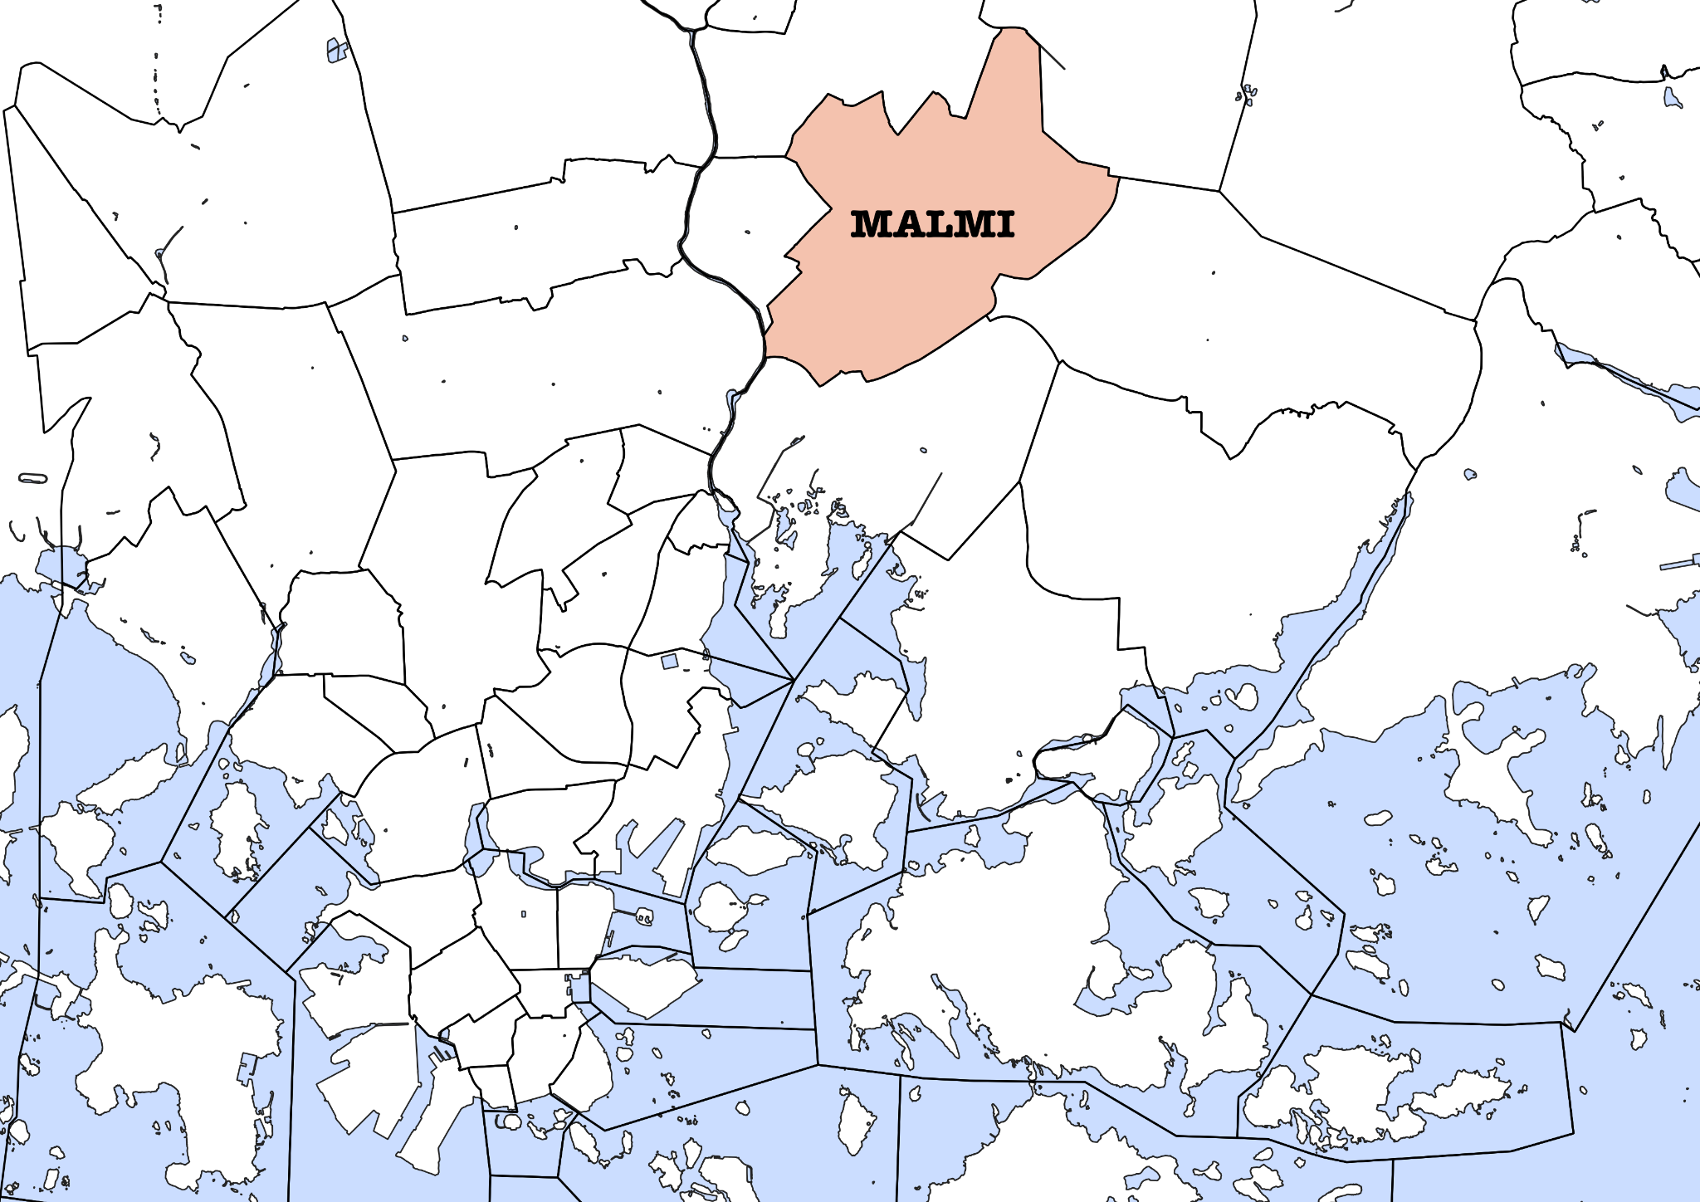
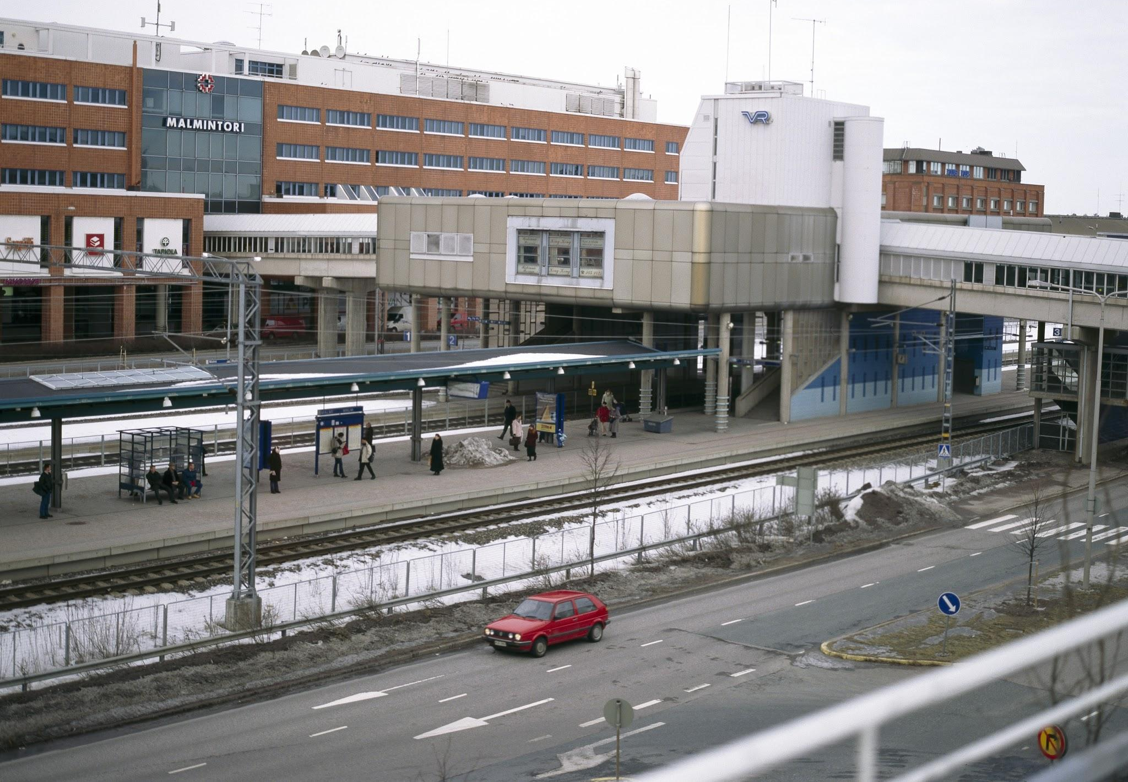
Problem Introduction
Suburb lacking identity
Reputation as poor, sketchy, rough area
Divided north/south across the train tracks
Well connected but not a destination

Slide 4
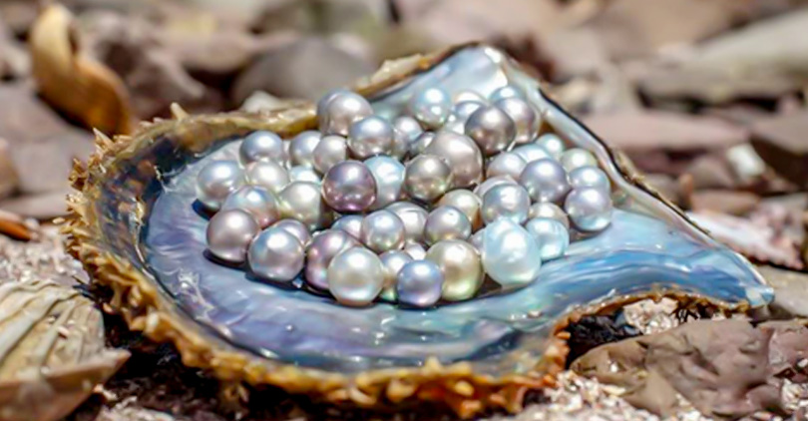
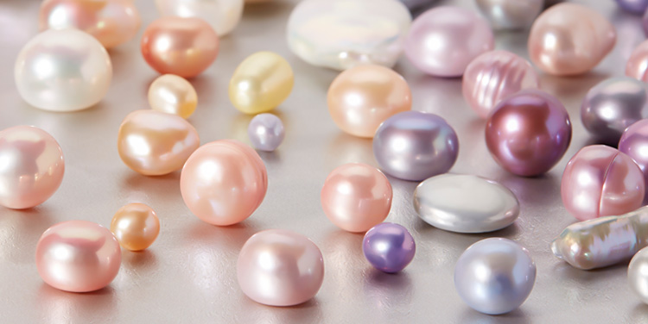
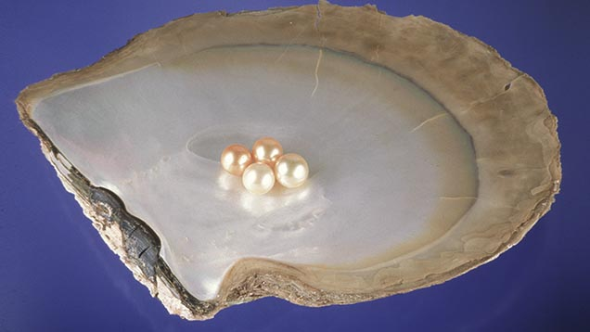
Vision for Malmi: The Pearl of Helsinki
The Pearl as the New Identifying Element for Malmi
Creates a shining, intriguing, aspirational image
Like Malmi, pearls are formed organically over time as oysters defend against irritants
Represents transforming the negative image of Malmi into something positive
Flexibility for residents to refine their identity
Pearls symbolize:
Purity
Innocence
Serenity
Self-love & care
Pearls are:
Radiant
Understated.
Beautiful
Colorful

Slide 5
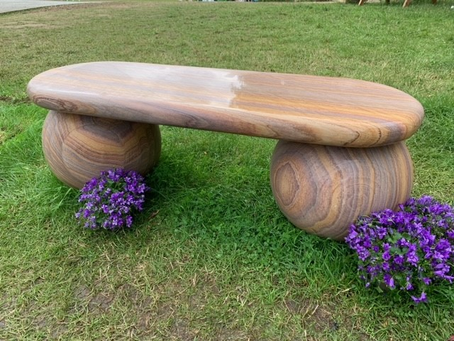
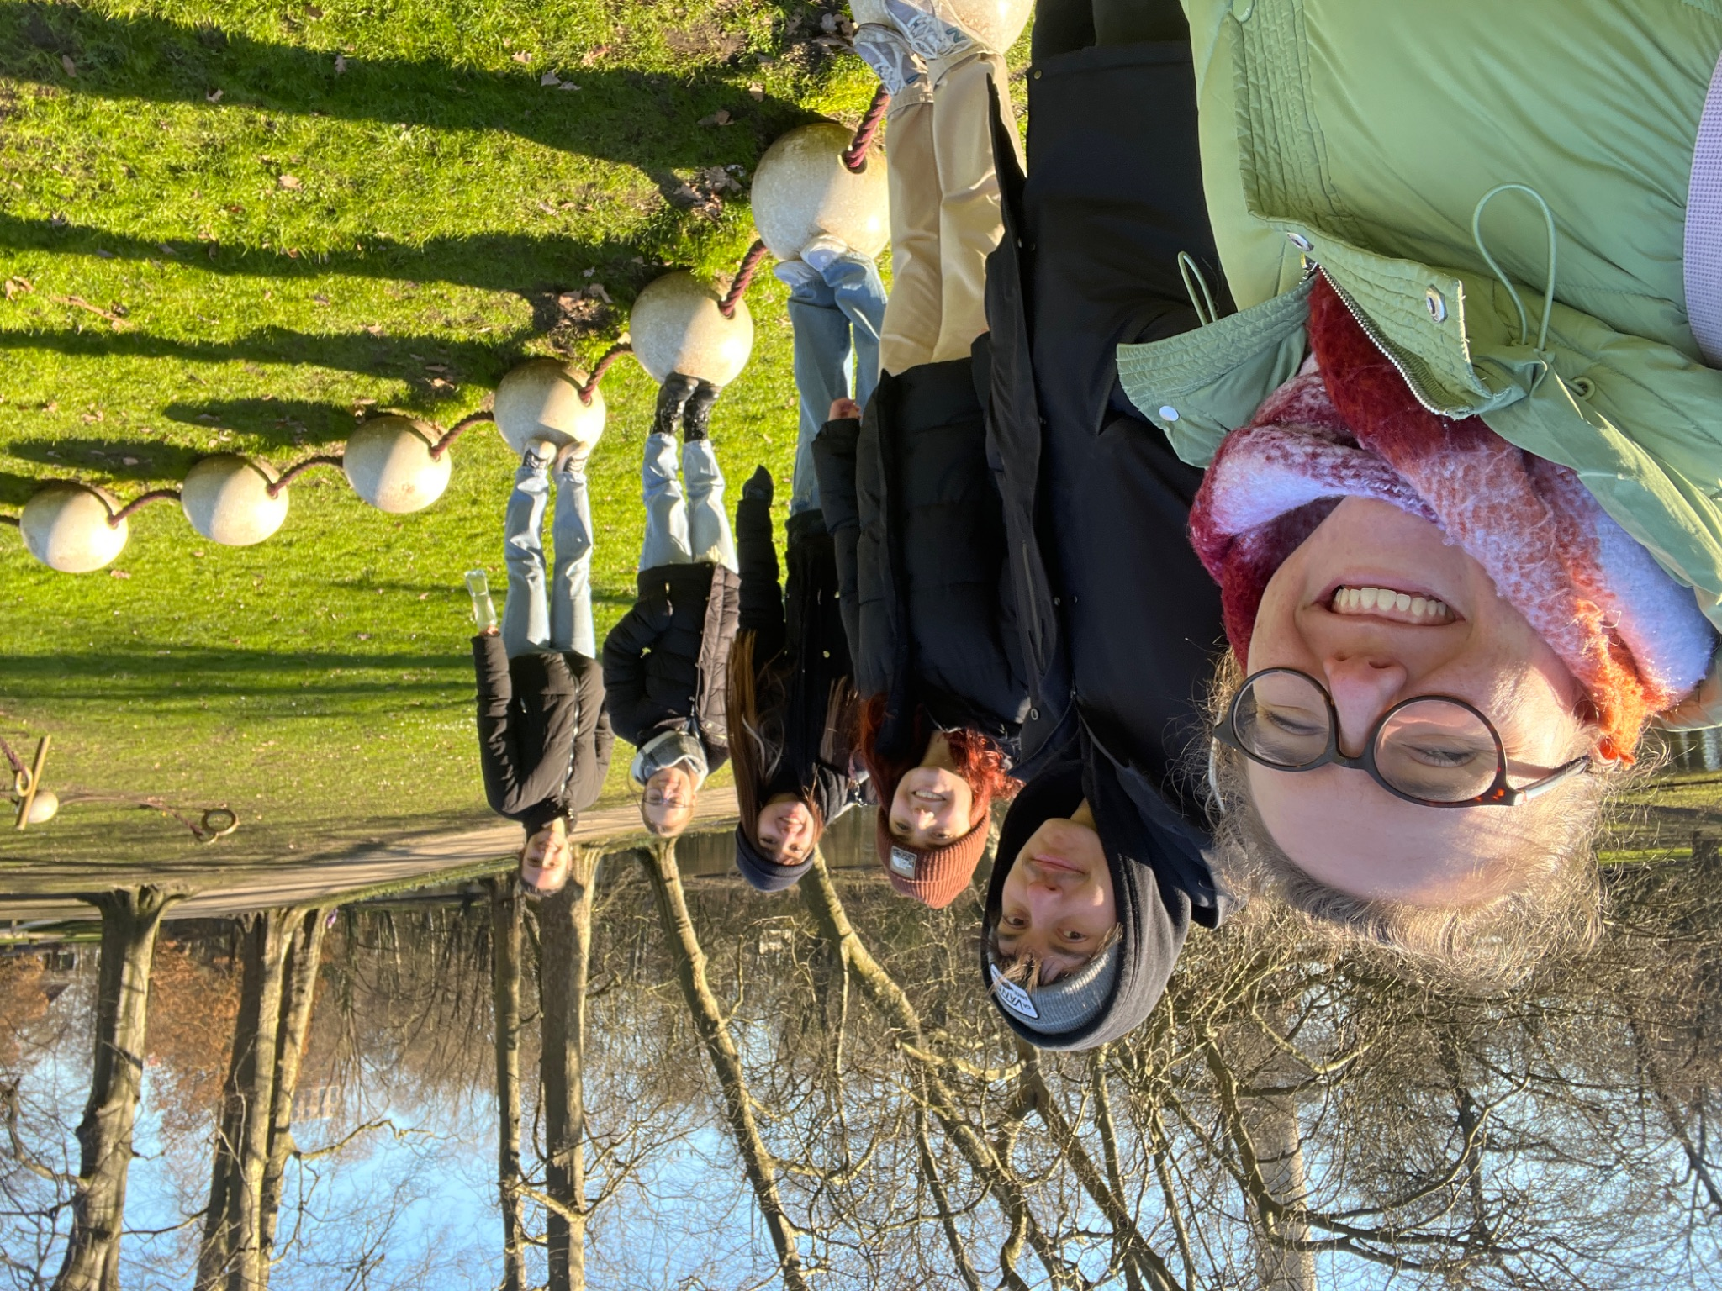
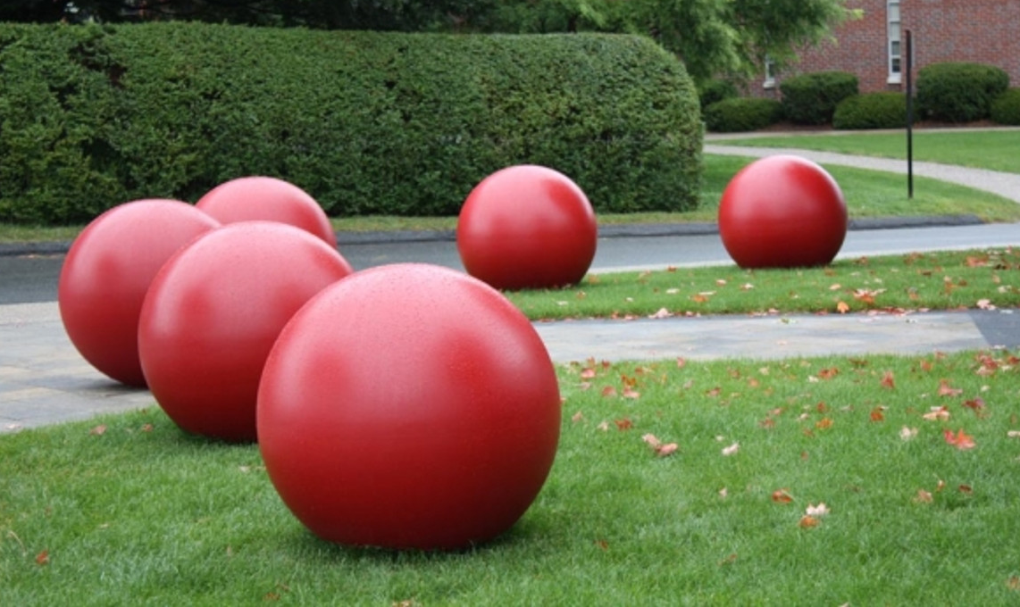
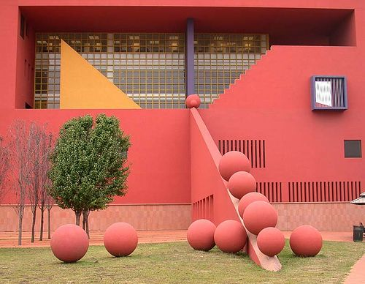
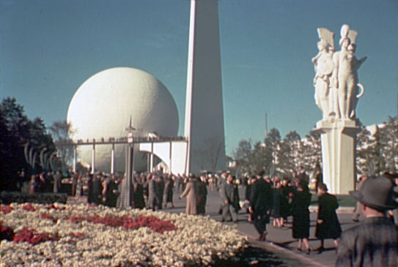
Pearls as a Malmian Design Element
Relatively inexpensive design concept to add visual interest to Malmi
Can be portrayed through spheres
Benches, bollards, and other design elements can be used to incorporate pearls into Malmi’s public spaces
Notes:
https://docs.google.com/document/d/1xWoFCyhgfKyVooI08SDERkwidvbs2SMcTafMgmgYOqA/edit?tab=t.0

Slide 6
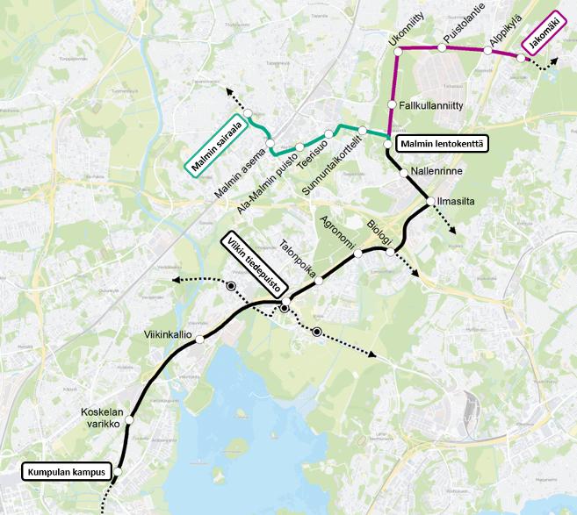
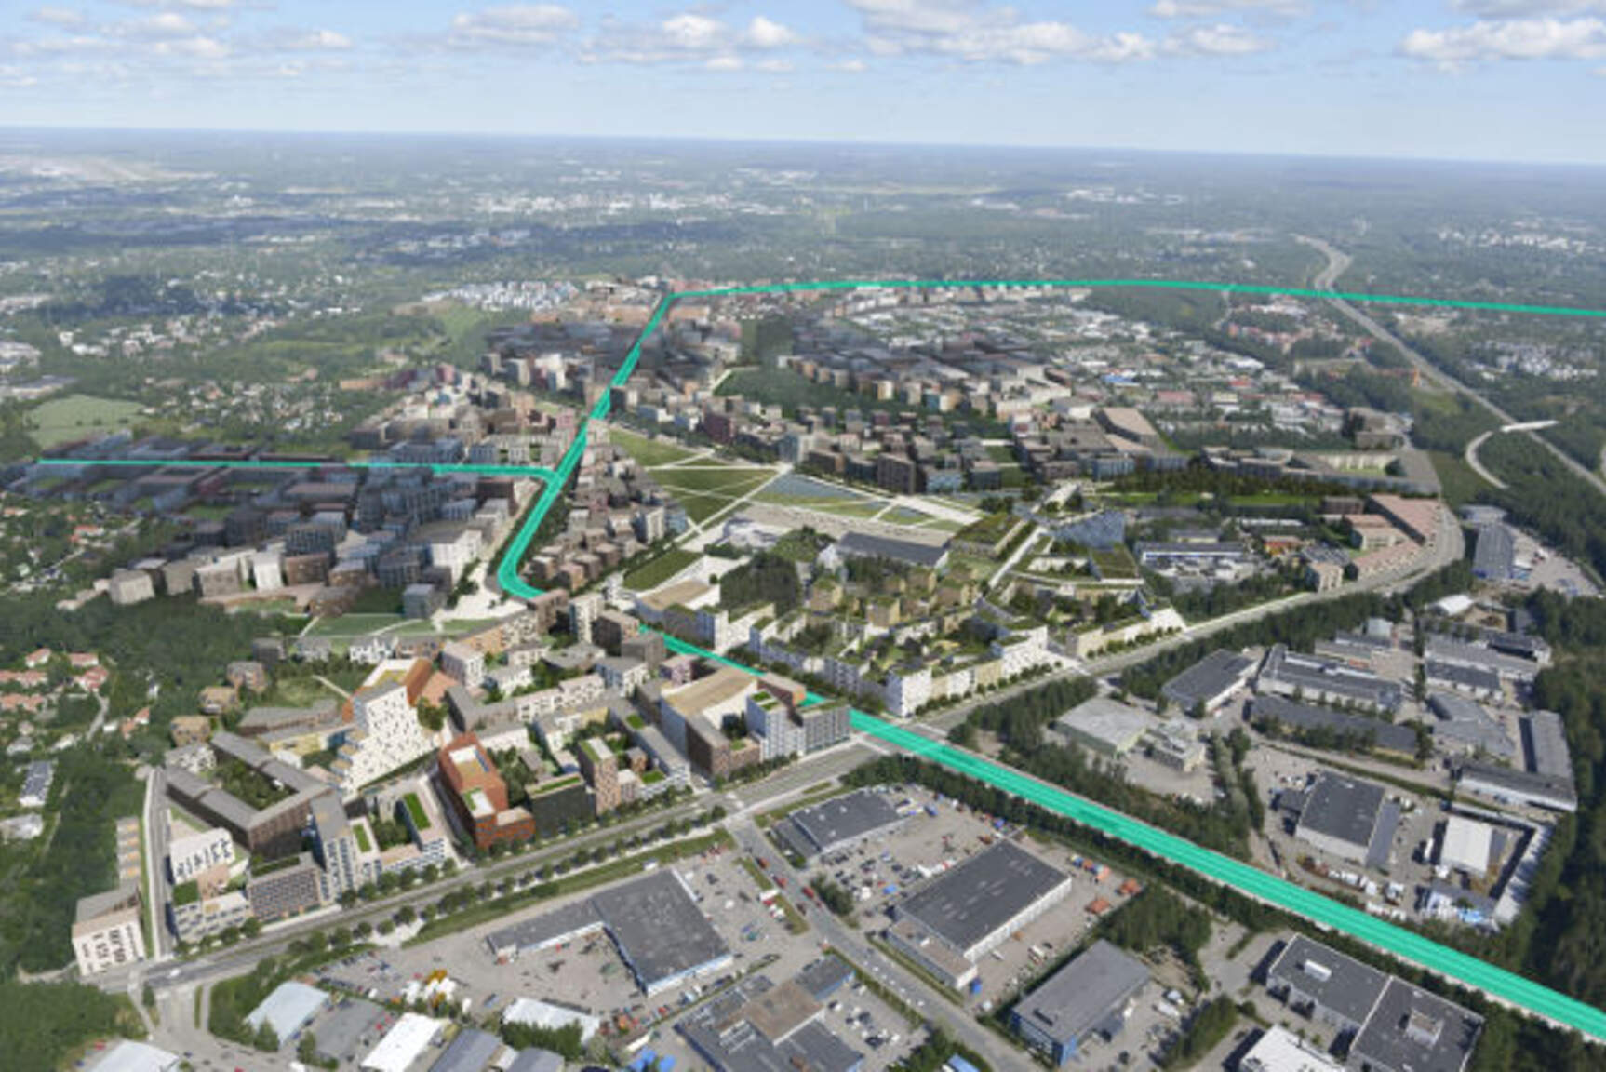
Malmi Needs More Than Just A Tram Extension

Slide 7
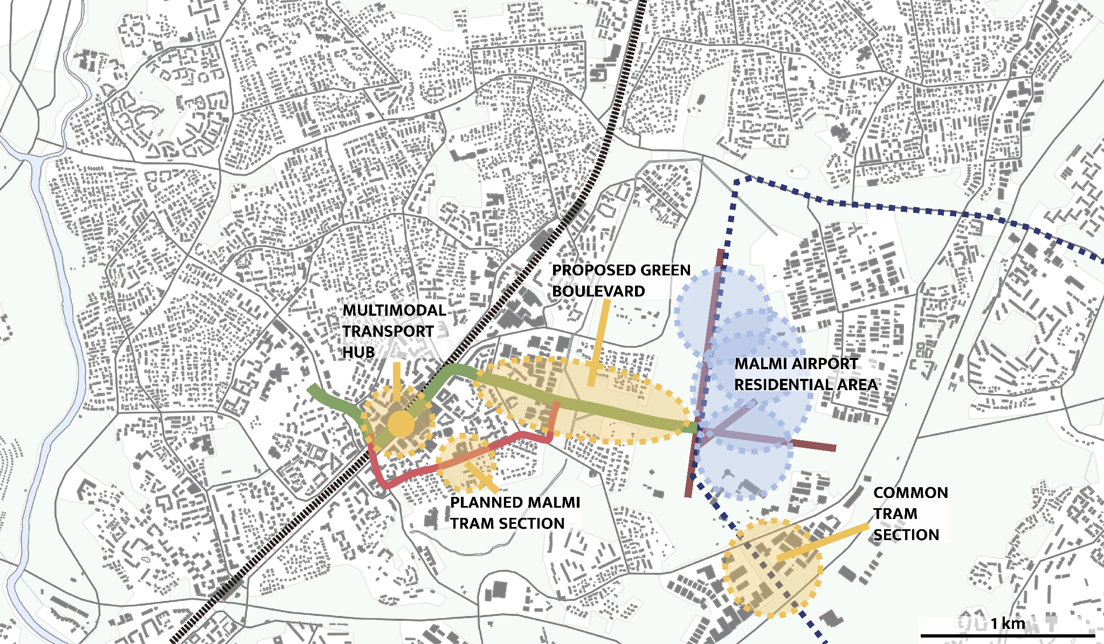
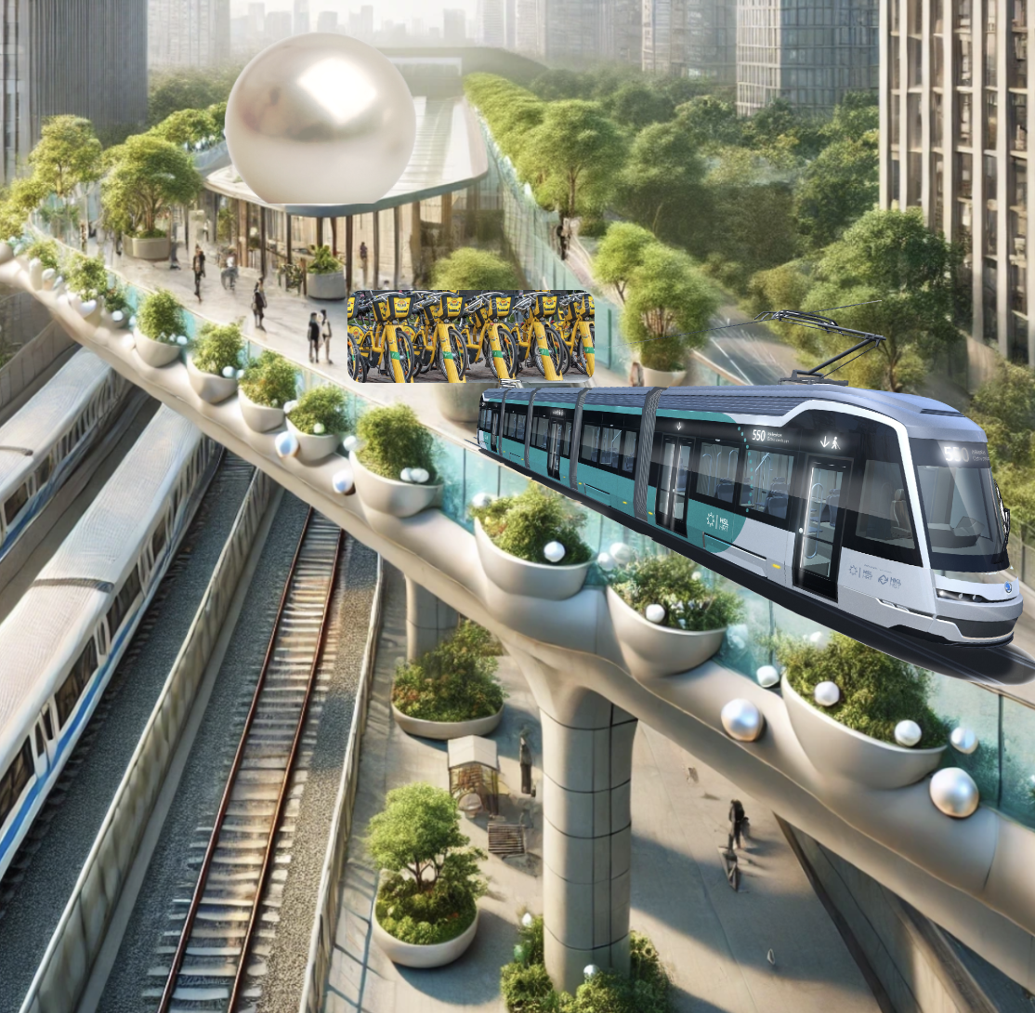
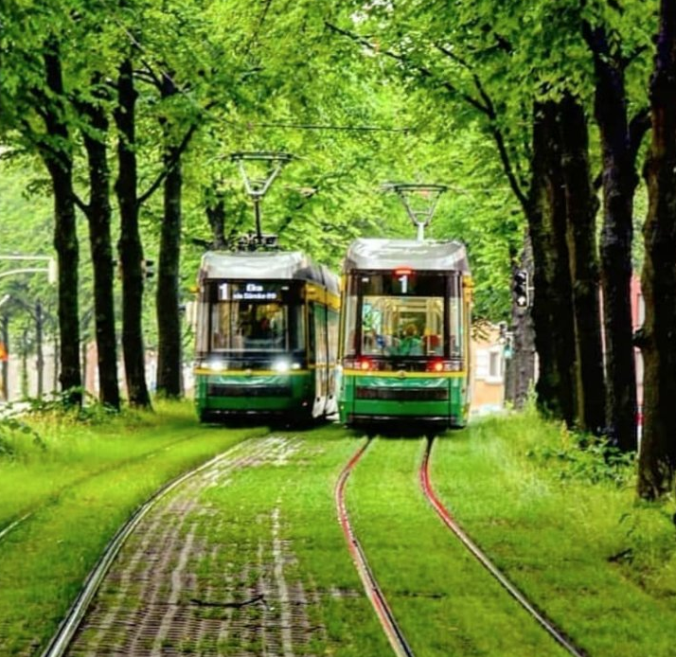
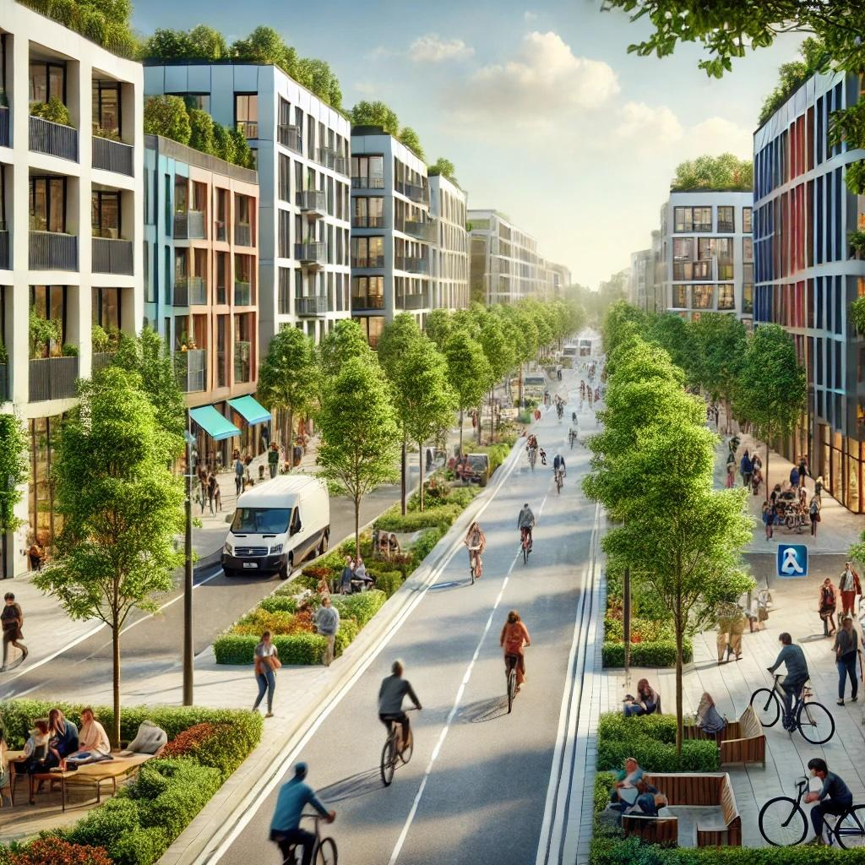
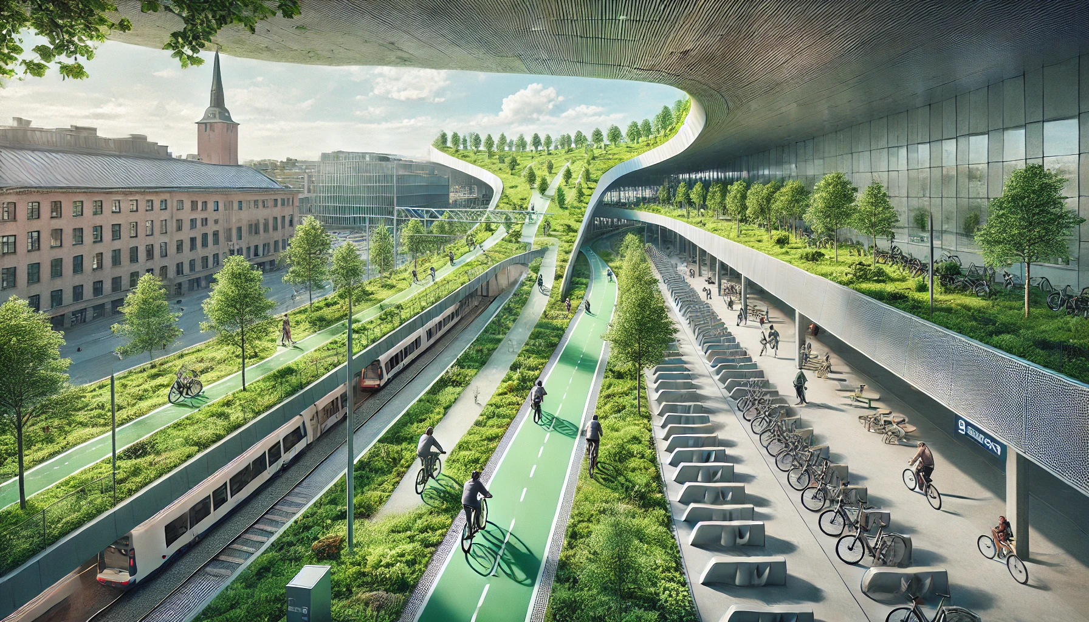
An Artery of Life

Slide 8
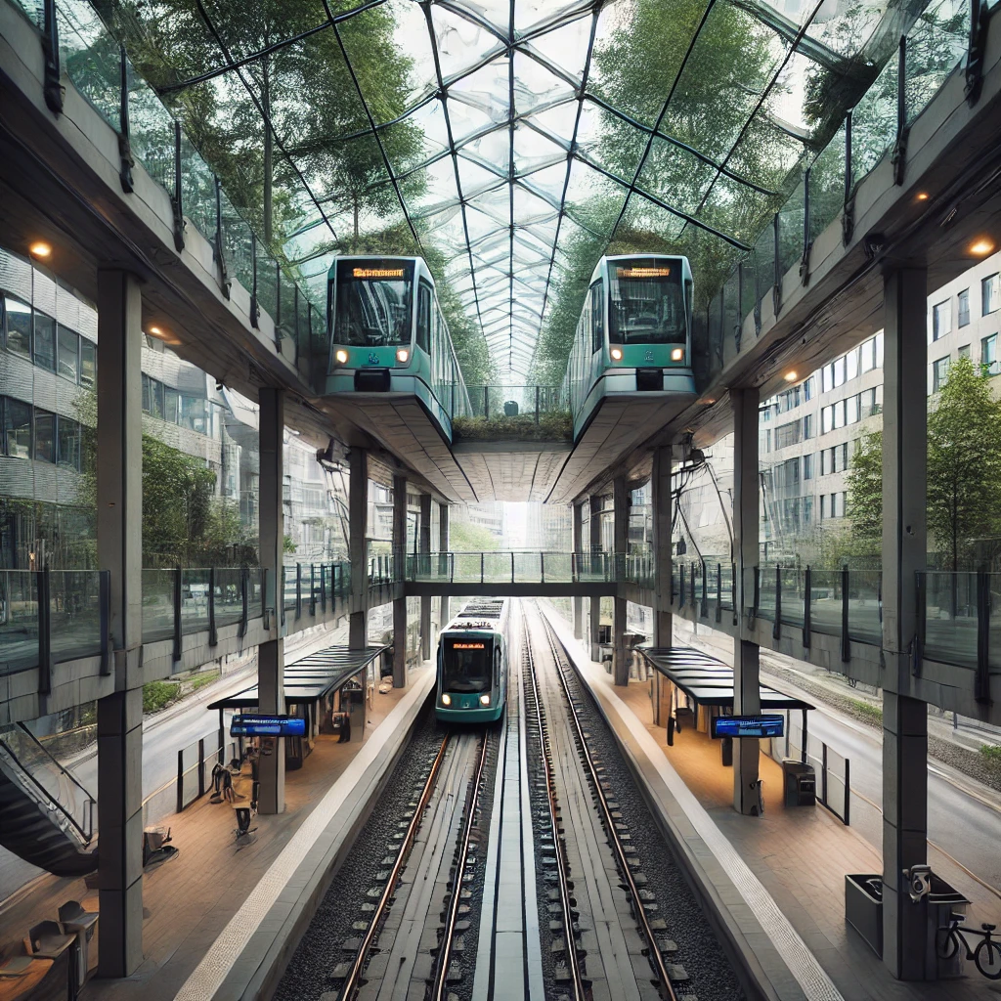
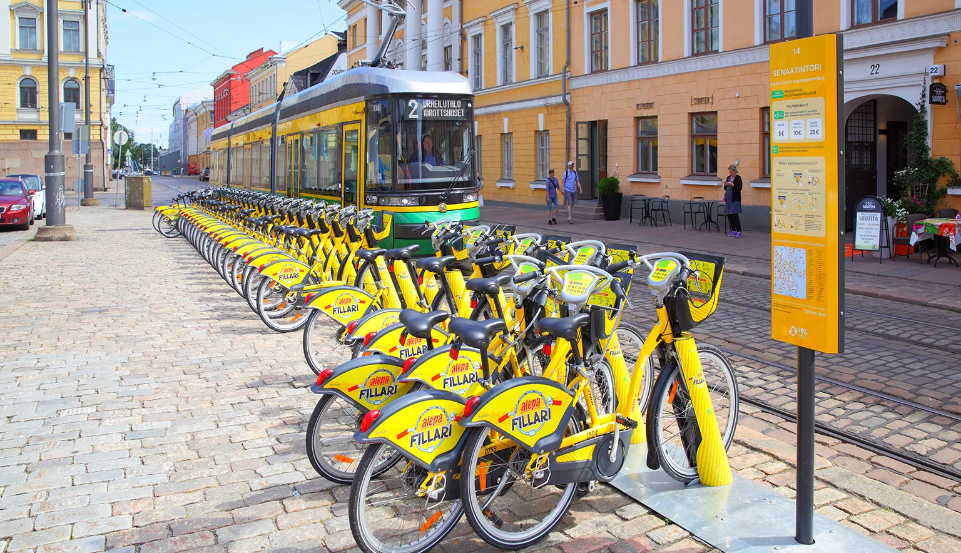
Malmi Station Concept
Bike share station and tram station directly above train makes for a quick and attractive travel chain
Multimodal transit hub as green boulevard with tram and bike lane runs parallel on top of railway

Slide 9
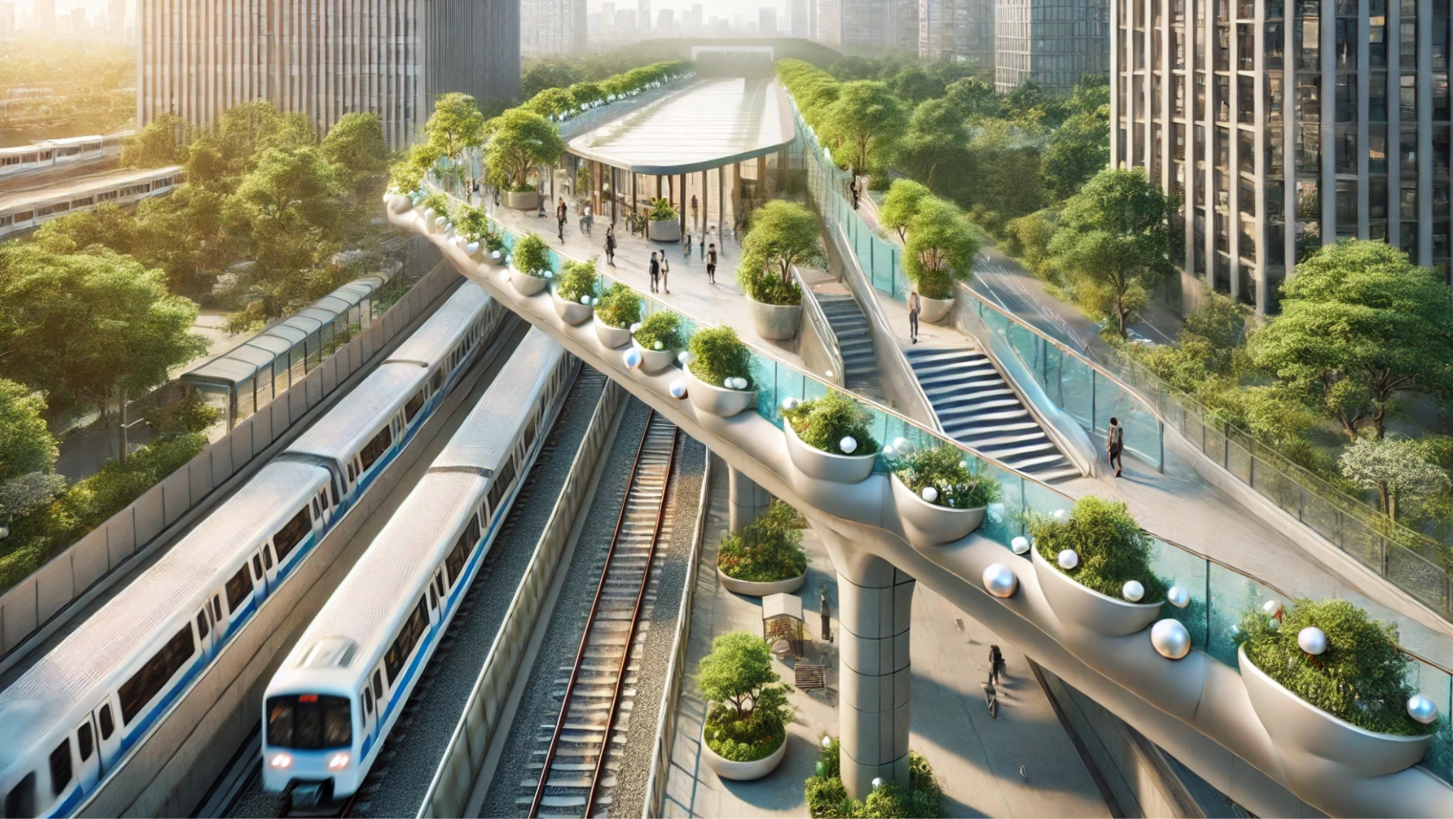
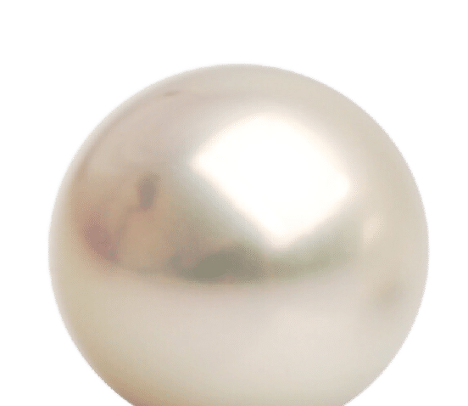
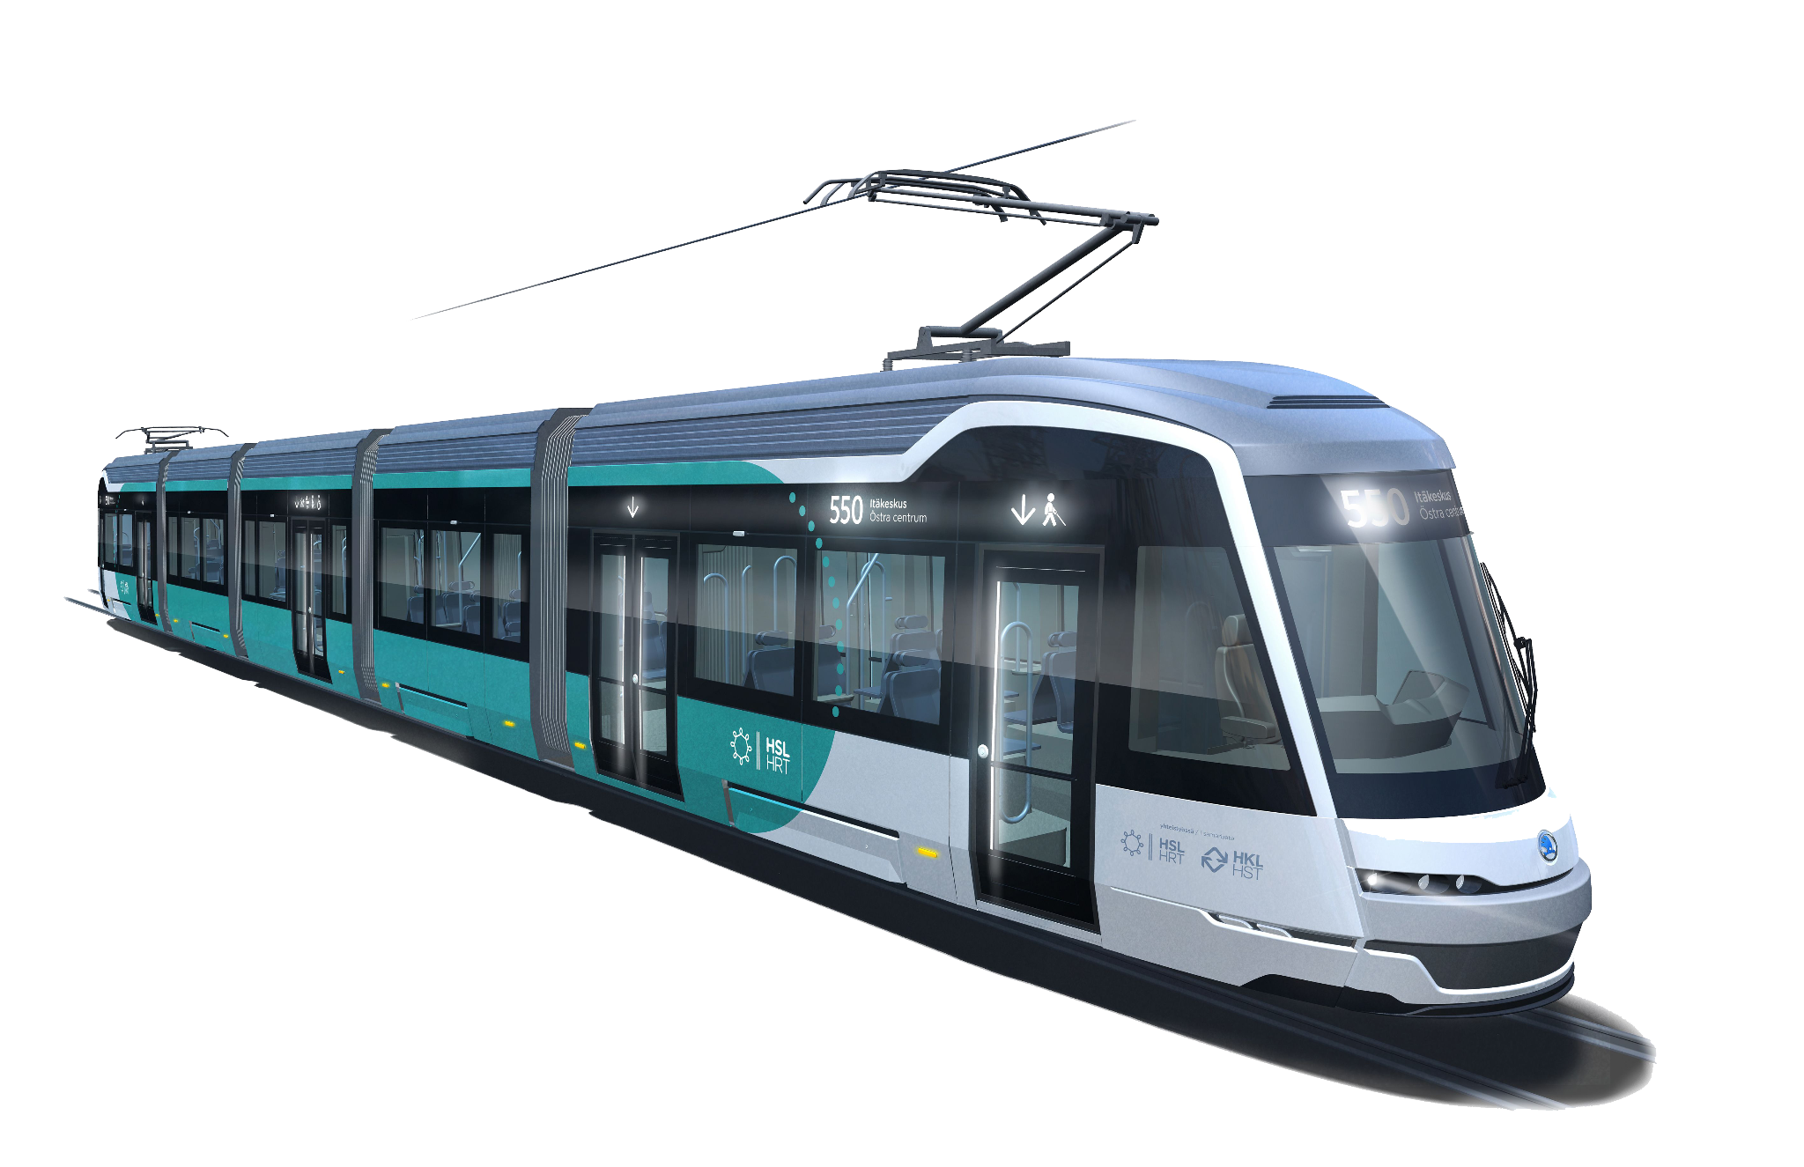
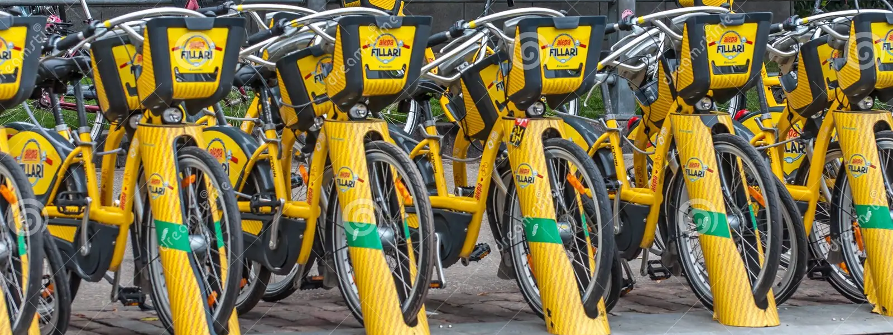

Slide 10
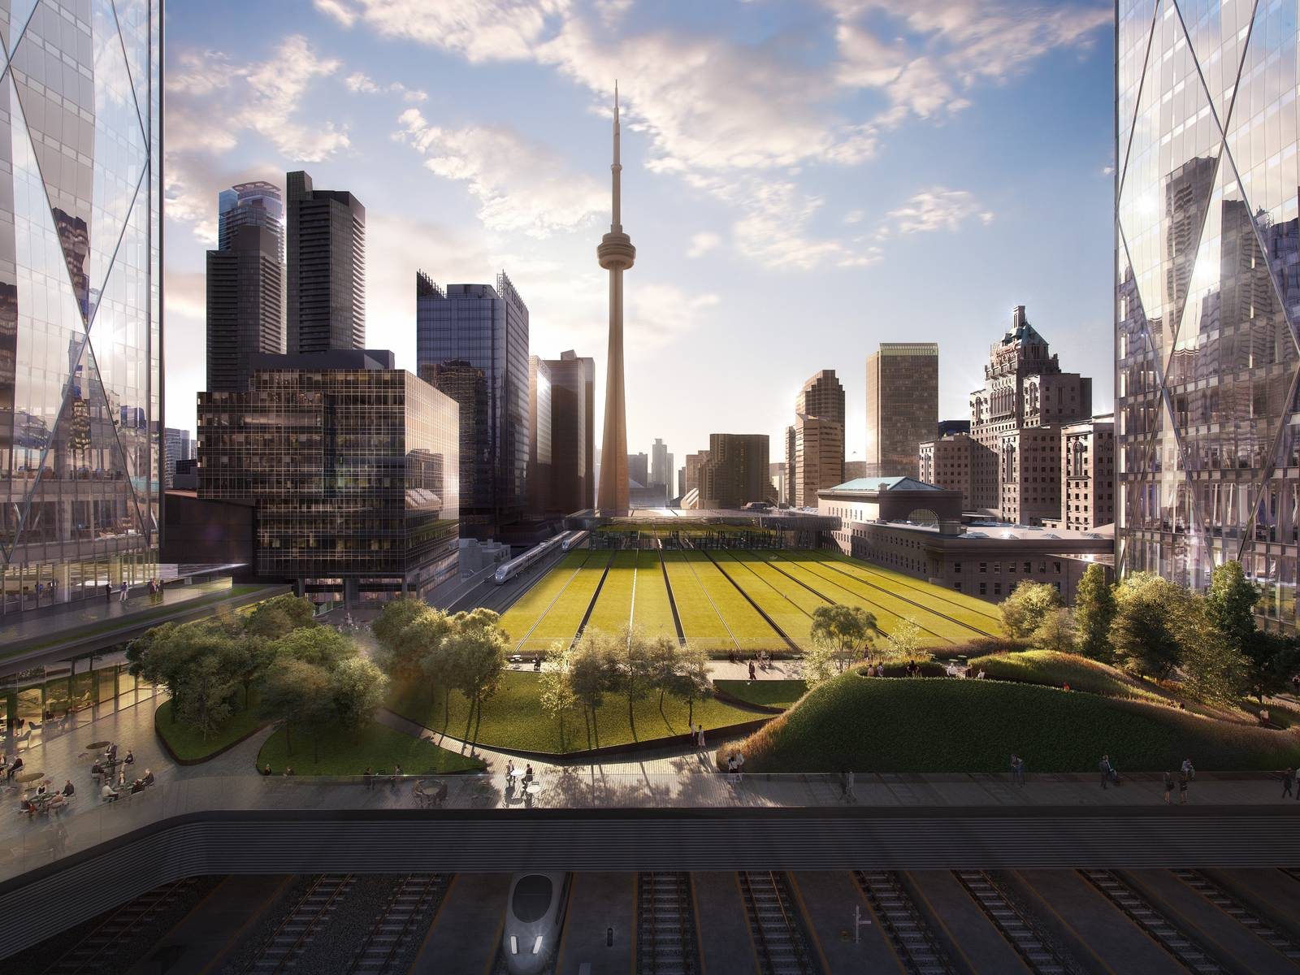
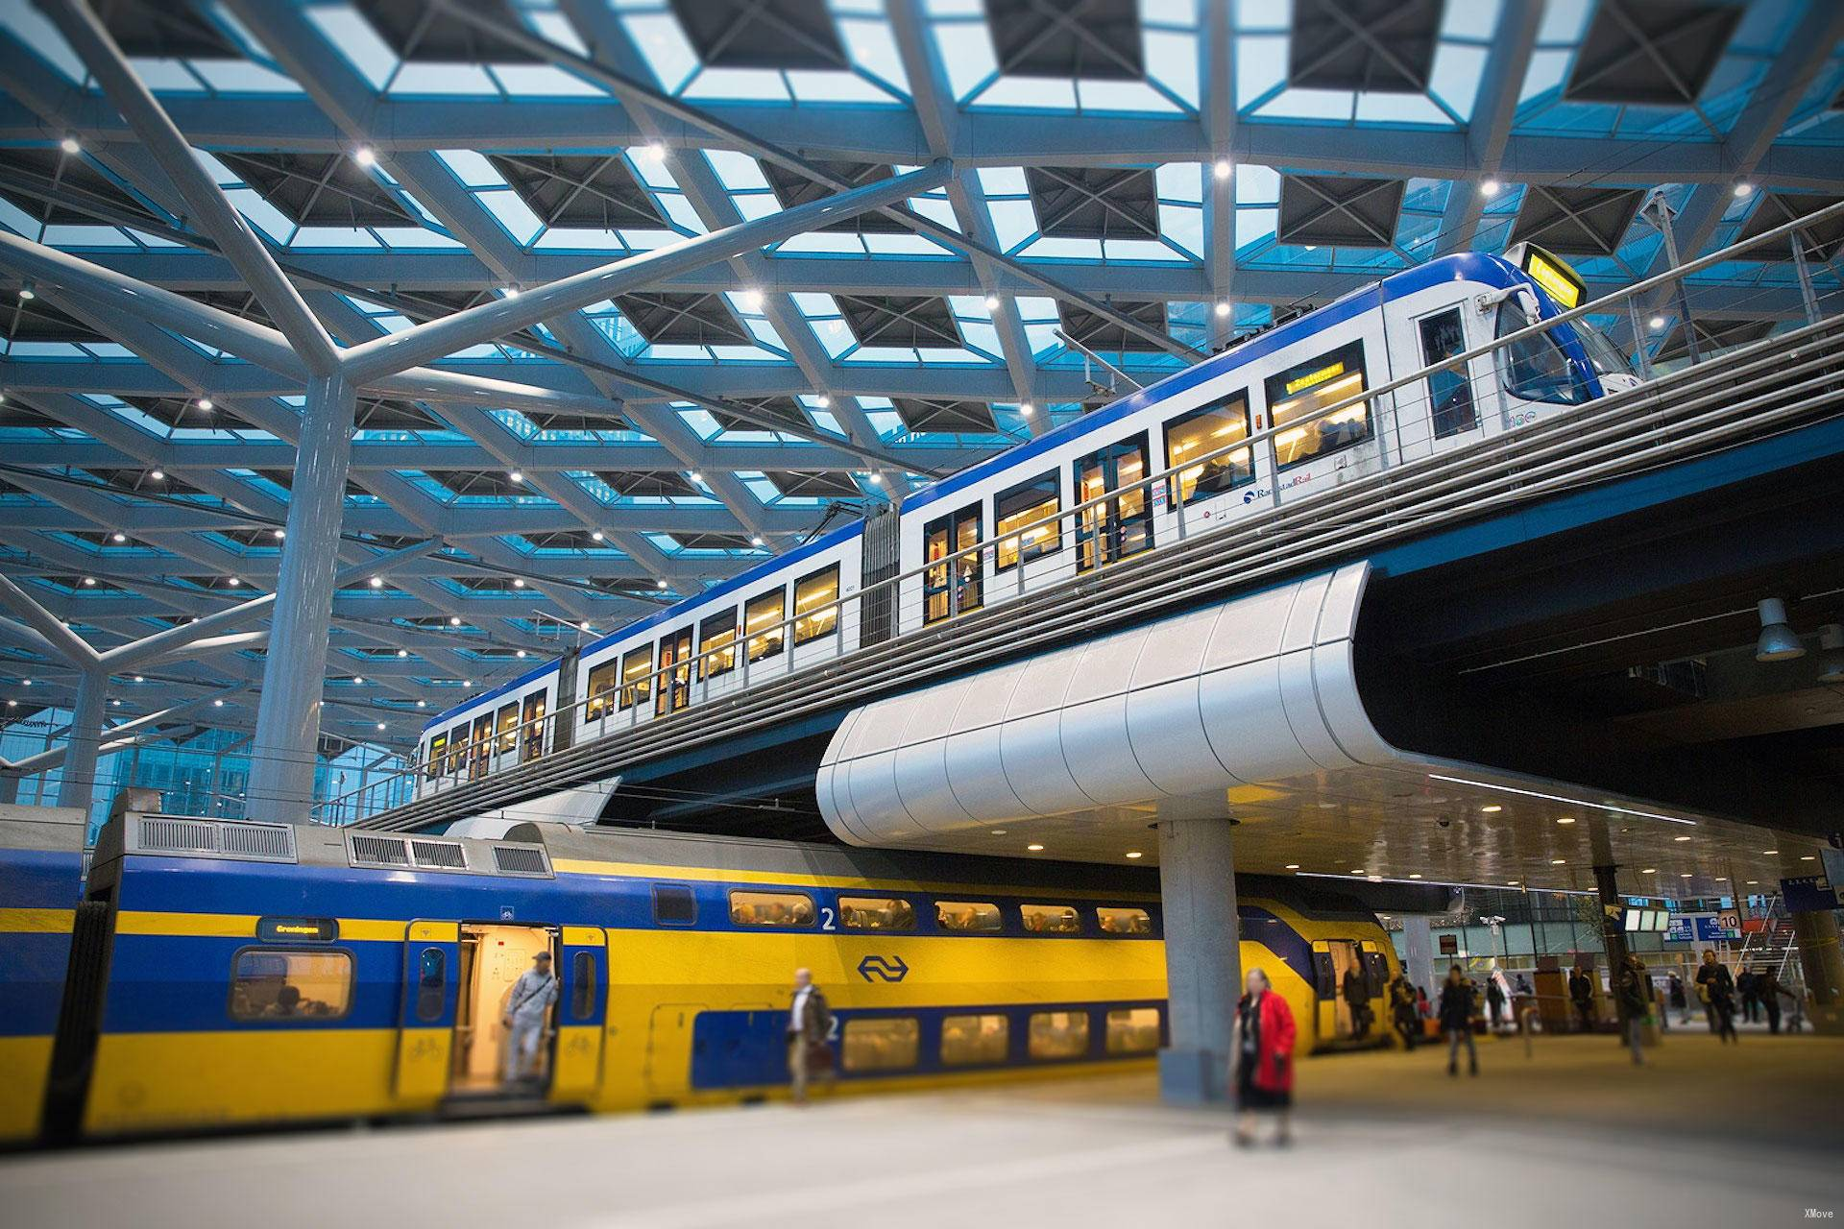
Inspirations
Toronto Union Station Rooftop Park The Hague Central Station Elevated Metro

Slide 11
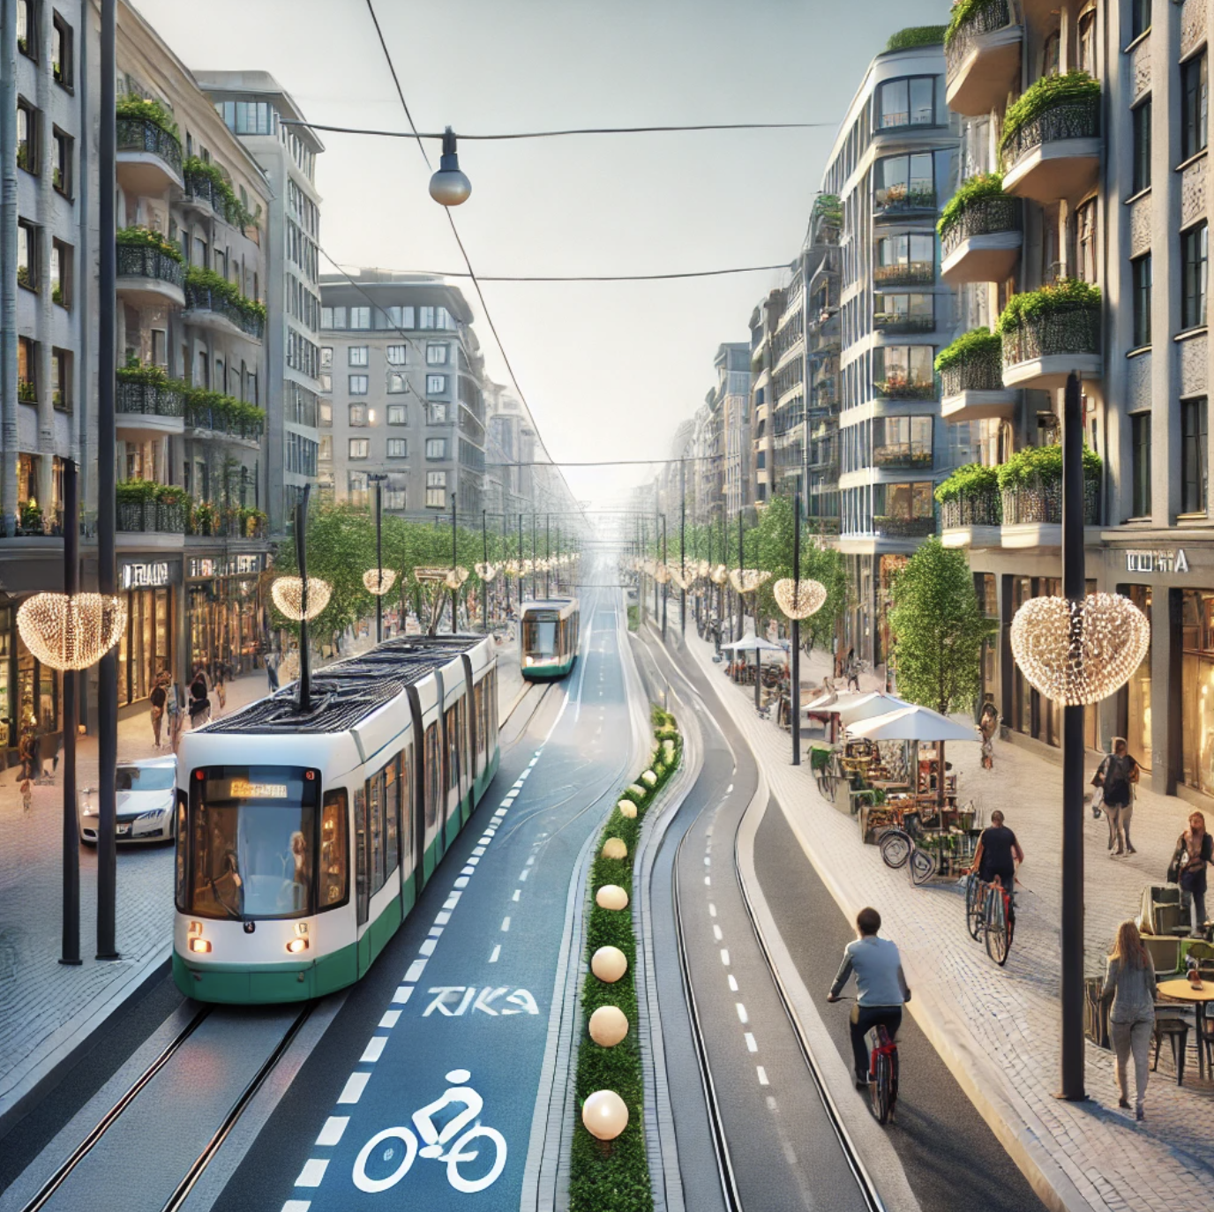
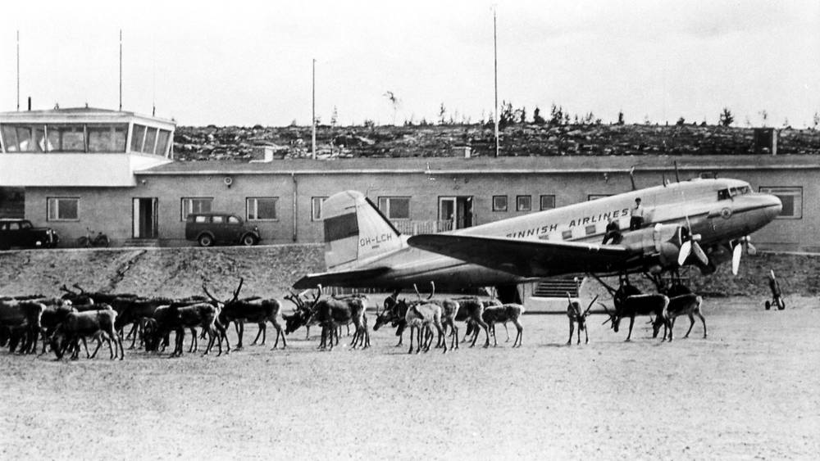
Reimagining the
Former Airport Area
Car-free Neighbourhood
Former Malmi Airport as local heritage
Protected airport buildings house services and attractions
Celebration of aviation history
Co-creation with Tampere and future residents

Slide 12
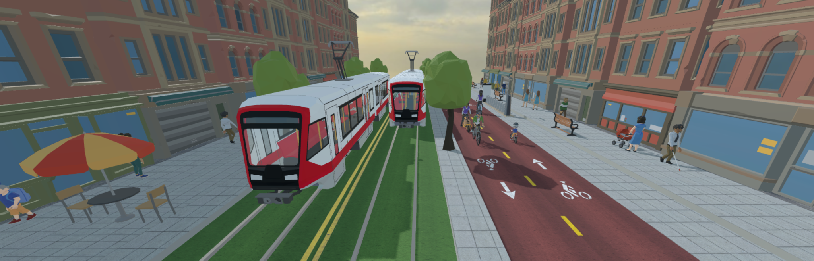
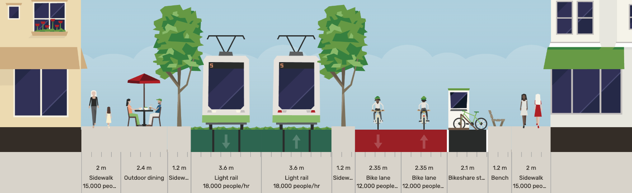
Regenerative Street Design

Slide 13
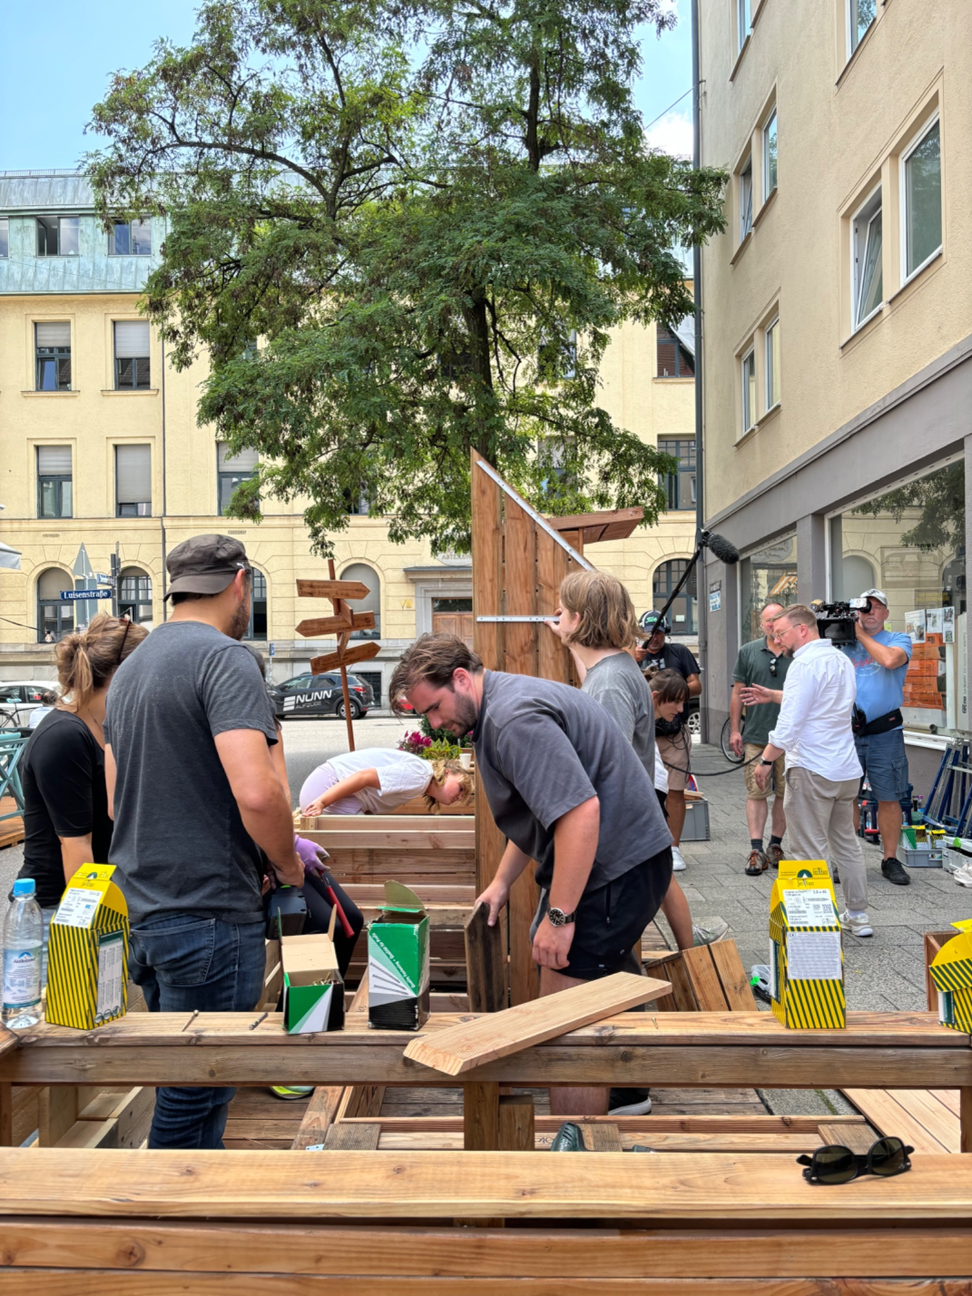
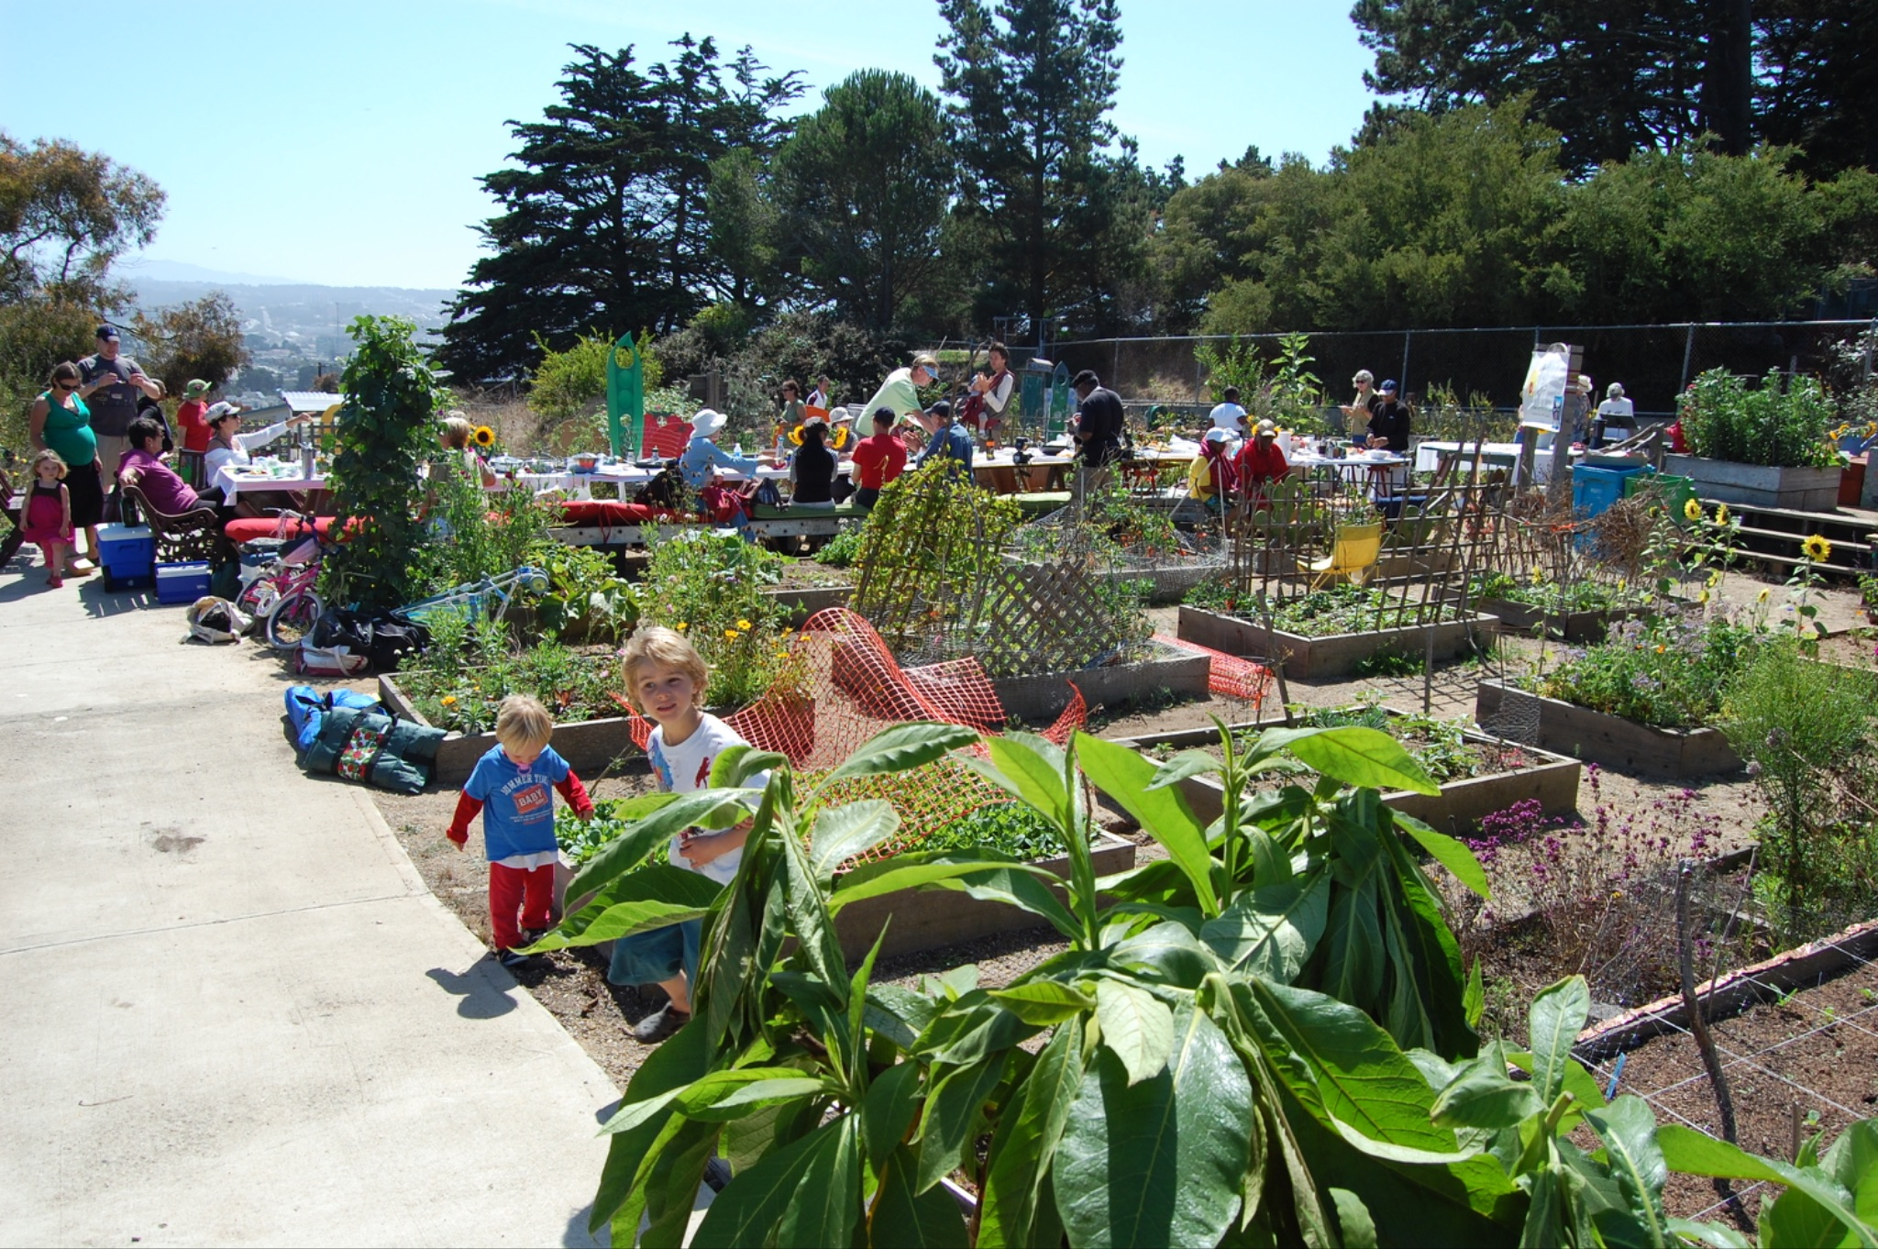
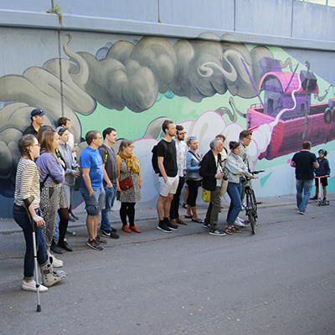
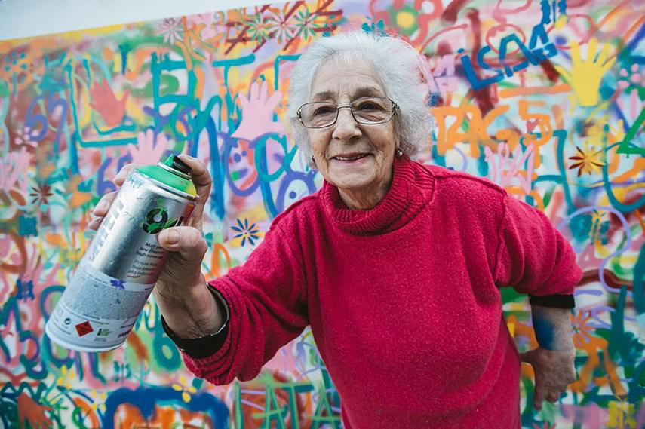
Reinvigorating
Existing Areas
Active Citizenship
Small-scale unique interventions
Funding from Municipal Budget
Marketplace for Street Vendors
Co-creation with Tampere

Slide 14
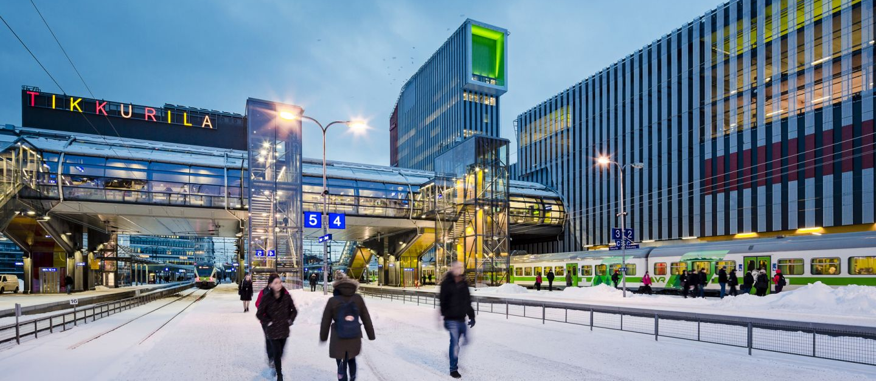
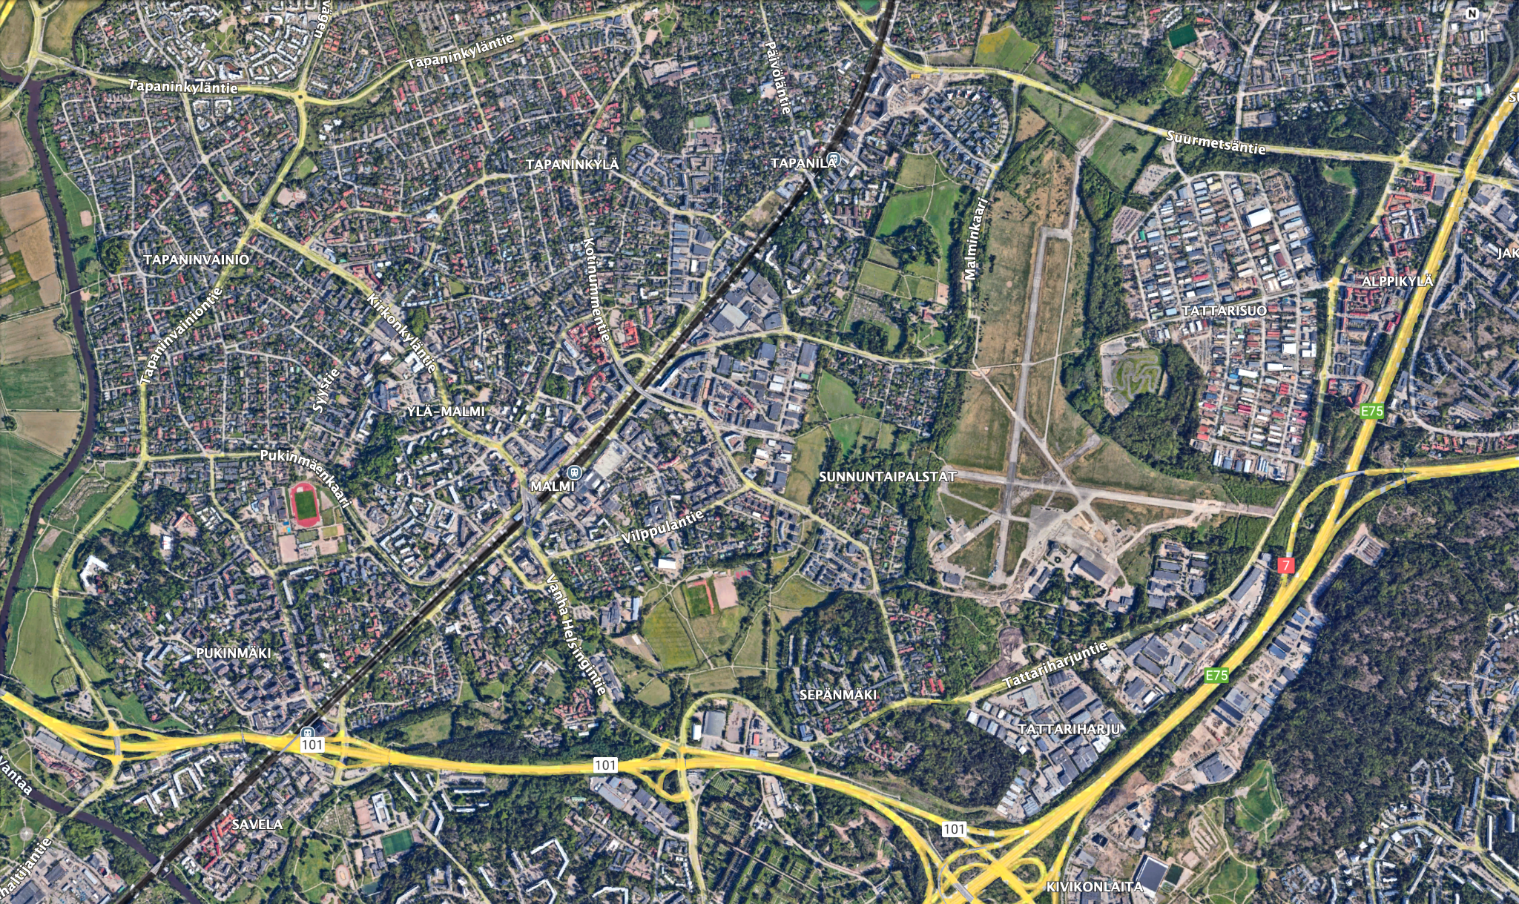
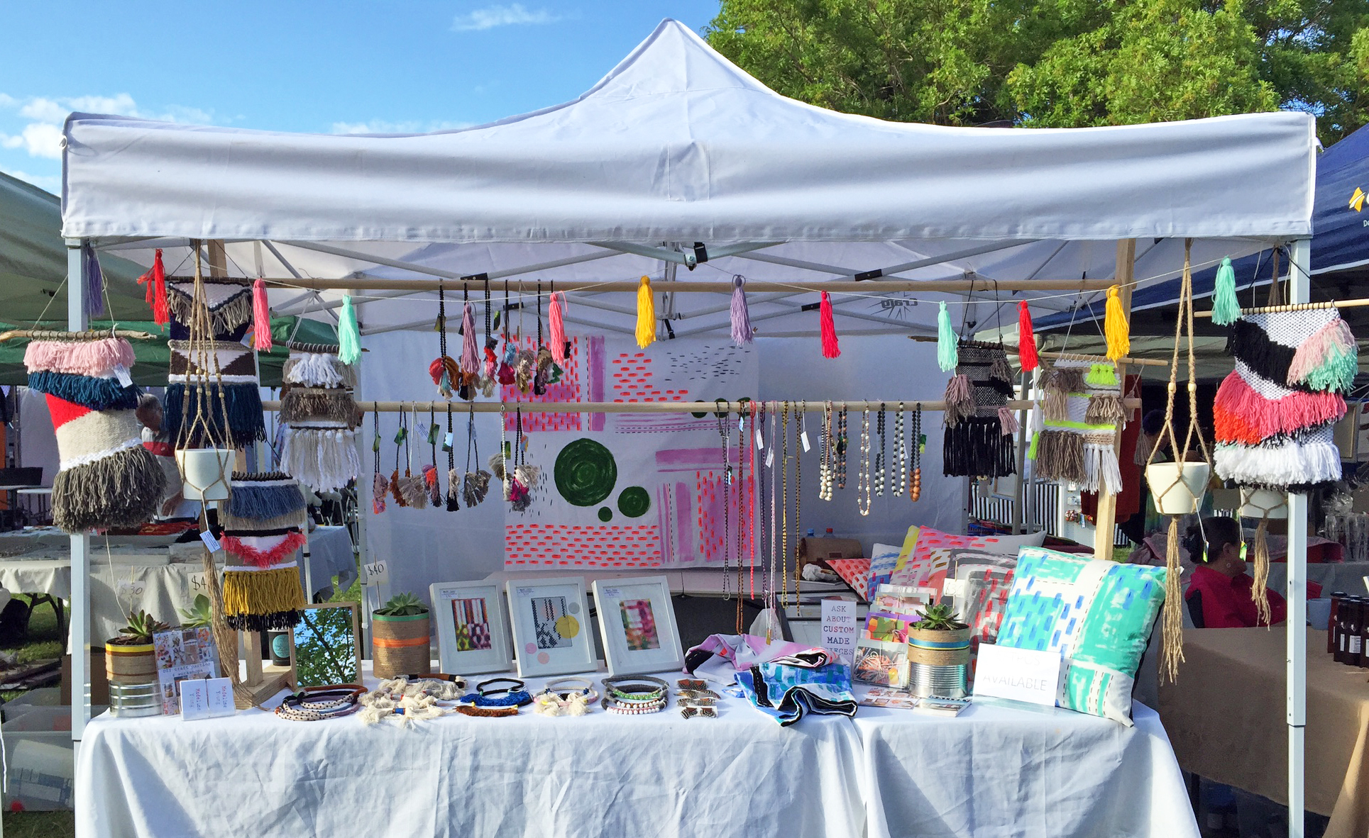
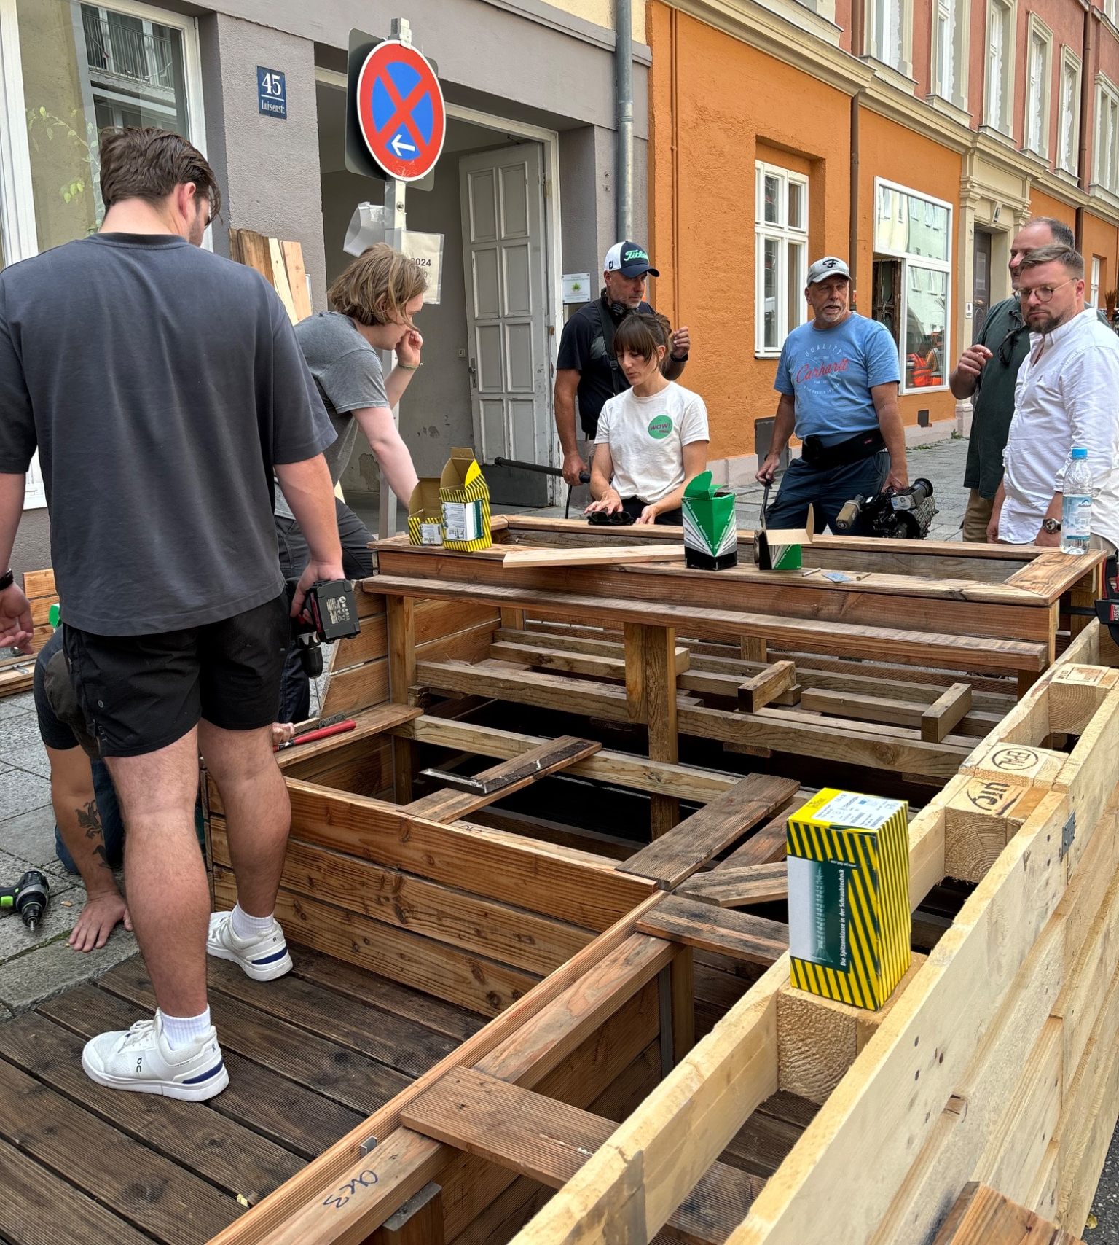
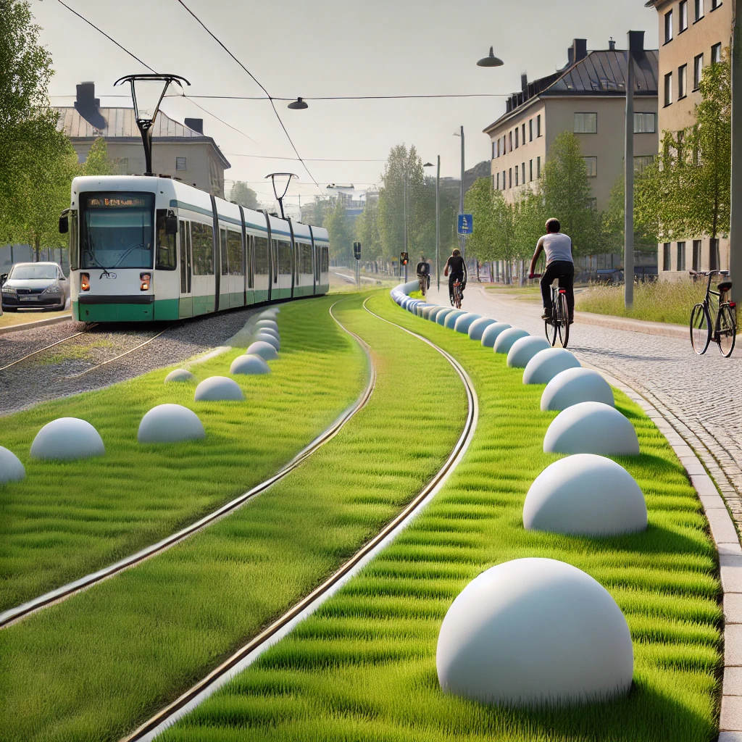
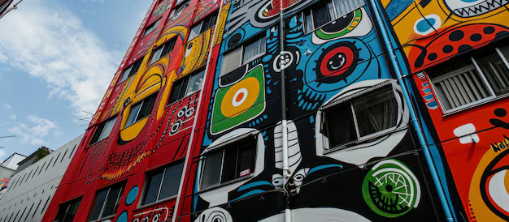

Slide 15
Key Benefit: Holistic Regeneration
Environmental
Economic
Green/active modes of transit
Urban greenery reduce emissions, noise & flooding
Increased train ridership
3.6X ROI on Cycle Spending
Office & Retail TOD
Social
Cultural
Desirable neighborhood boosts socioeconomic diversity
Safe, pleasant meeting space
Connects both sides of the tracks
Citizen ownership & care
Reactivate cultural traditions
Art events & installations

Slide 16
€22.5 million / km
€1.5 million / km
€1.5 billion
~
€125 million
Jokeri Tram Line Construction Costs
European Standard Cost of Urban Cycling Highway
Pasila Station Renovation Cost (2019)
Tikkurila Station Renovation Cost (2014)

Slide 17
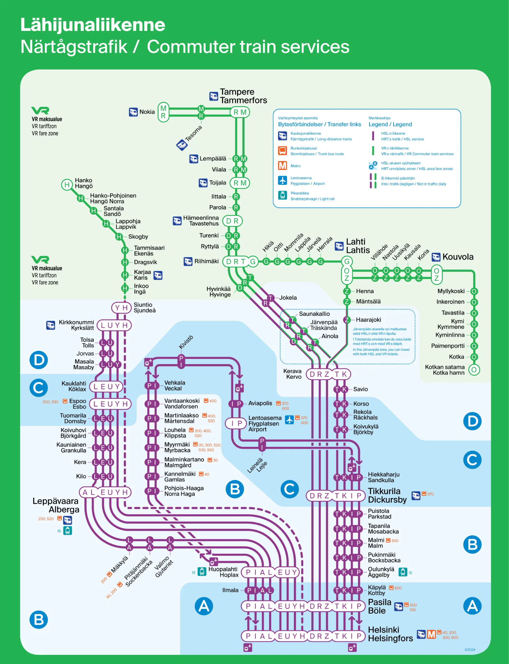
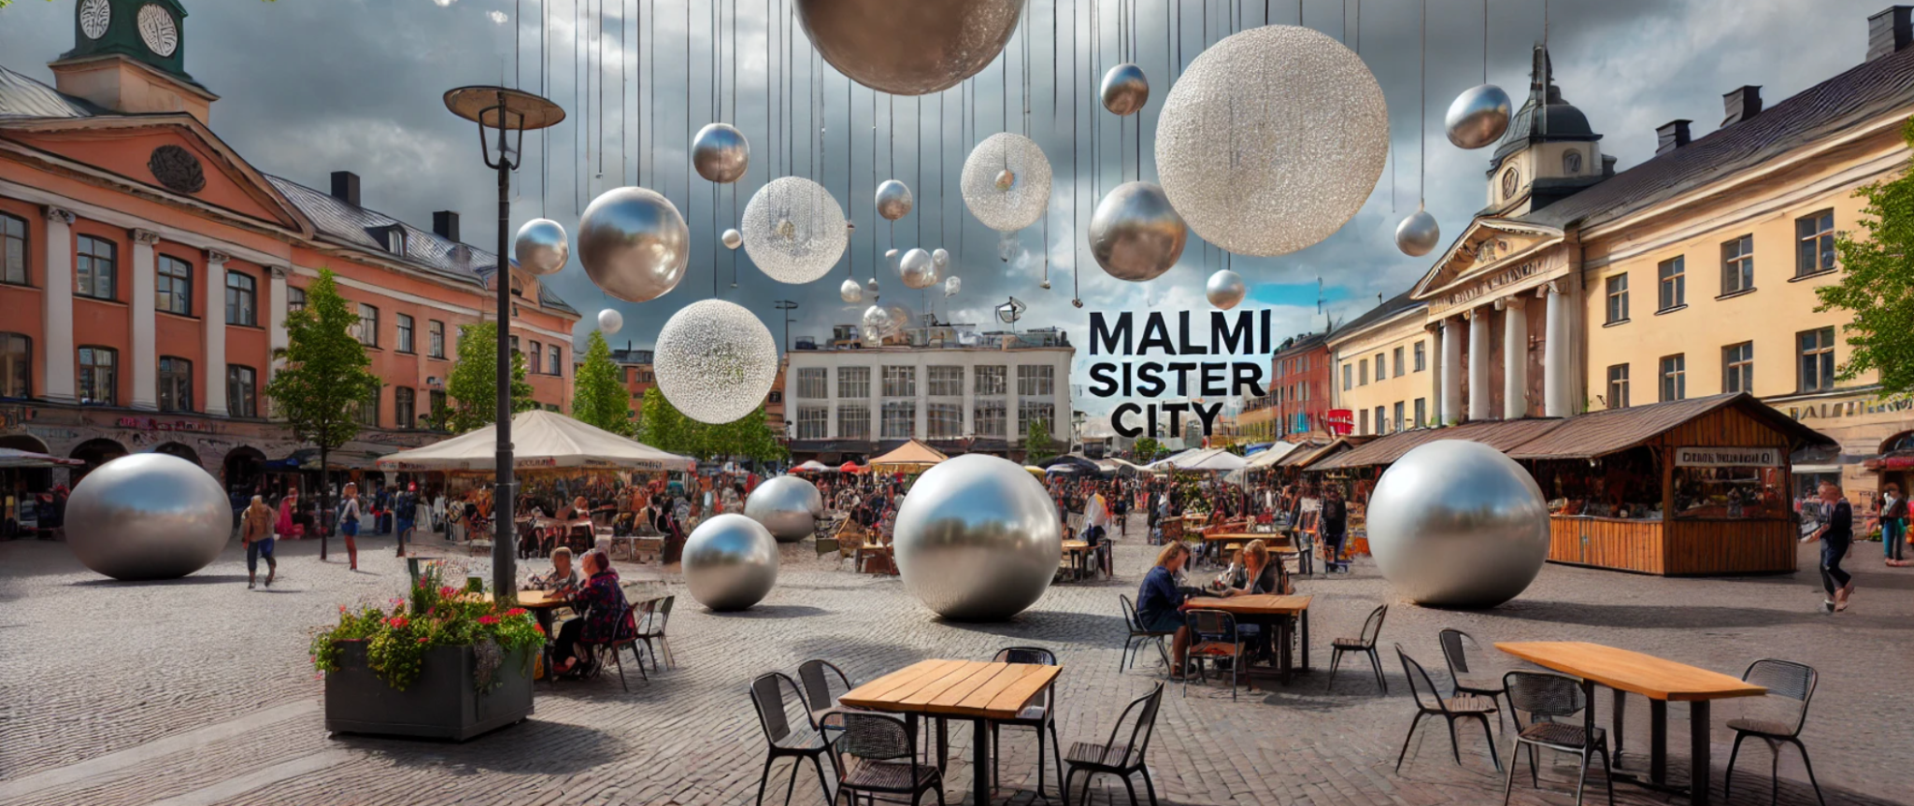
Link to Tampere
Physical Connections
Elevated station importance
IC stop, <1.5 hours to Tampere
Social & Cultural Connections
Twin neighbourhoods link
Artist exchanges & student visits
Artisan & small business markets

Slide 18
Implementation Plan
Initiative | 2025 | 2026 | 2027 | 2028 | 2029 | 2030 | 2031 | 2032 | 2033 | 2034 | 2035
Planning & Consultation
Building Green Boulevard (Tram Line Phase 1)
Housing Construction of Airport Neighborhood
Train Station Redevelopment (Tram Line Phase 2)
Citizen Engagement & Co-Creation
Malmi Station Area Economic Densification
Cultural Programme

Slide 19
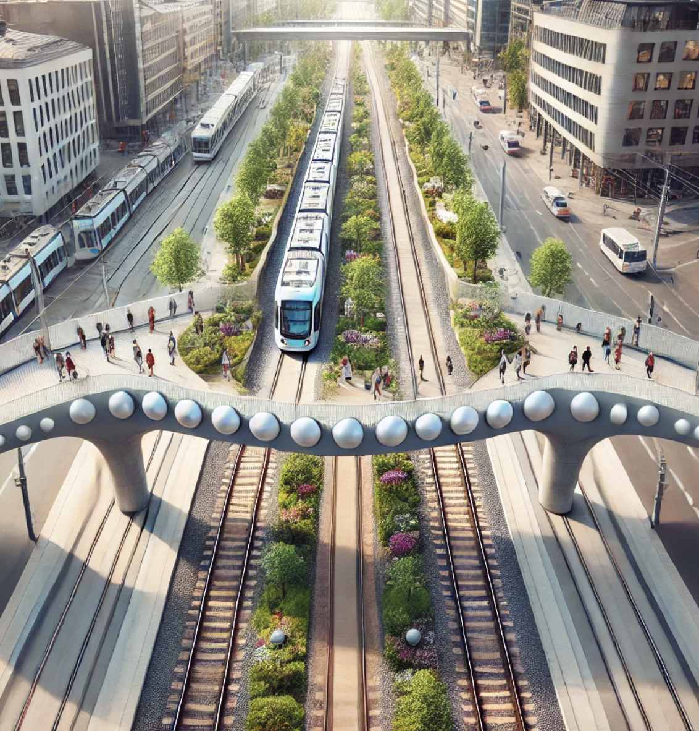
Thank You For Listening!
Thank You For Listening!
Malmi: The Pearl of Helsinki
Notes:
The people of malmi have a creative energy and cultural life that is currently hidden under a tough, grey shell, like a clam. With this project, we can really unlock the neighborhood’s social potential with a regenerative transit corridor to make a community that shines like a pearl on Helsinki’s necklace of railways suburbs
Photos
https://www.whitevictoria.com/blog/a-quick-guide-to-choosing-the-perfect-pearl-color.html
https://www.whitevictoria.com/blog/understanding-pearl-colors-how-do-oysters-make-colored-pearls.html
https://www.whitevictoria.com/blog/black-pearls-meaning-properties-and-intriguing-facts.html?srsltid=AfmBOorDdx6eiEJAx8Pi4pO2d04eryN6OPbUEKWtrrU7SCf4yZYedhCj
https://hotcore.info/babki/san-antonio-public-library-design.htm
https://www.baysidehistorical.org/events-1/80th-anniversary-of-the-1939-40-new-york-worlds-fair-2
https://www.postguard.com/concrete-bollards
https://www.astrastreetfurniture.com.au/concrete-sphere-ball-bollard/
https://sk.pinterest.com/pin/452259987557290409/

Slide 20
Resources
Photos
https://www.whitevictoria.com/blog/a-quick-guide-to-choosing-the-perfect-pearl-color.html
https://www.whitevictoria.com/blog/understanding-pearl-colors-how-do-oysters-make-colored-pearls.html
https://www.whitevictoria.com/blog/black-pearls-meaning-properties-and-intriguing-facts.html?srsltid=AfmBOorDdx6eiEJAx8Pi4pO2d04eryN6OPbUEKWtrrU7SCf4yZYedhCj
https://hotcore.info/babki/san-antonio-public-library-design.htm
https://www.baysidehistorical.org/events-1/80th-anniversary-of-the-1939-40-new-york-worlds-fair-2
https://www.postguard.com/concrete-bollards
https://www.astrastreetfurniture.com.au/concrete-sphere-ball-bollard/
https://sk.pinterest.com/pin/452259987557290409/
https://anston.com.au/products/architectural-outdoor-furniture/
https://commons.wikimedia.org/wiki/File:Malmin_rautatieasema._-_D1517_%28hkm.HKMS000005-km002irk%29.jpg

