Slide 1
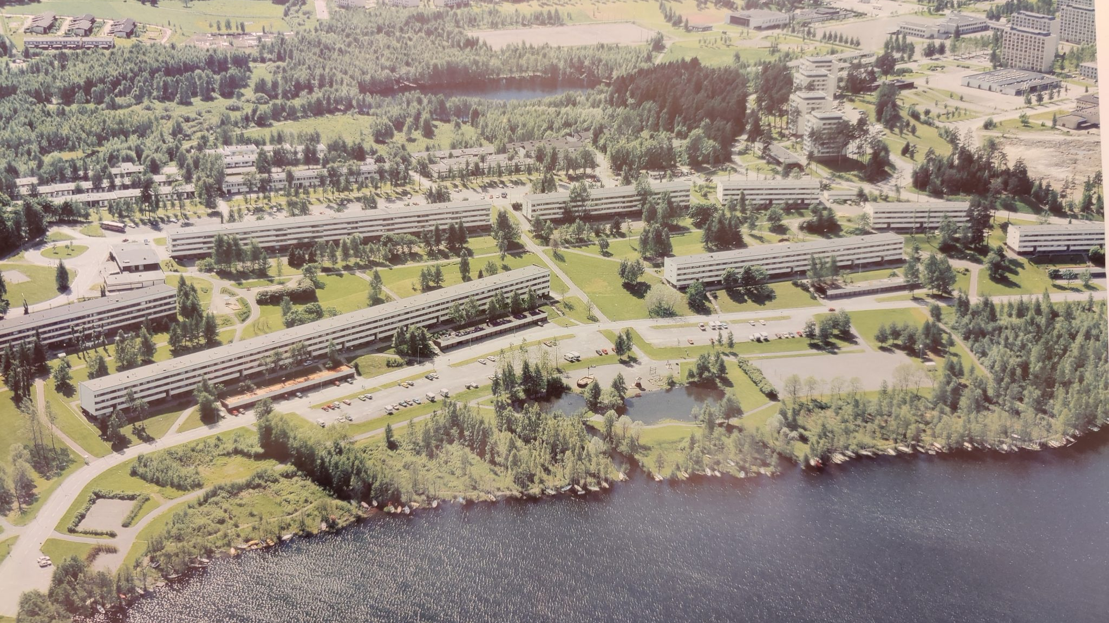
Kaukajärvi 2065
Celebrating 100 Years of History and Progress
71h 50min Transport Challenge

Slide 2


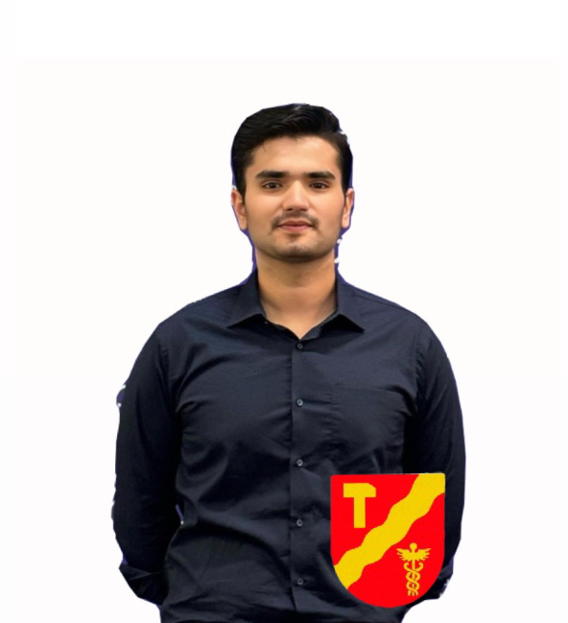


Team AURA members
Yasemin, Global Sustainability Director at Ramboll Transport
Emilia, Head of the Traffic System Planning Unit at the City of Tampere
Haseeb, Director of Strategic Urban Planning at the City of Tampere
Isra, Traffic Systems Expert at the Finnish Transport Infrastructure Agency
Doljinzuu, Leader of Aura Traffic Services team

Slide 3
Outline
Challenges and Regenerative Future of Tampere
Regenerative Kaukajärvi
Haihara Art Village
Connecting Kaukajärvi and Haihara to the wider urban Finland
Conclusion
Team Aura Introduction
1
2
3
4
5
6
Notes:
Enhancing urban vitality through flows between cities
People, goods, information
Synergies between cities: innovation
Different flows that harness urban vitality (nice station,)
Attractive and sustainable travel chains (TRE-HKI)
Examples of users' experiences (hki - kaukajarvi, kaukajarvi – airport)
Conclusion

Slide 4
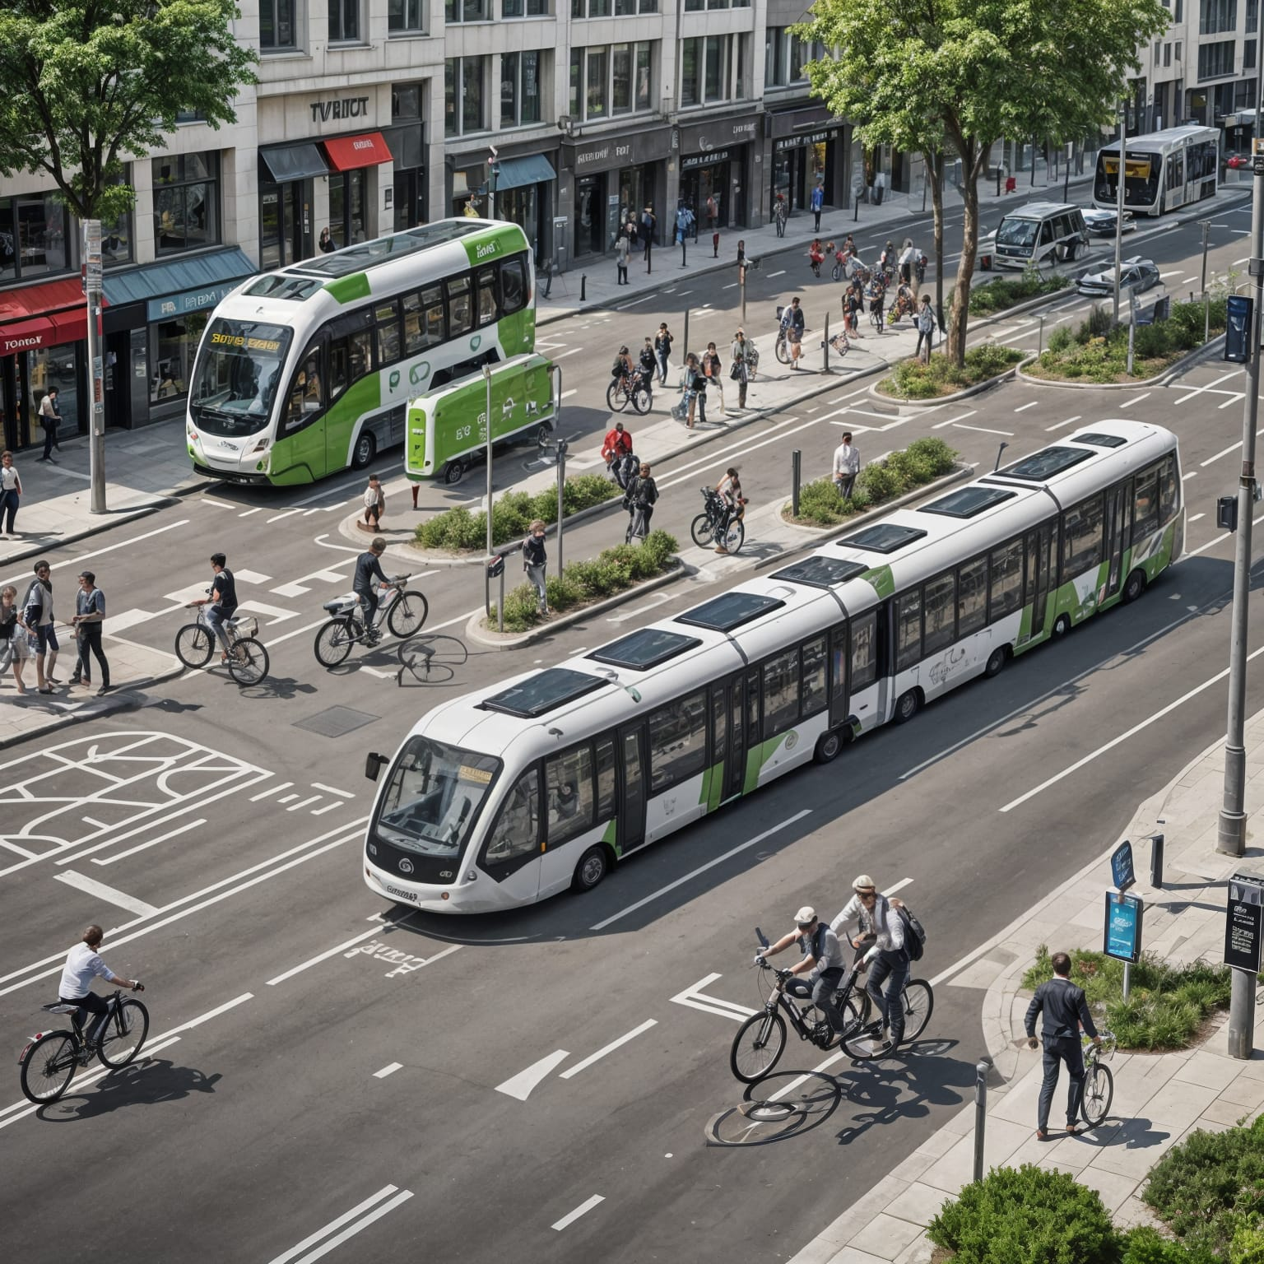
Challenges
Carbon emissions and transportation
Energy intensive Construction
Waste Management and Integration of Circular Economy
Urban Growth & Biodiversity

Slide 5
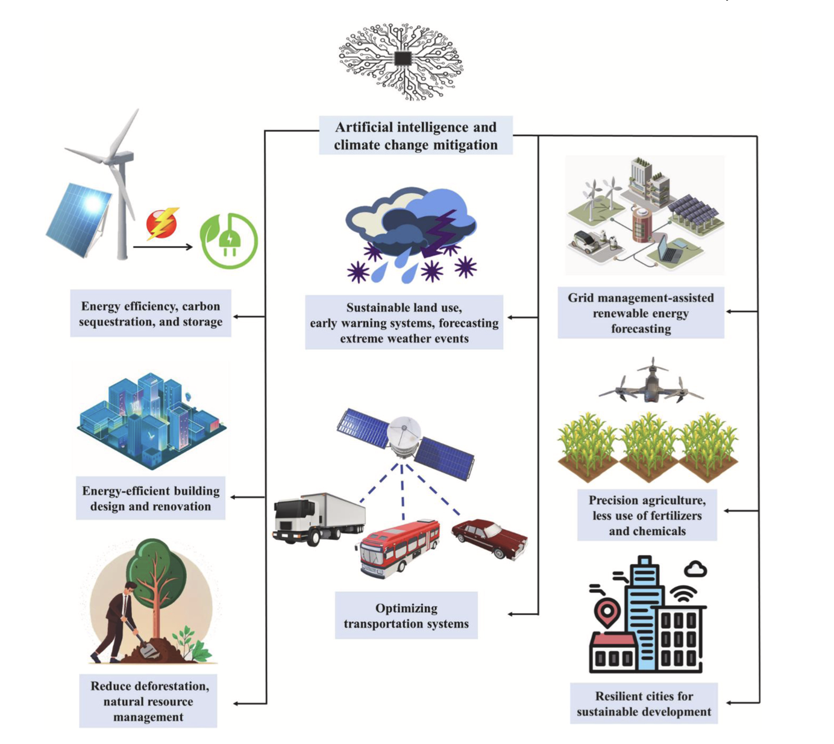

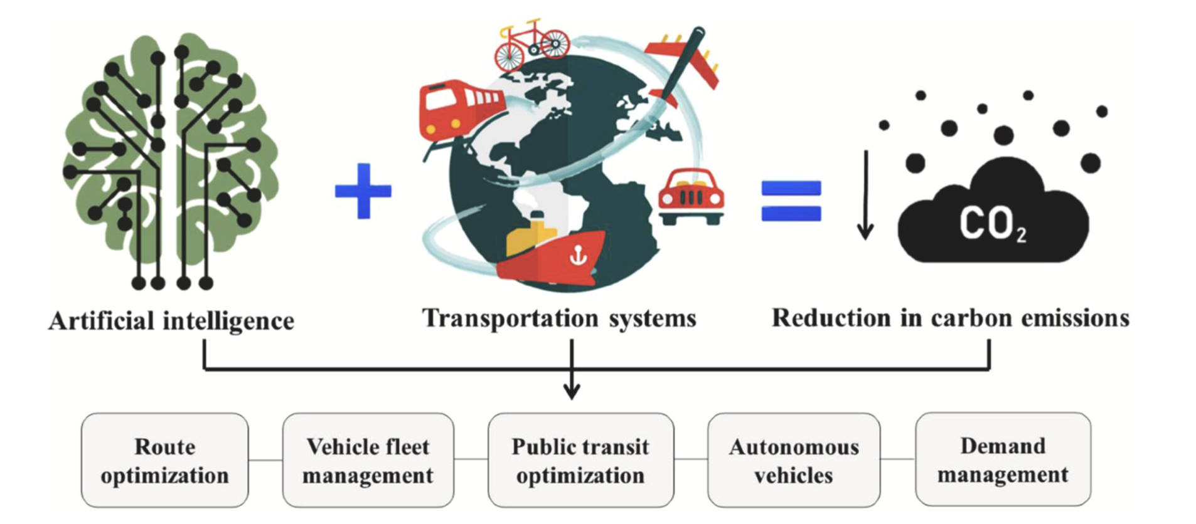


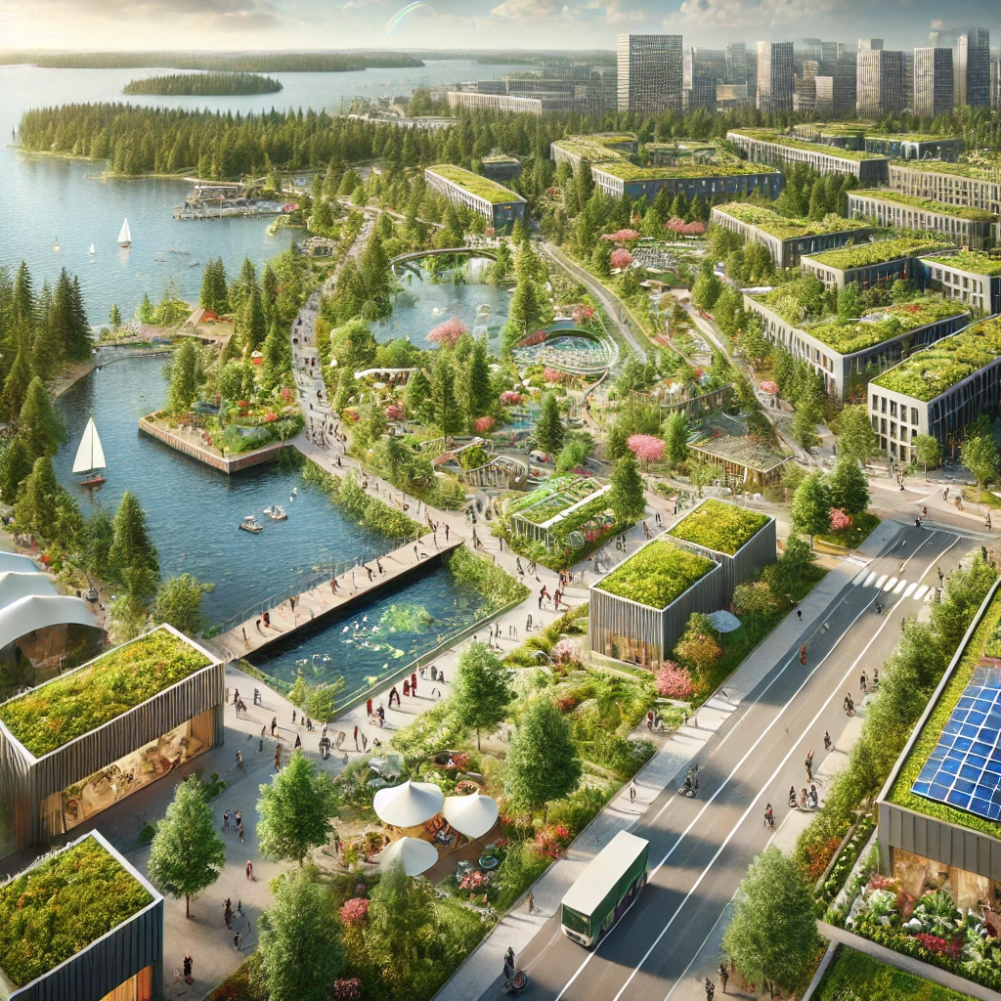




Regenerative Future Vision
Carbon Negative City
Circular Economy & Sustainability
Innovative & Green Infrastructure
Collaborative Policies
Smart, Energy Efficient Cities
Community Wellbeing
Source: Kharissova, A. B. et al. (2024)
Notes:
Buildings adapt to changing environmental conditions, such as temperatures, storms, and increased rainfall. These structures will regenerate and self-repair when damaged. (resilience). Vertical forests covering skyscrapers, streets lined with solar trees, and entire districts dedicated to urban agriculture. Natural habitats will be into every facet of urban life, with nature-positive buildings hosting rooftop gardens, water features, and green corridors connecting the entire city. (biodiversity) Buildings will be powered by ultra-efficient, transparent solar panels embedded in windows, smart energy grids connected to micro wind turbines, and bioenergy systems derived from waste-to-energy technologies. Homes and public spaces will have integrated AI energy management systems to optimize energy use based on occupancy and weather patterns. Waste is used as a resource, water is recycled,

Slide 6
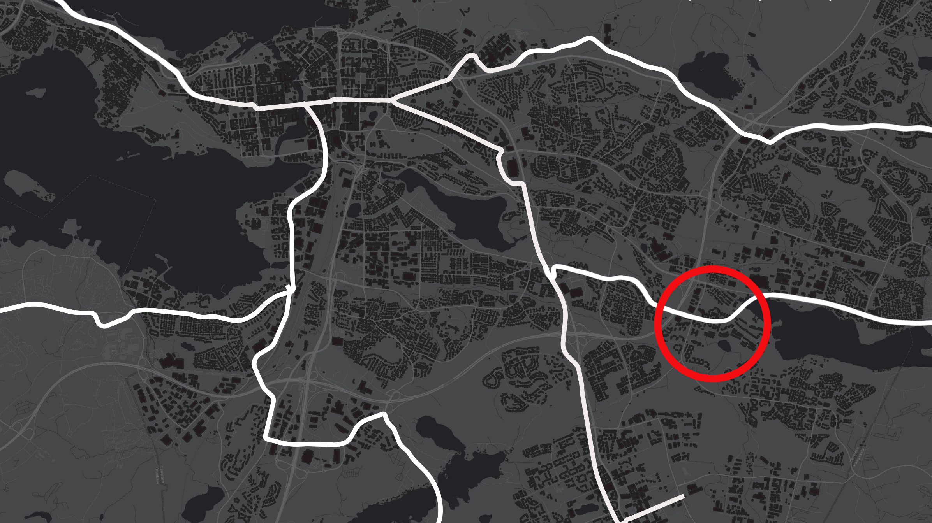
Changing
Kaukajärvi

Slide 7
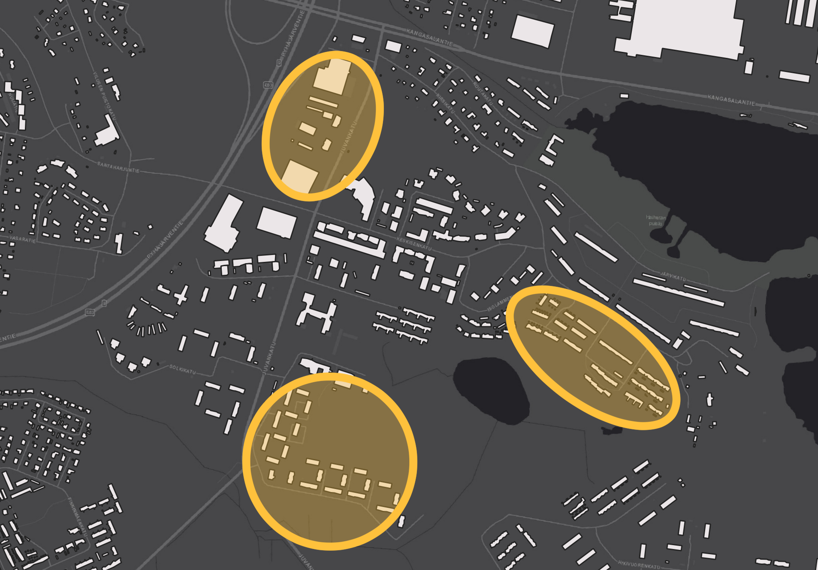
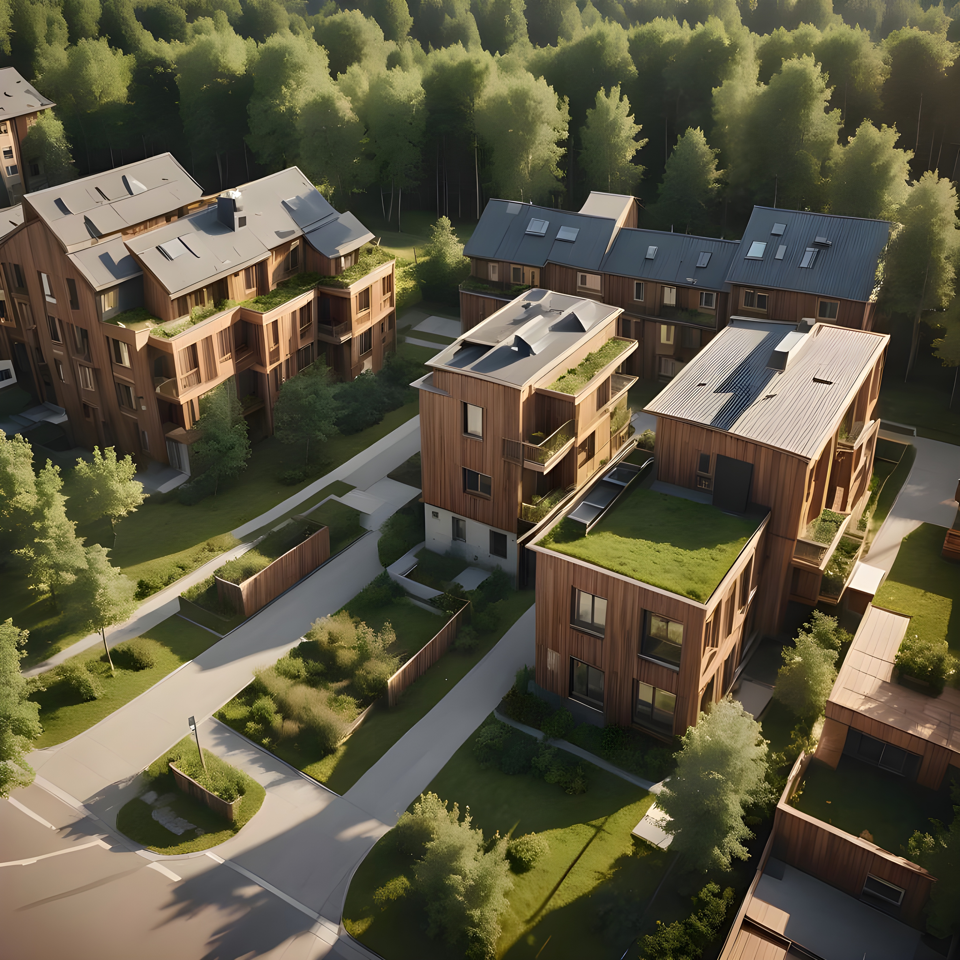
2030
Regenerative Housing

Slide 8
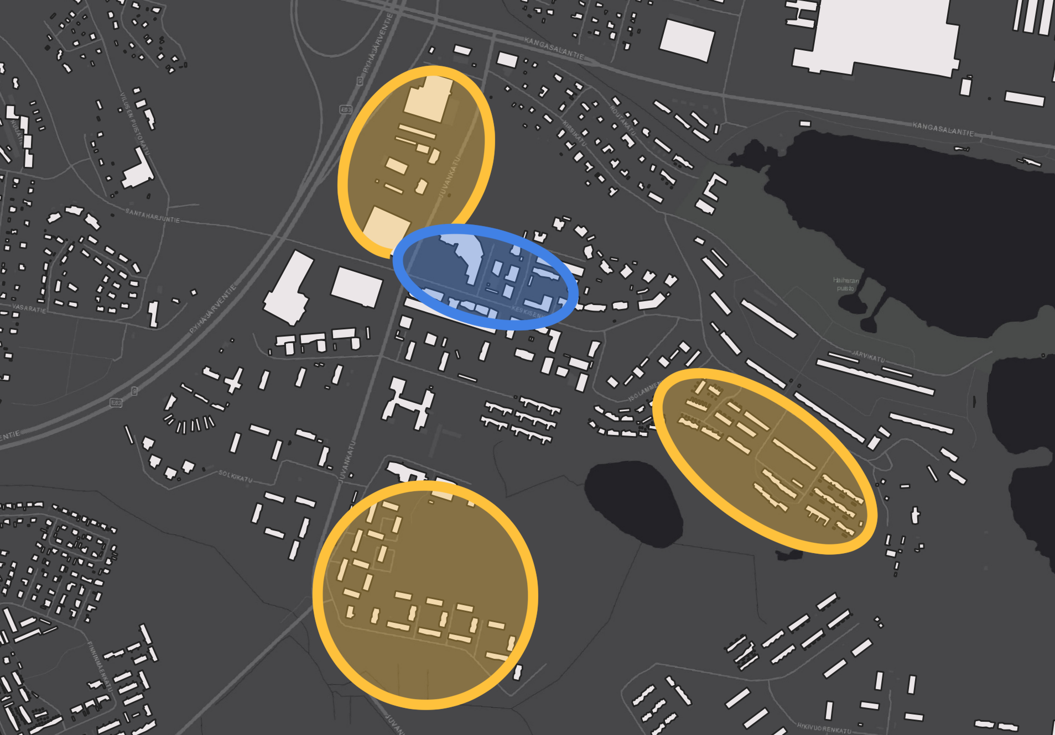
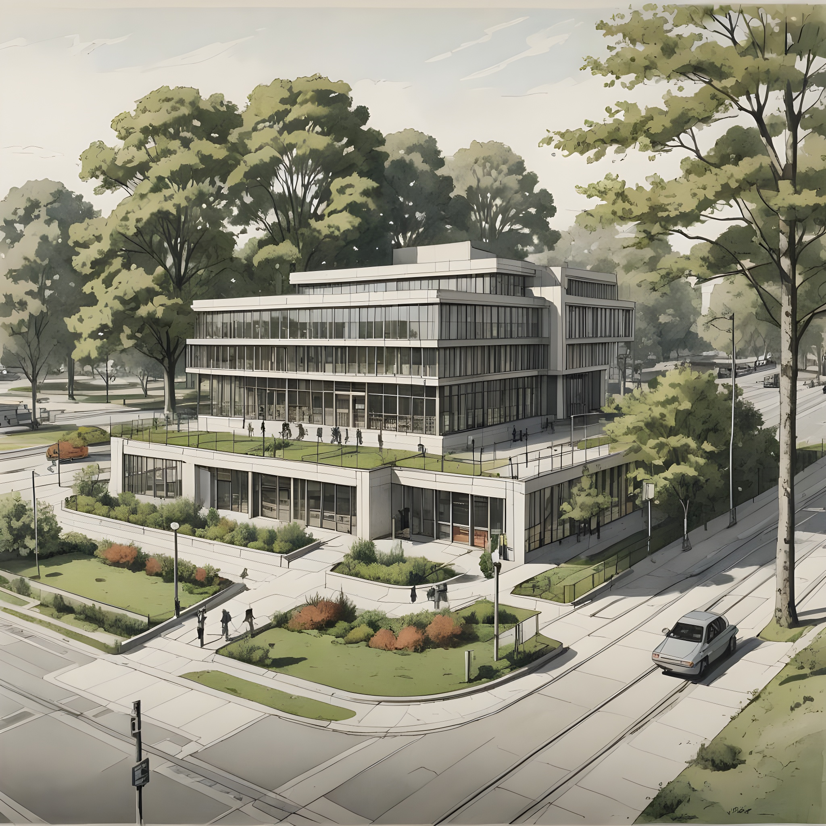
2040
Community
Centre

Slide 9
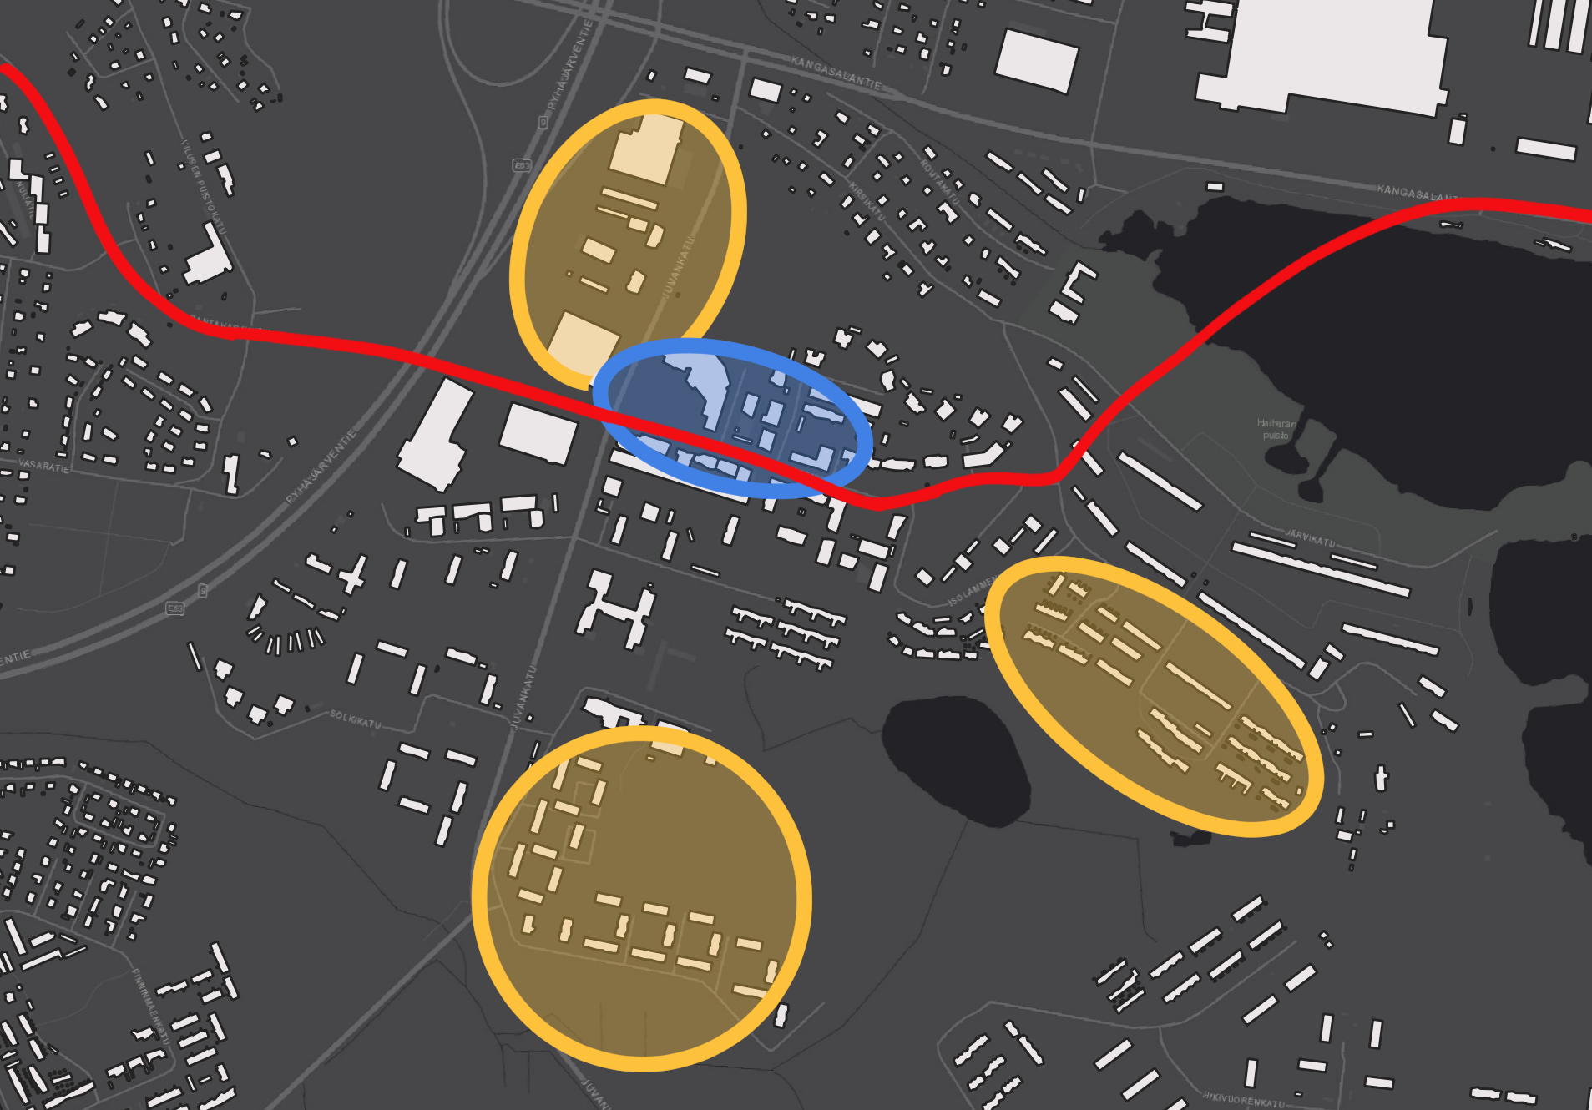
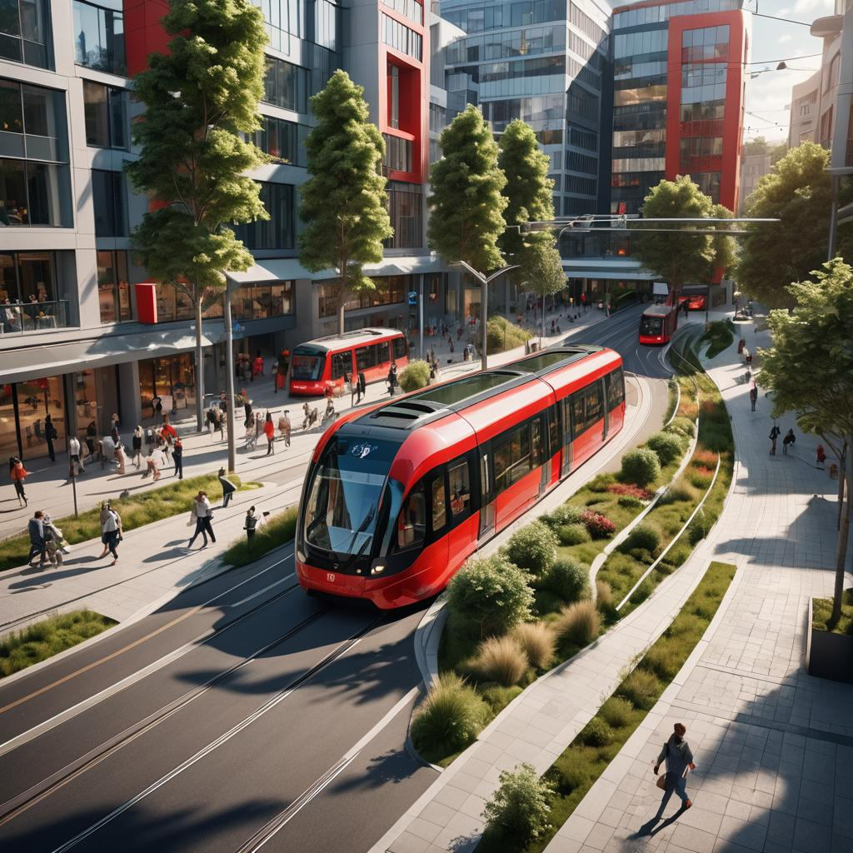
2060
Tram extension
From Turtola

Slide 10
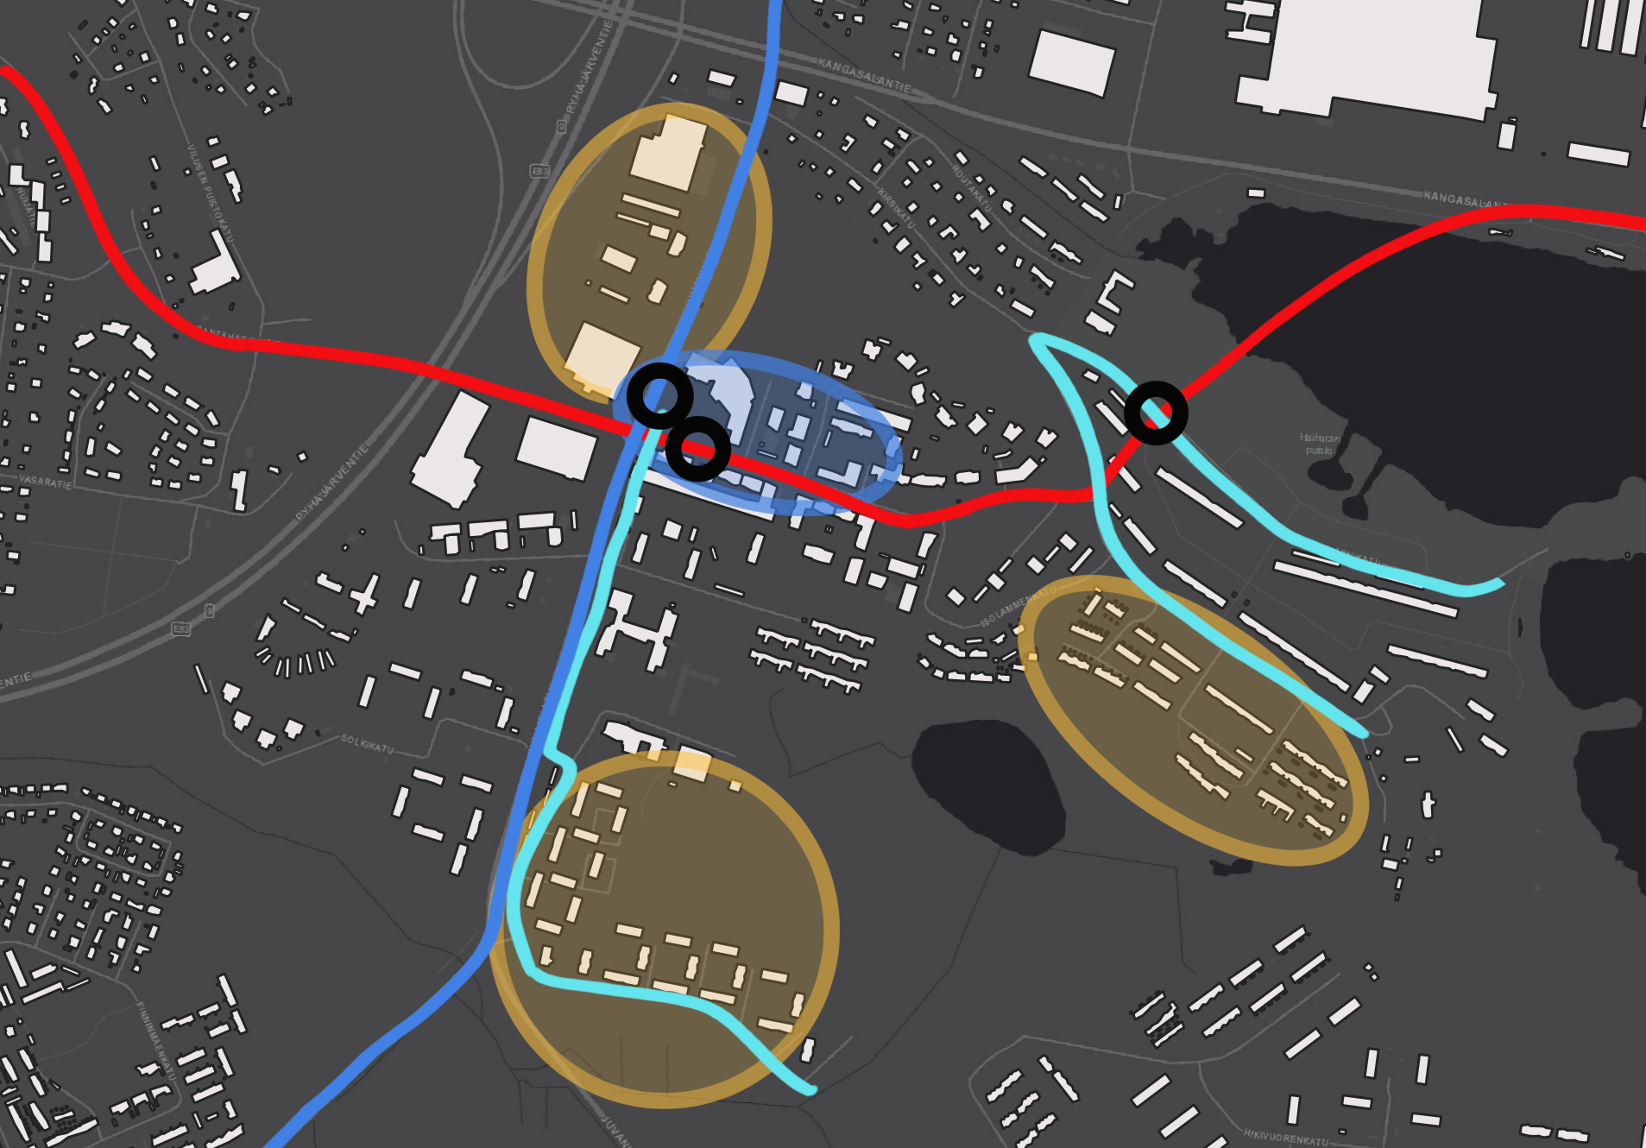

A Modern
Transport Hub
Tramline extension:
Turtola - Kaukajärvi
BRT connecting Eastern sub-centres
Autonomous shuttle bus
Transit stop
Regenerative housing
Community centre

Slide 11
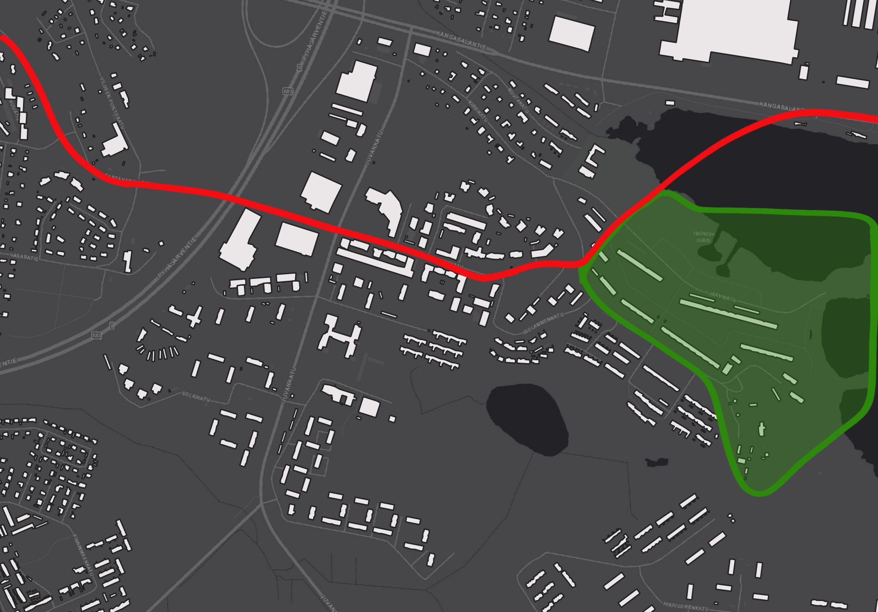
2062
The Next Step
Artistic Haihara

Slide 12
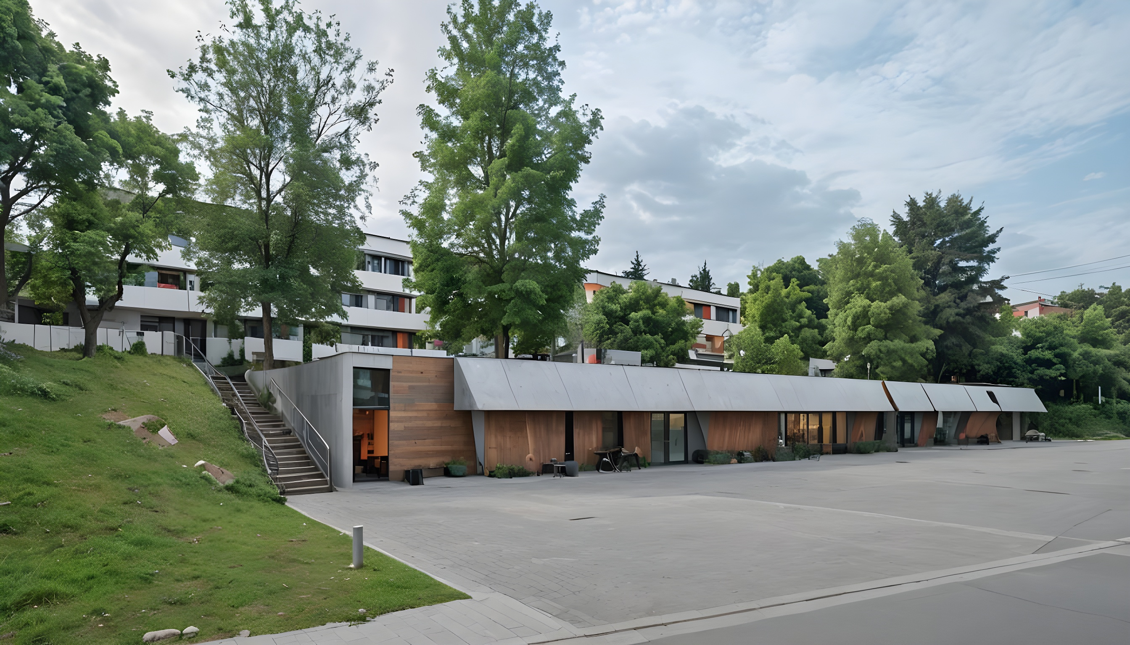
Haihara Art Village – Creative Innovation in a Futuristic Setting
Preservation of 60s architecture with modern, sustainable designs
Innovation Labs, Creative Studios, and Artist Residencies
Interactive public art and pop-up exhibitions
Eco-friendly, modular workspaces powered by renewable energy
Global collaboration through virtual and physical platforms

Slide 13
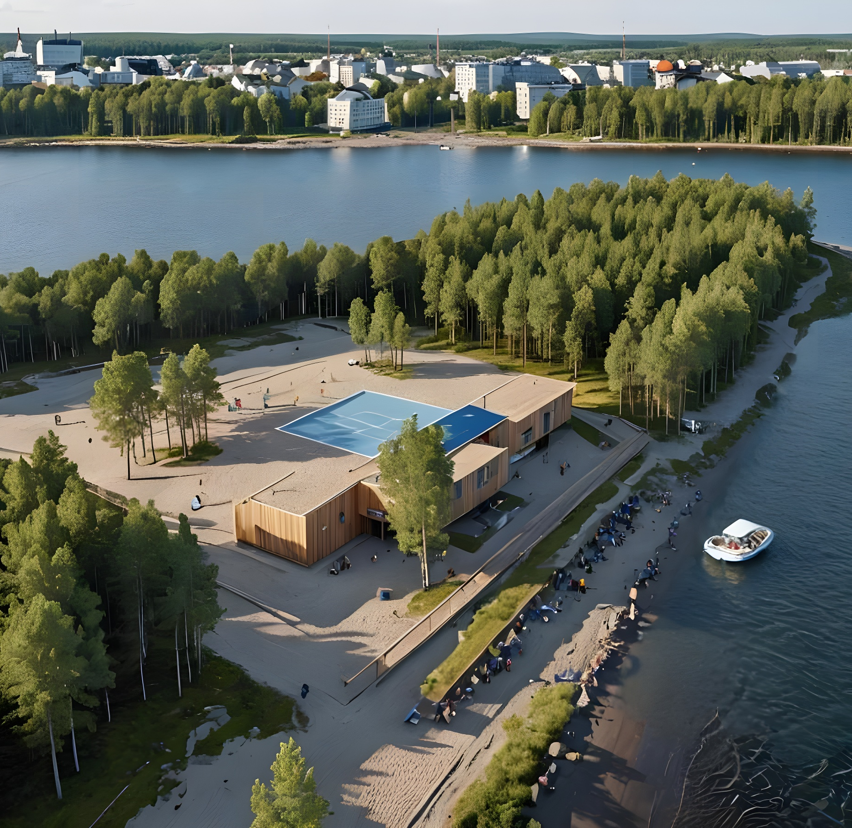
Kaukajärvi Waterfront – A Dynamic Space for Community and Recreation
Sports facilities for year-round activities
Kayaking, paddleboarding, and art tours in summer
Ice skating, ice sculpture festivals, and saunas in winter
Communal workshops, hackathons, and wellness activities
Sustainable waterfront integrated with natural landscapes

Slide 14

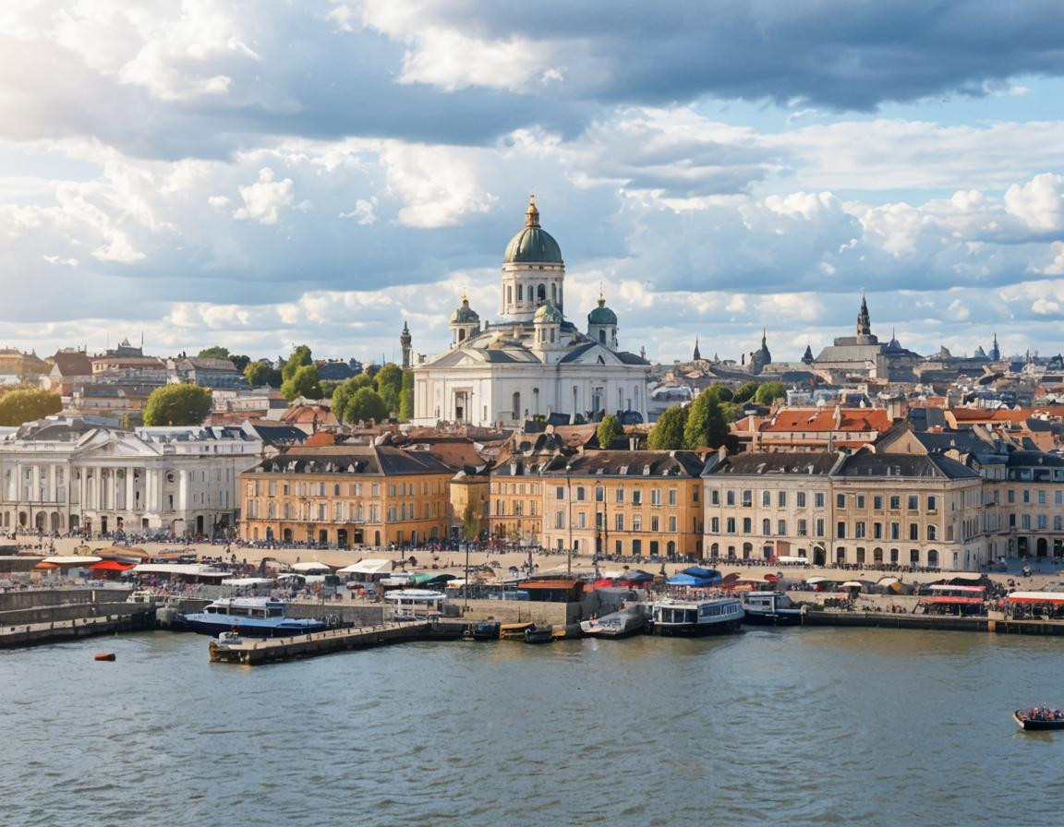





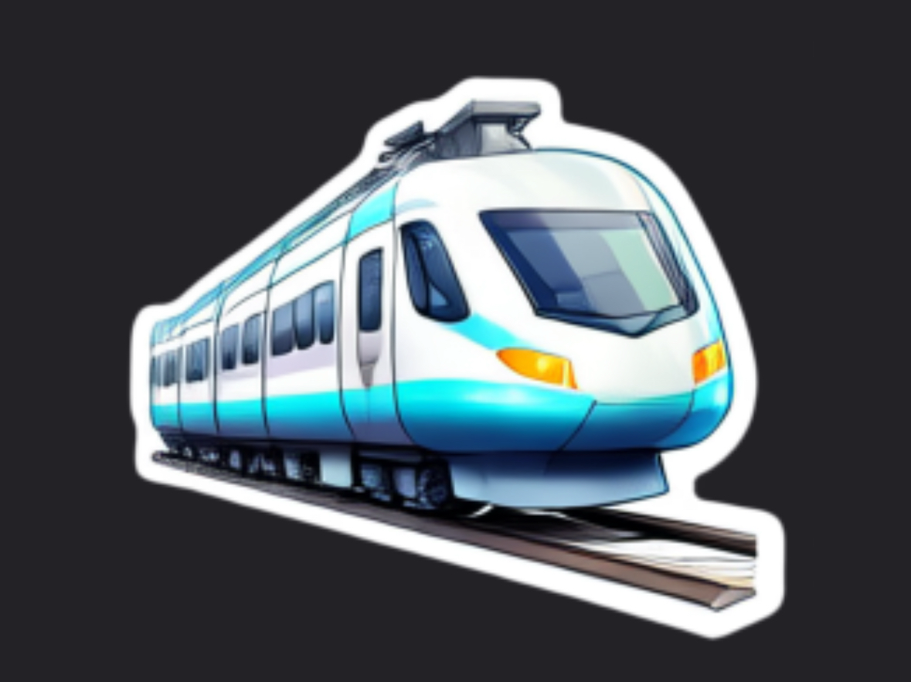

Attractive and Sustainable
Travel Chains between
Kaukajärvi and Helsinki

Slide 15
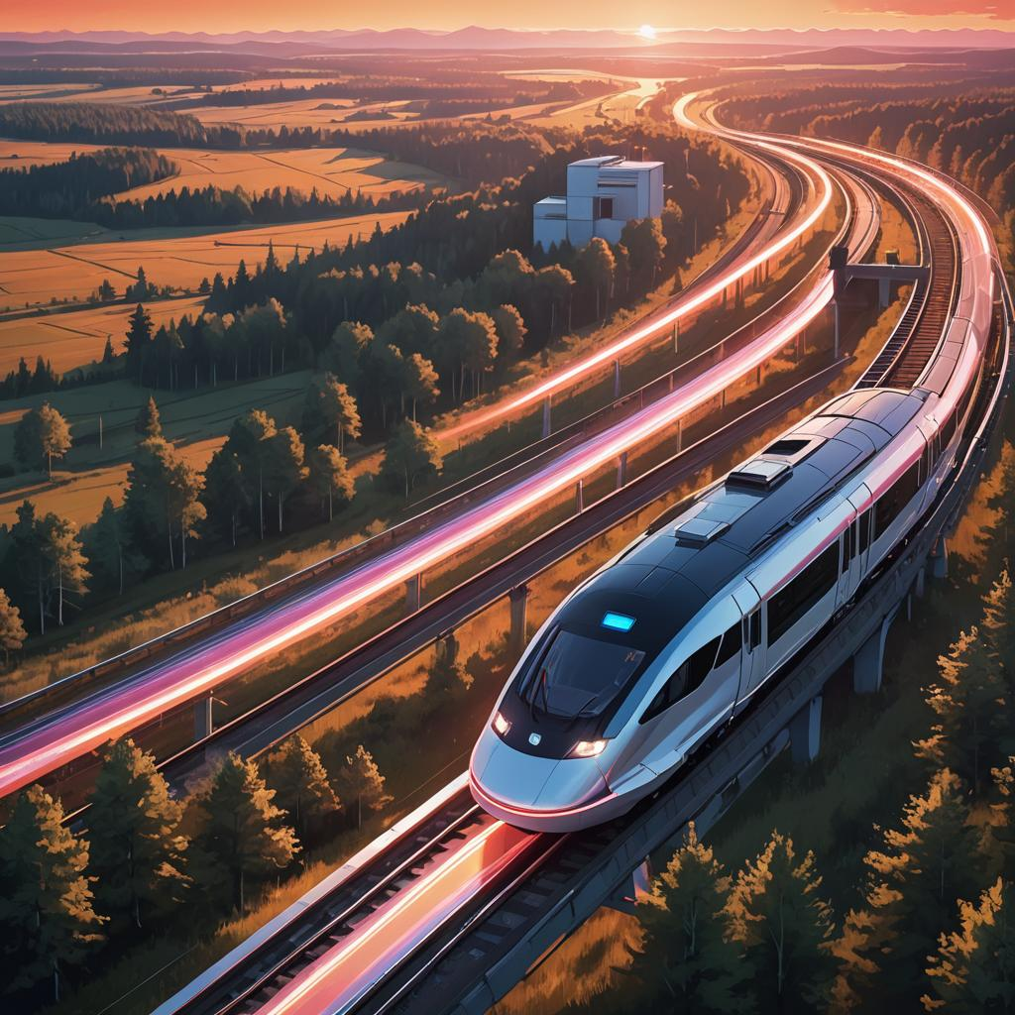
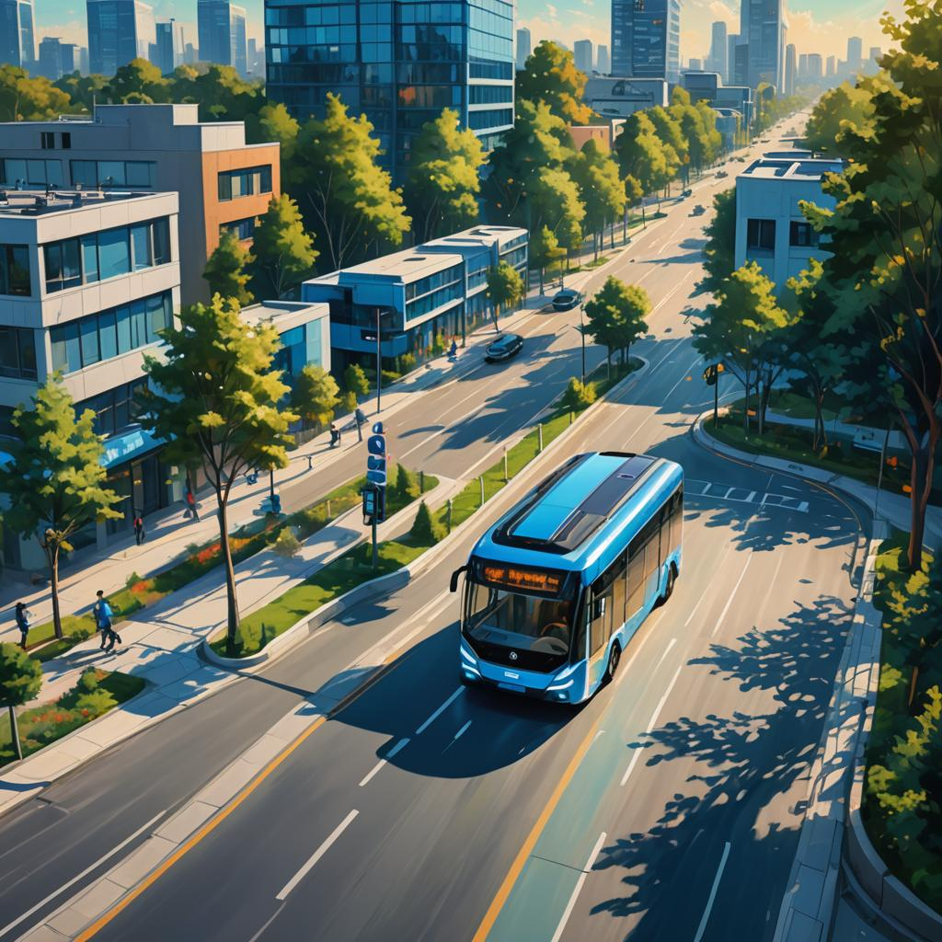
The world at our fingertips: Humans
Maglev – 15 minutes to Helsinki!
  Convenient, comfortable
  Limited capacity
Autonomous electric vehicles for private travel
  Takes longer
  Directly to destination
Fast travel shortens the experienced distance
Shared urban experience
Common work area
Common culture
Notes:
Transportation is fast, conventient and comfortable (15 minutes by Maglev)
Commuting to work, school and hobbies between cities is common
Shared cultural experience and events between the cities
-> more potential customers
Slower connections like electric cars used for transporting cargo
Fast and convenient transportation, seamless connectivity
Traveling Saunas
Bike/car sharing system for Last Mile Connections
Pedestrian-friendly pathways with travel buddies for safe and social journeys
Centralized Intelligent Ticketing System (MaaS)
Sustainable train stations with nature-inspired design

Slide 16
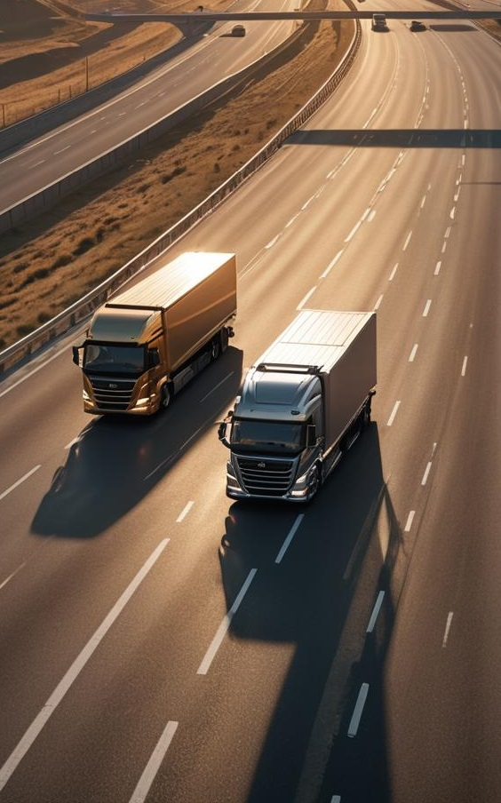
Cargo
Slower (older) rail technology
Hydrogen fuel lorries
Less need for transporting food due to increased urban agriculture and local food production
Local production/reuse chains for goods under development

Slide 17
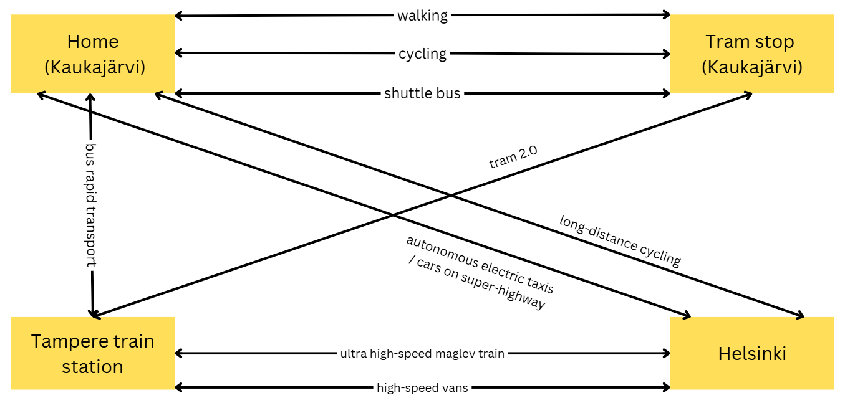
Attractive and Sustainable Travel Chains (TRE↔HKI)
cycling

Slide 18
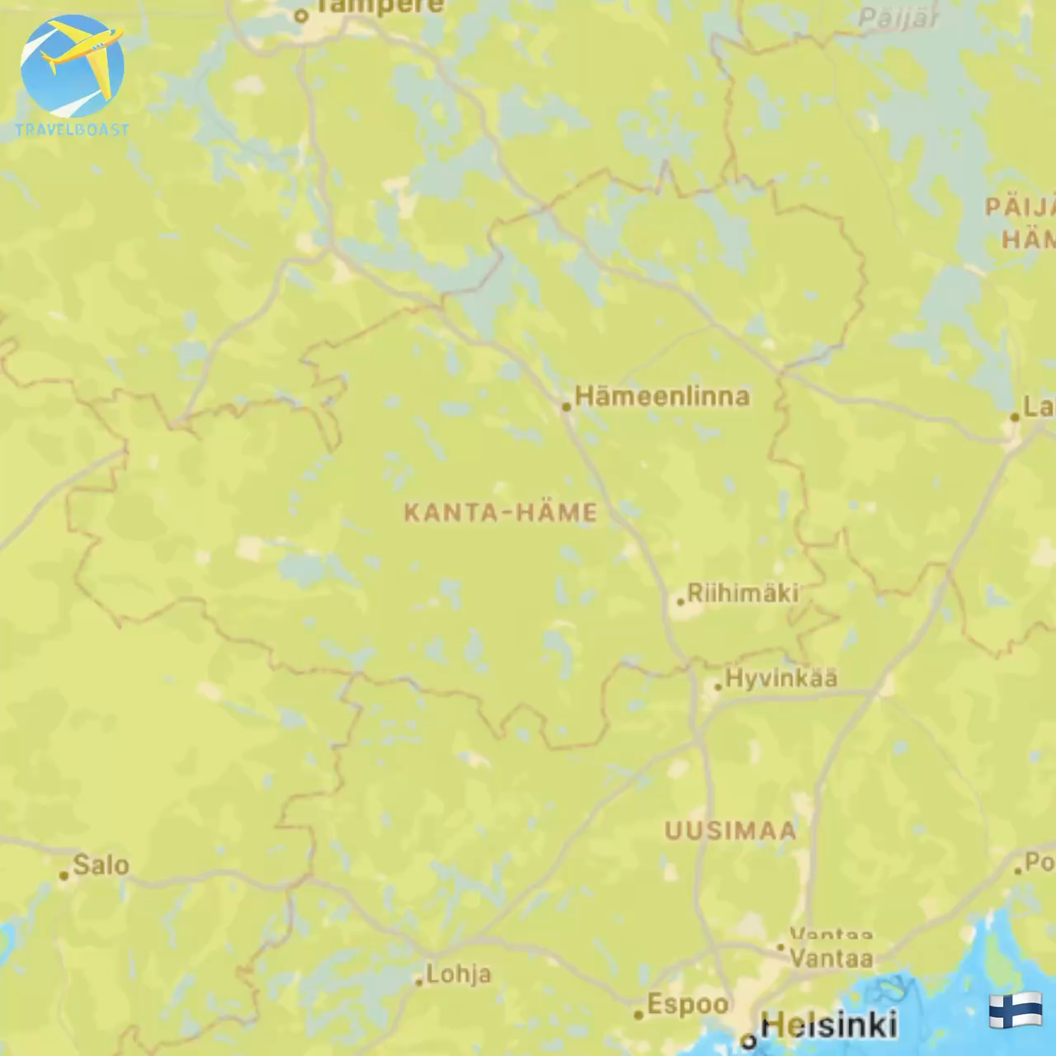
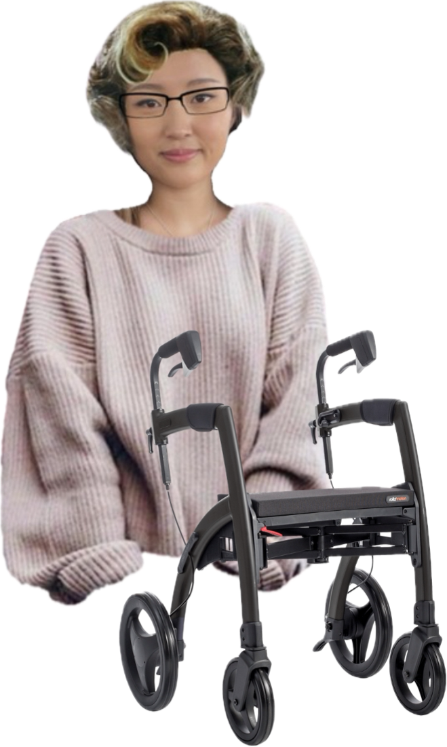
"I love how easily I can get travel options between Helsinki and my home based on real-time data and also buy a single ticket from one platform these days. The switch between tram and train was even more convenient than getting on a car"

Slide 19
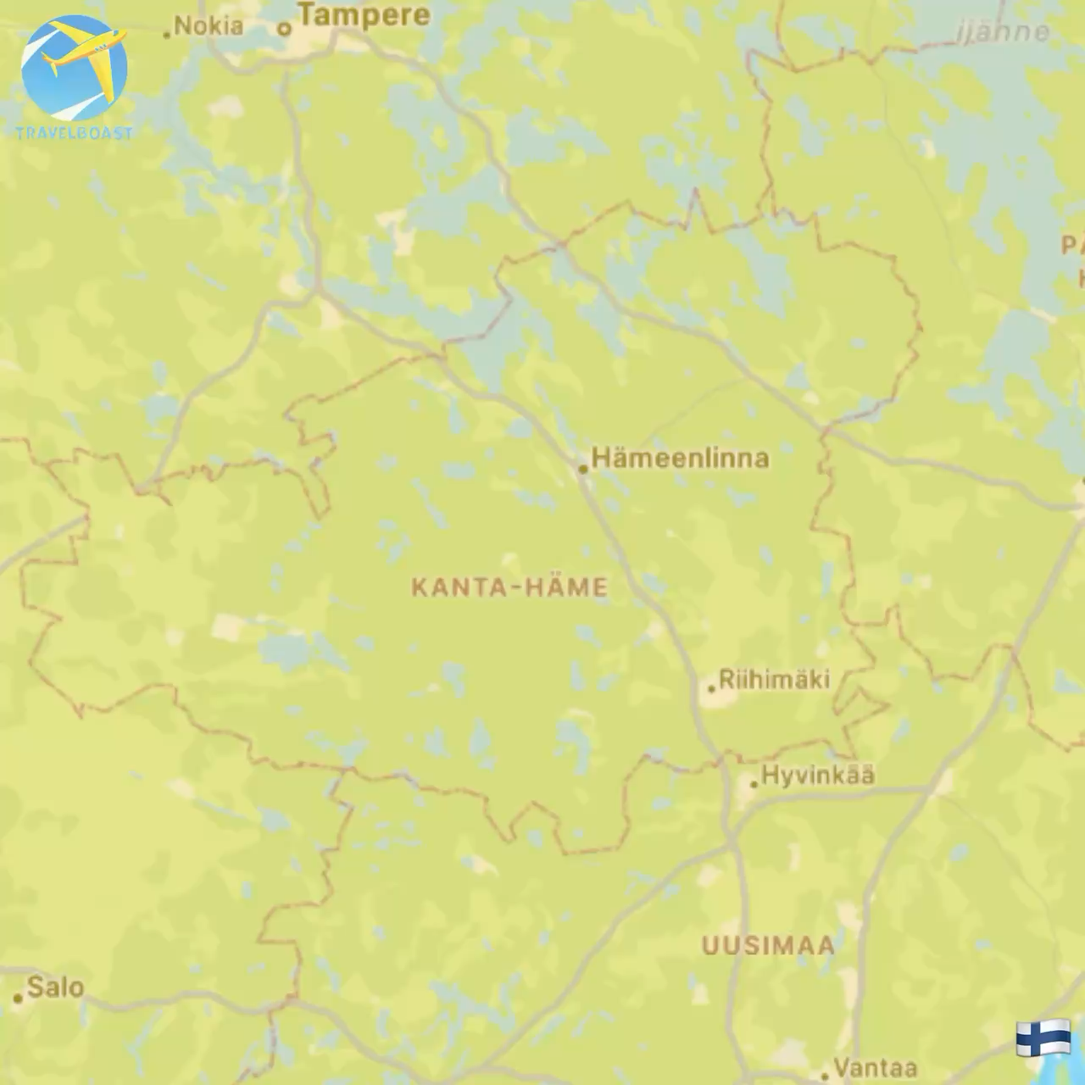

"My name is Zuzu, a new international artist visiting Haihara. I got travel assistance from AI on “Aura” platform and it suggested to me the fastest, the most eco-friendly travel option from airport to the neighborhood. I did not have to carry around my heavy suitcase"

Slide 20
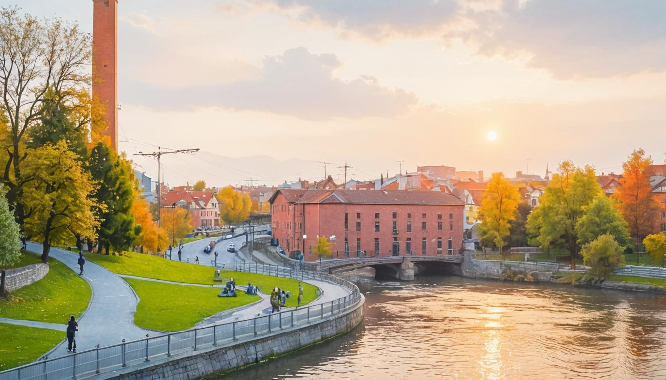
Conclusion
Regeneration and Identity: Kaukajärvi and Haihara have become vibrant, unique destinations, enriching Finland's cultural landscape
Notes:
In conclusion, Kaukajärvi 2065 is more than just a sustainable neighborhood. It’s a showcase for the future. By turning today’s challenges into regenerative opportunities, we are planning to create a city with zero-emission transport, use circular economy principles, and have a green urban area. It’s going to be a place where people, nature, and innovation come together, leading the way to a carbon-negative, resilient Tampere. Our journey to 2065 shows what’s possible when we commit to regeneration and build a future that benefits both the environment and the community.

Slide 21
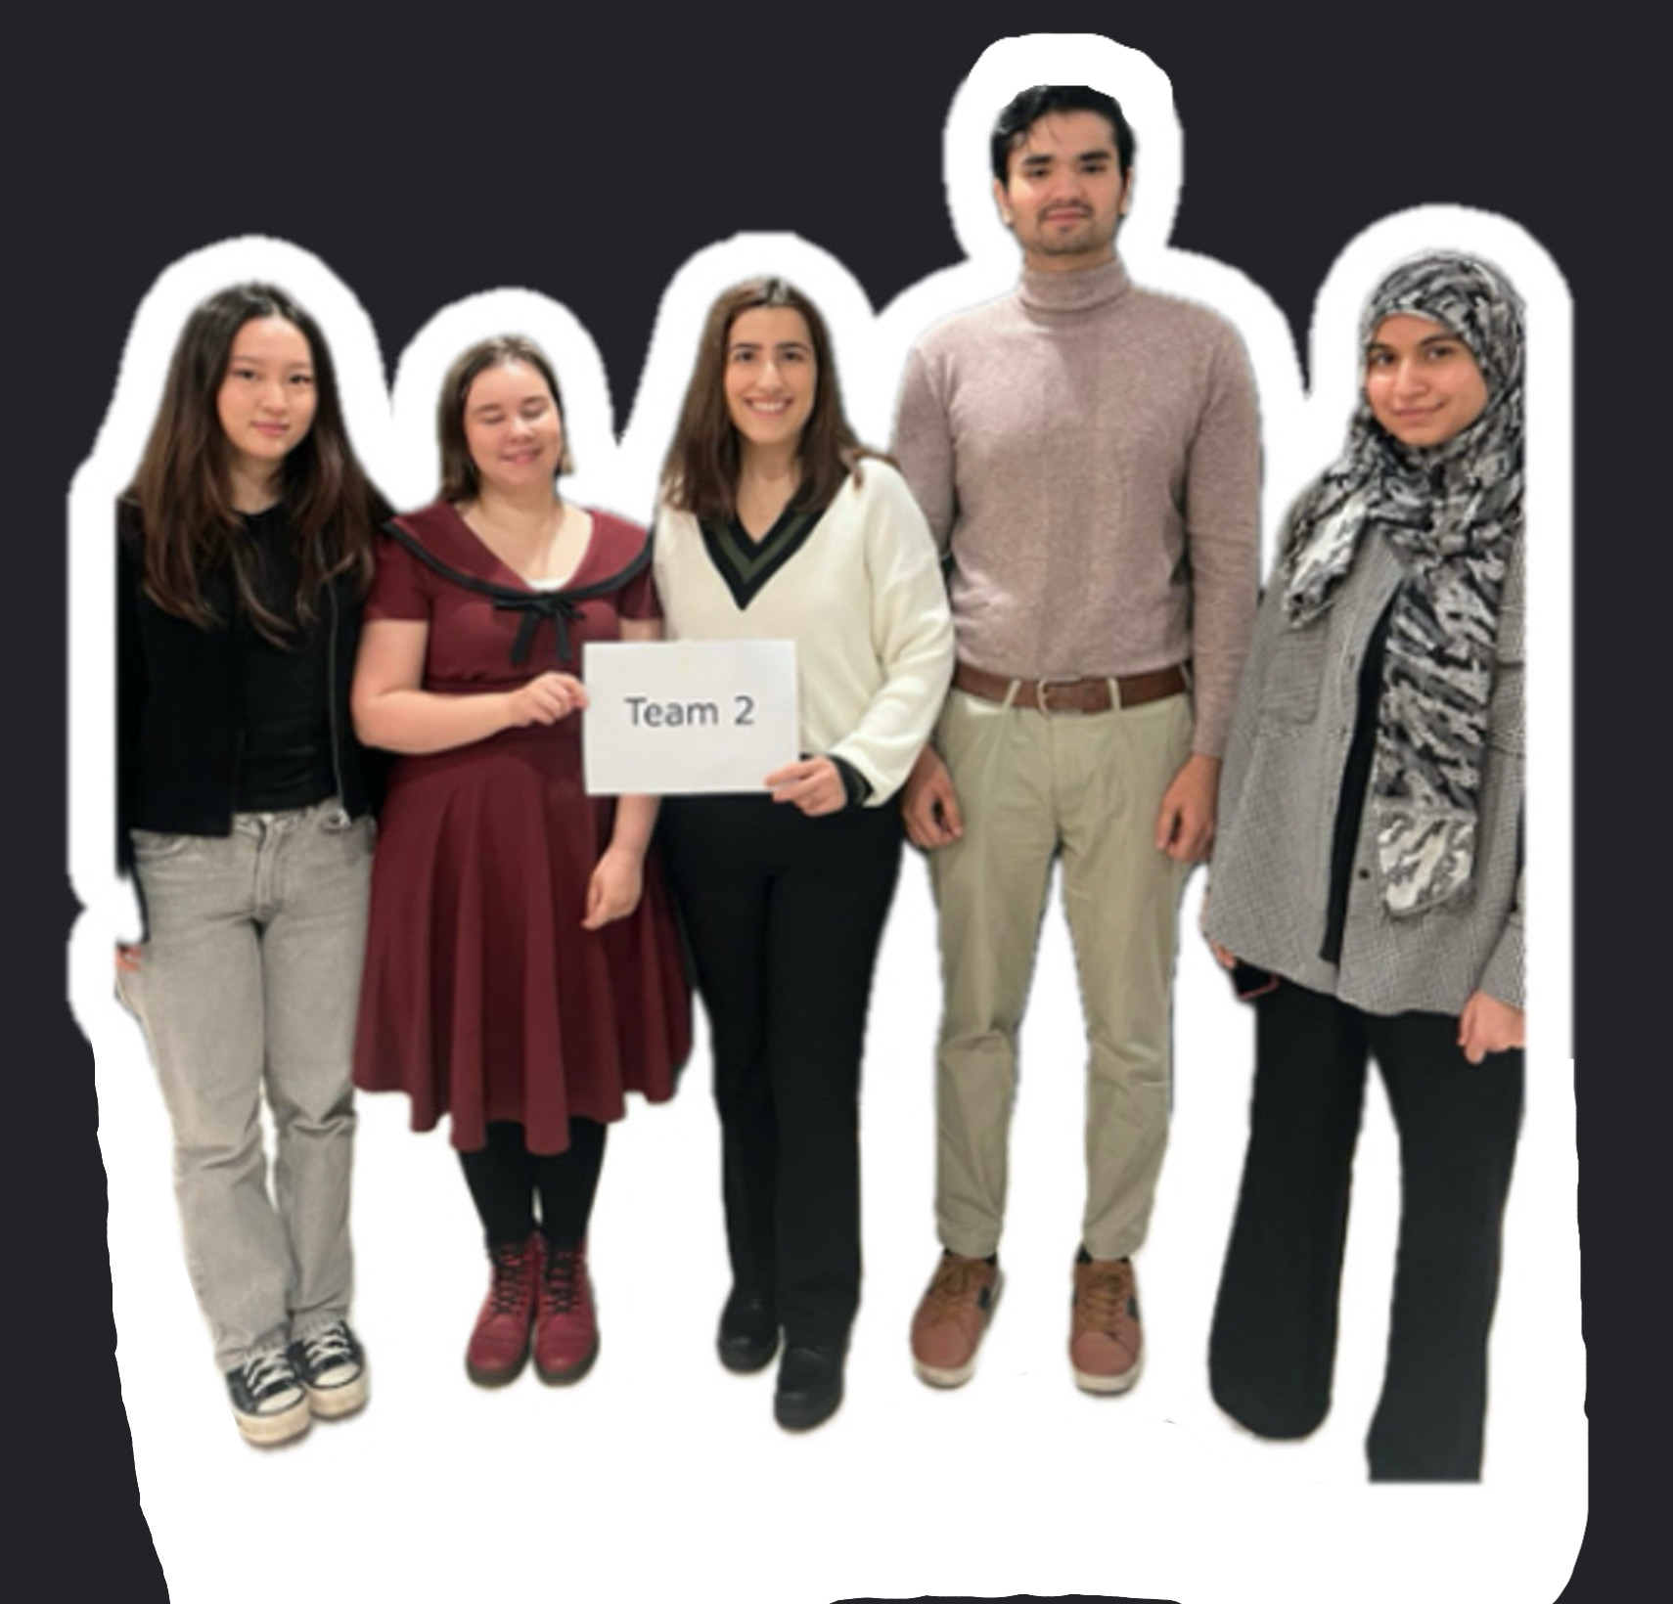

Thank you!

Slide 22
References
Kharissova, A. B. et al. (2024) Carbon negative footprint materials: A review. Nano-Structures & Nano-Objects. [Online] 37101100-.
City of Tampere. (2010). Tampereen keskustan ulkopuolisten 1960- ja 1970-luvun asuinalueiden inventointi ja arvottaminen. City of Tampere. Available at: https://ekstrat.tampere.fi/ytoteto/aka/nahtavillaolevat/8628/selvitykset/tampereen_1960_ja_1970_luvun_asuinalueiden_inventointi_ja_arvottaminen_2010.pdf
City of Tampere. (2024). The Vision of Kaukajarvi and Annala and Operational Programme. Available at: https://www.tampere.fi/sites/default/files/2023-12/kaupunginosavisio_asukasversio.pdf (Accessed: 24 October 2024).
Reconnecting Tampere - Lundén Architecture Company (2022a). Lundén Architecture Company -. Available at: https://www.lunden.co/project/tampere-travel-service-centre/ (Accessed: 24 October 2024).

Slide 23
Picture references, in order of appearance
Kaukajärviosuuskunta: https://kaukajarviok.fi/kaukajarvi-osuuskunta/historia/
Google maps: https://maps.app.goo.gl/6jiMMM3niNXX6eXR9
Reissuesan kuvapankki: https://www.matkablogi.fi/kuvapankki/tuote/riihiniemen-uimaranta-kaukajarvi-tampere/
Tampereen kaupunkiseutu: https://tampereenseutu.fi/tampereen-kaupunkiseutu/
World cities culture forum: https://worldcitiescultureforum.com/city/helsinki/
Photos edited with Nightcafe AI: Dreamshaper XL Lightning.
Prompts can be found at:
https://docs.google.com/document/d/1F8jo1MQEgDqZrO09eRUnywfZr8bZcANUA0nOyrZFnpU/edit?usp=sharing

