Slide 1
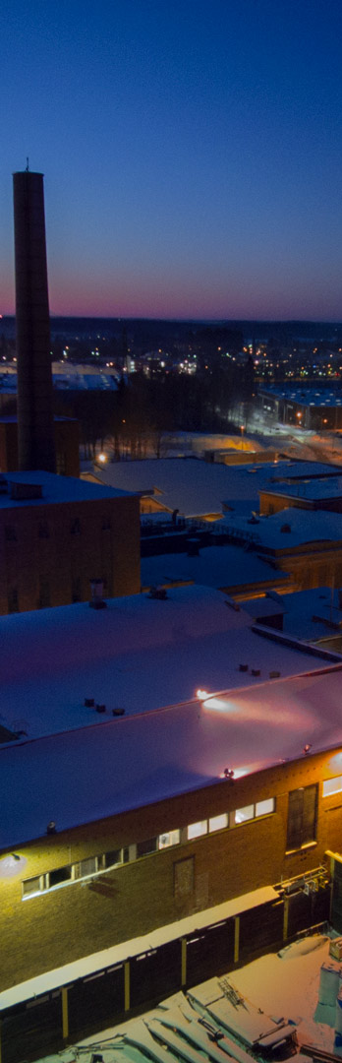
HIEDANRANTA - A VISION FOR SUSTAINABLE FUTURE
Team
AURORA
How does a future carrying the glimpses of the legacy look like?

Slide 2
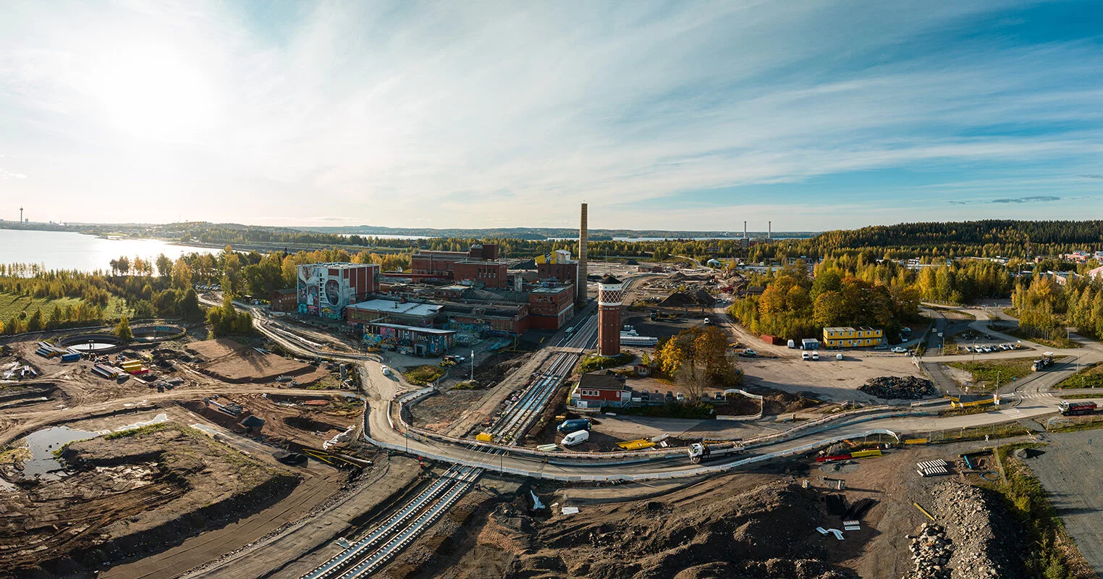
CURRENT STATE
City with high potential and existing plans of development
Team
AURORA

Slide 3
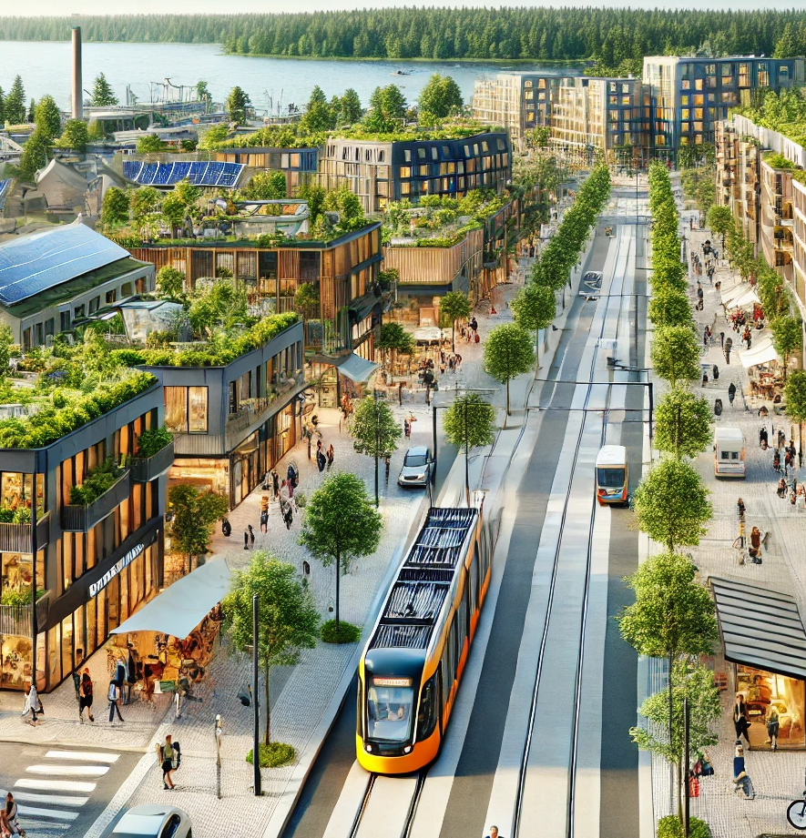
OUR PROMISE FOR 2035
unique
city for
people.
Light traffic area
Regenerative city
10-minute city
Fast connection to Helsinki and beyond
Smart city pilot
Team
AURORA

Slide 4
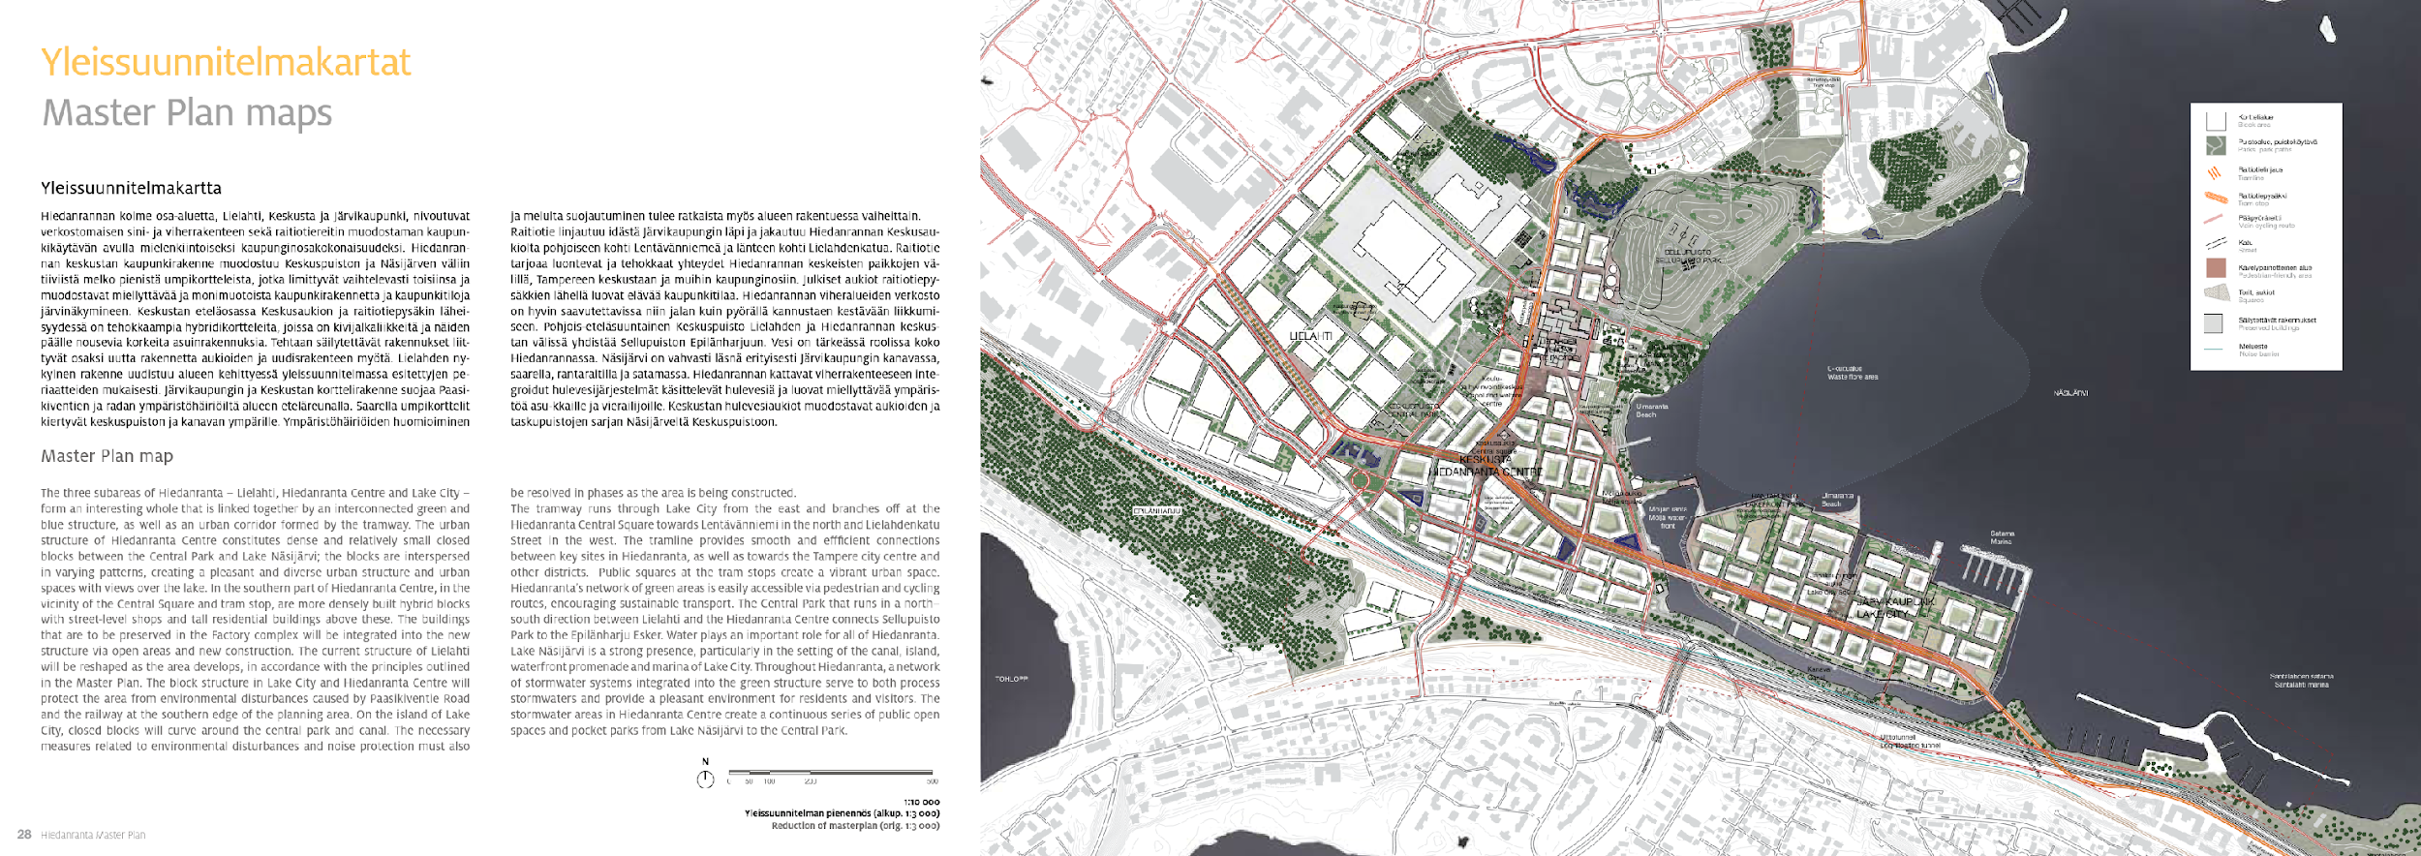
FUTURE PROJECTS
3
2
4
1
5
Five focus zones for developments
Team
AURORA

Slide 5
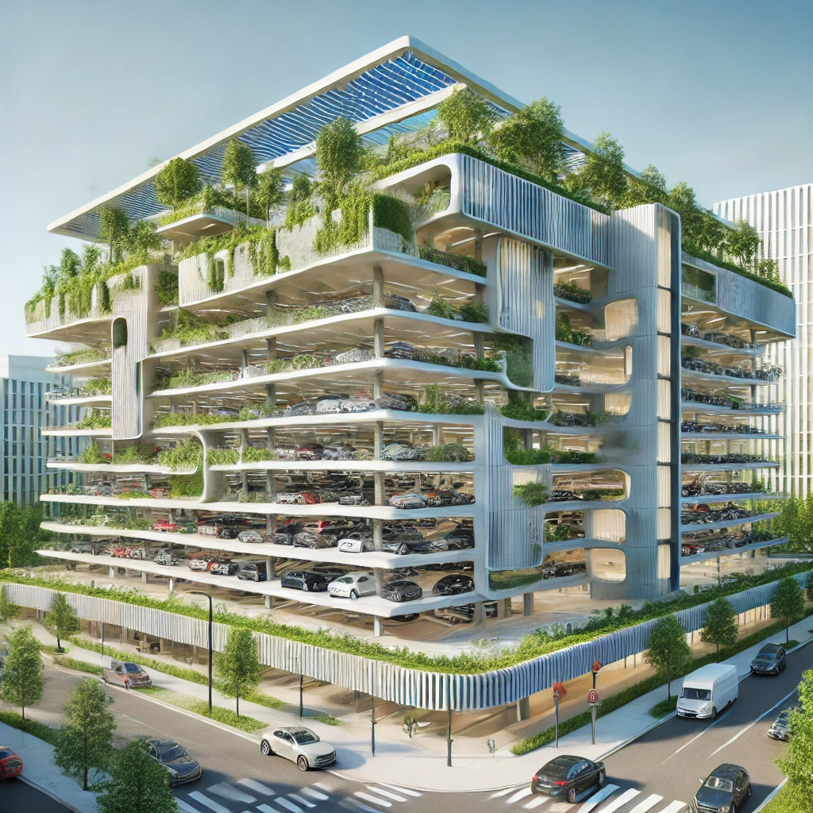


LIGHT TRAFFIC AREA
1
How can we significantly reduce the traffic in key areas of the district?
Bus & Tram Station
Multi-storey car parking building
Car sharing
Automated Accessibility Service
Team
AURORA

Slide 6
FUTURE PROJECTS
3
2
4
1
5
Five focus zones for developments
Team
AURORA

Slide 7


10- MINUTE CITY
2
How can we provide the best mobility experience in most sustainable way?
Shopping District
Hiedanranta culture reflected in urban spaces
From old factory to community library
Beach & Floating Sauna cafe
Team
AURORA

Slide 8
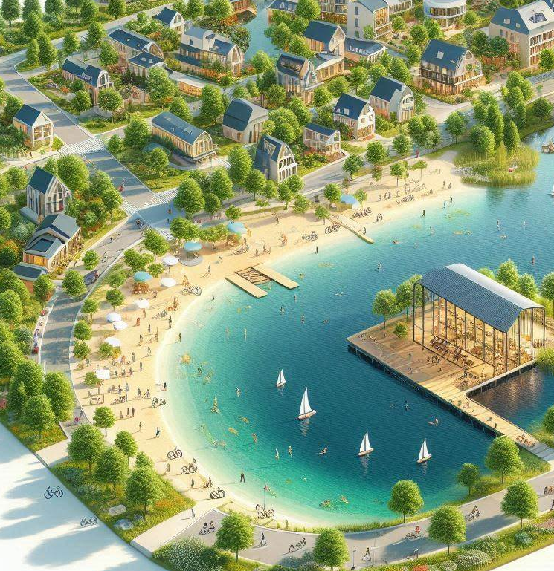
BEACH &
FLOATING SAUNA CAFE
How can we make Hiedanranta the main attraction point of Tampere?
Appealing lakeside
Summer and winter sports
Floating café with sauna
Attraction point for local tourists
Team
AURORA

Slide 9
FUTURE PROJECTS
3
2
4
1
5
Five focus zones for developments
Team
AURORA

Slide 10
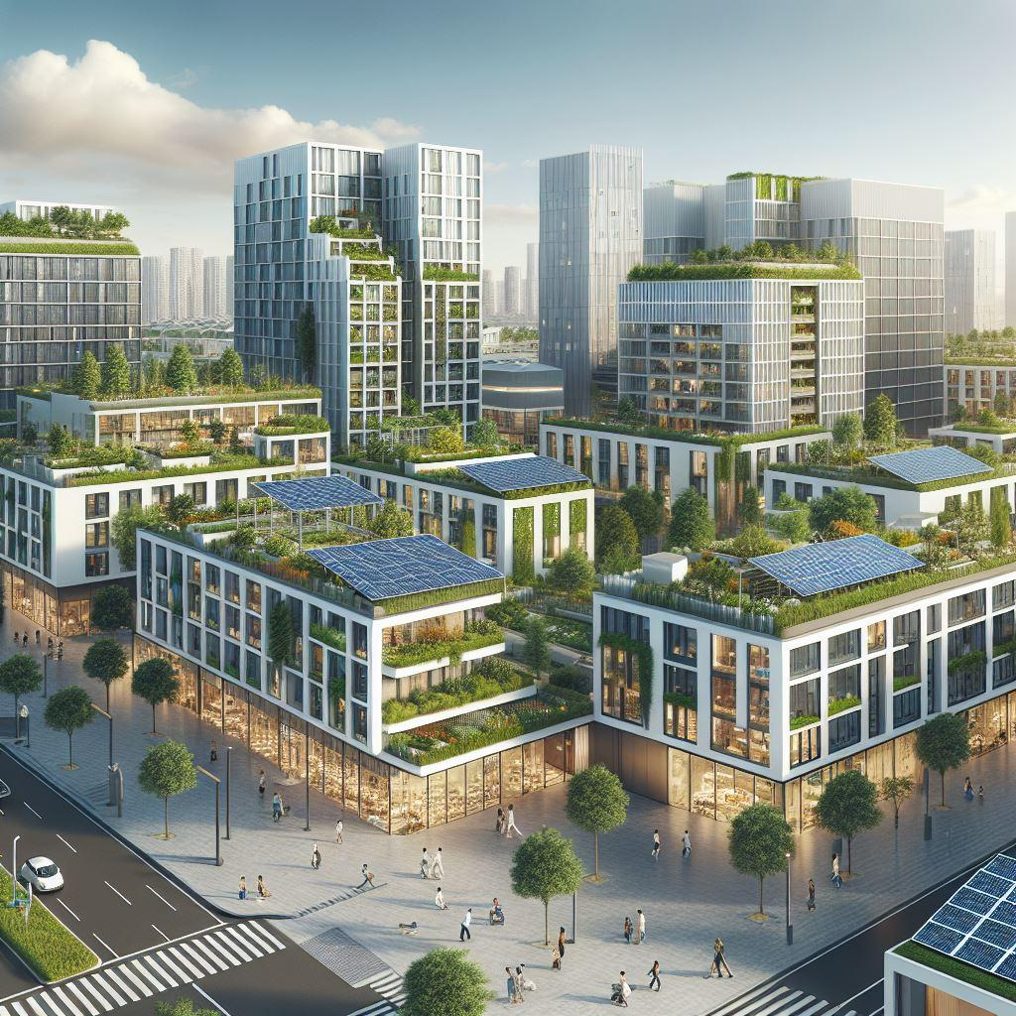
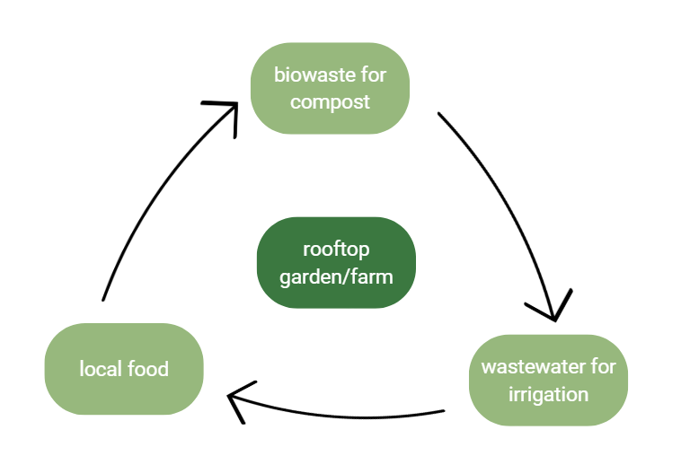
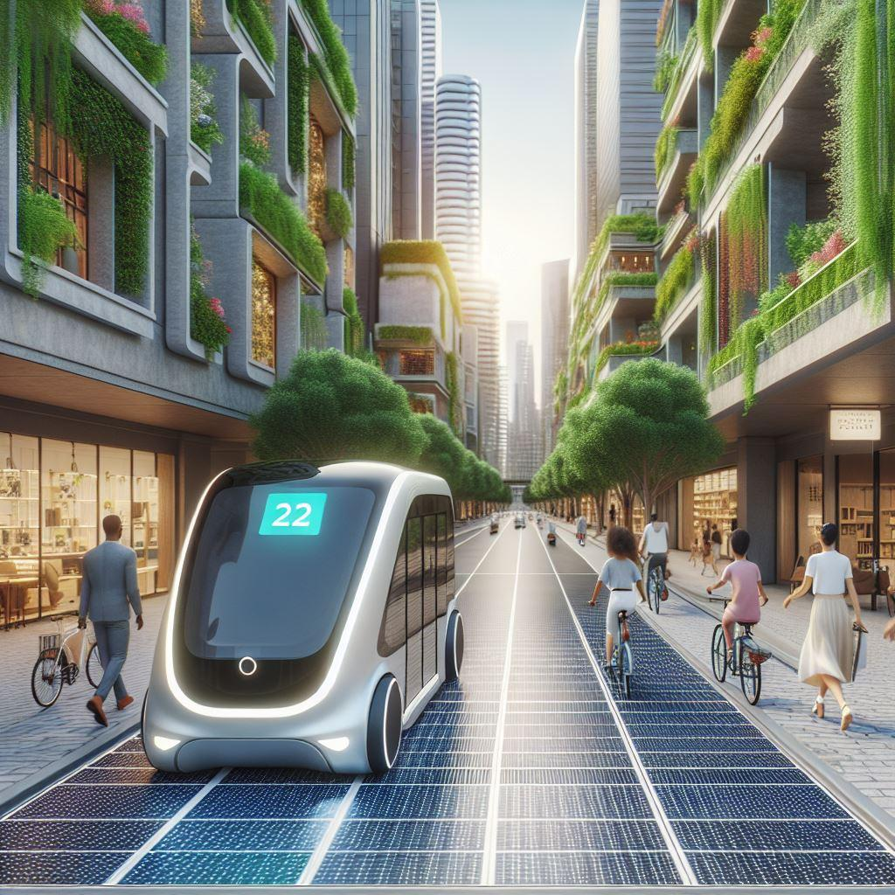


REGENERATIVE CITY
3
How does the future regenerative city look like?
Close-loop rooftop garden/farm
Efficient solar panels & Energy
harvesting pavements
Green corridor and nature area
Team
AURORA

Slide 11
FUTURE PROJECTS
3
2
4
1
5
Five focus zones for developments
Team
AURORA

Slide 12
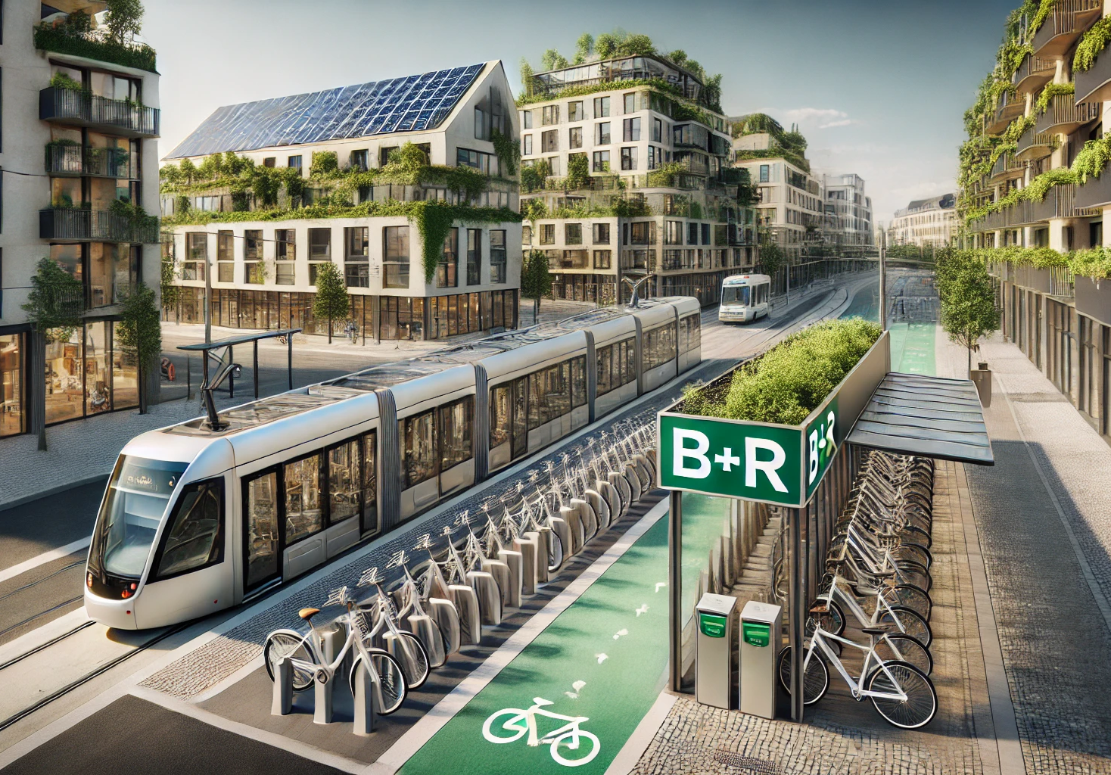

INCREASE THE MULTI MODALITY AT HIEDANRANTA DISTRICT
4
Walkable and cyclable catchment area (car free zone)
Cycling highway between
Hiedanranta and the Tampere city center
Multi modality support at the station area (B+R)
Bike sharing system at the area
Team
AURORA

Slide 13
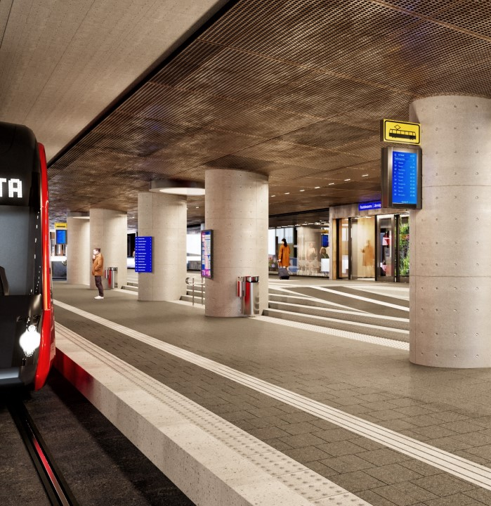
FAST CONNECTION TO HELSINKI AIRPORT AND BEYOND
Connection to other cities like Helsinki?
Tampere Asemakeskus multimodal transportation hub will provide excellent connection between tram, train and bus
Direct Inter City connection from Tampere central station to Helsinki Airport
Team
AURORA

Slide 14
FUTURE PROJECTS
3
2
4
1
5
Five focus zones for developments
Team
AURORA

Slide 15
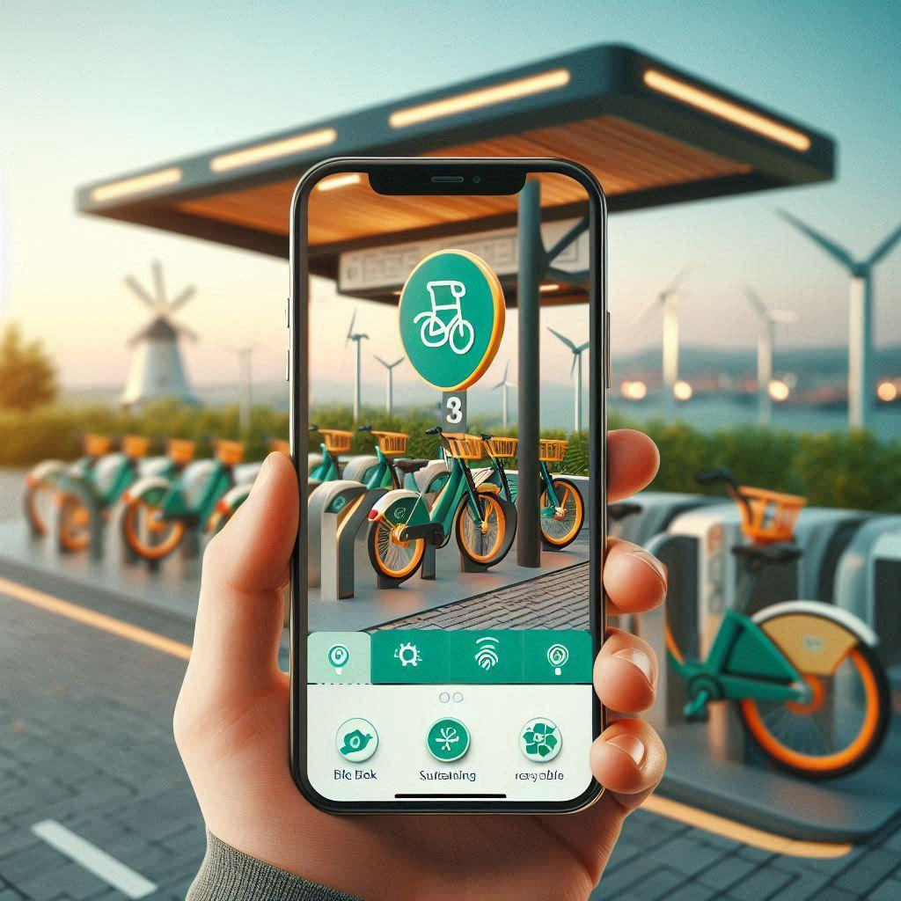
HIEDANRANTA AS
DATA PILOT
5
Enable the potential for being the pilot for Tampere and whole Finland.
Traffic flow
Public transit and usage
Bicycle and pedestrian counts
Smart City and IoT
Gamification of Mobility
Team
AURORA

Slide 16
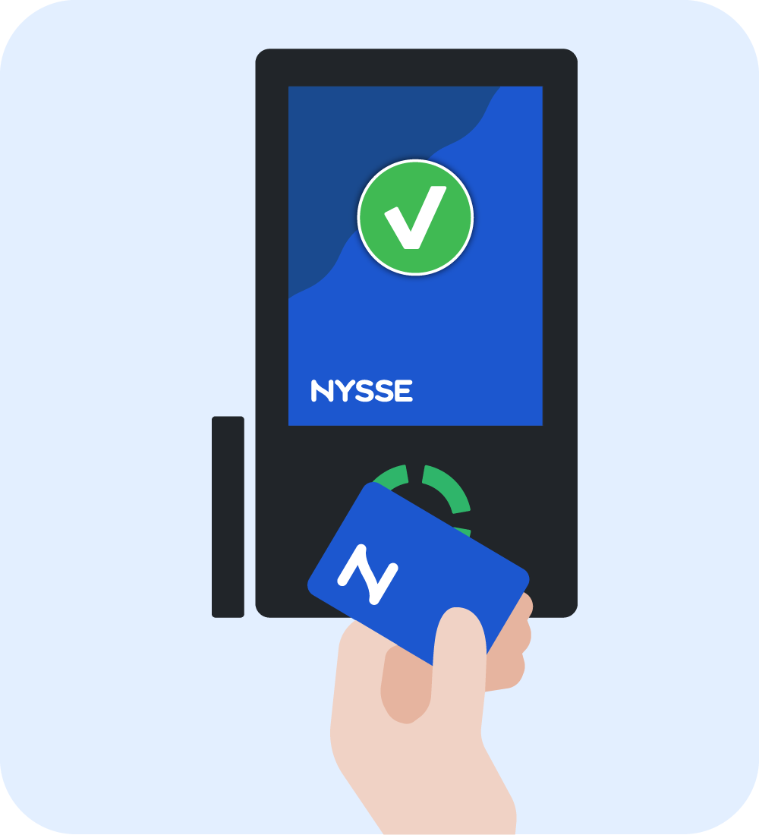

GAMIFICATION OF MOBILITY
Residents can earn points for choosing eco-friendly transport .
Daily Point Collection
City App - Nysse Integration
Rewards System
Plant a tree
Team
AURORA

Slide 17

THANK YOU
Team
AURORA
WOODGROVE BANK
Alexander Golovkov
Renganayaki Venkatakrishnan
Ahtesham ur Rehman
Aleyna Eser
Jere Sinivuori
Bingbing Lan
Gergely Barta

