Slide 1
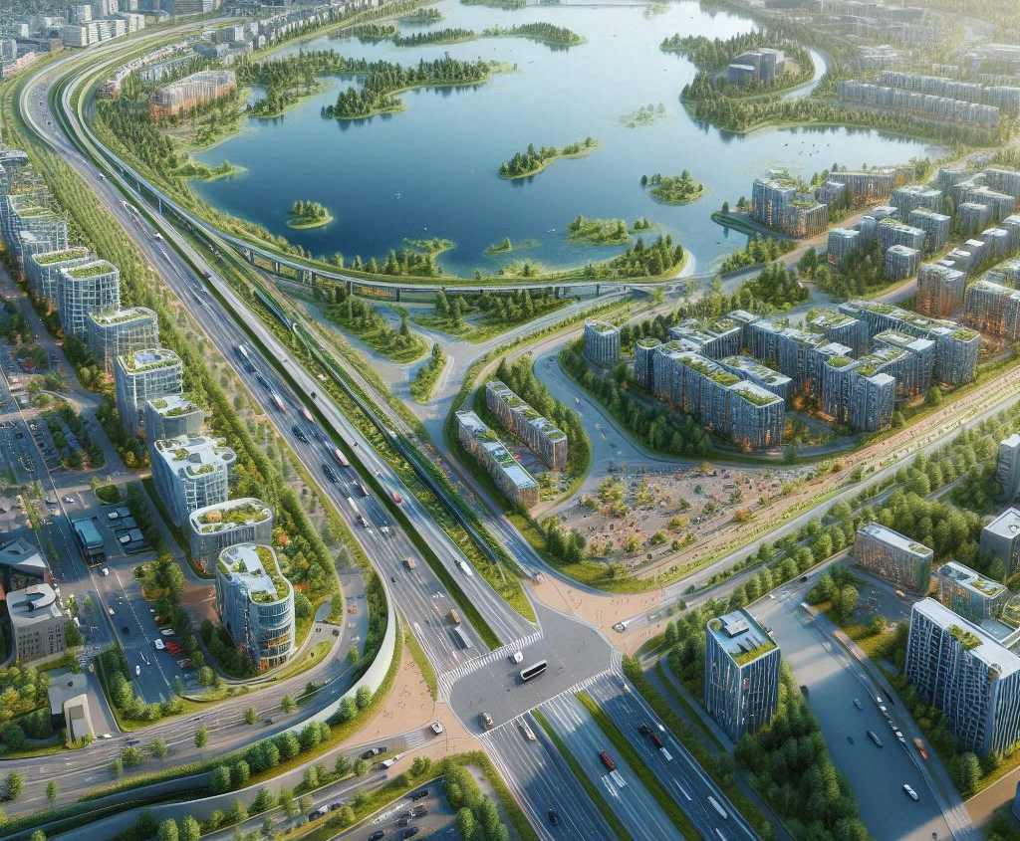
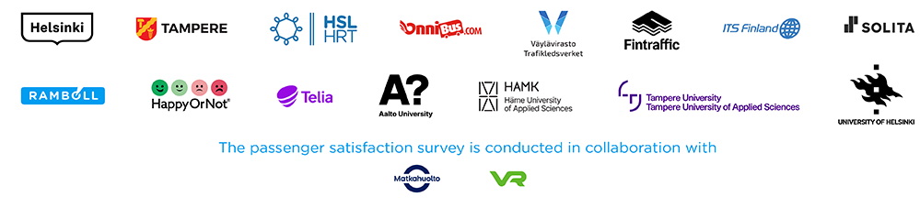

Hiedanranta 2050
A Zero-Carbon Urban Oasis
Team:
Eco City Navigators

Slide 2
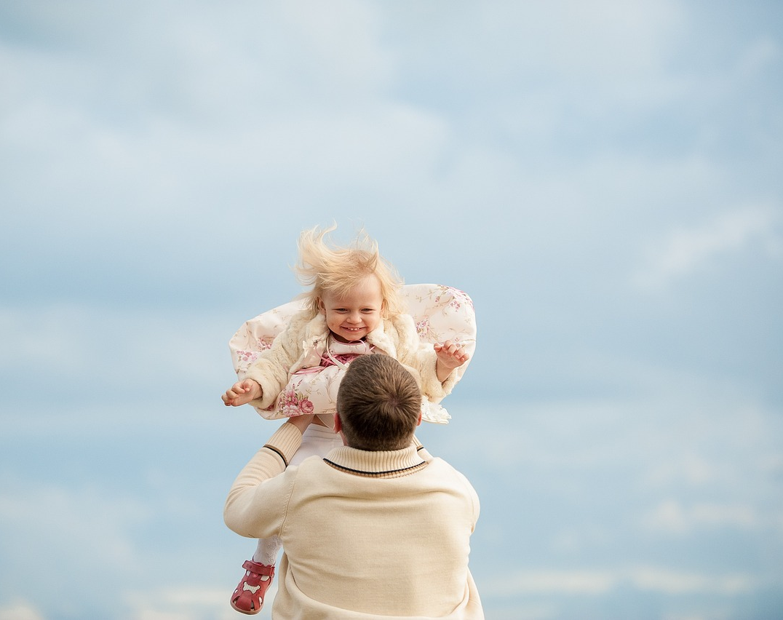
Finnish Values – A Vision For Hiedanranta
Affordable and Inclusive housing
Health and well-being
High-quality healthcare and education
Access to nature
A culture of physical activity
Simplicity and minimalism
Social mobility and income equality
Notes:
Finland is well known for a lot of things
Somehow it seems as times goes because of resource constraints these very important ideals are being diluted little by little
We are redefining everything but rather bringing back things to the way they were supposed to be through the model of Hiedranta

Slide 3
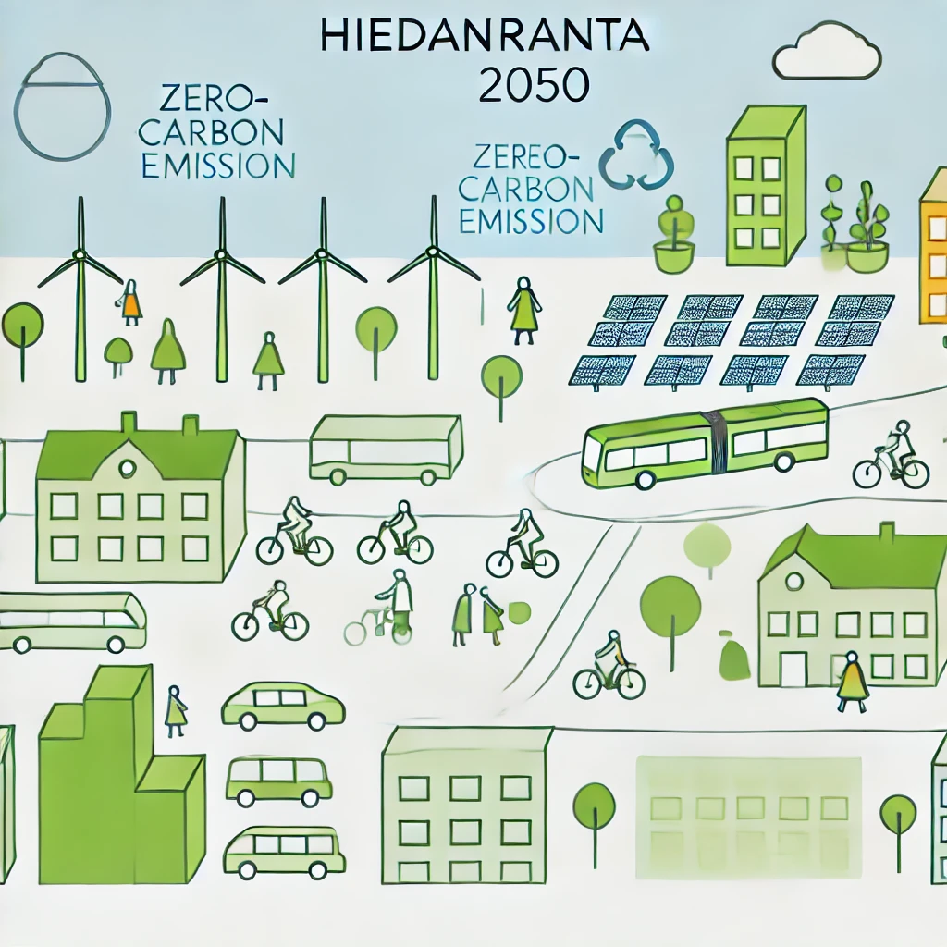
Vision for Hiedanranta 2050
Regenerative design
Zero-carbon emissions
Green energy
Green transport networks
Multi-cultural society
Sustainable living
Notes:
In our proposal we have been guided by the following to define our true north
How are we going to do this

Slide 4
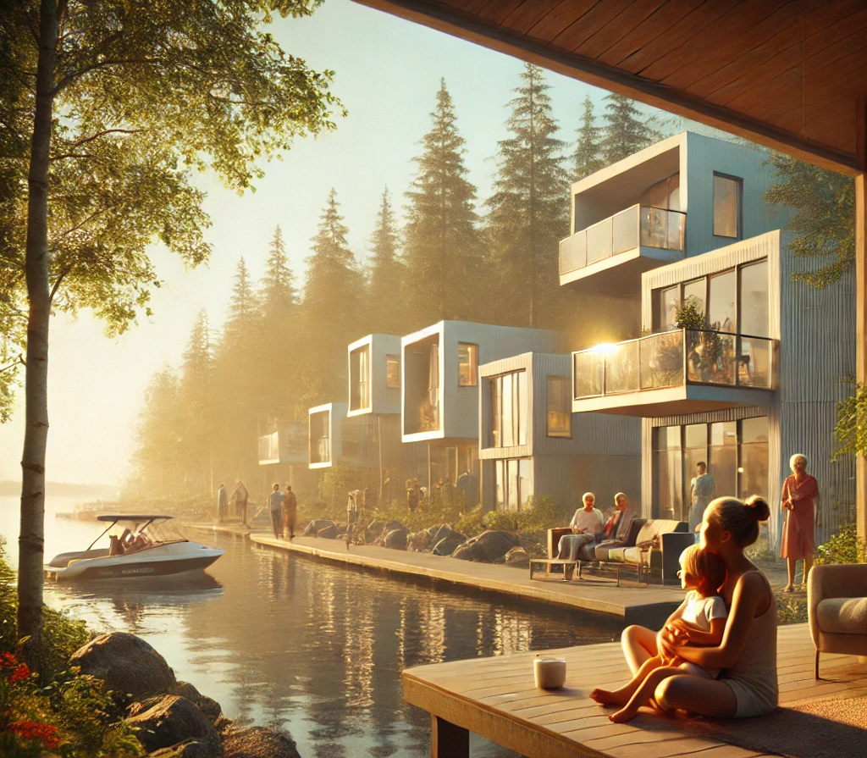
A Family-Friendly, Inclusive Community
A safe, clean, and efficient environment for families
Affordable housing initiatives
High-quality public services: healthcare, education, elderly care
Connecting Sarkaniemi to Hiedranta via the lake
Notes:
Safety, clean and Elederly facilities:
Theme Park Sarkaniemi: Särkänniemi, which already has a popular amusement park in Tampere, could become a hub connecting Hiedanranta via sustainable transportation modes like boats and activities like kayaking. The attraction for residents and visitors could include not just the amusement park itself will enhance cultural or recreational facilities, water activities, or scenic routes that highlight the lakefront views.

Slide 5
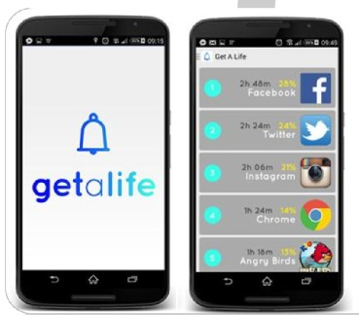
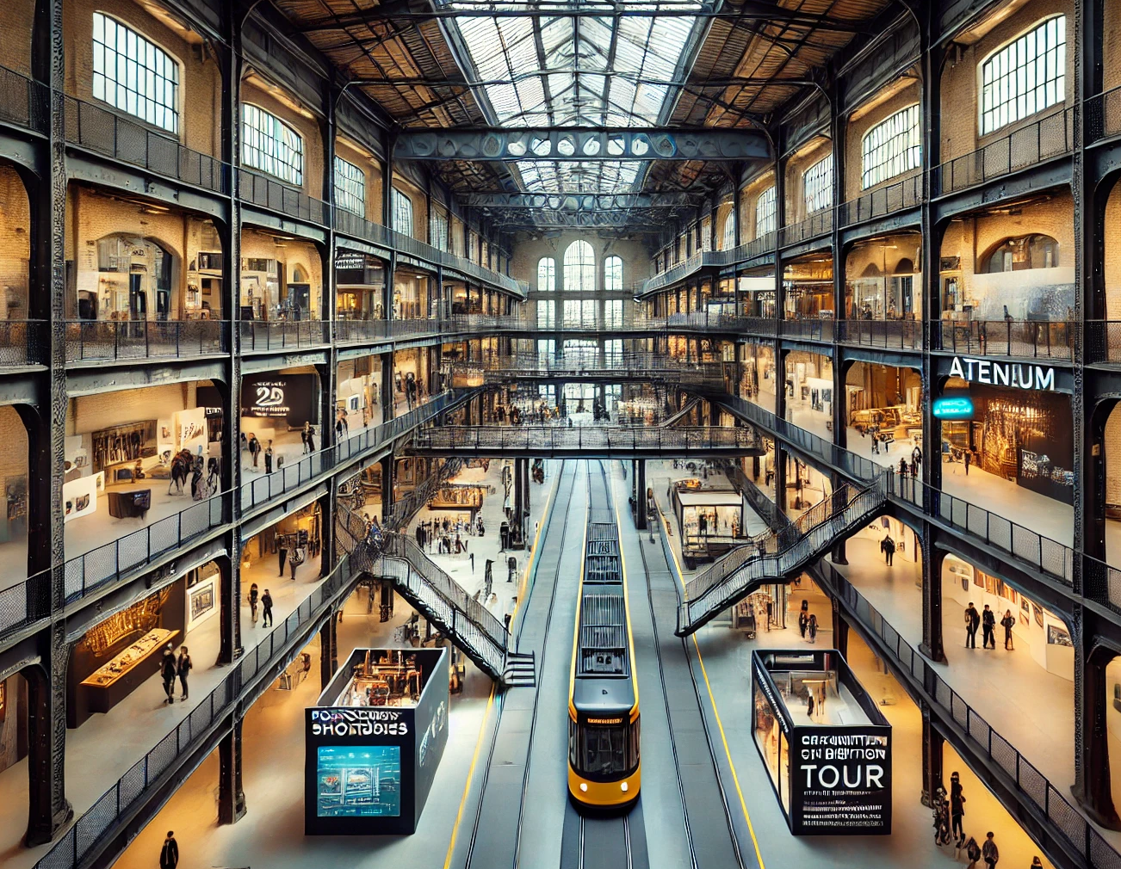
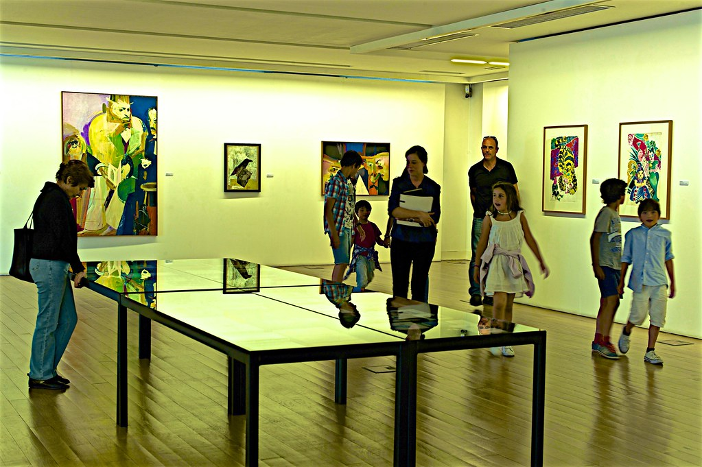
2. Retrofitting the Old Factory
Repurposing the old factory as a cultural centre (Art galleries, community events, festivals, music and exhibitions)
Ateneum Art Museum (Helsinki) to open a co-exhibition center in Hiehderanta.
An app offering personalized AI-powered checkpoint tours
Notes:
Retrofitting : The old industrial sites in Hiedanranta will be repurposed into cultural centers. This could include spaces for photography studios, visual artists, writers, art galleries, community events and festivals, music, and exhibitions, turning the historical factory area into a vibrant part of the district’s identity. We also propose a partnership with Ateneum Art Museum to open a co-exhibition center in Hiehderanta.
With its extensive collection and frequent temporary exhibitions, we can host shared exhibitions, traveling collections, and co-curated displays.
Cultural Centre: Currently there are already Shoe maker handicraft school, art shop, skate park, studio , food carts, second hand market, movies. We need to generate traffic for these local businesses
App: with a gamified reward system to engage users in exploring local areas, enhance their experience, and promote interaction with the community

Slide 7
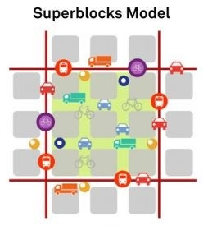
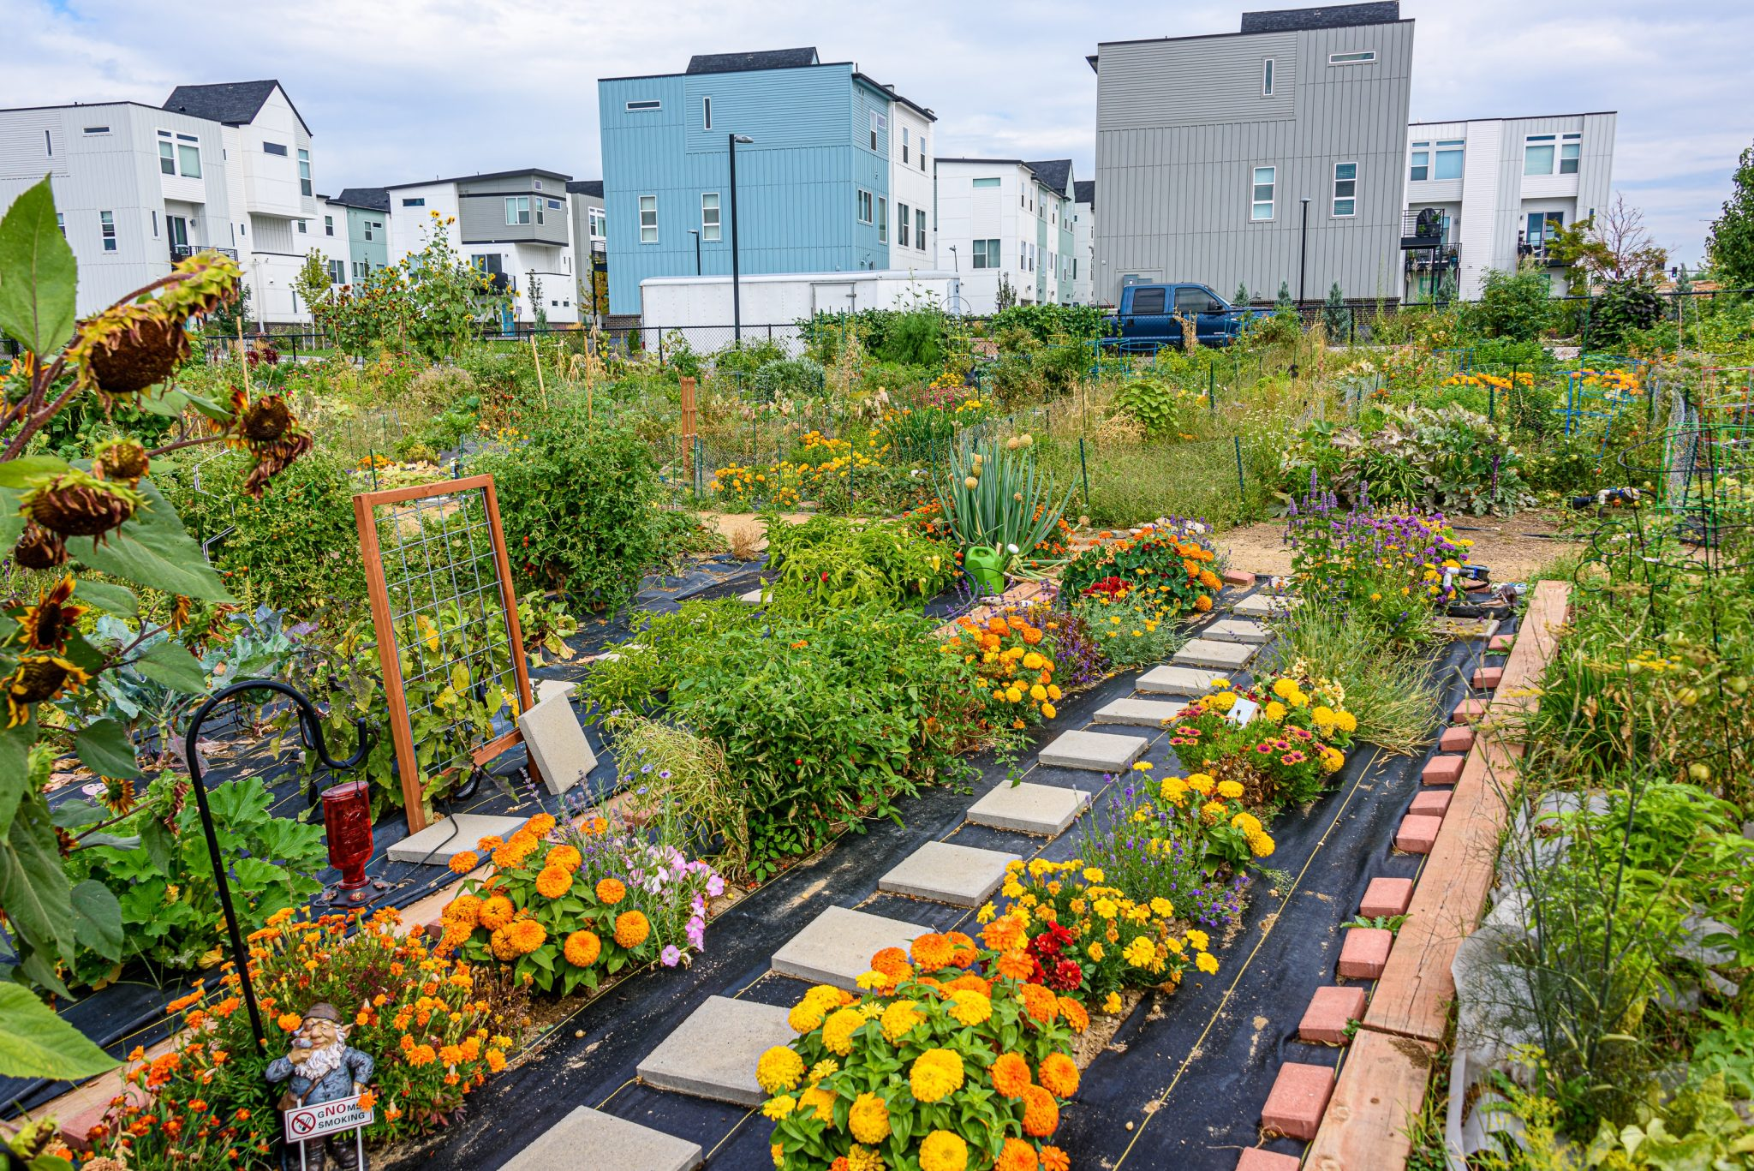
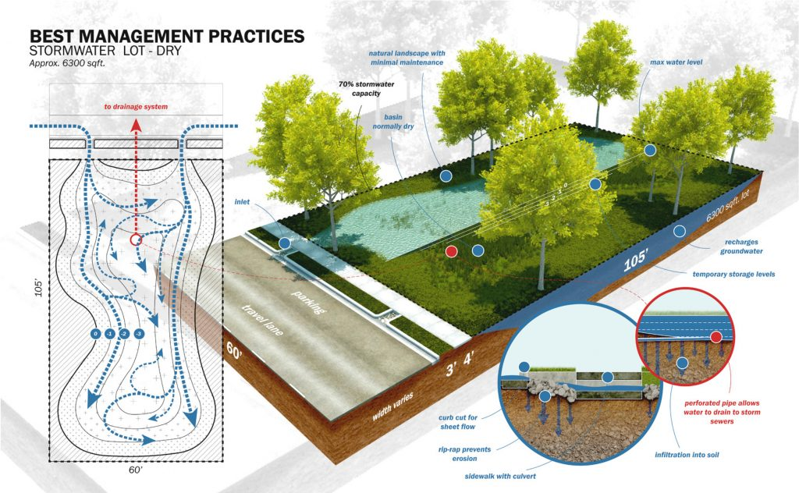



3. Regenerative Green Living Spaces
Superblock with community gardens, green roofs, and enhanced urban biodiversity
Green spaces for stormwater management and urban cooling
Seasonal agricultural plots for local food production
Notes:
Superblock:
Stormwater:
Agriculture:
Bio-gas:

Slide 8
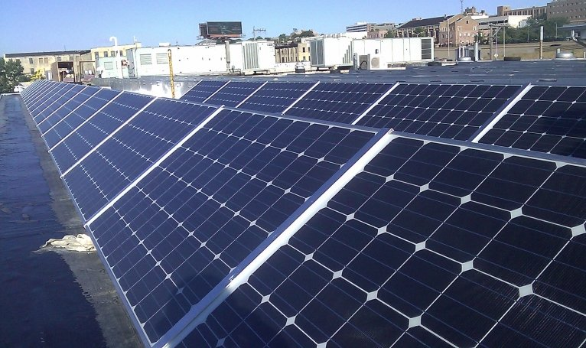
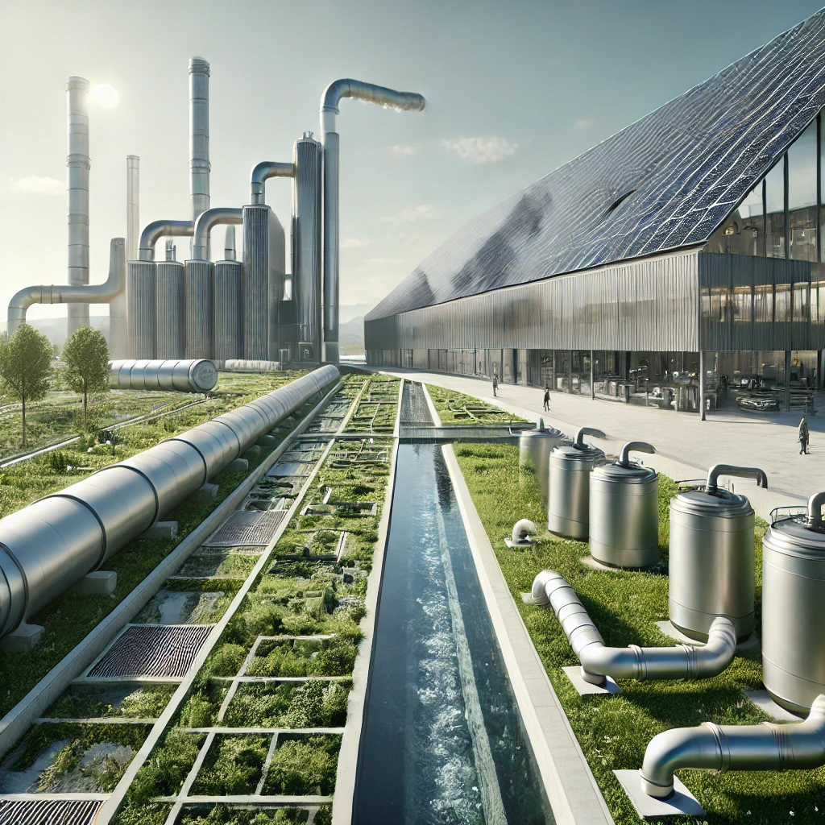
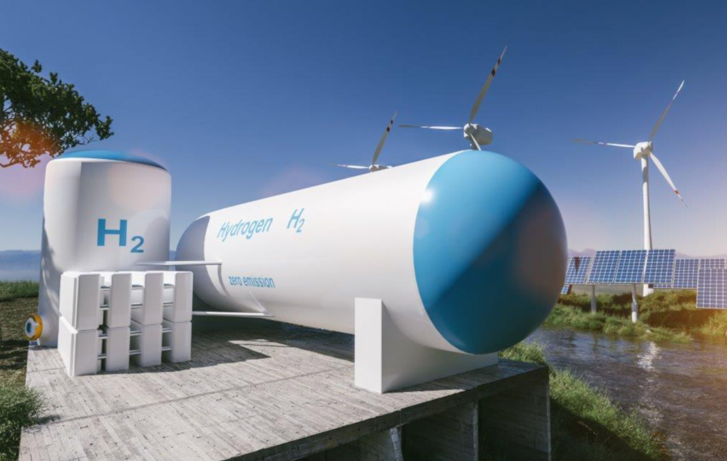
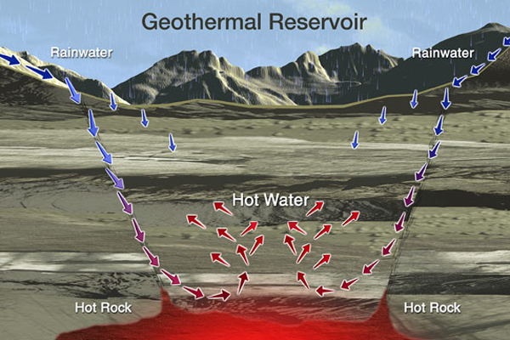
4. Green Energy & Clean Living
Plans for geothermal, solar, and hydrogen energy.
Repurposing the old factory drainage system to be used as a bio-gas digester for energy to be used in heating

Slide 9
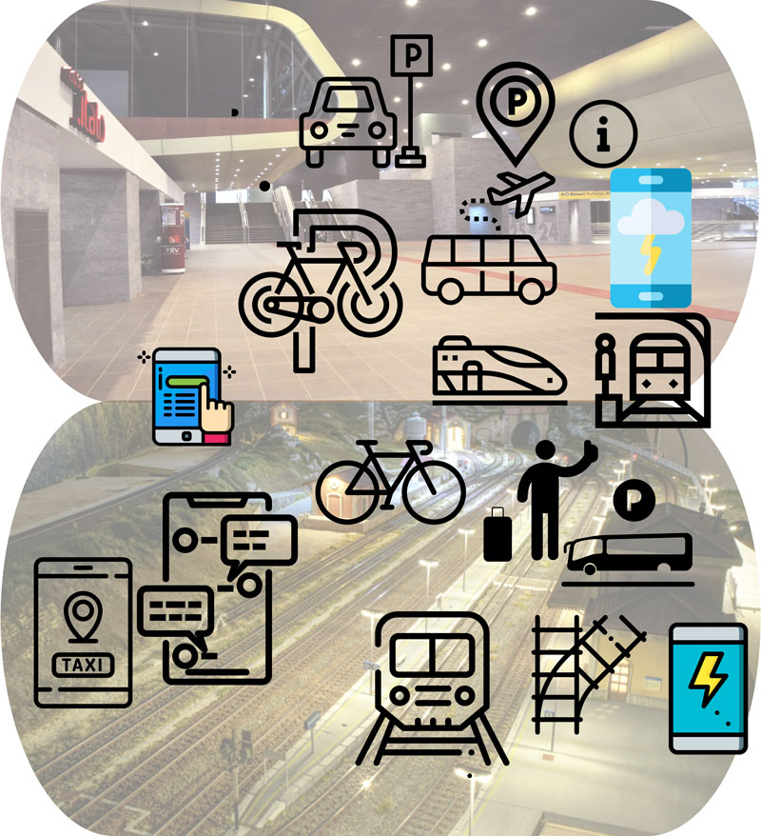
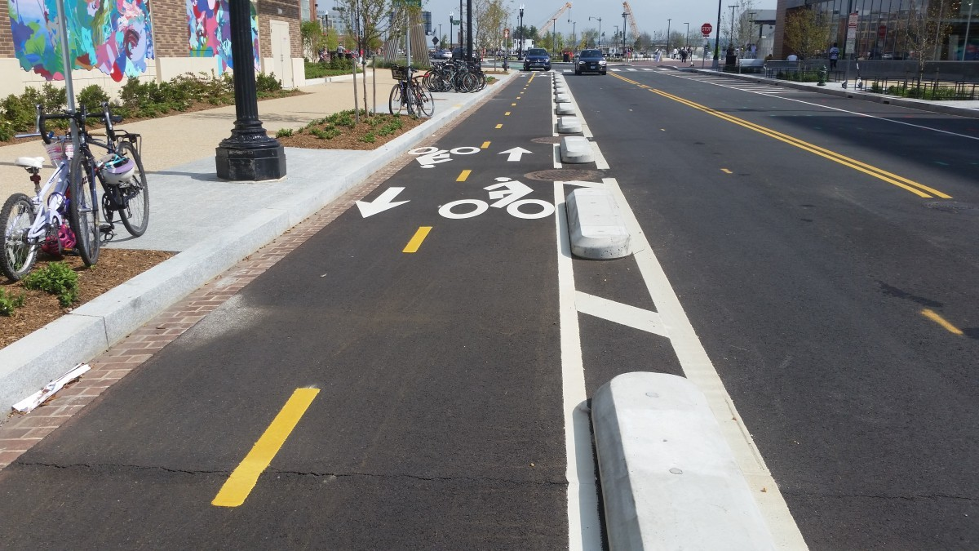
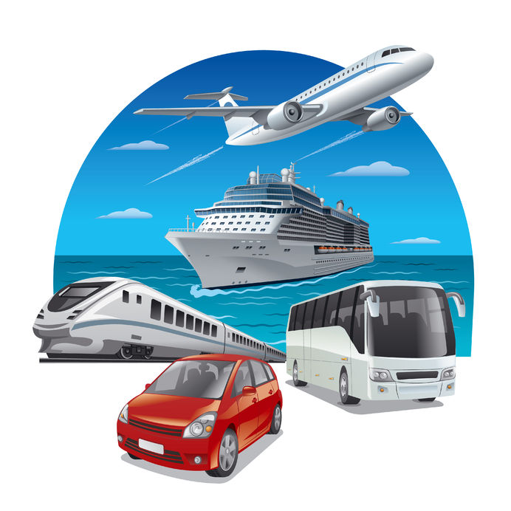
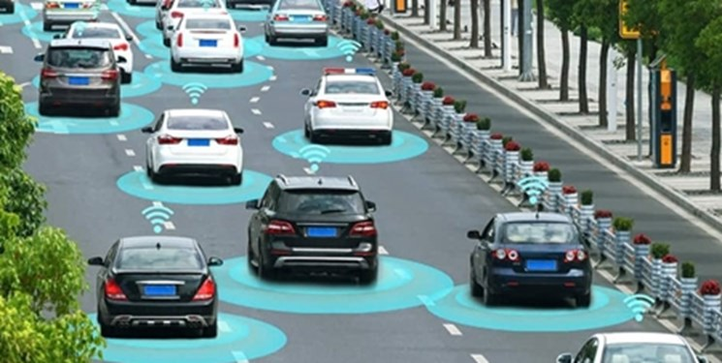




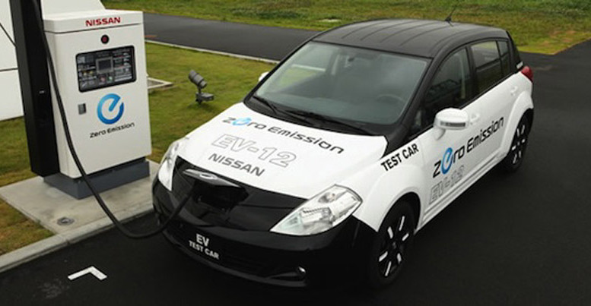
5. Green Multi Mode Transportation
Sustainable & Multi-Modal Transport
Decay city model (everything within walking/biking distance)
Electric vehicles, bike lanes, e-bike sharing and hydrogen cars.
Predictive analytics, dynamic route optimization, autonomous driving, and smarter traffic management systems

Slide 10
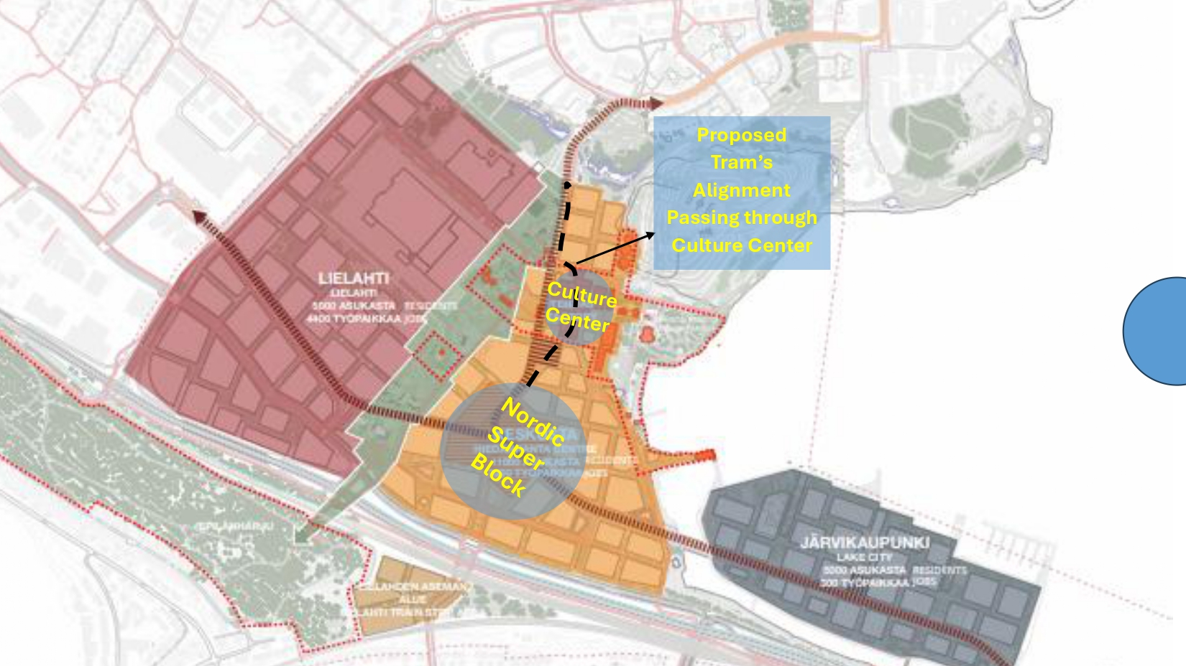
6. A Model of the Transport Design
The 3 Point Triangle Model
Parking Outside this Zone
Bike path goes through tram station
15 Minute decay model

Slide 11
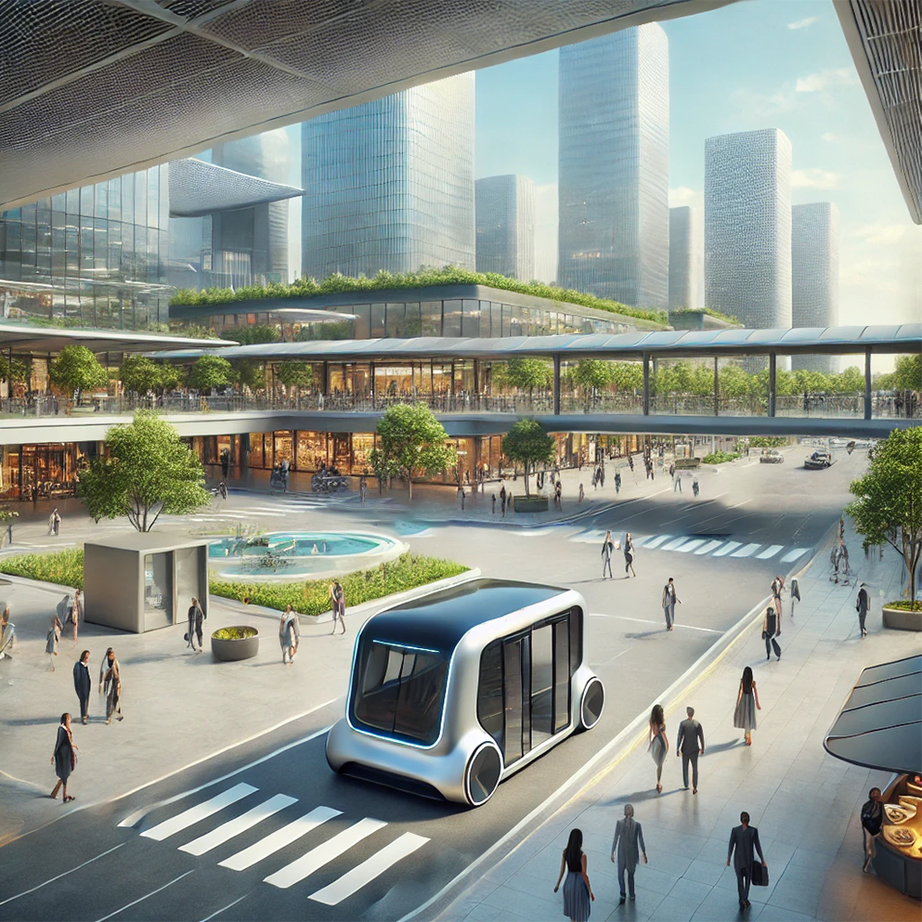
7. E-Self Autonomous AI Powered Vehicle
Parking & Charge Stations
Works with Mobility Sensors and Predictive AI
3-Stops Conforming to the 15min Decay Model
AI-powered traffic systems
shopping areas seamlessly blending with transport zones

Slide 12
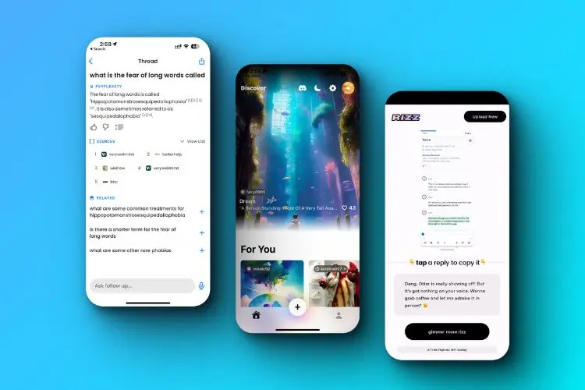
8. An AI Powered Future
An app that connects the whole of Hiednrata, a virtual map, attractions, things to do, transport schedules etc.
App experiences from the smart homes, motion sensors in the streets, carbon use tracking, events and social activities

Slide 13
Summary
Making Hiedranta a destination not just a suburb
Collaborative cultural experiences
Wellbeing
Multi Modal Transport
AI Powered future
An interconnected travel experience with Helsinki

Slide 14
Hiedanranta 2050
A Zero-Carbon Urban Oasis
Thank You

