Slide 1

TEAM 6-SIPP
PELTOLAMMI-LAKALAIVA
Ralph - Shuaib - Ammar - Richard - Nikoo

Slide 2
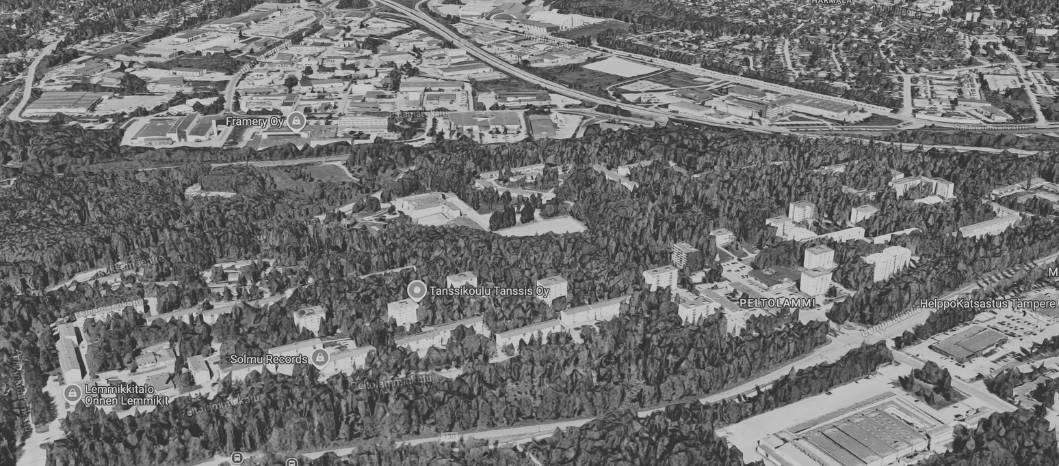
PELTOLAMMI NOW
Positives​:
  Green and blue infra​
  Nature
  Affordable housing​
  Potential development of old elementary school area​
  Interesting landscape​( Verticality, Differences in elevation ​)
Opportunities
  Lack of services and infrastructure​
  Sustainable and safe transport infrastructure​
  Low connectivity ​
  Car centric​
  Low social cohesion​
​

Slide 3
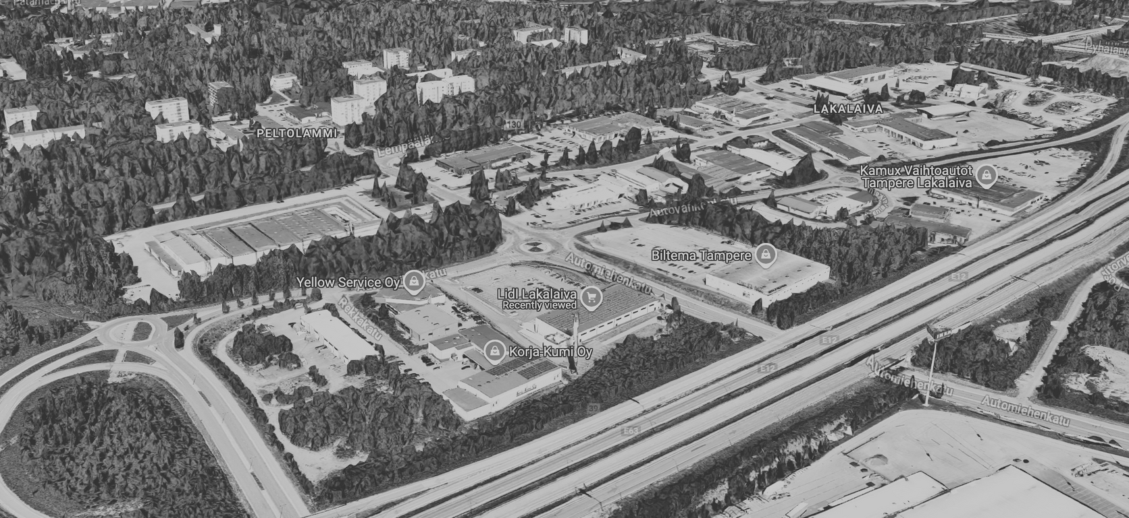
LAKALAIVA NOW
Opportunities
  Brownfield (grayfield)​ Large concrete and asphalt surfaces​
  Heat island ​
  Non-permeable surfaces
  Easy to develop​
  Can’t be much worse​
​

Slide 5
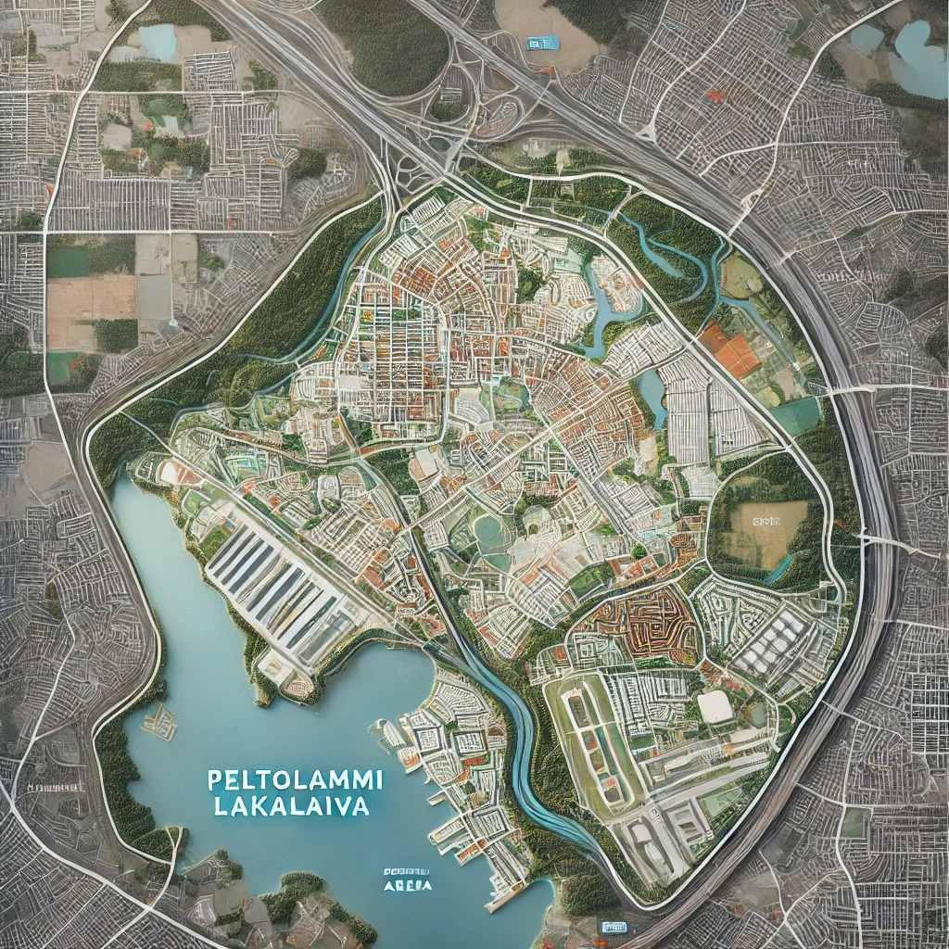
THE FUTURE of
PELTOLAMMI-LAKALAIVA

Slide 6
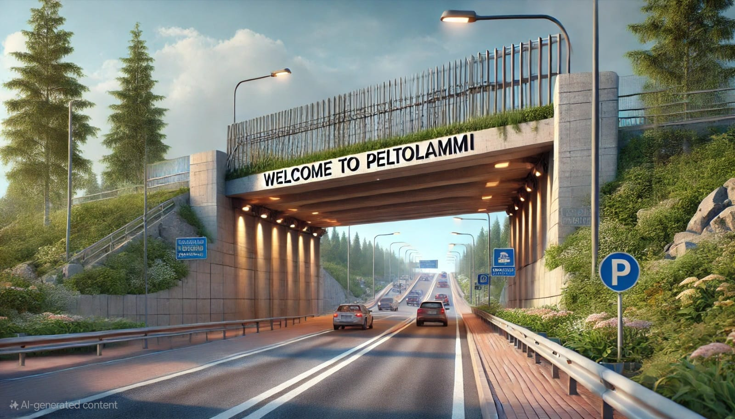
GATEWAY TO TAMPERE

Slide 7
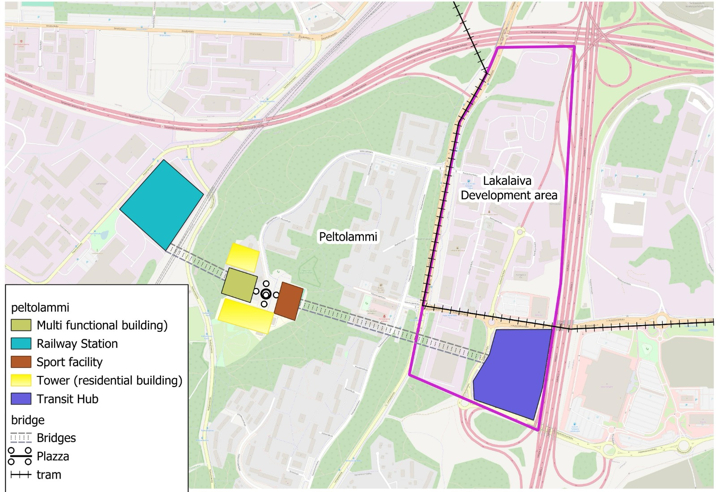
THE MASSIVE
IDEA
Main Principles
  Mixed-use​ infrastructure
  Climate change mitigation​
  Sponge cities​
  Rain gardens​
  Advanced sewers​
  Green and blue infrastructure​
  Walkability, cyclability​
​

Slide 8
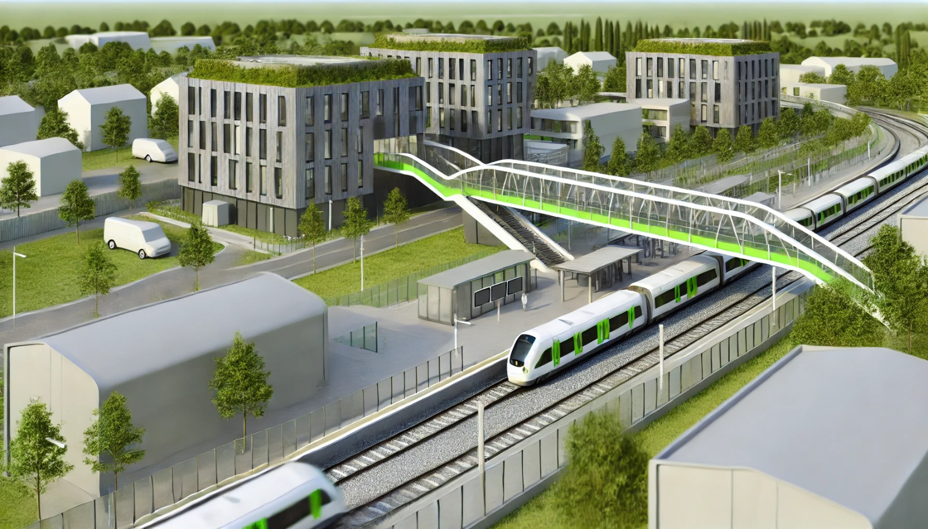
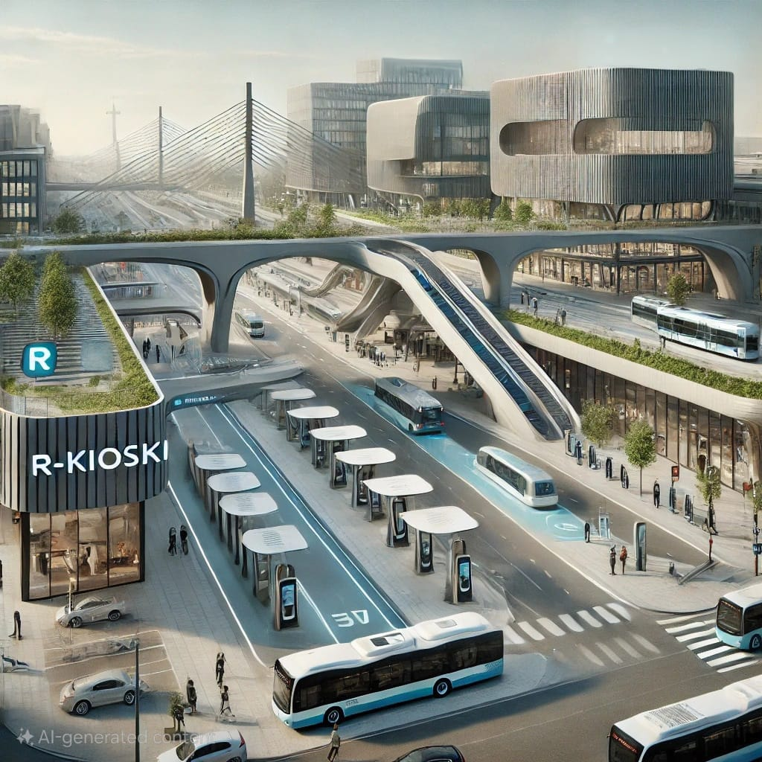

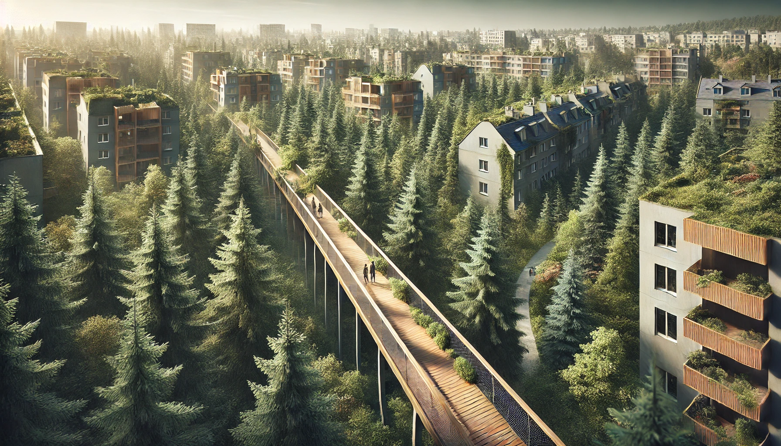
THE MASSIVE
IDEA
Main Principles
  Mixed-use​ infrastructure
  Climate change mitigation​
  Sponge cities​
  Rain gardens​
  Advanced sewers​
  Green and blue infrastructure​
  Walkability, cyclability​
​

Slide 9
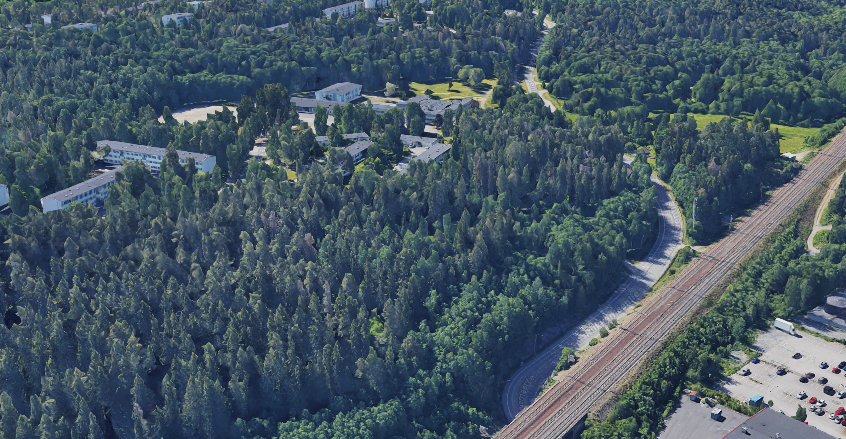
PELTOLAMMI TRAIN STOP

Slide 10
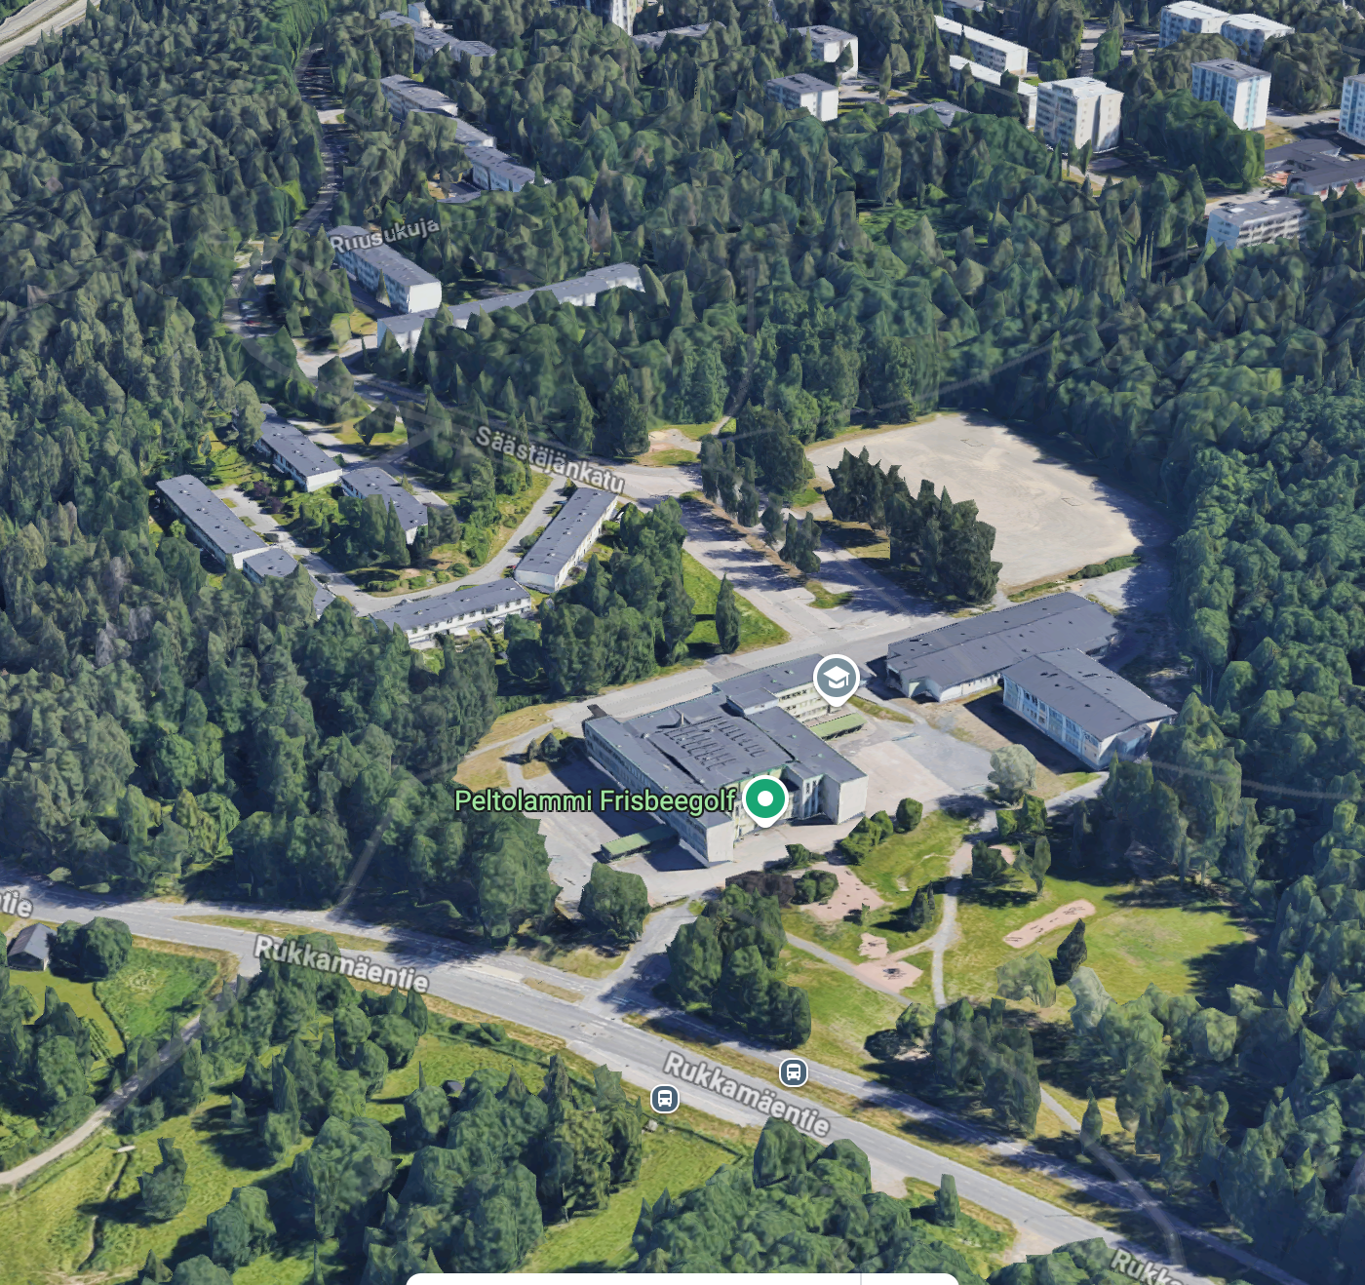
MULTI-PURPOSE HALLS/COMMUNITY CENTRES

Slide 11
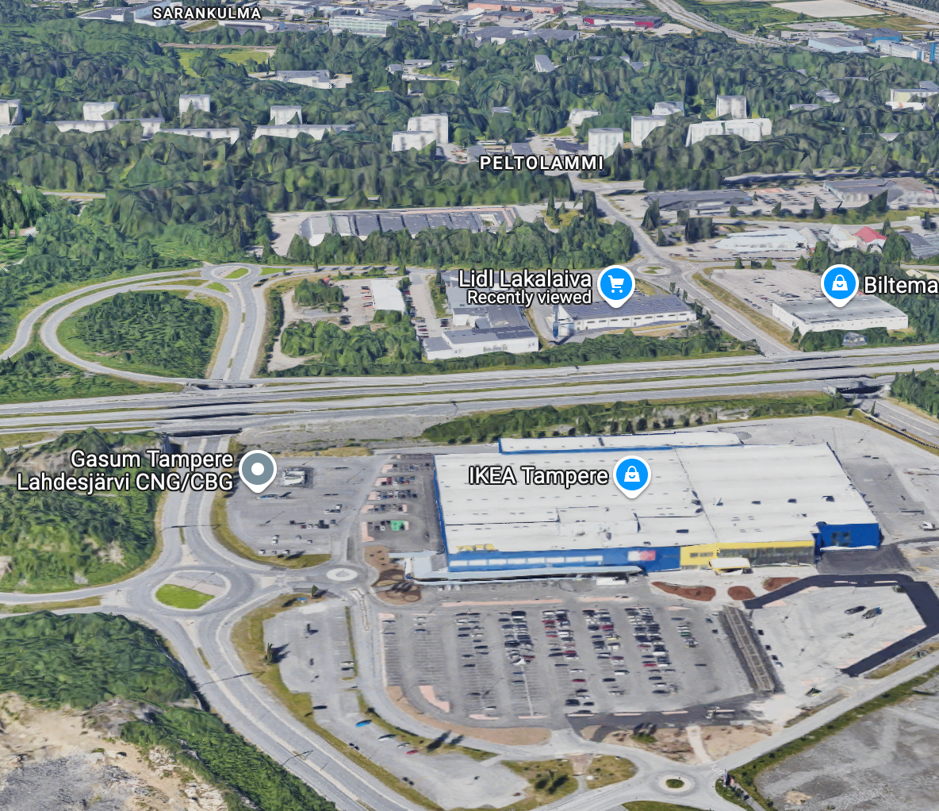
TRANSPORT HUB
Notes:
Mostly commercial and office use towards the highway​
Height gradation towards the highway to shield from the noise​
Use of acoustic isolation?​

Slide 12

How can flows between cities be harnessed to enhance urban vitality?
What do attractive and sustainable travel chains look like?
What will the future attractive regenrative urban center look like?

Slide 13

HOW DO WE ENVISION?
ATTRACTIVE, AND REGENRATIVE URBAN CENTERS

Slide 14
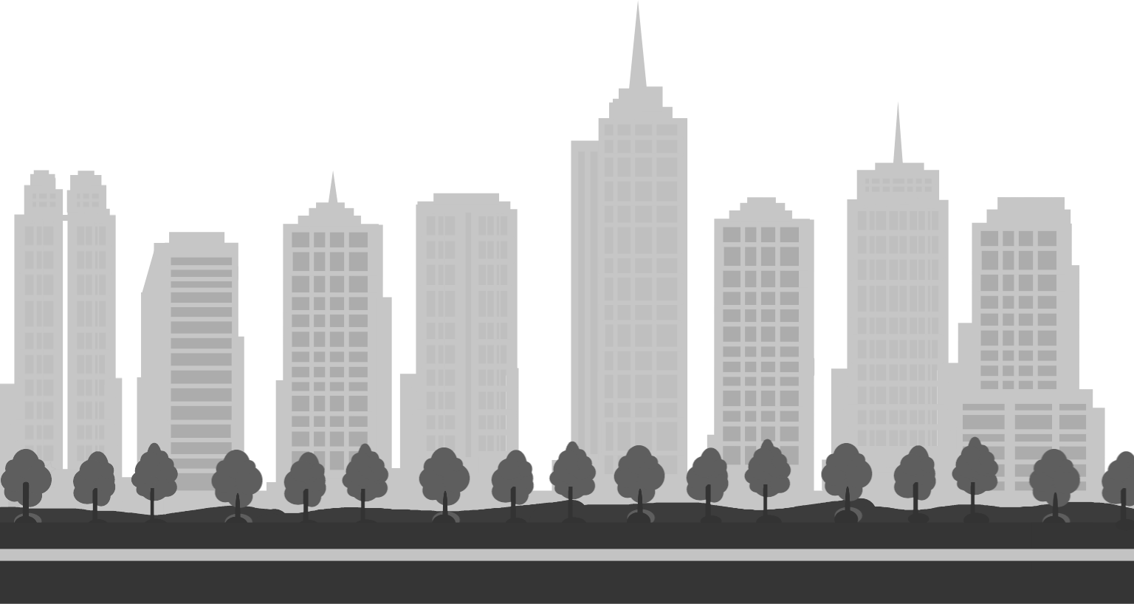


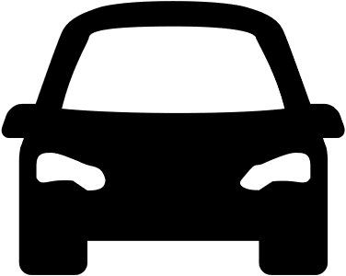



ATTRACTIVE, AND REGENRATIVE URBAN CENTERS
Accessibility and Mobility
MULTI MODAL
CAR-FREE CENTER
WALKABLE, CYCLABLE

Slide 15
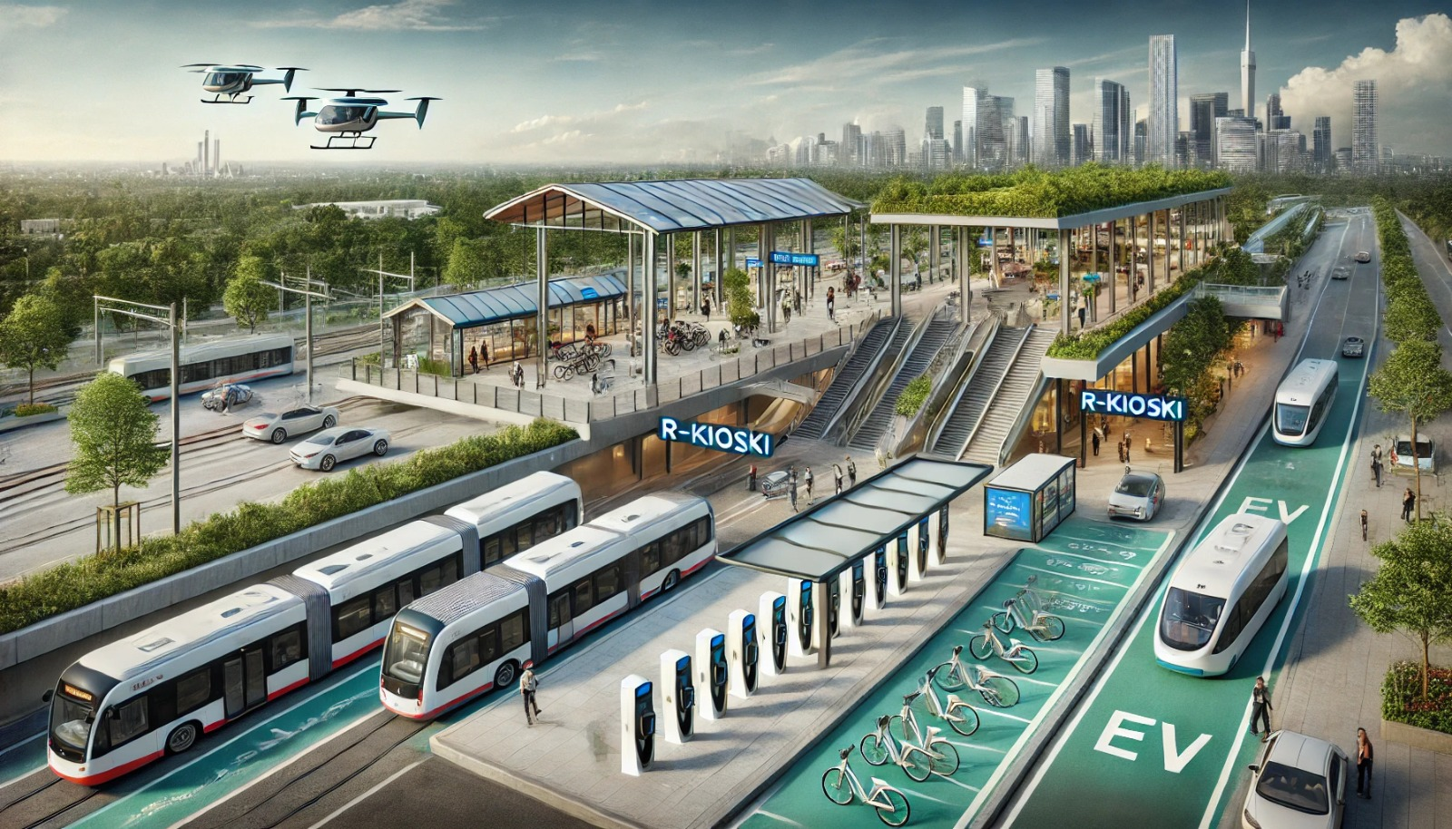
ATTRACTIVE, AND REGENRATIVE URBAN CENTERS
Accessibility
MULTI MODAL
Notes:
Solutions​
Mixed-use 15-minute brownfield development​
Wood construction​
Built around a tramline​

Slide 16
ATTRACTIVE, AND REGENRATIVE URBAN CENTERS
Accessibility
CAR-FREE CENTER
WALKABLE, CYCLABLE

Slide 17
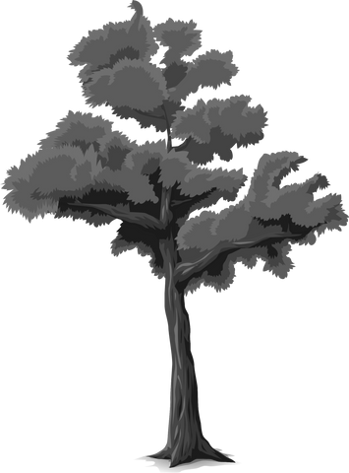
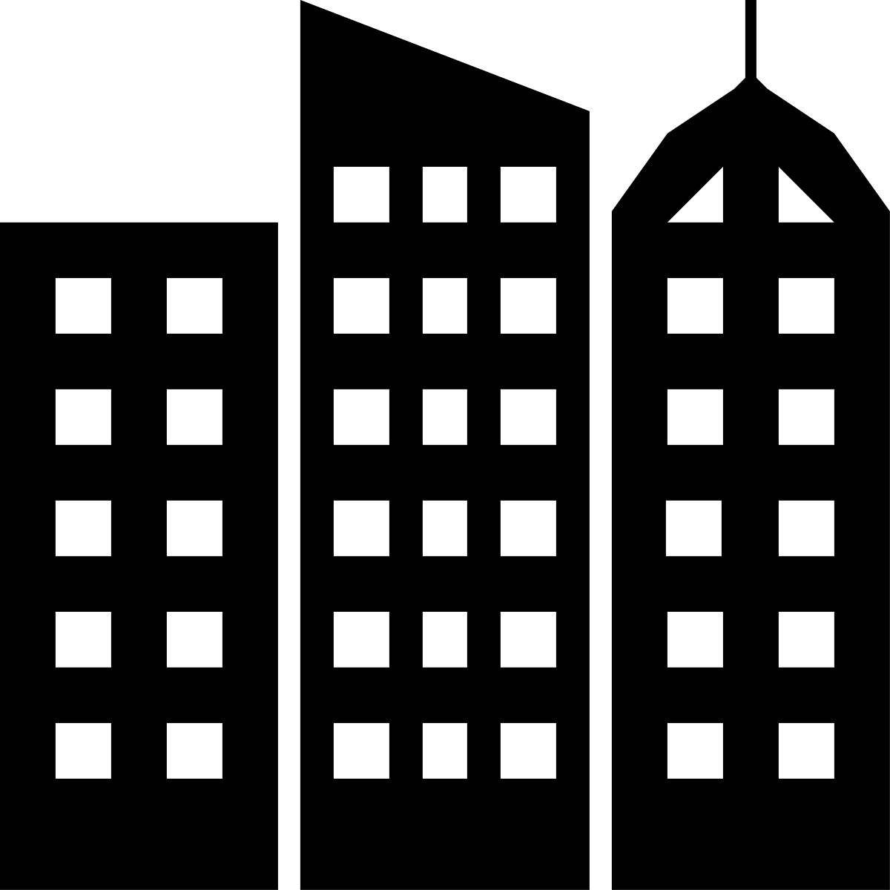



ATTRACTIVE, AND REGENRATIVE URBAN CENTERS
Connected to Nature
URBAN GREENERY
SPONGE NEIGHBORHOODS
NATURE ACCESSIBILITY

Slide 18
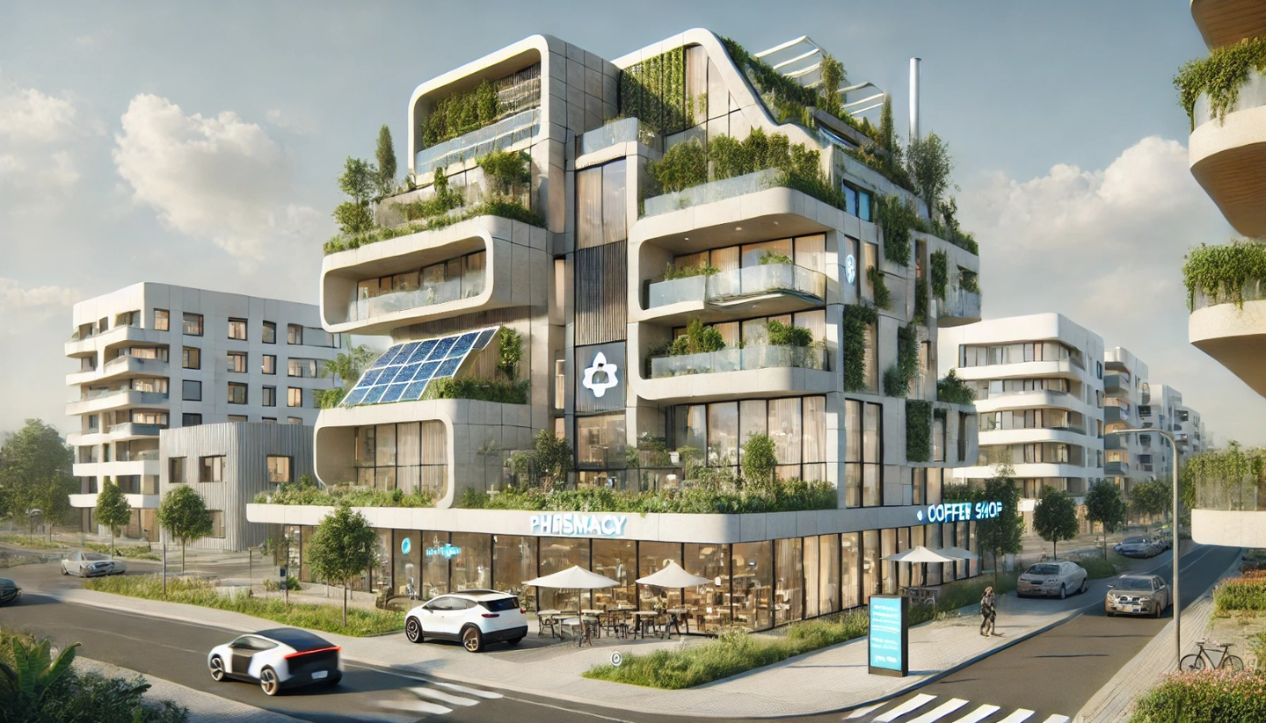

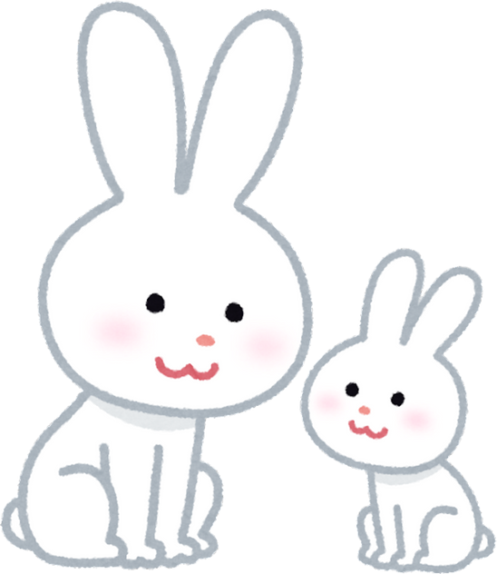
ATTRACTIVE, AND REGENRATIVE URBAN CENTERS
Connected to Nature
URBAN GREENERY
Dont Forget about us! Thanks :)
Notes:
Urban greenery​
Access to nature​
Biodiversity (accessibility for non-humans)​
Urban farming?​
Sponge cities – water absorption and management​

Slide 19
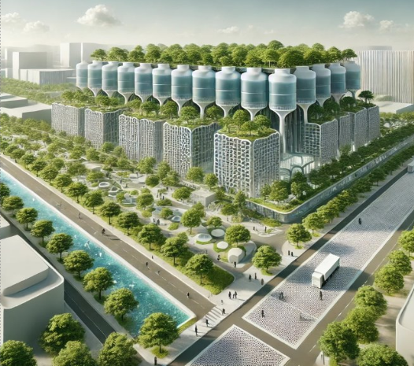
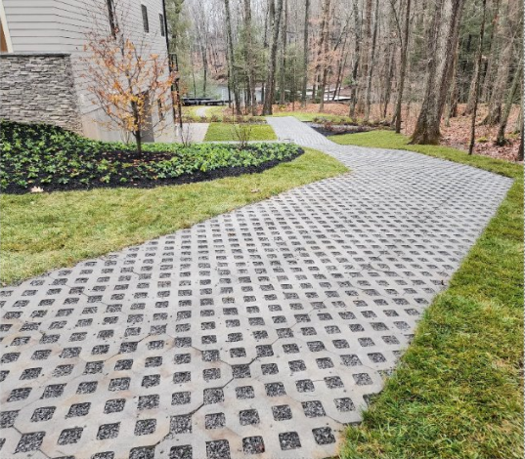
ATTRACTIVE, AND REGENRATIVE URBAN CENTERS
Connected to Nature
SPONGE NEIGHBORHOOD

Slide 20
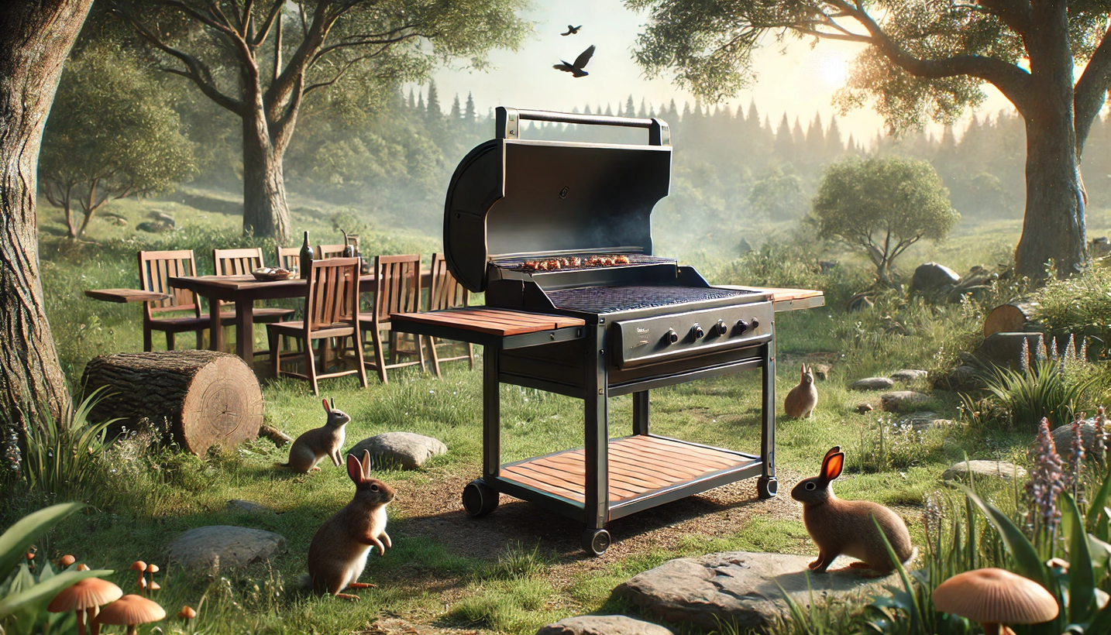
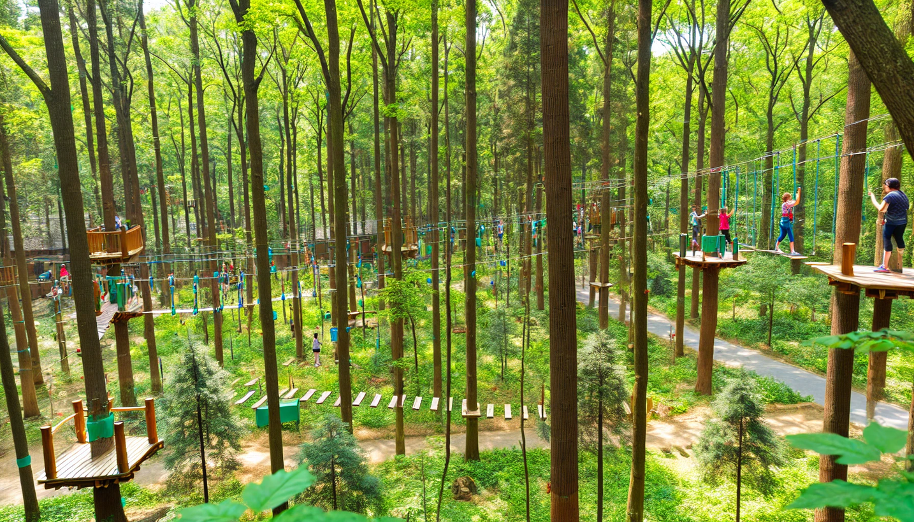
ATTRACTIVE, AND REGENRATIVE URBAN CENTERS
Connected to Nature
NATURE ACCESSIBILITY

Slide 21



ATTRACTIVE, AND REGENRATIVE URBAN CENTERS
Community-Driven
SHARED AMENITIES
COMMUNITY CENTERS
ACTIVE STREETS

Slide 22
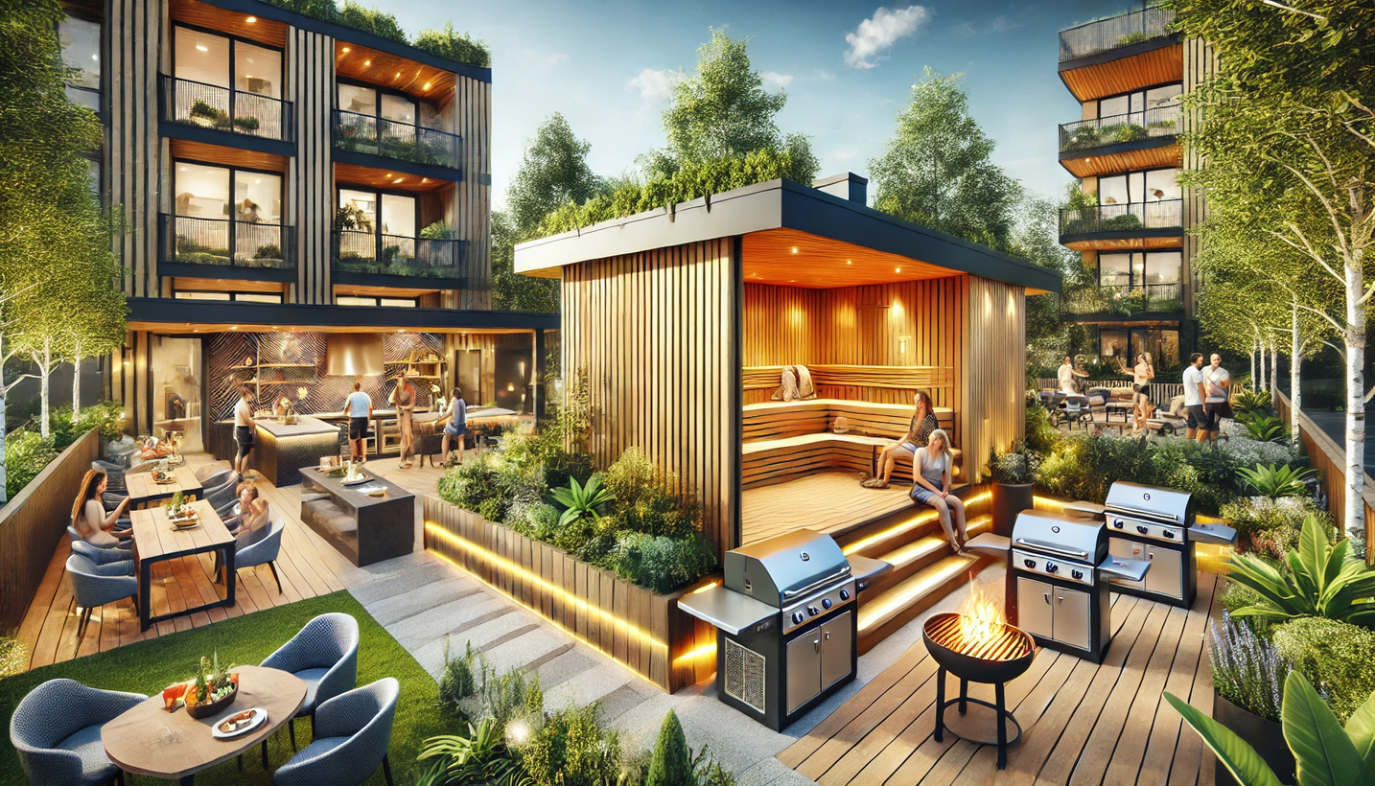
ATTRACTIVE, AND REGENRATIVE URBAN CENTERS
Community-Driven
SHARED AMENITIES
Notes:
Recreation and communal areas in the forests ​
Gardens, fireplaces, rope park?​
Gives locals reason to spend time in the neighborhood​
Improves community and character of neighborhood​

Slide 23
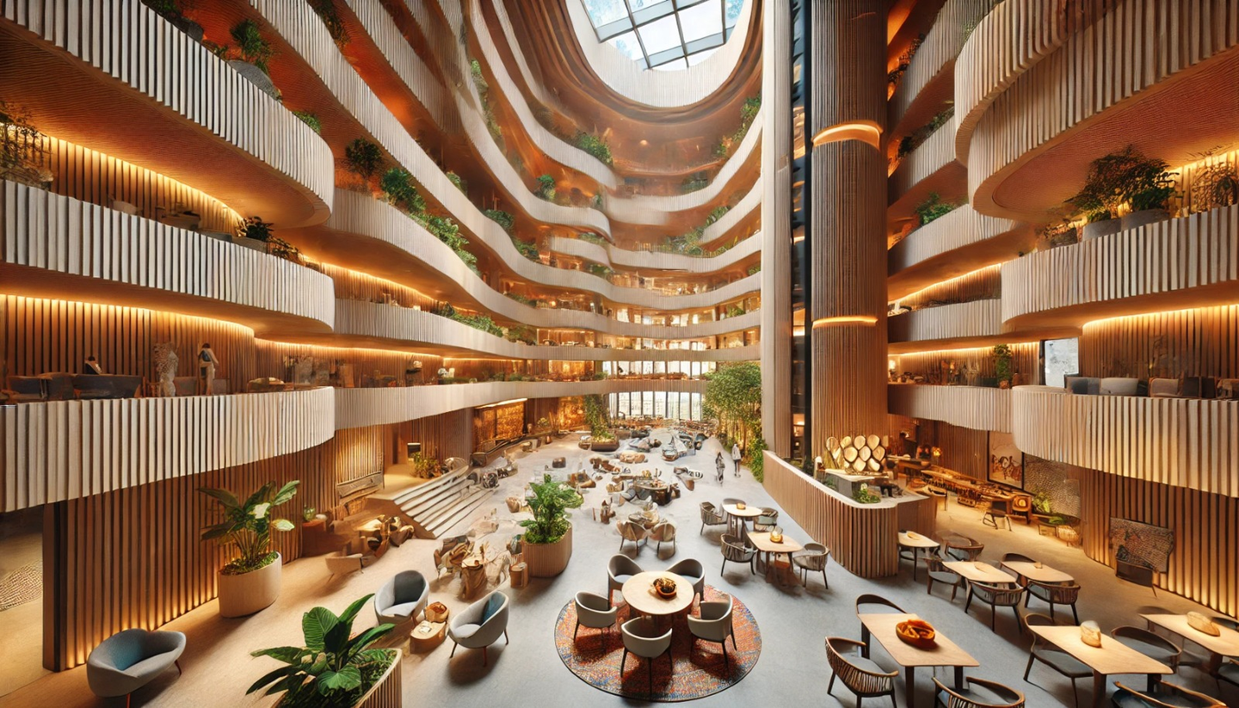
ATTRACTIVE, AND REGENRATIVE URBAN CENTERS
Community-Driven
COMMUNITY CENTERS

Slide 24
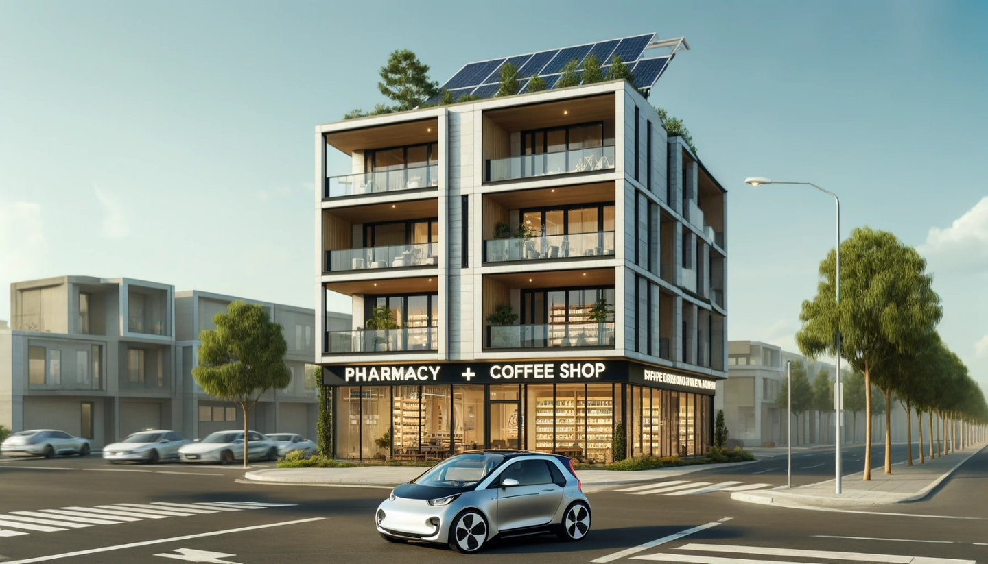
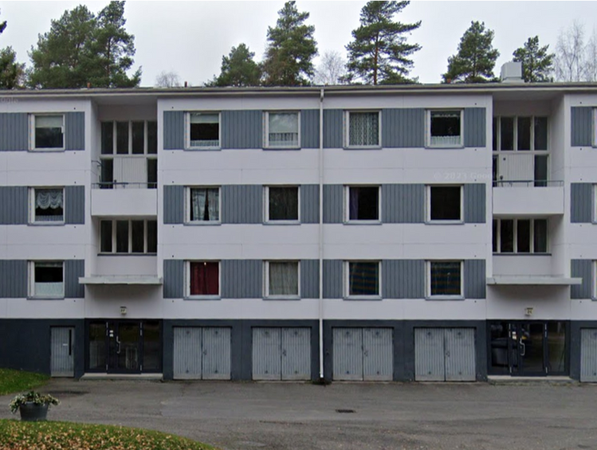
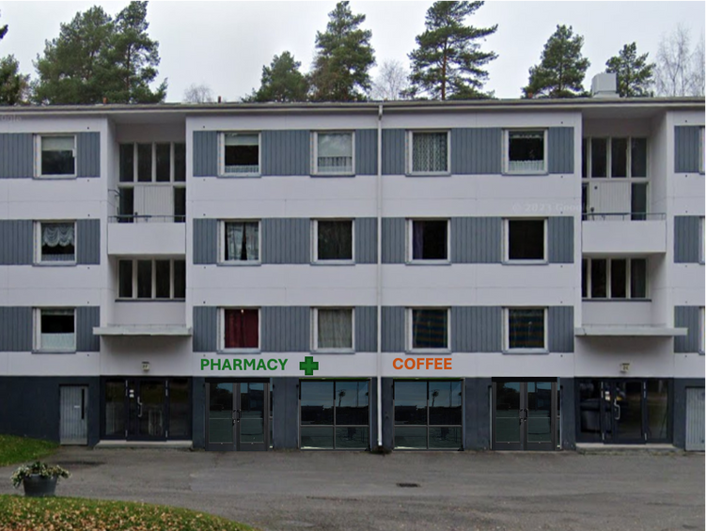
ATTRACTIVE, AND REGENRATIVE URBAN CENTERS
Community-Driven
ACTIVE STREETS
CURRENT
VISION
Notes:
Adding services to the groundfloor of existing buildings​
Grants for owners to set up businesses​
Assistance of the city in renting the spaces to businesses​

Slide 25
HOW DO WE ENVISION?
ATTRACTIVE SUSTAINABLE TRANSPORT CHAINS?

Slide 26





ATTRACTIVE SUSTAINABLE TRANSPORT CHAINS
ELECTRIFICATION OF VEHICLES
AFFORDABLE PUBLIC TRANSPORT
ECO-CORRIDORS
SEAMLESS TRANSPORT
ATTRACTIVE RAILWAYS

Slide 27
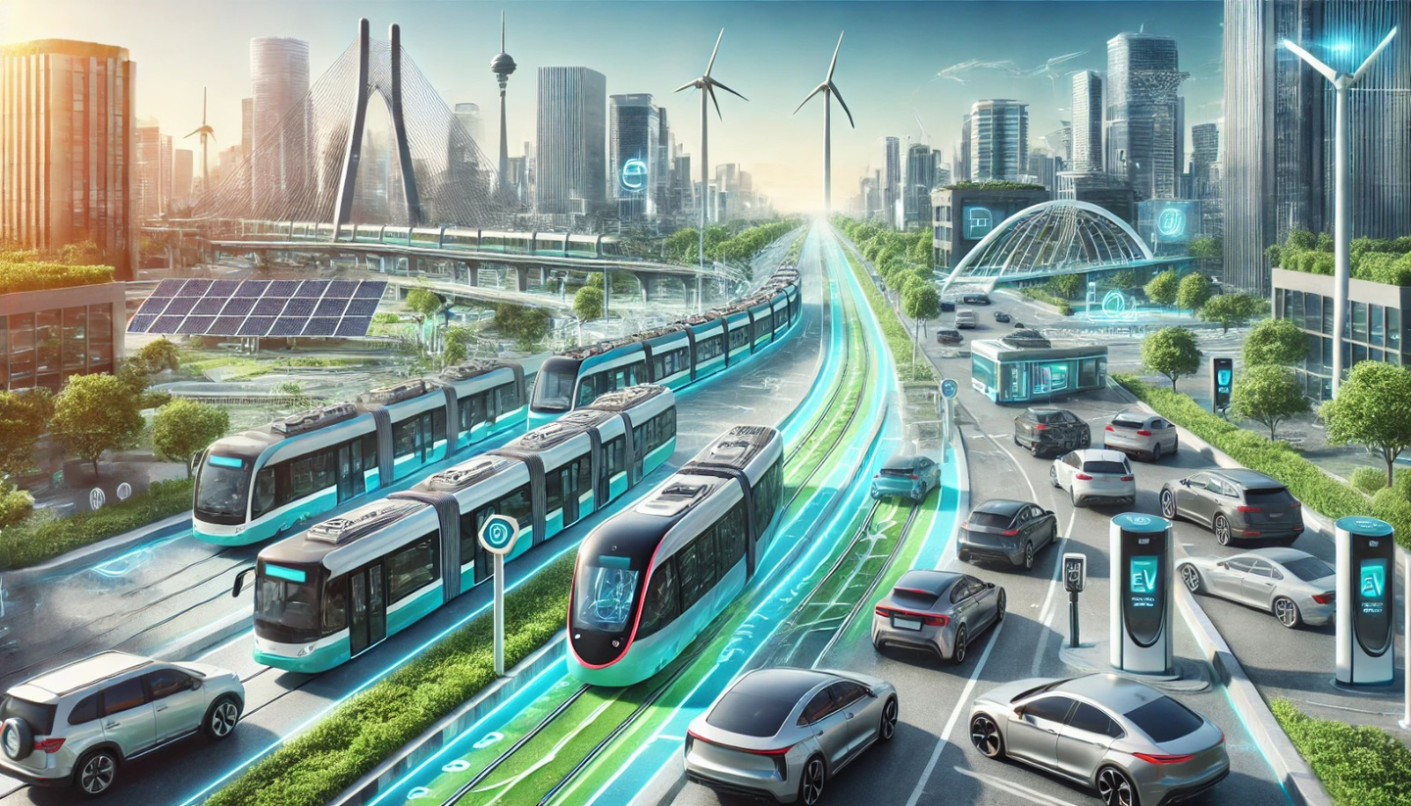
ATTRACTIVE SUSTAINABLE TRANSPORT CHAINS
ELECTRIFICATION OF VEHICLES

Slide 28
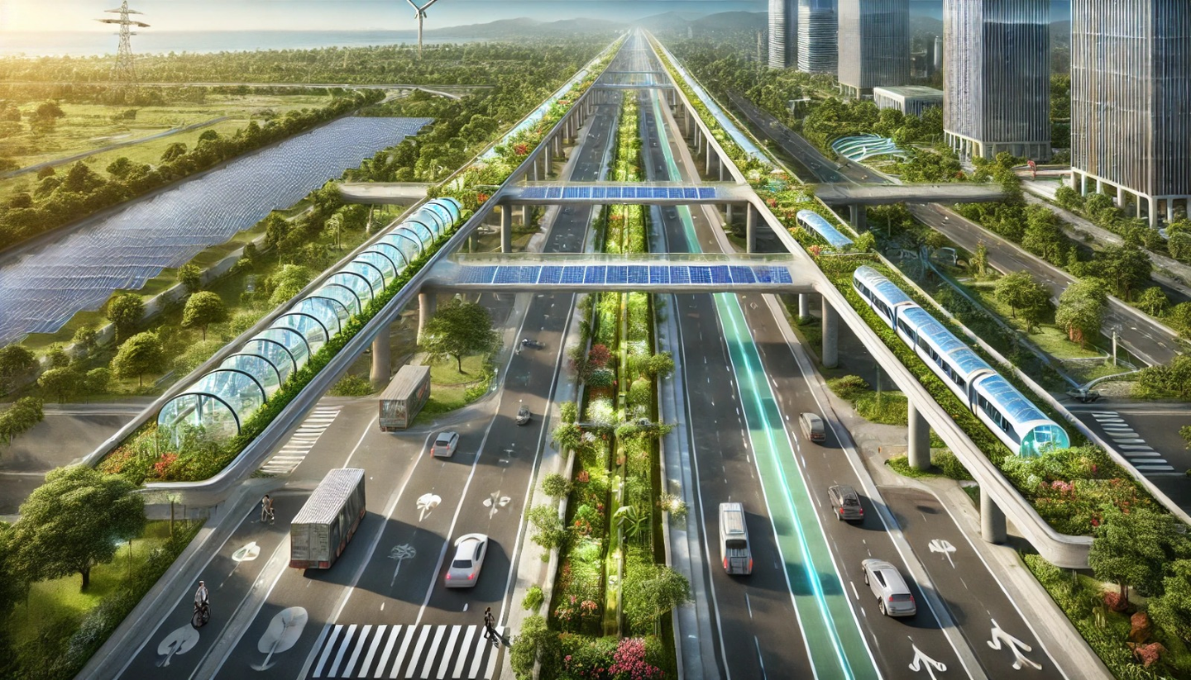
ATTRACTIVE SUSTAINABLE TRANSPORT CHAINS
ECO-CORRIDORS

Slide 29
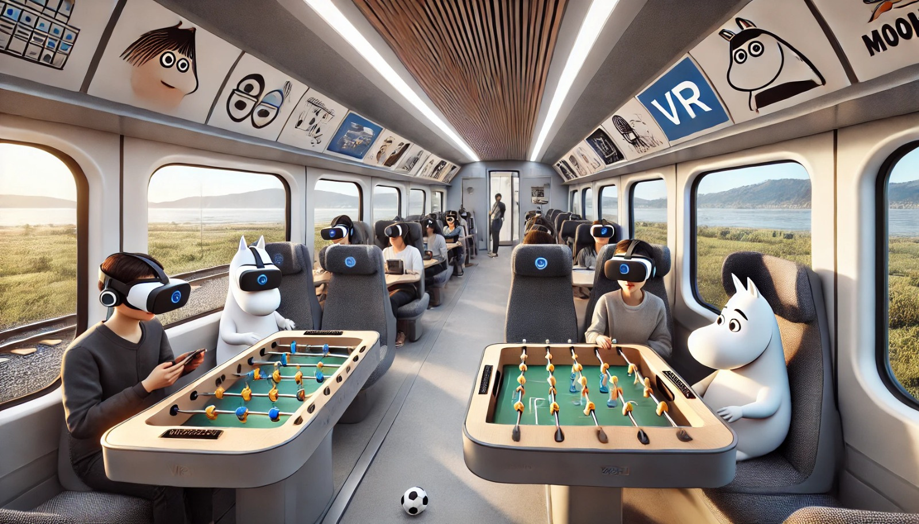

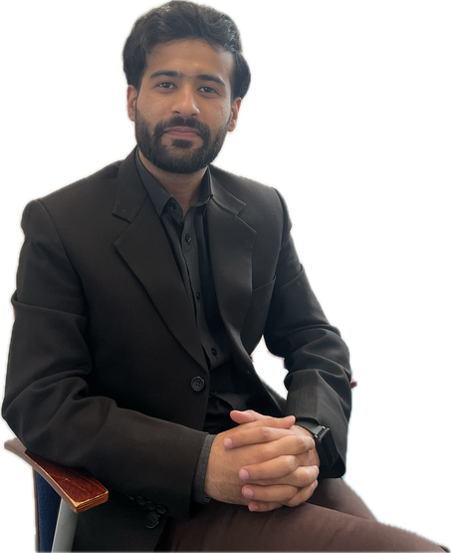
ATTRACTIVE SUSTAINABLE TRANSPORT CHAINS
This future is nice!
ATTRACTIVE RAILWAYS

Slide 30
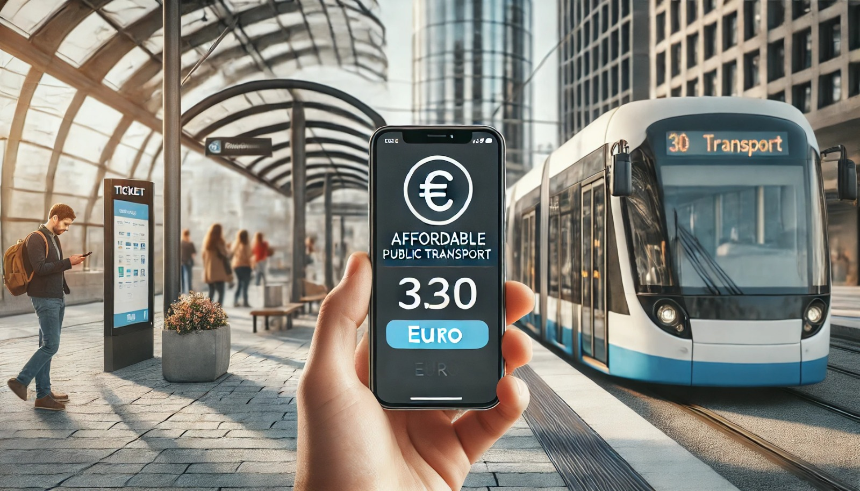

ATTRACTIVE SUSTAINABLE TRANSPORT CHAINS
BUY
AFFORDABLE PUBLIC TRANSPORT

Slide 31
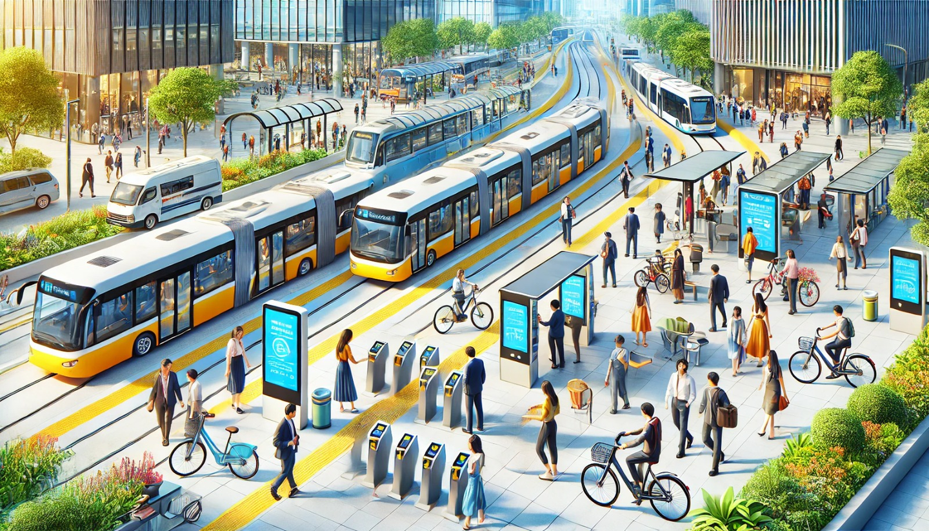
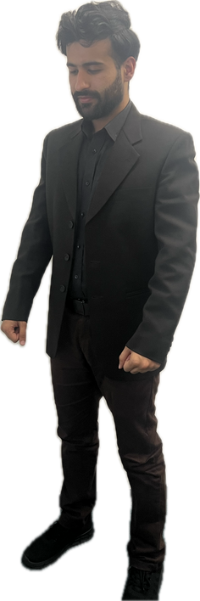
ATTRACTIVE SUSTAINABLE TRANSPORT CHAINS
WOW! SO SEAMLESS! I was just at the train earlier now Im so close to my destination
SEAMLESS TRANSPORT

Slide 32
HOW DO WE ENVISION?
ENHANCED FLOW BETWEEN CITIES TO IMPROVE URBAN VITALITY

Slide 33
ENHANCED FLOW BETWEEN CITIES TO IMPROVE URBAN VITALITY
TRANSPORT HUB

Slide 34
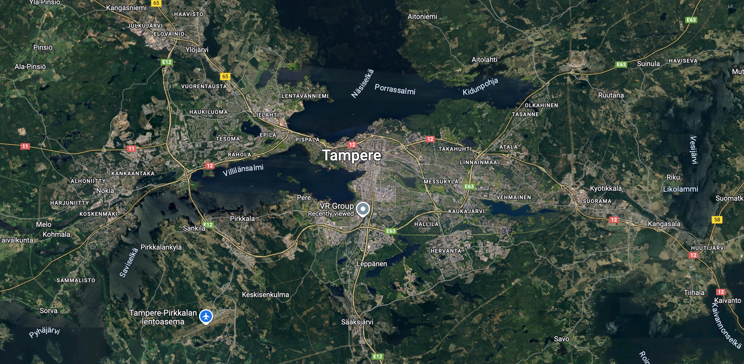


Slide 35

TRANSPORT HUB
  Train Stop - Direct connection to the Intercity/Commuter Trains​
  Hub with bus and Tram connections
  Park and Ride and Station
  Direct connection to major highways
​
Notes:
Addressing the somewhat difficult topography and crossing barriers (roads, railway)​ Pedestrian, bicycles and micromobility ​ Automated movers/travelators​ Attractive biophilic design​ Wooden construction​ Covered in the winter​ Practical connections to ground level​

Slide 37
THE MASSIVE
IDEA
Main Principles
  Mixed-use​ infrastructure
  Climate change mitigation​
  Sponge cities​
  Rain gardens​
  Advanced sewers​
  Green and blue infrastructure​
  Walkability, cyclability​
​

Slide 38
GATEWAY TO TAMPERE

