Slide 1
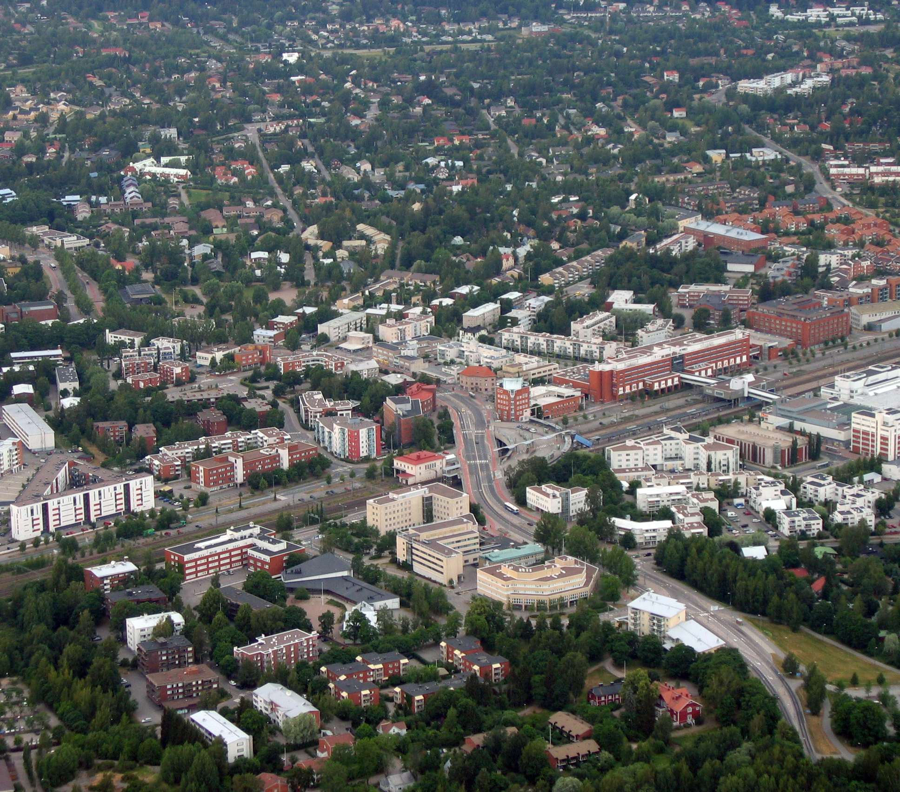
Malmi,
Helsingforce x
72h Ramboll Challenge

Slide 2
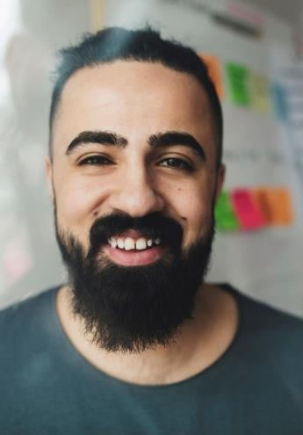
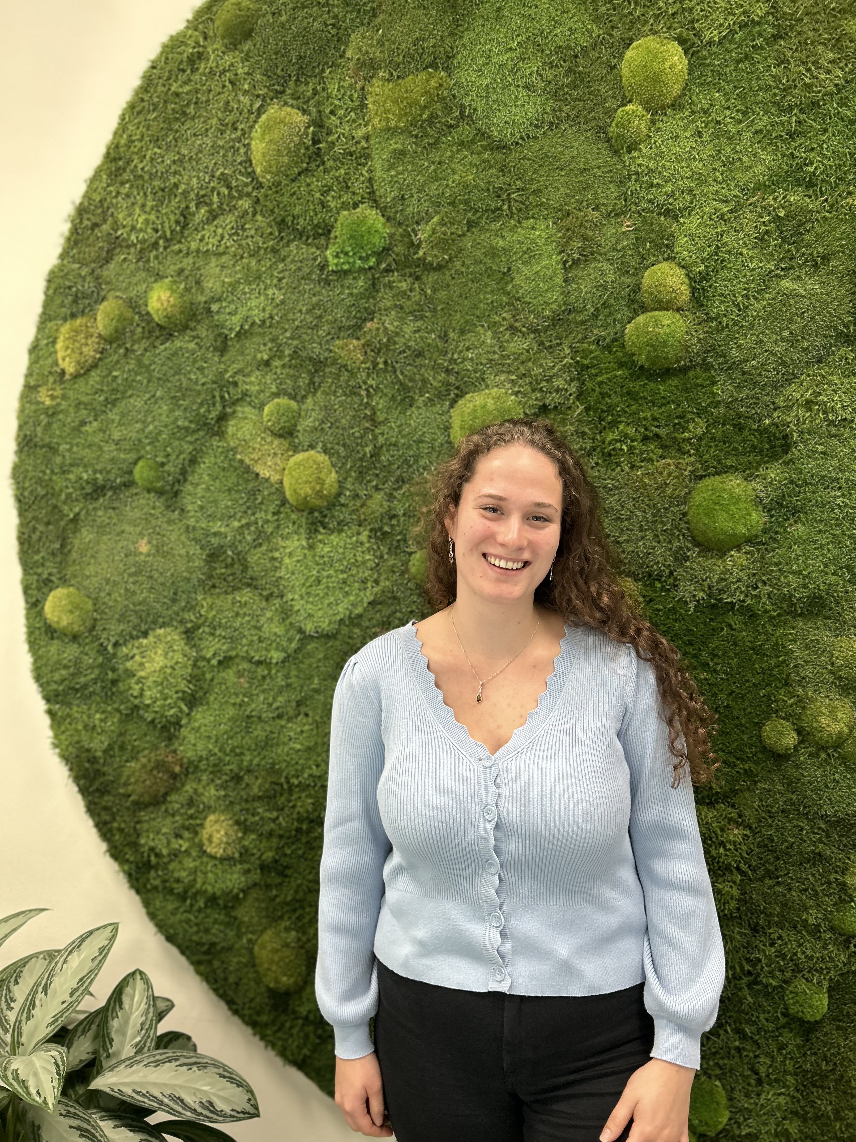
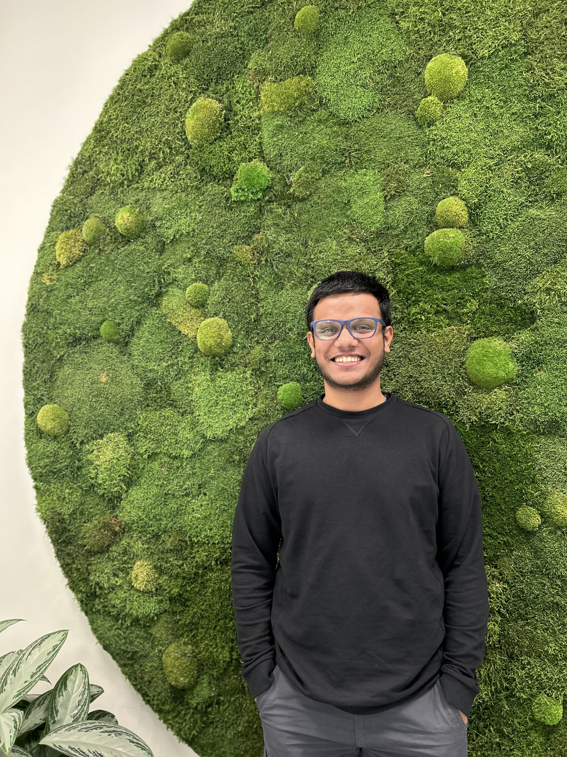
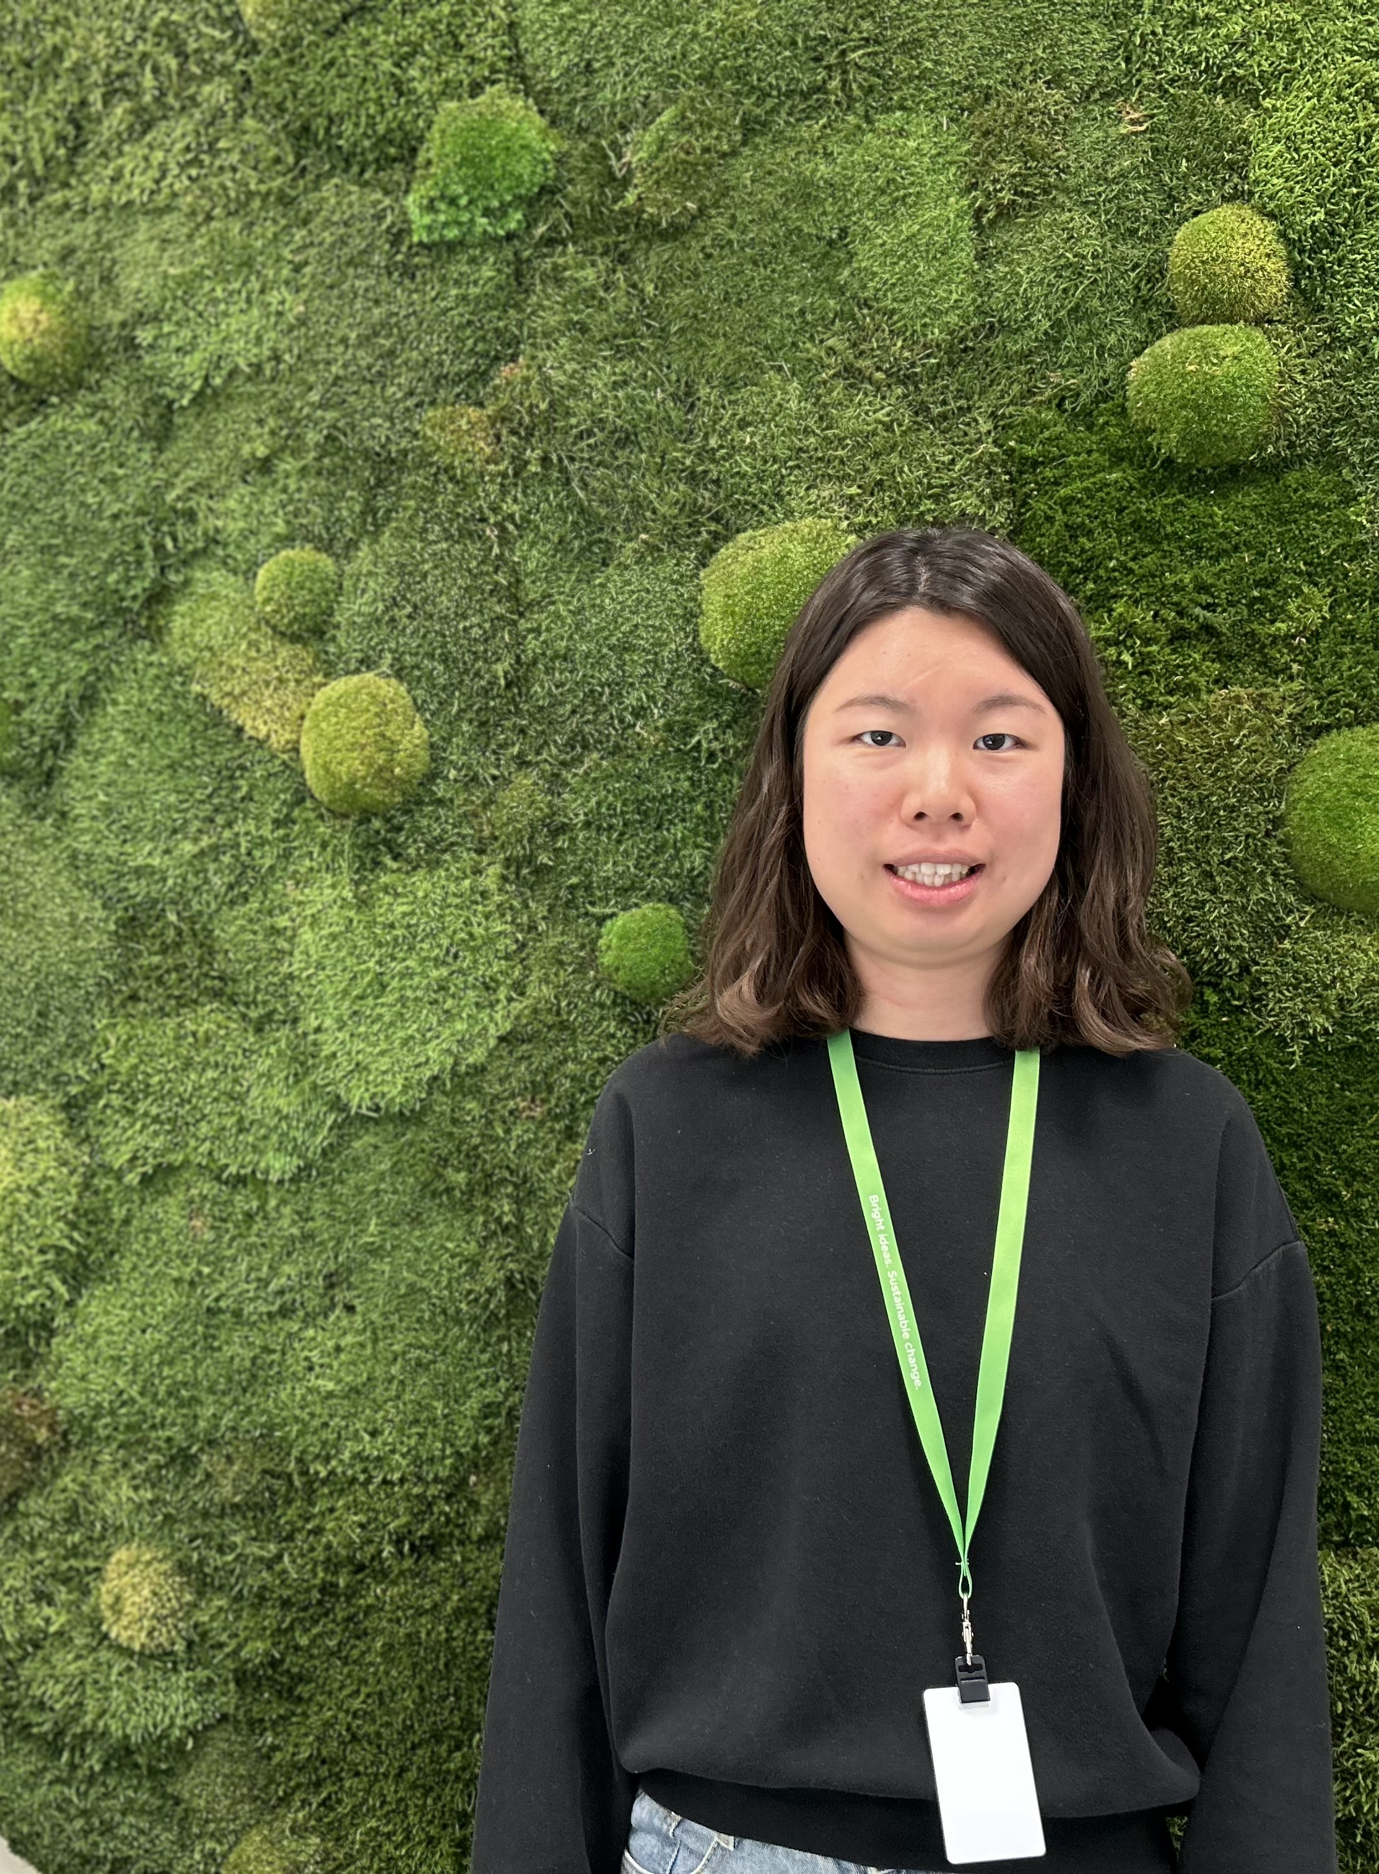
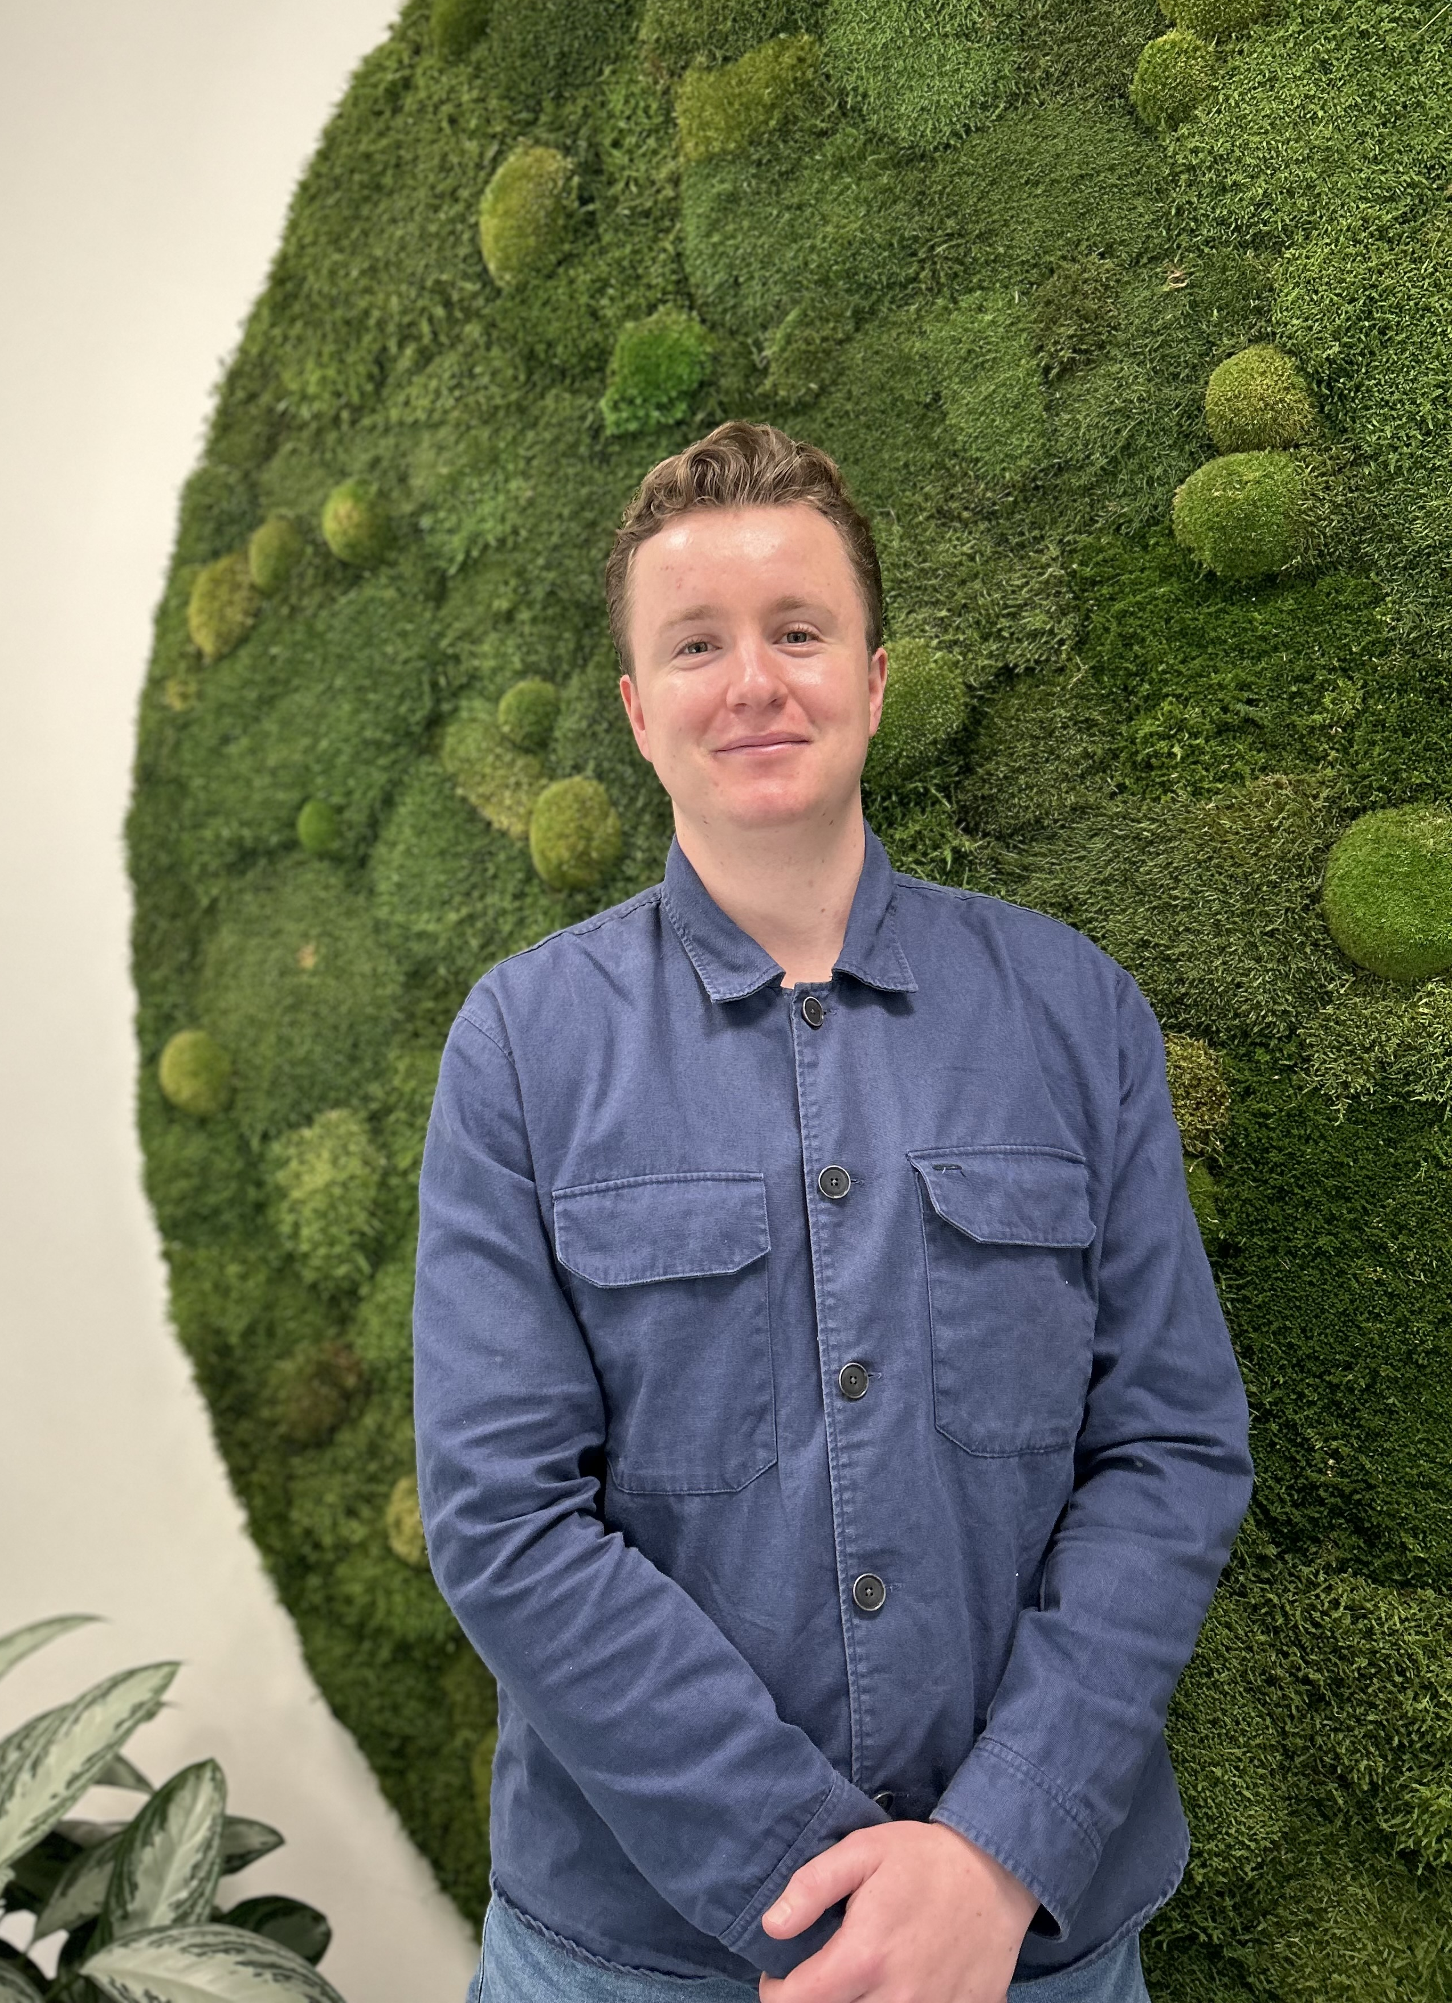
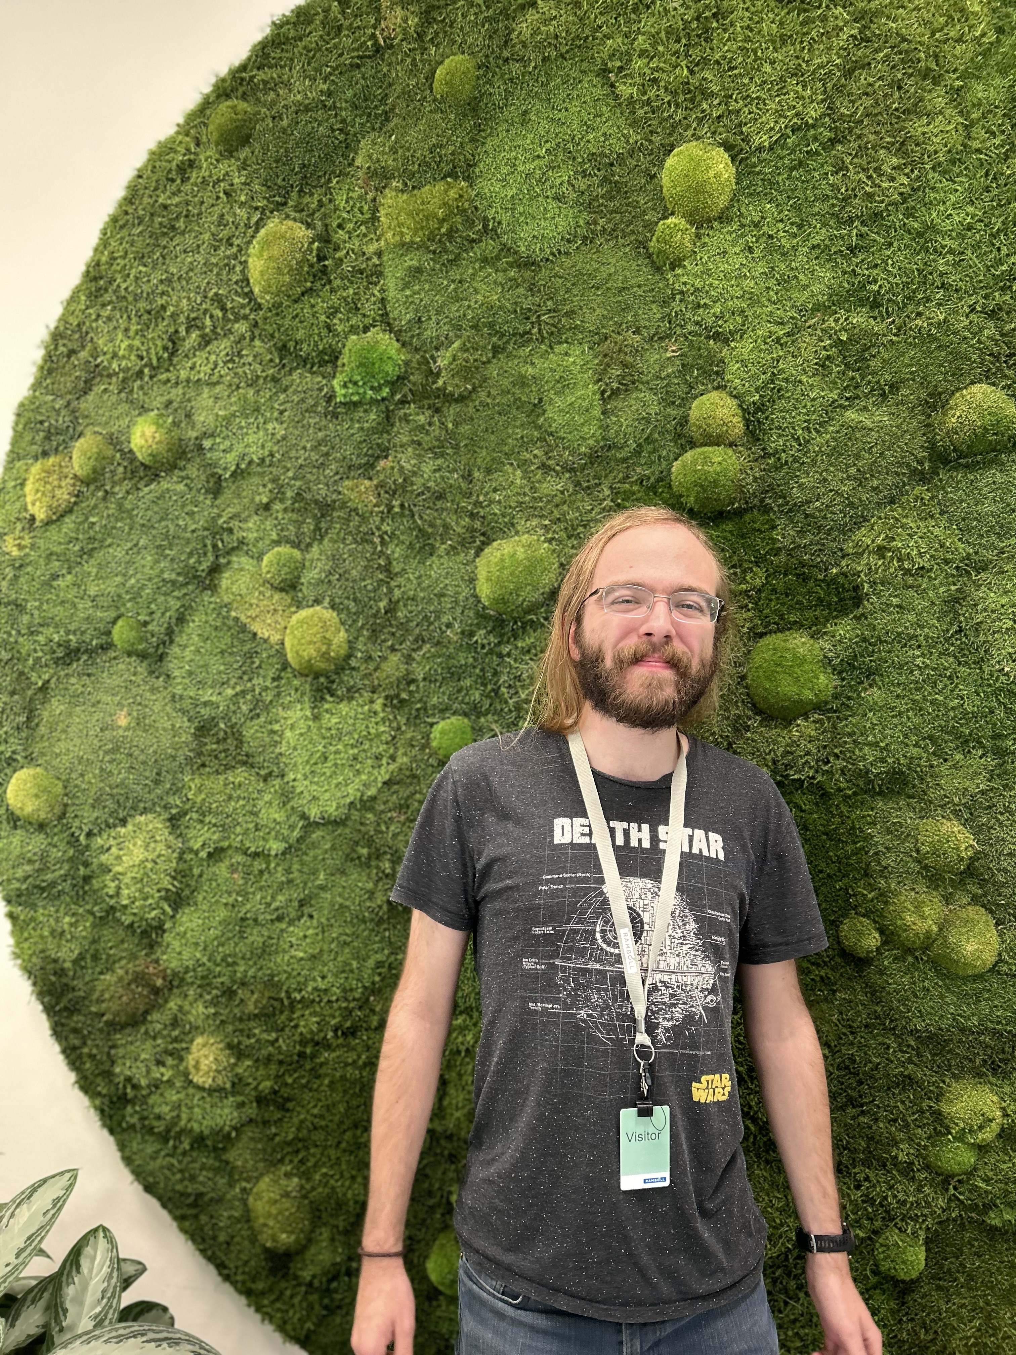
MEET THE TEAM
Katja Dinnissen
Dhanush Harish
Iwen Yeh
Hamish Mardell
Badlvin Konradsson
Chairman
Designer
Analyst
Mobility
Cartographer

Slide 3
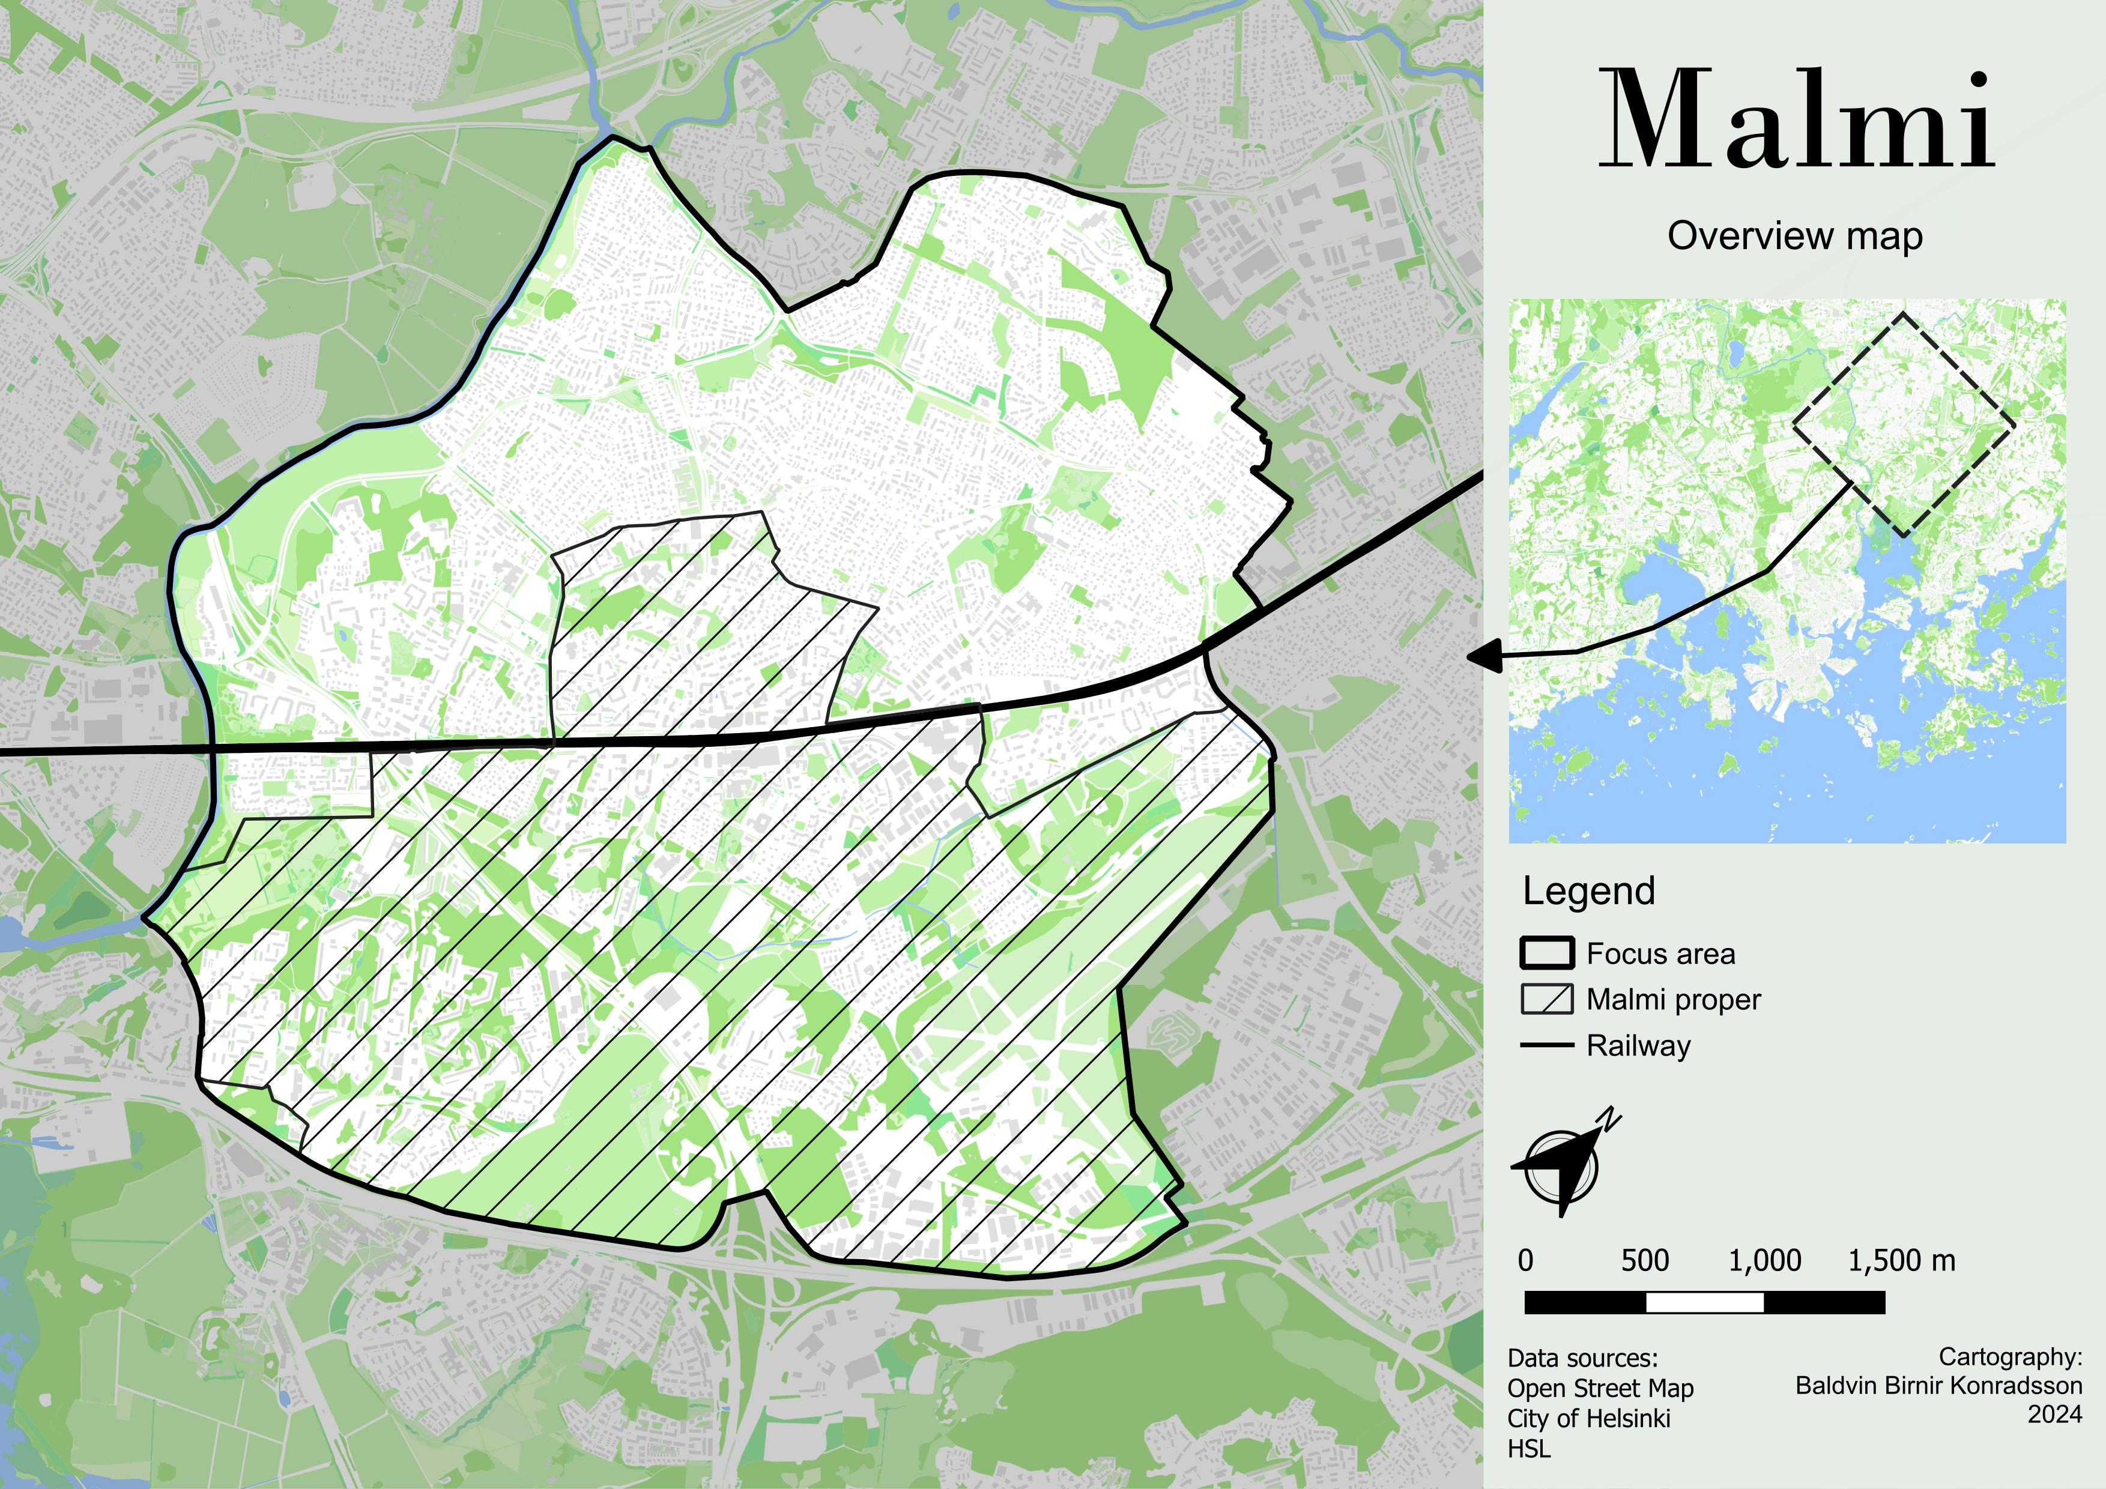
The center of northeast Helsinki
With 30k population
Agricultural roots
1 of 5 urban regeneration areas

Slide 4
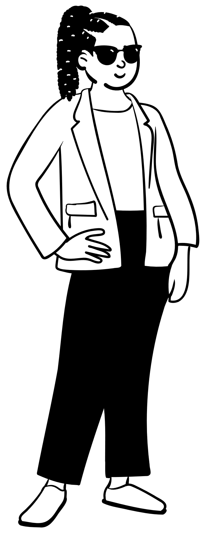
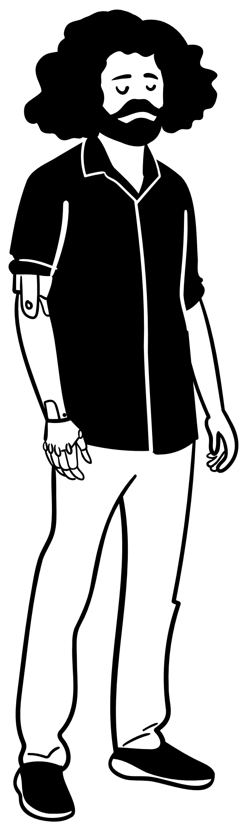
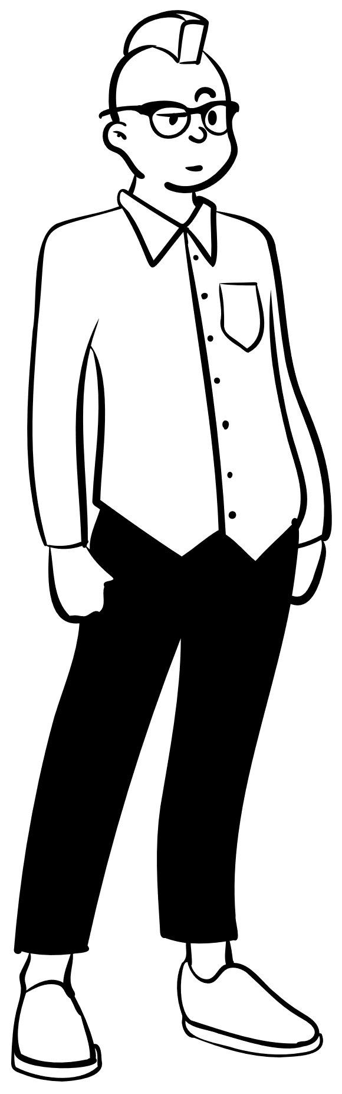
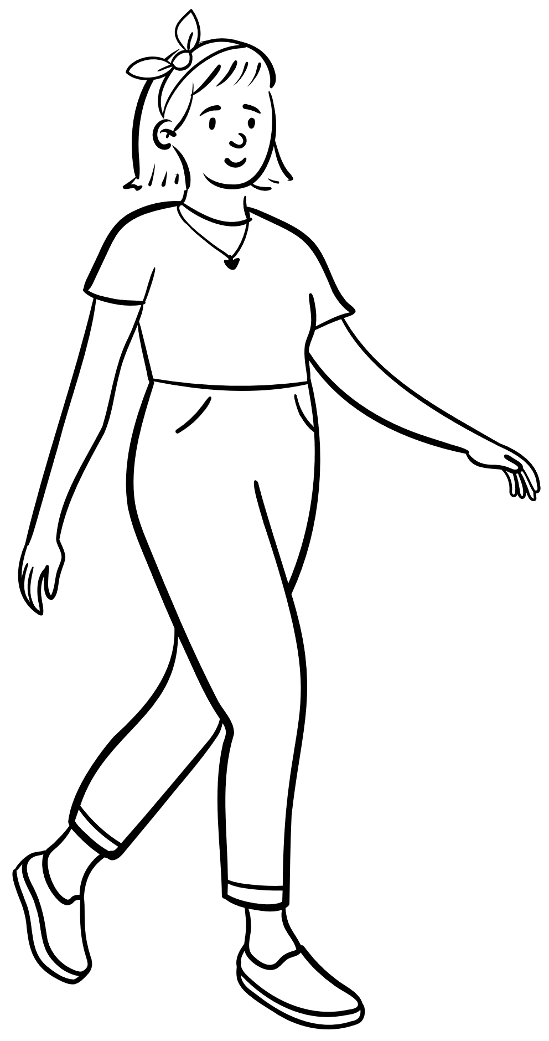


Local Opinions (online discussion platform)
Unsafe
Dodgy
Unpleasant
Noisy
“Just don't talk to or look at weird looking strangers, keep yourself on the move and you'll be fine.”
“In Helsinki standards, it's considered slighty less safer than average, mainly due to higher amount of drunks and druggies, that usually show up around night time.”
“Malmi is generally safe, but I think the area around station is just generally unpleasant. I mean dirty, smelly, and buildings around are ugly and not well maintained. The train tracks make it hard to walk around the neighbourhood.”

Slide 5

Upper and Lower Malmi
Social issues centre
Few job opportunities
Planned High speed light rail

Slide 6
Guiding Principles
Bee analogy

Slide 7
Guiding Principles
Cultural Heritage
Accessibility
Digitalization
Safety
Healthy Lifestyle
Bee analogy
Community
Ecology

Slide 8
1. Shared Spaces
2. Connecting Nodes
Cultural Heritage
Accessibility
Digitalization
Safety
Healthy Lifestyle
Community
Ecology

Slide 9
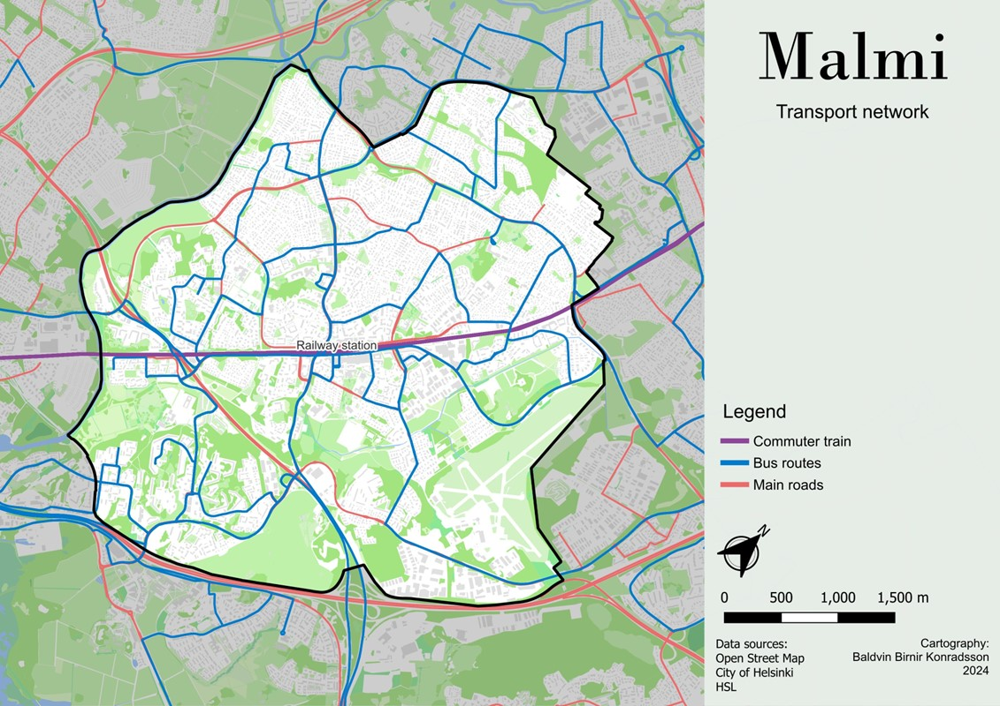
Shared
Space
Planned High speed light rail
Hierarchy network
Arterial roads
Busroutes

Slide 10
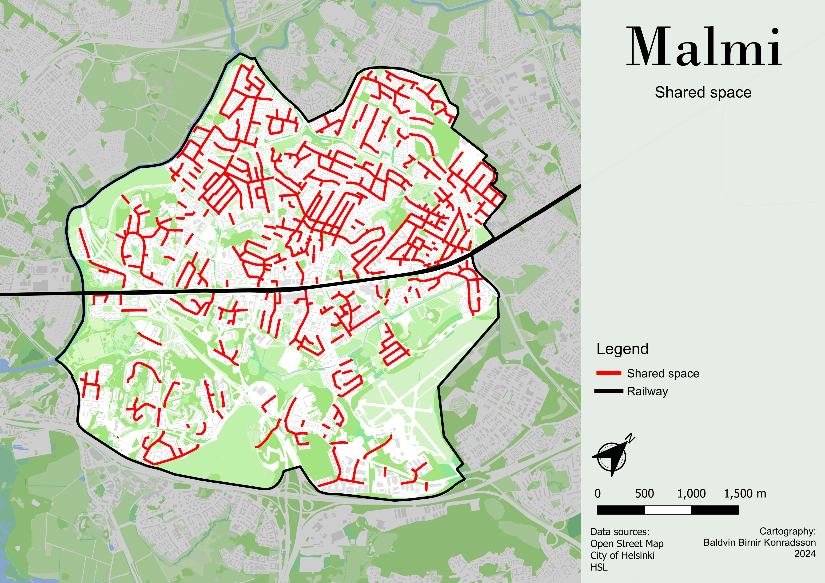
Shared
Space
Planned High speed light rail
Hierarchy network
Shared space

Slide 11

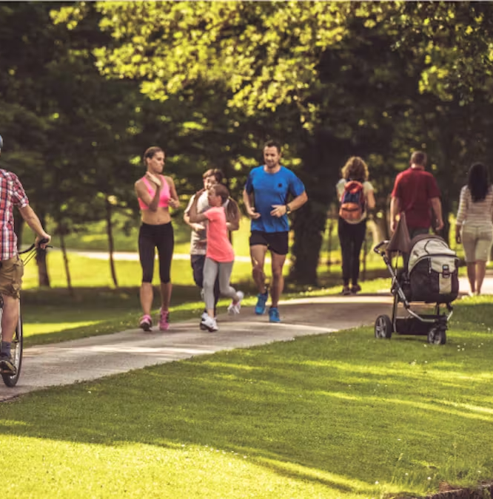
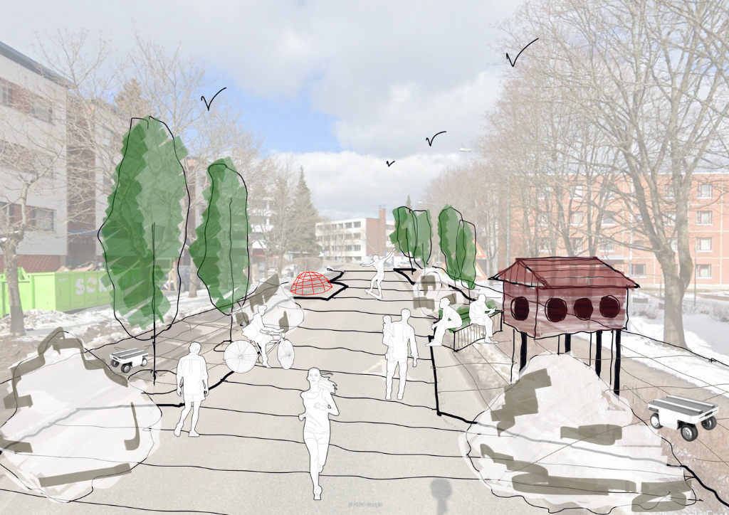
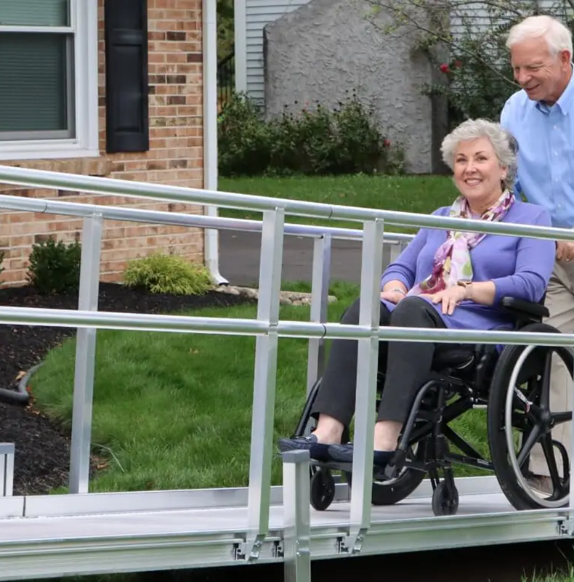
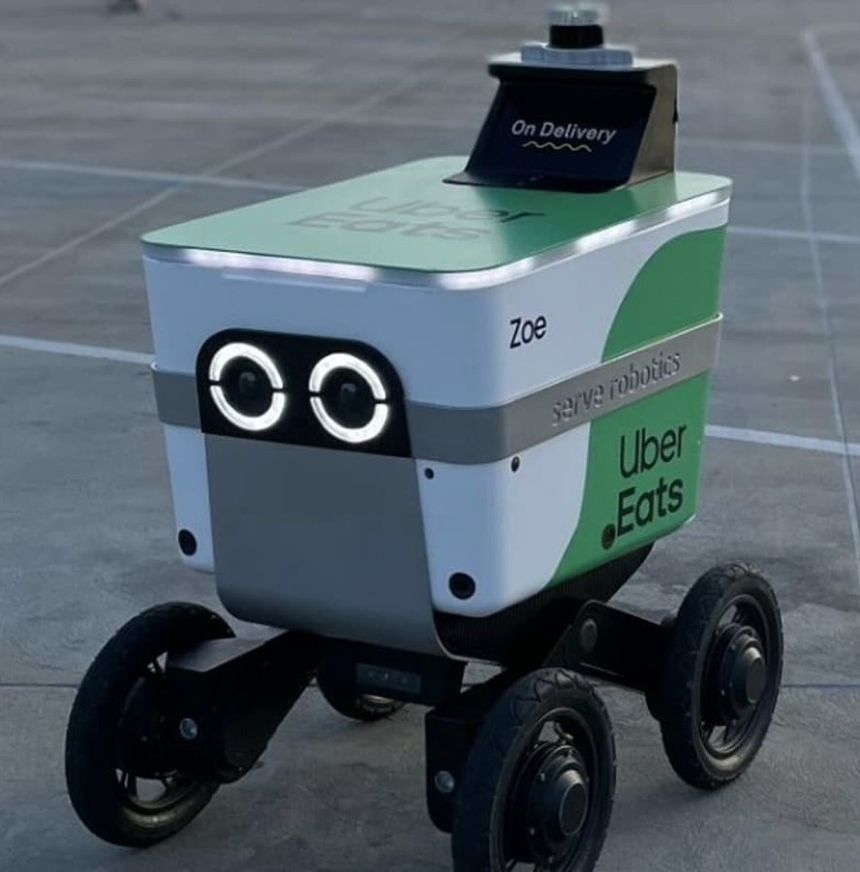
Shared Space
Living streets
Traffic calming
Active mobility
Healthy Lifestyle
Accessible streets
Accessibility
Safety
Delivery robot
Digitalization

Slide 12
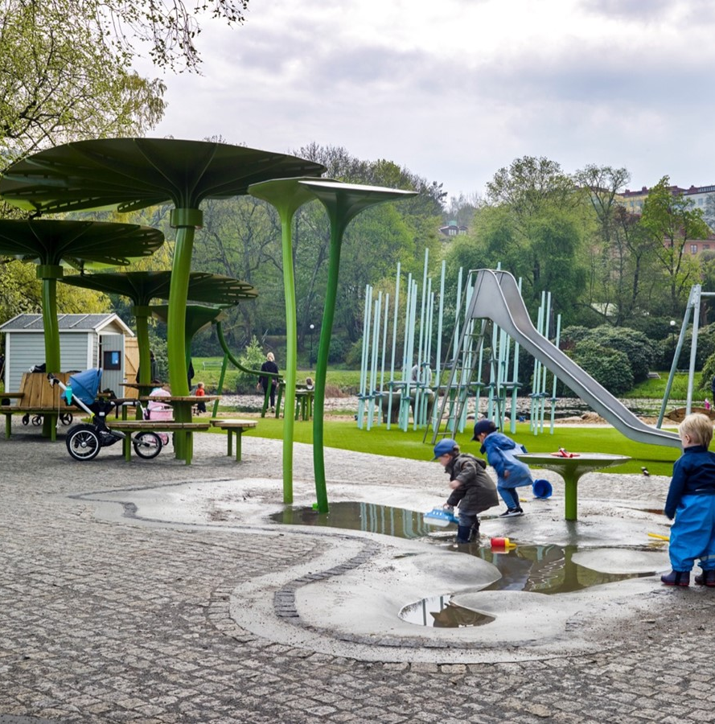
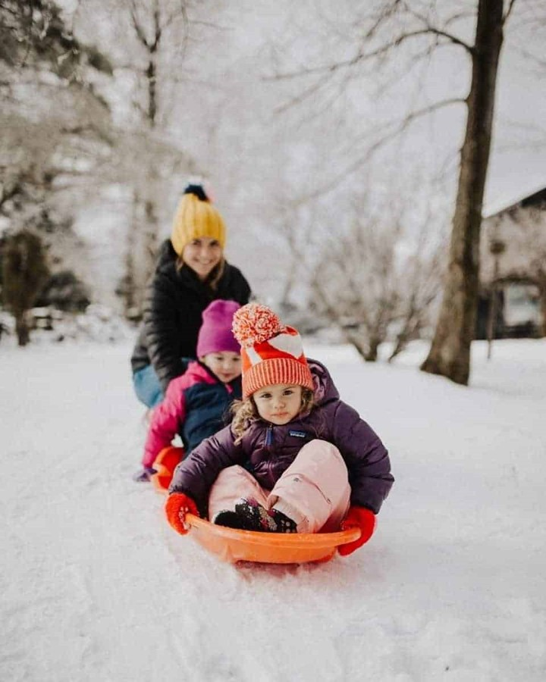
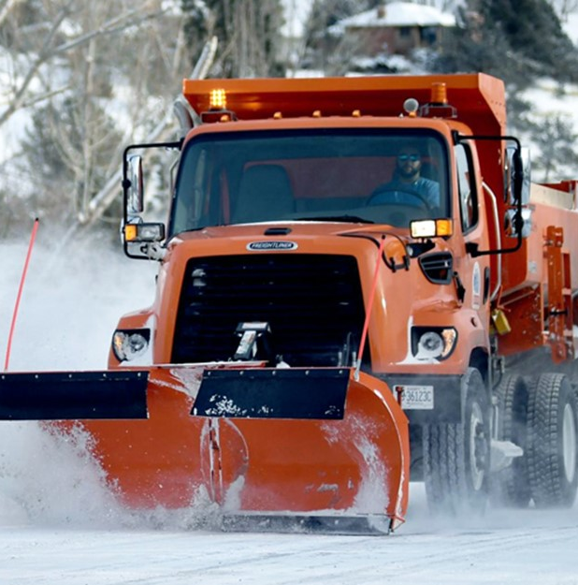
Shared Space
Ecology
Water recycled
Healthy Lifestyle
Seasonal fun
Commun-ity
Safety
Allocated plowing
Access-ibility

Slide 13
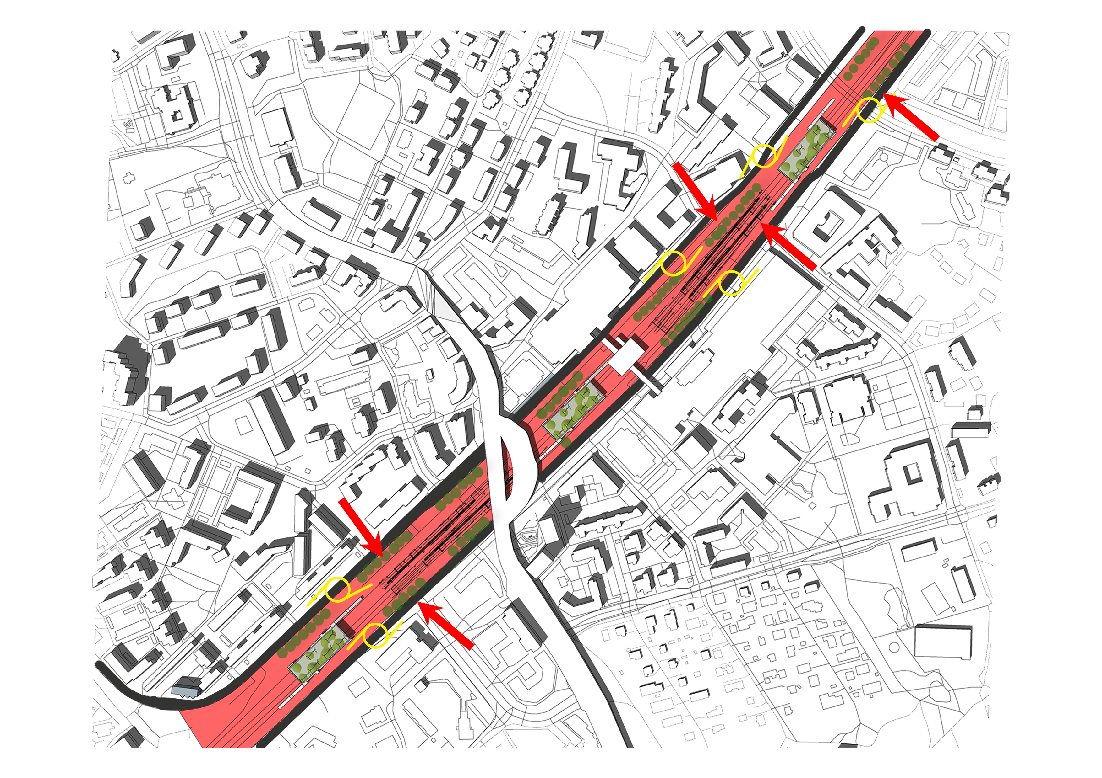

Slide 14
Regeneration Plan – Nodes
Nodes of Green Corridors:
Connect upper and lower Malmi
Thoroughfare
Transferring green language into the spine
Inspired by Tampere train station

Slide 15
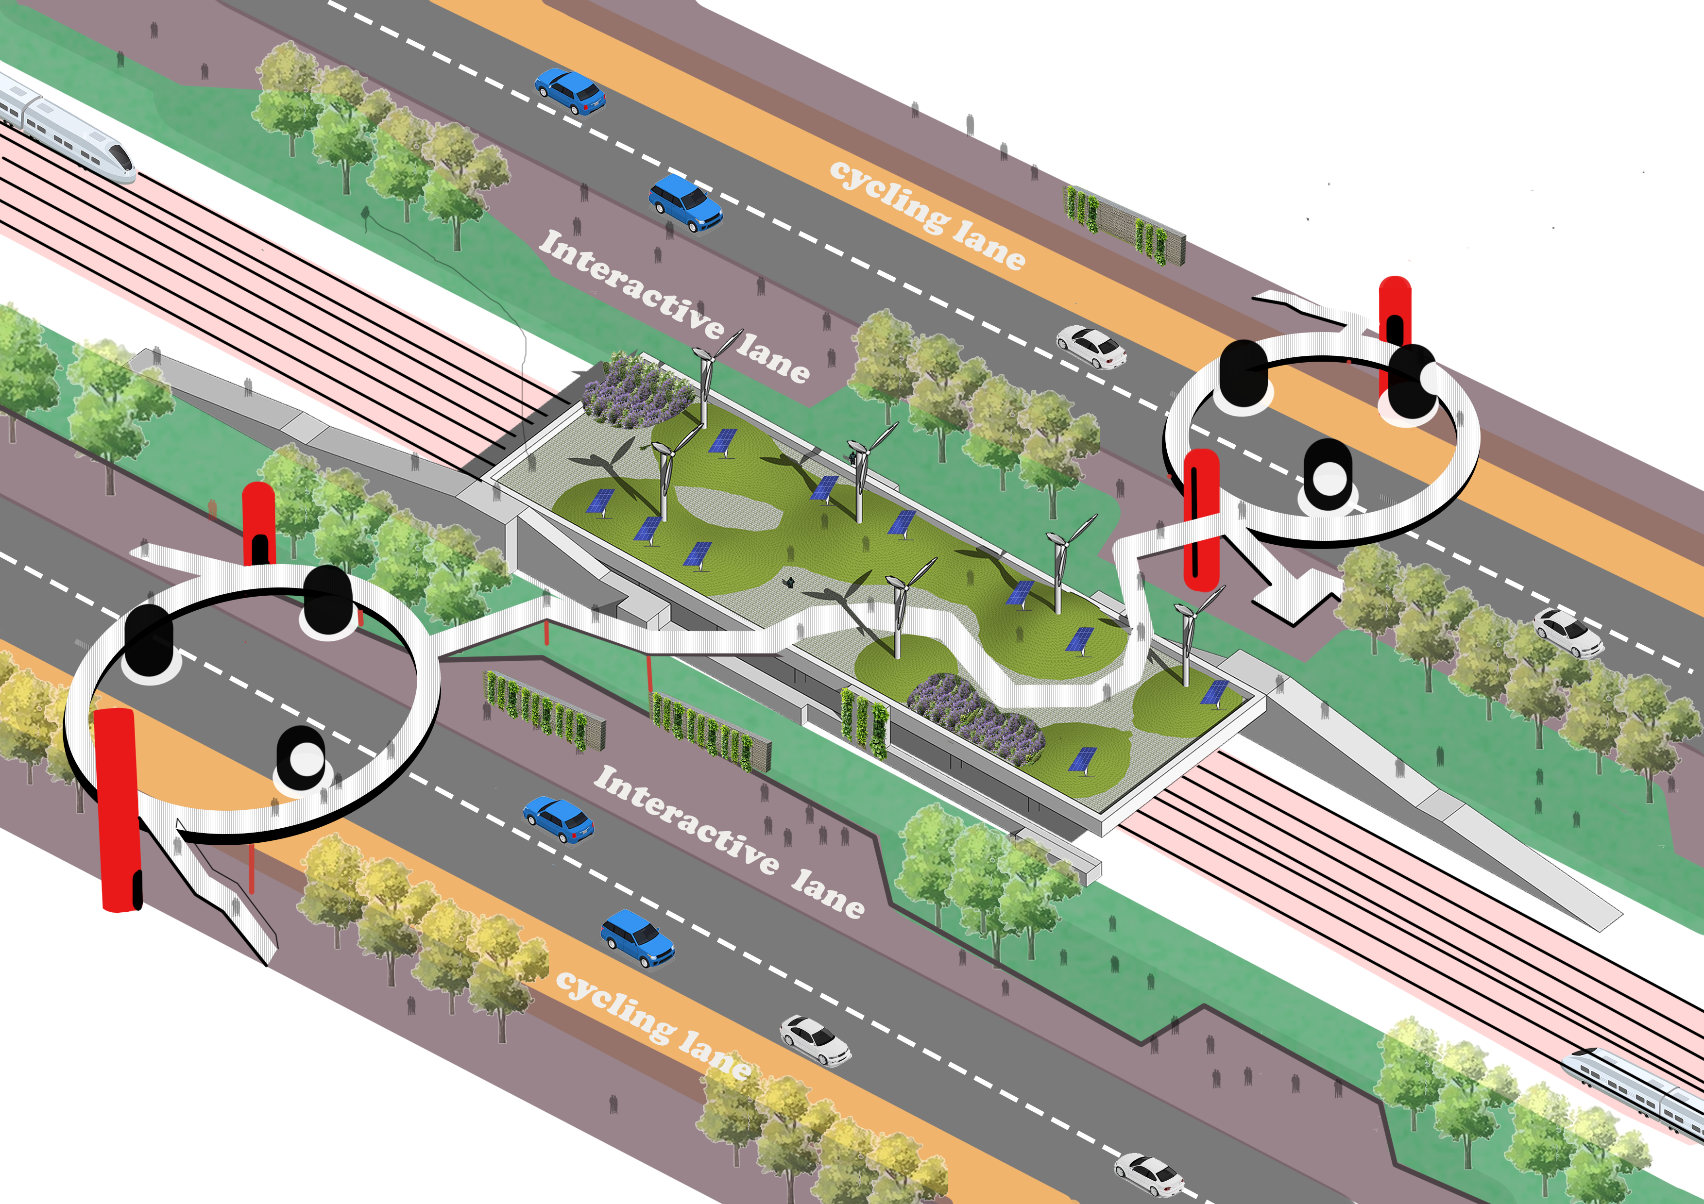
Illustration Singular Node
Connecting upper and lower Malmi
Dynamic walkthrough
Green terraces
Community hub
Urban farming
Leisure space
Solar energy
Stop to Tampere

Slide 16
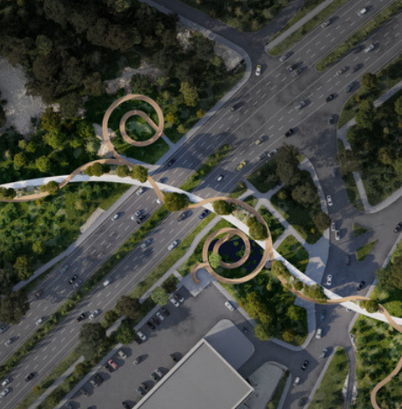
Transitory Connection
Building a sense of identity of social network, enhancing social cohesion. We want to eliminate feelings of detachment
Connection of upper and lower Malmi, through green network
Community
Ecology

Slide 17
Universal Accessibility
Easy access for pedestrians, cyclists and disabled.
Focus on the railway station as a hub, where people go to and feel safe to stay.
Safety
Accessibility
Accessible ramps

Slide 18
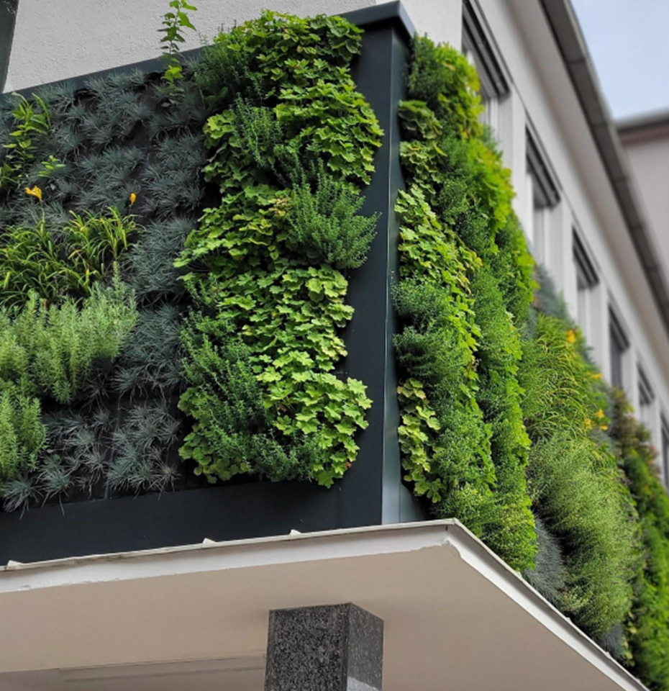
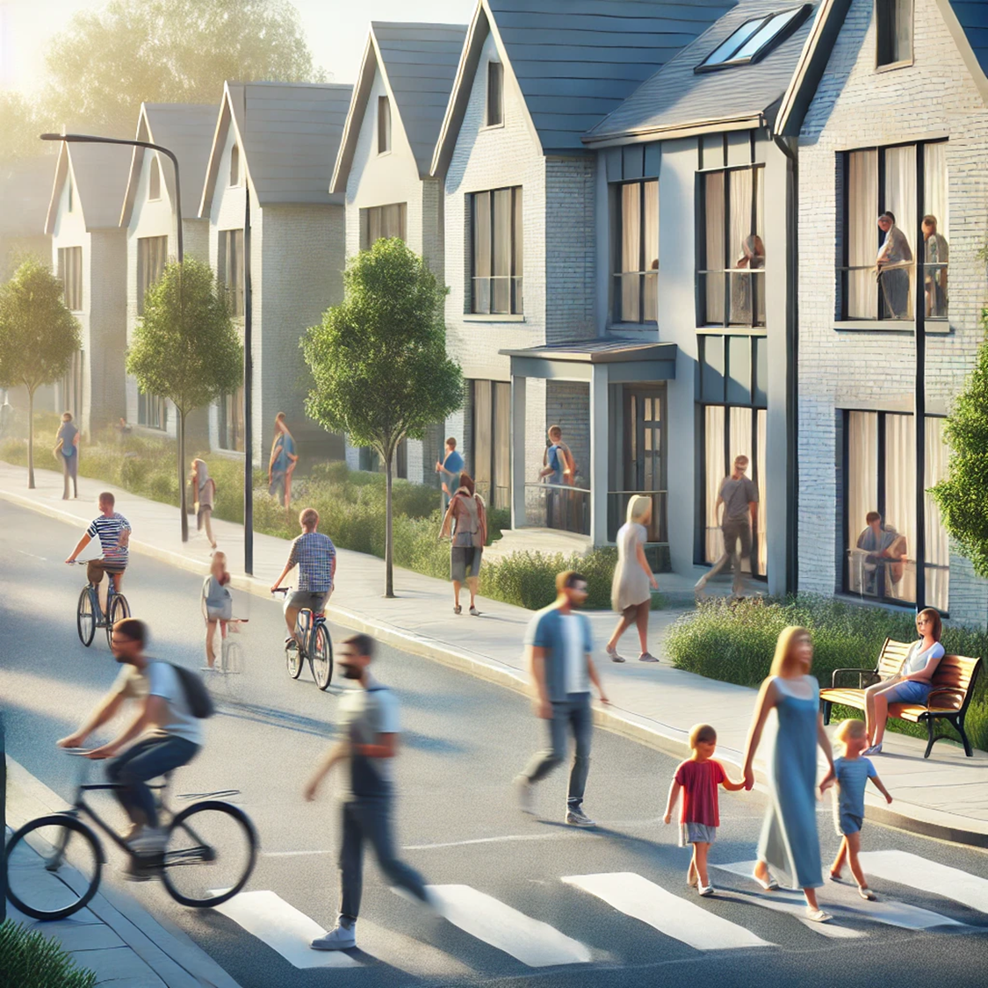
Urban Plaza
Ecology
Healthy Lifestyle
Community
Vertical community gardens
Safety
Eyes on the street

Slide 19
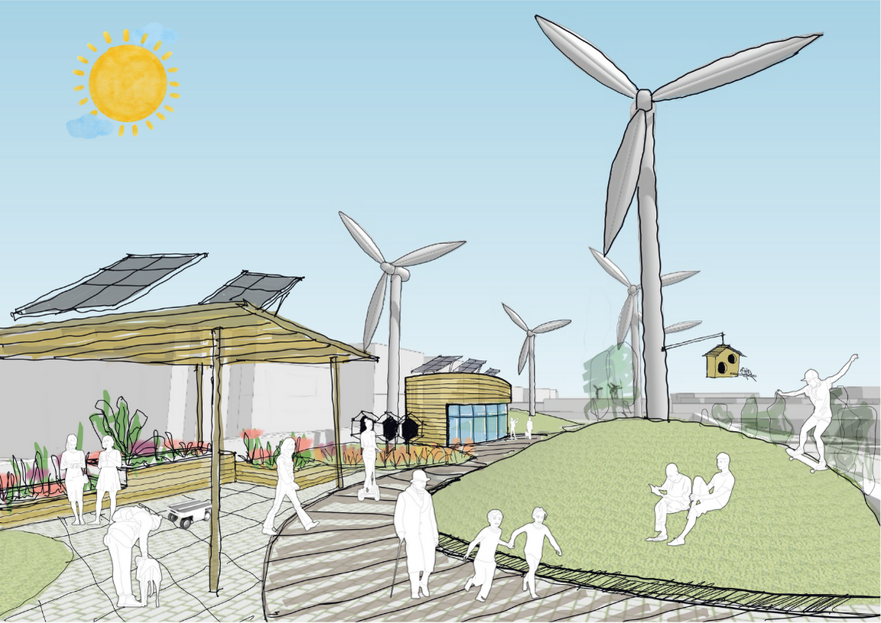
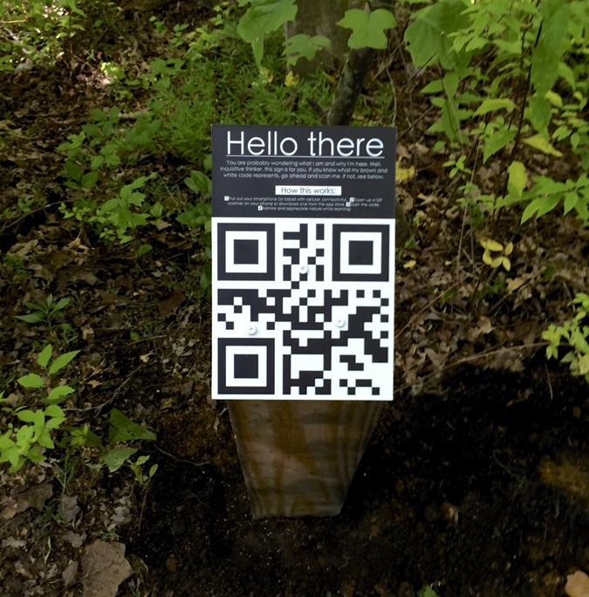
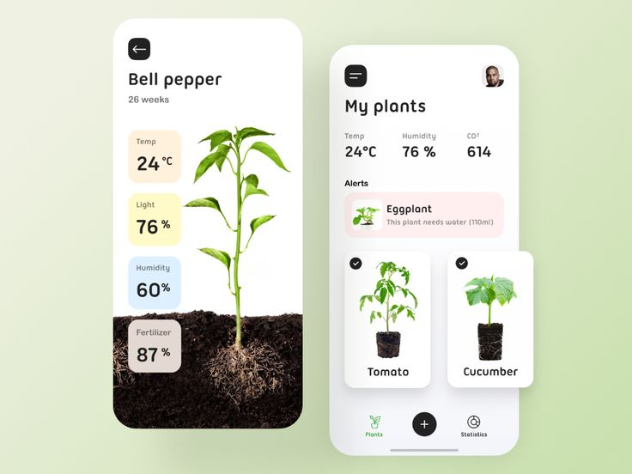
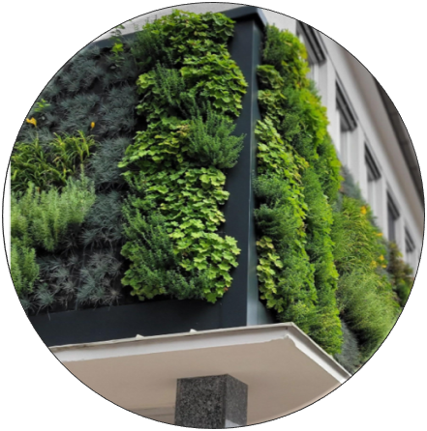
Urban Farming
Digital education
on biodiversity
Digitalization
Ecology
Plant health
Healthy Lifestyle
Community garden
Community

Slide 20
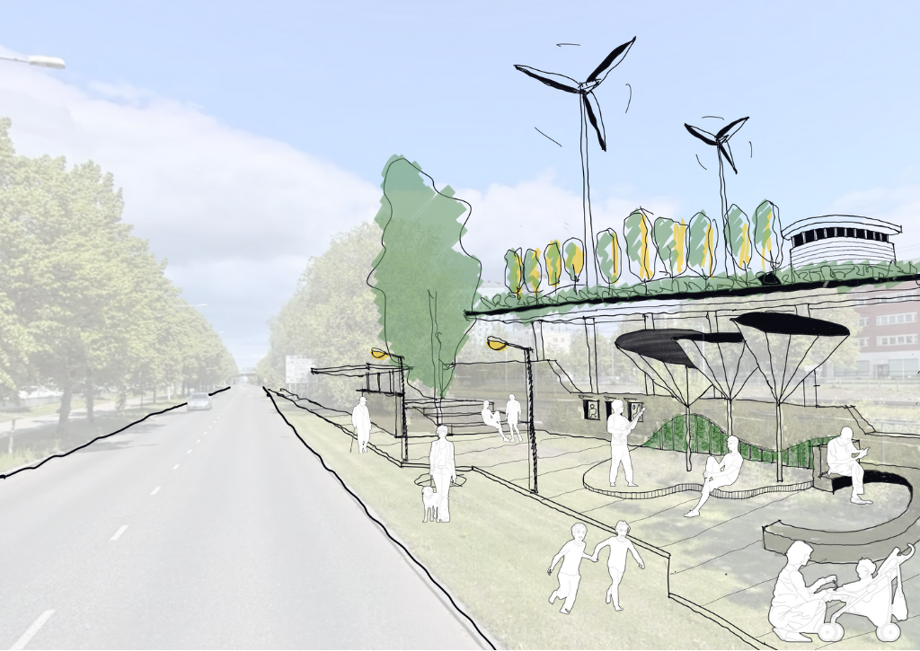
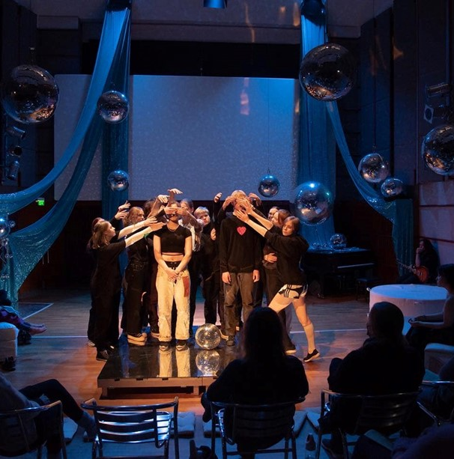
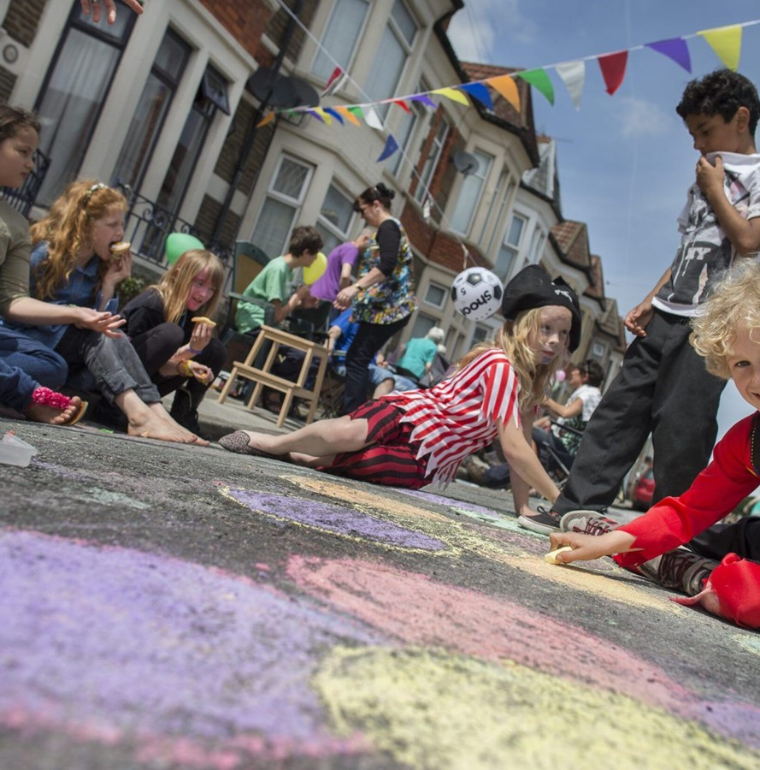
Public Cultural Spaces
Utilising the musical heritage of the neighbourhood
Cultural Heritage
Community
Cultural
music scene
Healthy Lifestyle
Outdoor activities

Slide 21
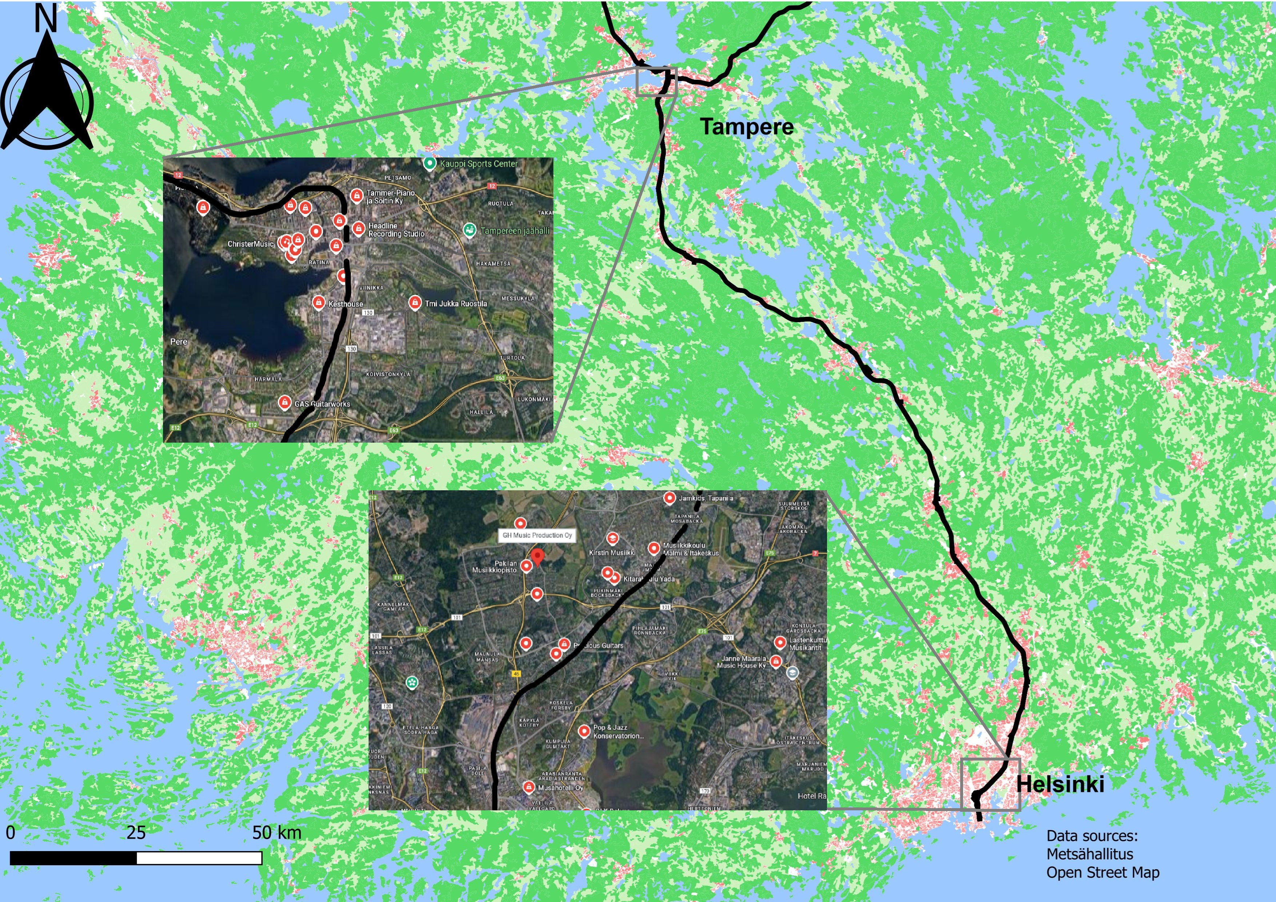
Cultural musical line along the rails

Slide 22
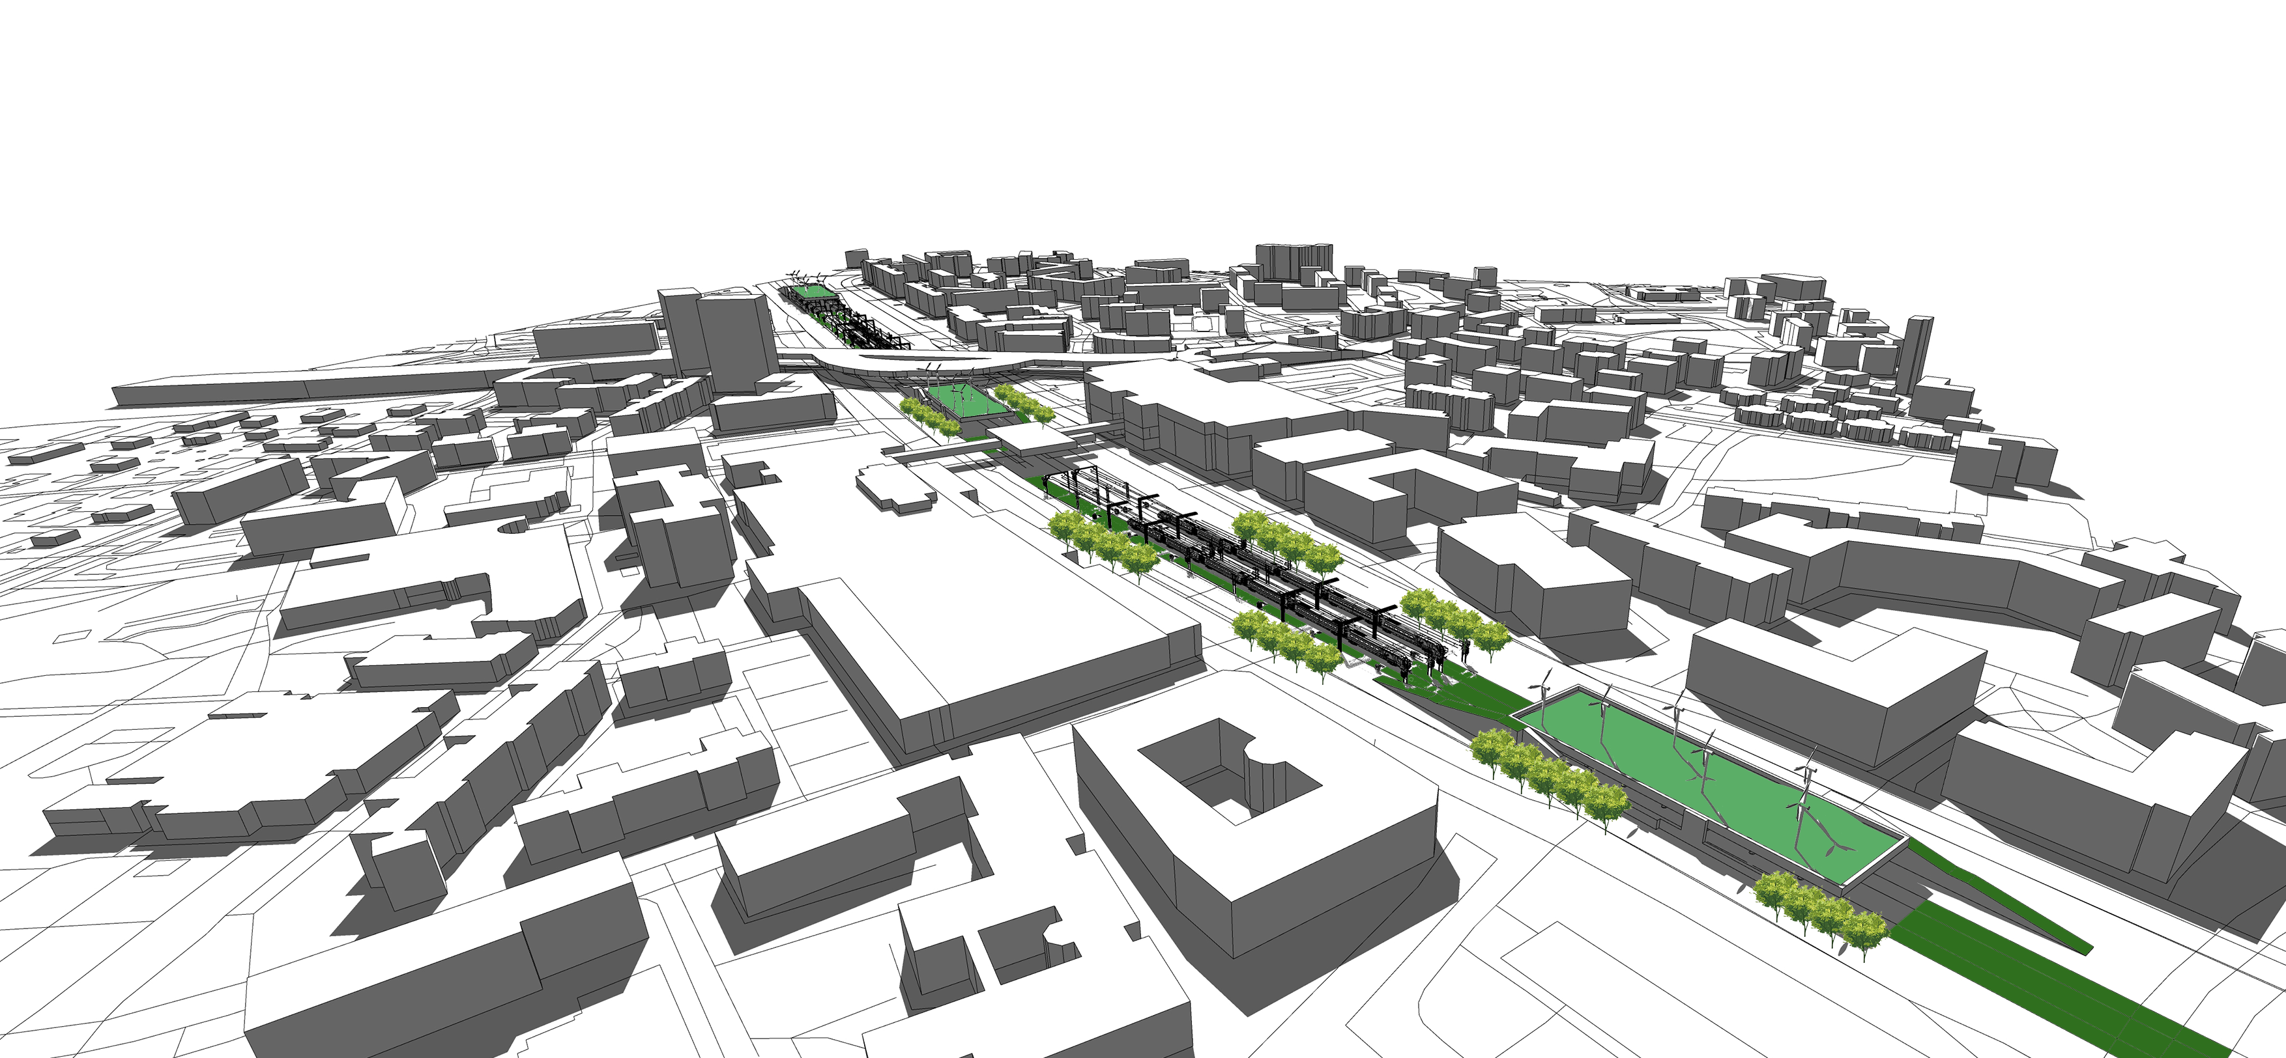
Blueprint for Finnish Regeneration
Future urban centres:
Effective use urban world
Sense of community
Vibrant living streets
Pedestrians and cyclists, a force to be reckoned
NODE 1:
Ecological centre
NODE 2:
Musical and Cultural centre
NODE 3:
Commercial centre
Urban flows:
Musical and Cultural connection
Adding stop Malmi
Frequent service
Sustainable travel chain:
Safe
Attractive

Slide 23
Thank you
Helsingforce
“Innovative in its sensible design, regenerating the context by enhancing and improving what was already there, breathing new life into familiar foundations.”

